Slide 1





W
E
L
O
E
C
M

Slide 2


Teacher’s Identity
Md Jahid Hossen Khan
Headteacher
Rajihar Government Primary School .
Agailjhara , Barishal .
Mobile: 01623309794

Slide 3
Class:1
Subject:English
Unit:2
Lesson:3
Topic: cC dD

Slide 4
Learning Outcomes:
Students will be able to…
listen the letter c and say it.
introduce with the letter
and phonetic sound c.

Slide 5

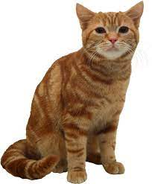

Slide 6
C …………C…………..C……………Cat …………..C…………….C
c …………c………….c……………cat …………..c………………..c

Slide 7
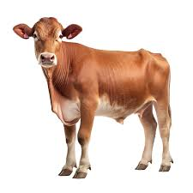

Slide 8

C …………C…………..C…………Cow …………..C…………….C
c …………c………….c……………cow …………..c………………..c

Slide 9
C
c

Slide 10
Group Work
C …………C…………..C…………Cow …………..C…………….C
c …………c………….c……………cow …………..c………………..c

Slide 11
Pair Work
C …………C…………..C…………Cow …………..C…………….C
c …………c………….c……………cow …………..c………………..c

Slide 12
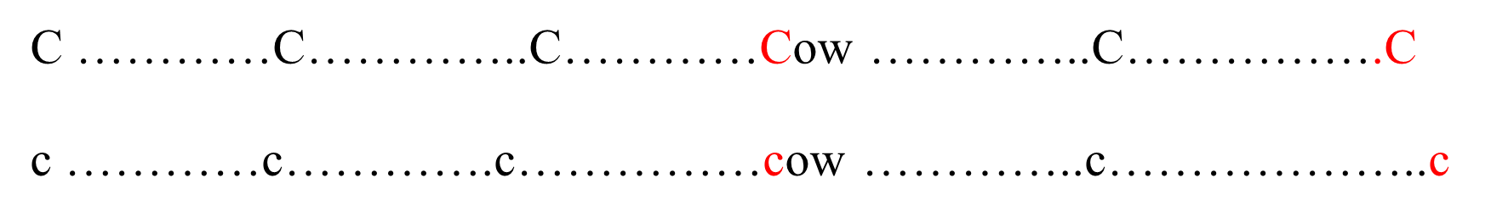
Individual Work

Slide 13
Look at the picture and say the name of
it & it’s starting phonemic & letter sound.

Slide 15
Identify the Capital & Small C-c letter
C
c

