Slide 1


Slide 2

Teachers’ Identity
SUMI DAS
Assistant Teacher
Purba ziri Amania Lokman Hakim Model Govt. Primary School.
Patiya , Chattogram.

Slide 3
Lesson Introduction
Class: 5
Unit: 7
Page: 38(4.1)

Slide 4
Learning Outcome
7.4.4- write short legible and organized compositions.

Slide 5
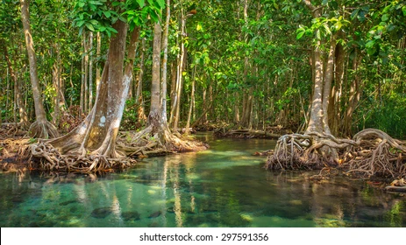

Slide 6
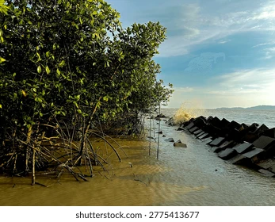

Slide 7
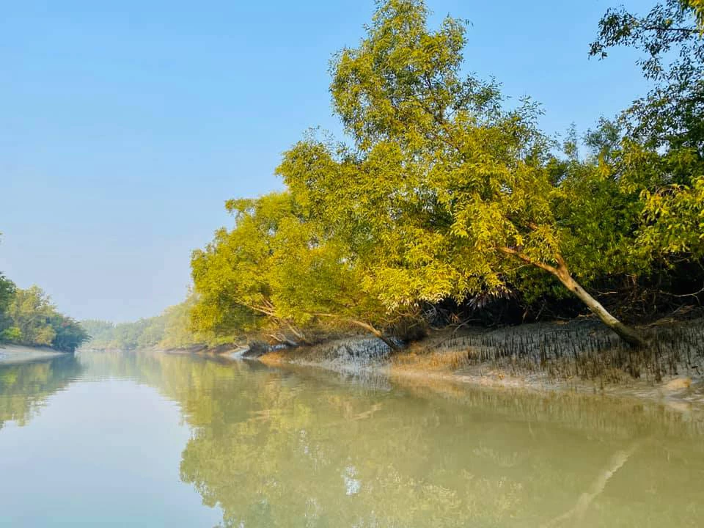

Slide 8
The Ways the Sundarbans helps us:
protects land from big waves
prevents coastal erosion
guards against tsunamis, cyclones, and tidal waves
provides habitat for endangered animals
offers a source of palm leaves, wood, and honey
attracts tourists with wildlife and natural beauty

Slide 9
Assignment
Write a letter to your friend how the Sundarbans us.

Slide 10
Date: 24.06.2026
Patiya , Chattogram
Dear Kanij ,
How are you? I hope you are well . Today I am writing to you how the Sundarbans help us.
The Sundarbans is the largest mangrove forest in the world . It protects our country in many ways. The strong roots of the mangrove trees save the land from the big waves. The roots keep our lands safe from coastal erosion and also guards our land from tsunamis , cyclones, and tidal waves. It is also a good source of palm leaves, wood and honey.
We should protect the Sundarbans because it is very important for our environment and economy.
No more today. Give my regards to your parents.
Your friend
Saba

Slide 11


