Slide 1
Welcome to all to our English class

Slide 2
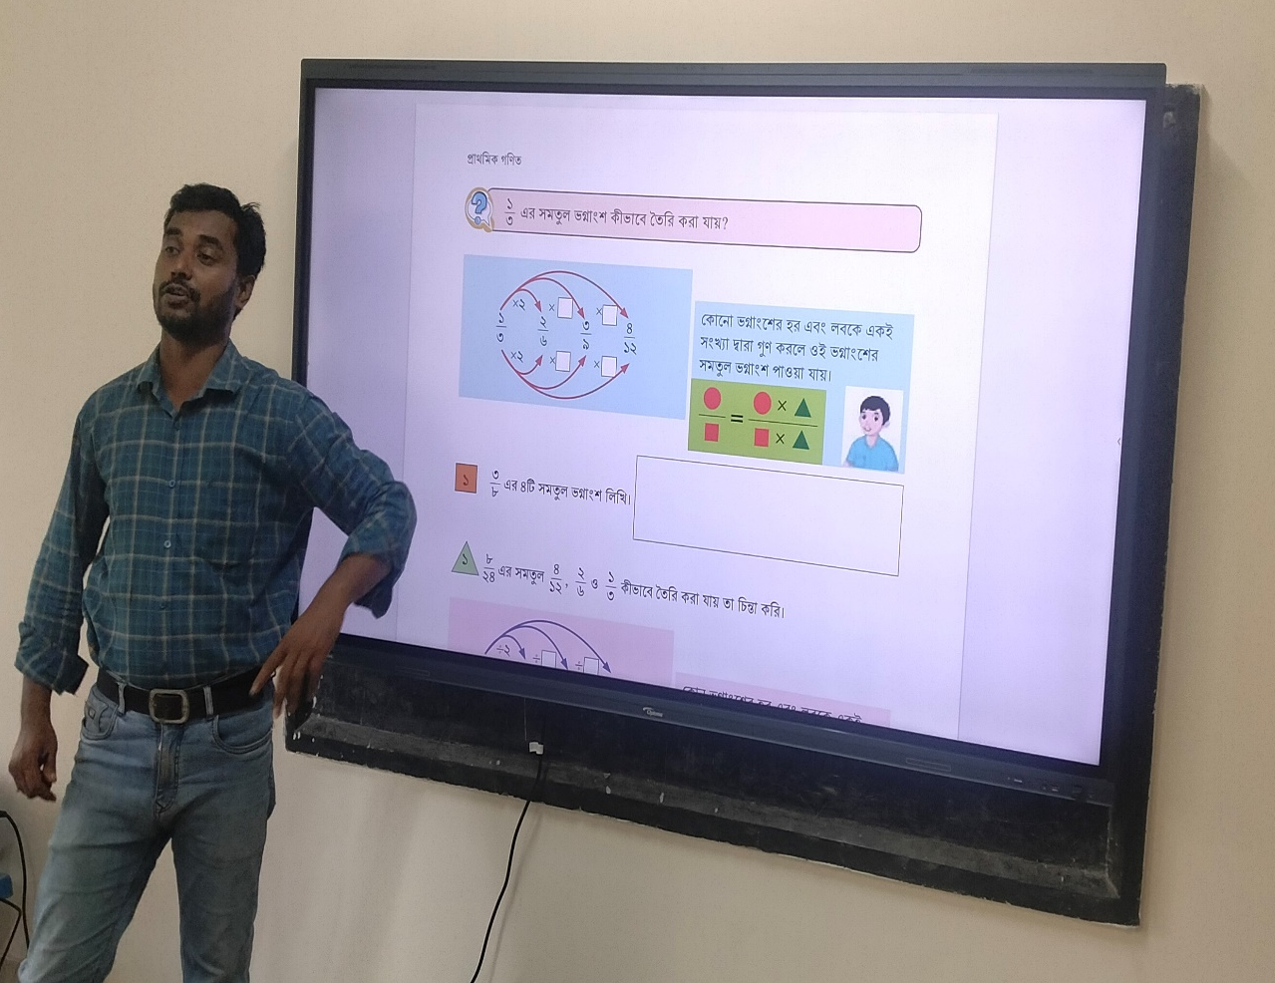
Identity
Presented by:
Md Mizanur Rahman
Assistant teacher
Ledu companir hat GPS
Kabirhat-Noakhali

Slide 3

Lesson
English for today
Class-3
Unit-02
Lesson title-My family
Page-26

Slide 4
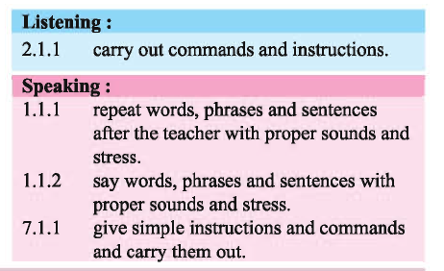
Learning outcomes

Slide 5
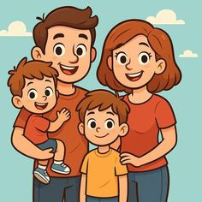
What can you see in this picture?
This is a picture of a family

Slide 6
Lesson declaration
My family

Slide 7
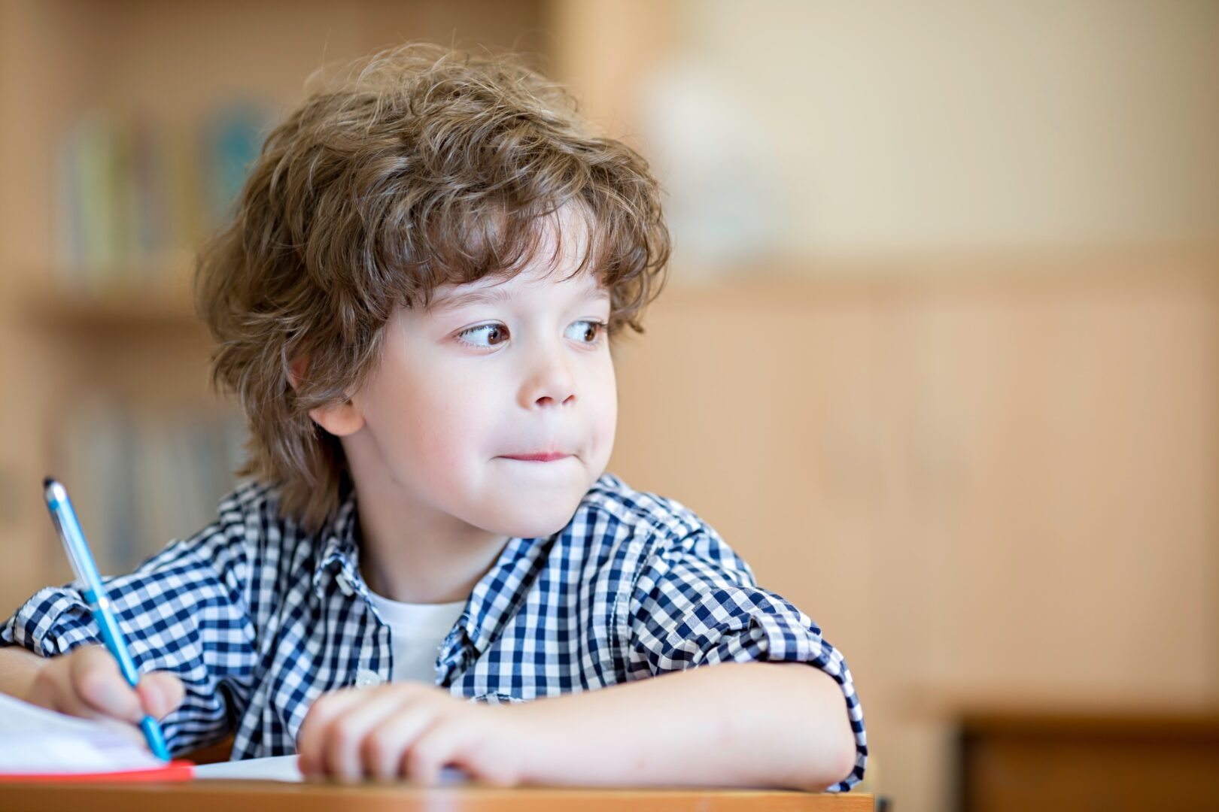
What can you see?
student
s-t-u-d-e-n-t
He is a student

Slide 8
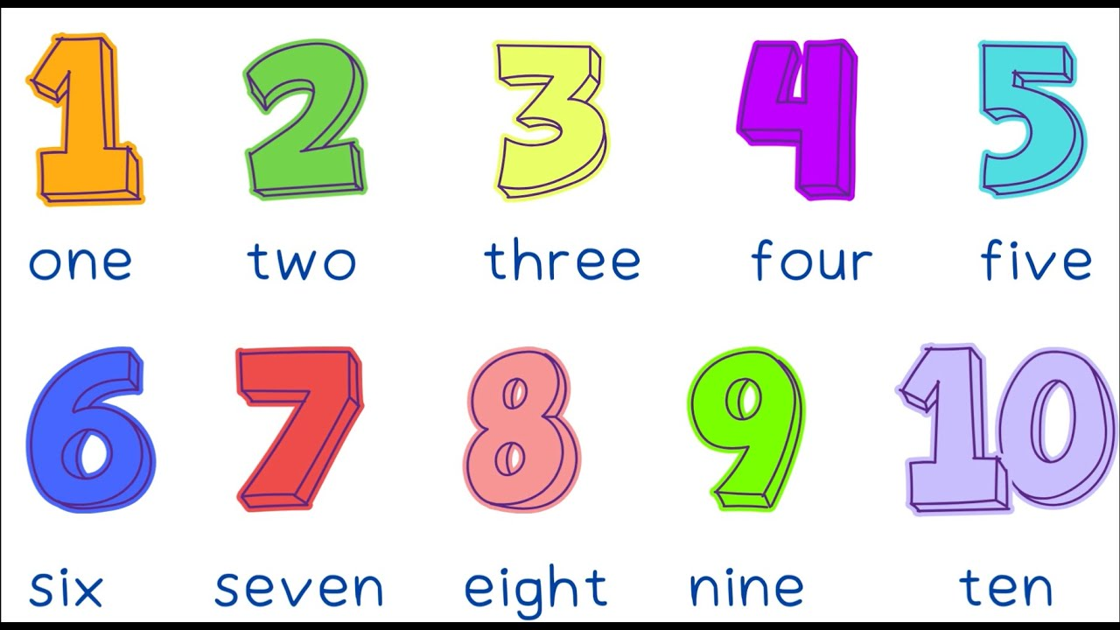
What can you see?
members
m-e-m-b-e-r-s
My family has four members

Slide 9

What can you see?
Teacher
t-e-a-c-h-e-r
My father is a teacher

Slide 10
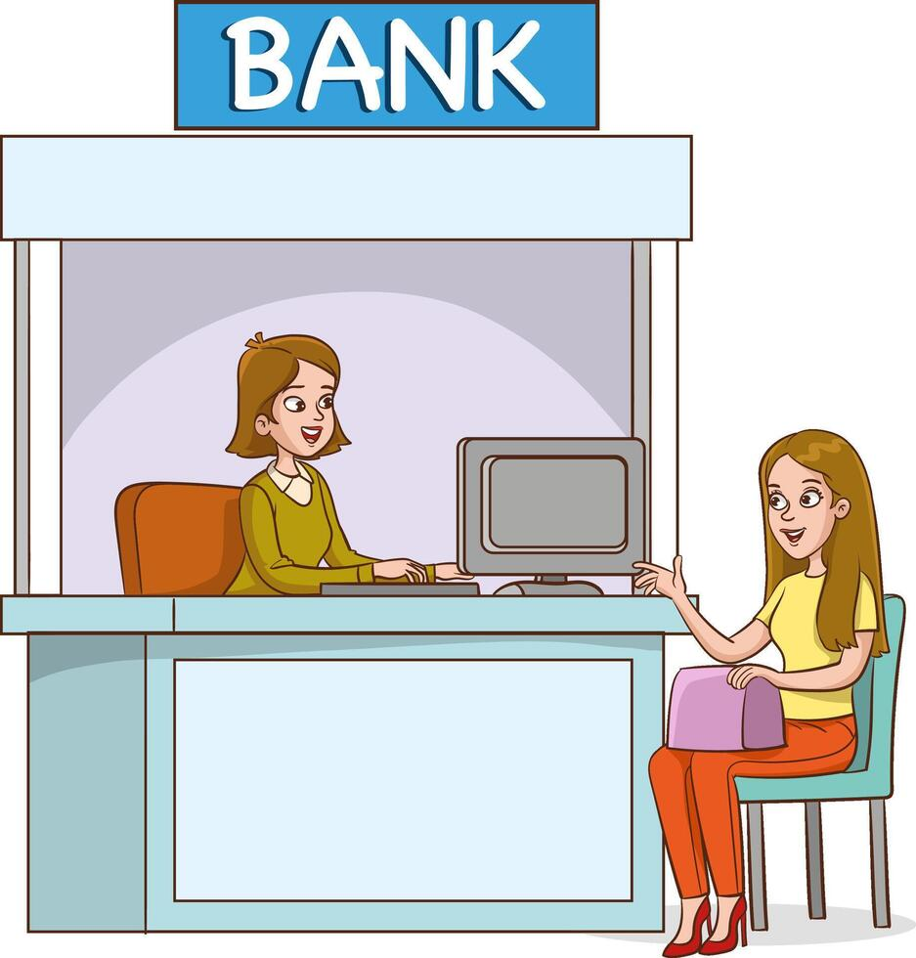
What can you see ?
Banker
b-a-n-k-e-r
She is a banker

Slide 11
B. Read the sentences. Write T for True and F for False.
1. The girl’s name is Samia. _____________
2. She is in class three. _______________
3. She is a student. _______________
4. There are four members in her family. ____________
5. Her brother is 3 years old. _____________
False
True
True
True
False

Slide 12
C. Pairwork: Ask and answer.
1. What is the girl’s name?
2. How many members are there in her family?
3. What does her mother do?
4. What does her father do?
5. How old is her brother?

Slide 13
Chaindrill

Slide 14

Goodbye

