Slide 1
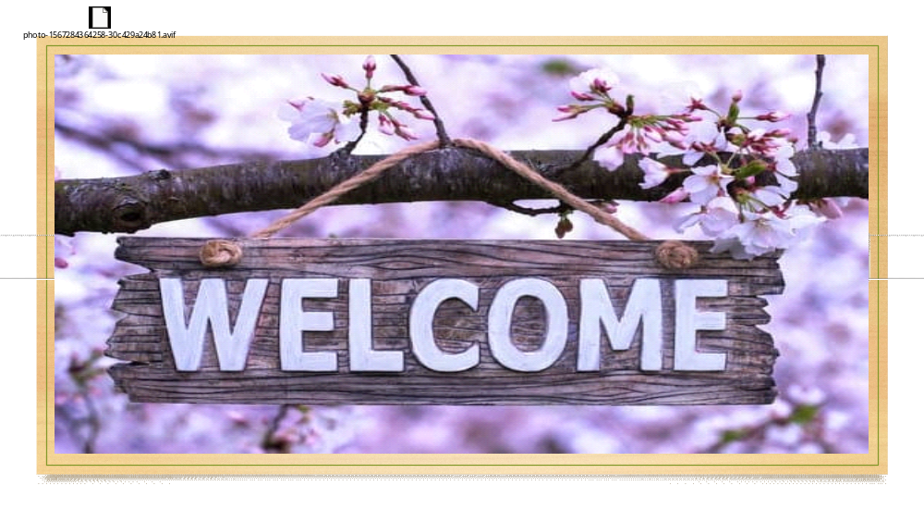

Slide 2
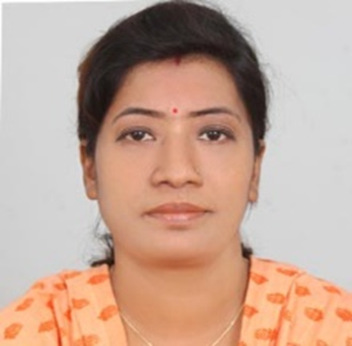
Teachers’ Identity
SUMI DAS
Assistant Teacher
Purba ziri Amania Lokman Hakim Model Govt. Primary School.
Patiya , Chattogram.

Slide 3
Lesson Introduction
Class :5
Unit :9
Title : Get Ready to Listen(1.1, 1.2)
Page : 47,48

Slide 4
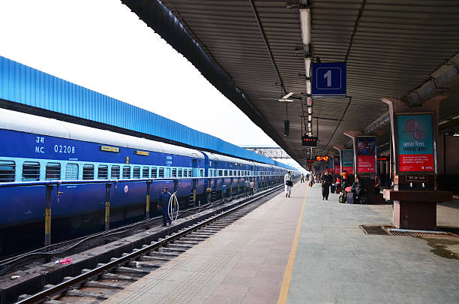

Slide 5

Announcement -
A public statement or notice

Slide 6

Decorate-
To make something look beautiful

Slide 7
Drew-
(Past form of draw)
To attract or pull attention
Draw Drew Drawn

Slide 8

Excited-
Very eager

Slide 9
Get Ready to Listen

Slide 10
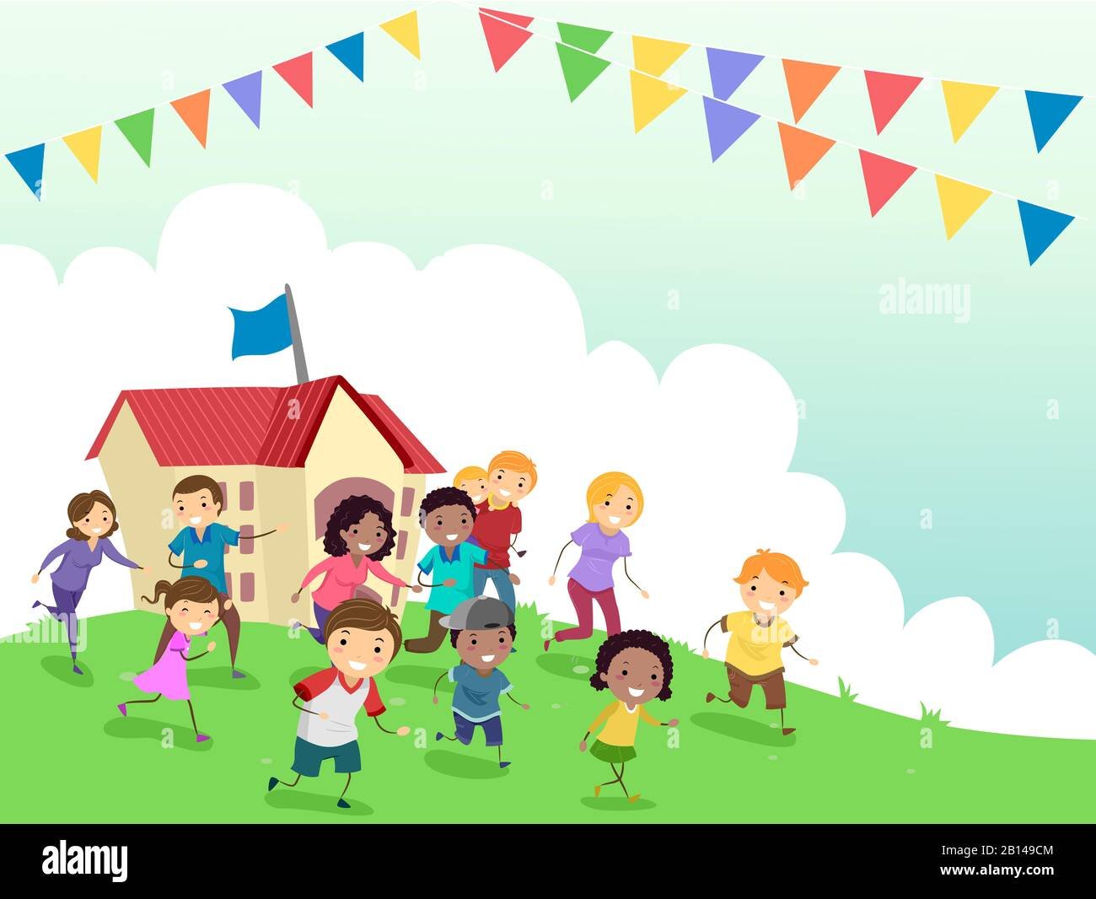
Get Ready to Listen
Today is the annual sports day at Suman’s school. The school field is decorated with colourful flag. They are happy and excited to attend the events. Suddenly, the boys in the loudspeaker drew their attention and they are all ears.

Slide 11

Good morning, everyone! Welcome to our Annual Sports Day! I have an important announcement for you. Please listen carefully and follow the instructions.
First, there will be a 100-meter race, please go to the green flag area. The flag is on the west side of the field. Your race will start at half past nine(9:30 a. m.). That’s in about 15 minutes. So get ready!
Boys, your 100-meter race will be starting from quarter to ten(9:45 a.m.). Please go to the east side of the field marked with a red flag.
Next, the event will be a tennis ball throw.
All the boys participating in the tennis ball throw, please go to the blue flag area. The flag is on the south side of the field. Your event will begin at quarter past ten(10.15 a.m).
Girls your tennis ball throw will take place at the yellow flag marked north side of the field at half past ten(10.30 a.m).
The cub –scout volunteers are their to help you. Let’s have a fantastic sports day!

Slide 12


