Slide 1


Slide 2

W
E
L
C
O
M
E

Slide 3



Slide 4
How are you today?
Are you ready for the English class?

Slide 5


Slide 6
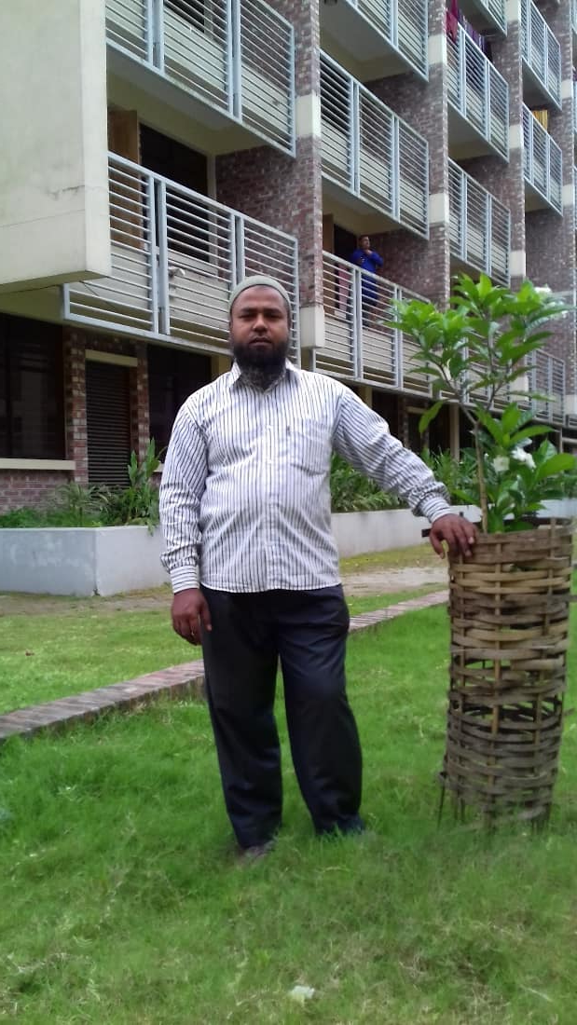
PRESENTED BY
Md. Mominul Islam
Assistant teacher
BaburHat Model Govt.Primary School
Dimla, Nilphamari
E-mail: mominul5797@gmail.com
Cell phone Number-01718835797

Slide 7
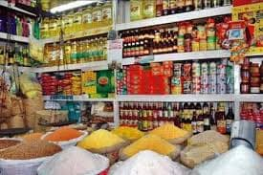

Slide 8
I will ask some questions like:
1)Have you ever bought anything from a store?
2) What did you buy from a store?

Slide 9

Announcement of the Lesson
Eating Healthy

Slide 10
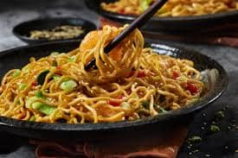
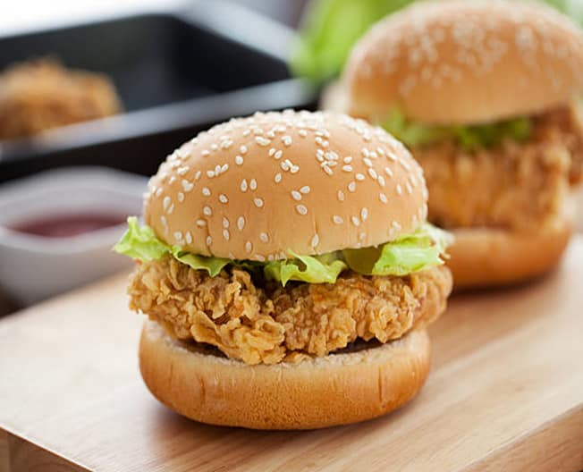
1.2 Read the following conversation.
Shihab : It’s tiffin time. Let’s eat together.
Sarah: Sure. Who else like to join us ?
Mong : Let’s sit over there to enjoy our tiffin.
Sarah : Noodles again ! I wish to have a chicken burger for tiffin everyday.

Slide 11
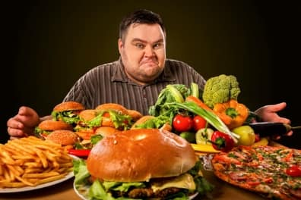
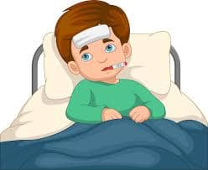
Mong : If you eat them regularly you’ll get fat and sick.
Shihab: Mong is quite reasonable. You shouldn’t eat them too often, Sarah.

Slide 12

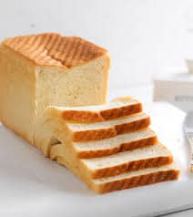
Mong : I have bread and banana today. My mother sometimes prepares new items for me.
Sarah : Oh ! This banana looks fresh. It has vitamins to give you energy.

Slide 13
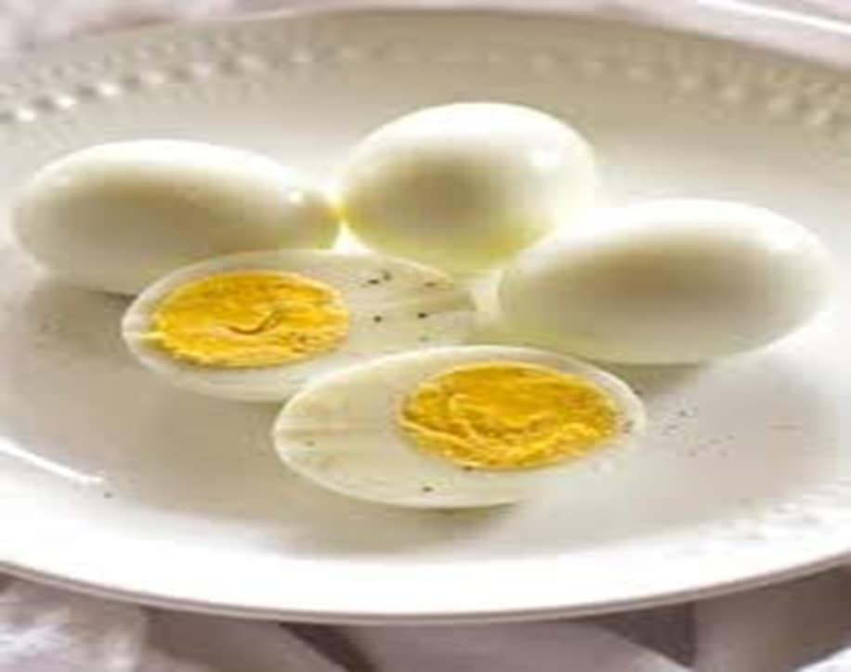
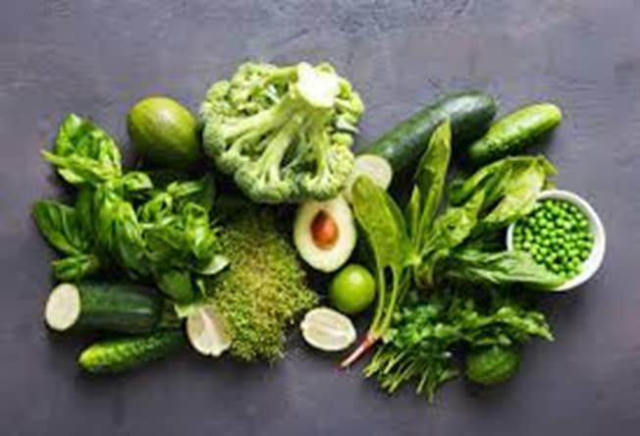
Mong : That’s right. By the way , your noodles with sliced eggs and green vegetables looks delicious .

Slide 14

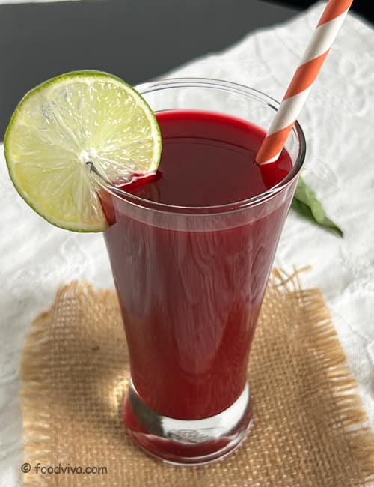
Shihab: Look ! I have sweet cake and juice for my tiffin.
Sarah: Don’t you think those sugary foods are harmful for our healthy?
Mong: Yes, I usually avoid junk food. You also should try.
Shihab: I know. But healthy foods are not always tasty.

Slide 15
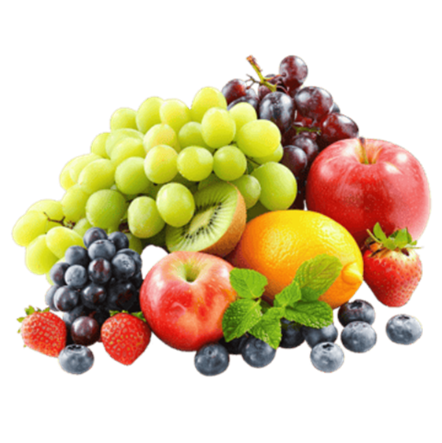

Mong : Really? I find fruits and vegetables tasty. You can also try them regularly.
Sarah: Yes, besides, we must wash foods properly before cooking.

Slide 16
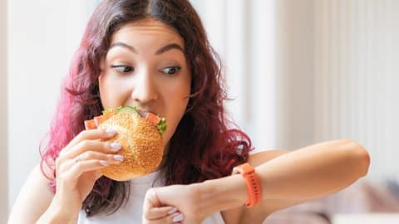
Mong : Oh, our tiffin break will be over soon. Let’s eat quickly.
Shihab: No, Mong, my mom says that eating hastily can cause digestion problems.
Mong: Yes. You are right. We should take time and eat slowly.
Sarah: Let’s finish and go back to the class.

Slide 17
Discuss in pairs and list the healthy and unhealthy foods mentioned in the conversation.
Healthy foods
*Bread and Banana
*Noodles with sliced egg and green vegetables
*Juice
Unhealthy foods
*Chicken and Burger
*Sweetcake
Why are this foods healthy?
Ans: These foods are healthy as they provide our body with vitamins and minerals.
Why are these foods unhealthy?
Ans: These foods are unhealthy as they can make us sick.

Slide 18
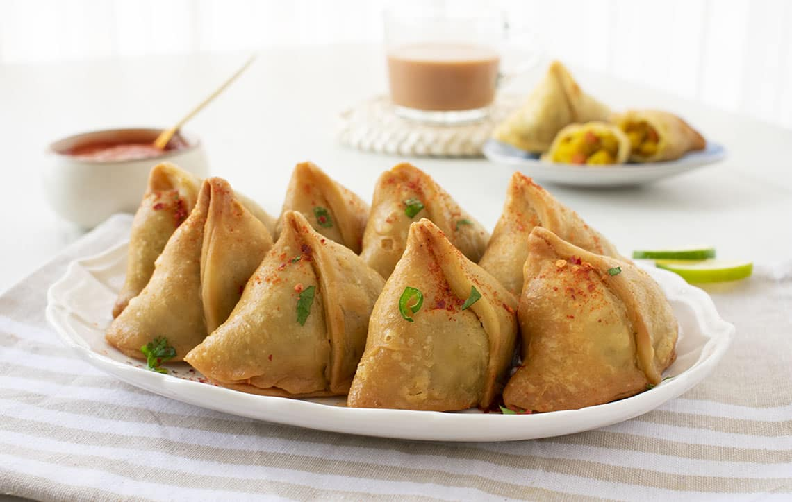
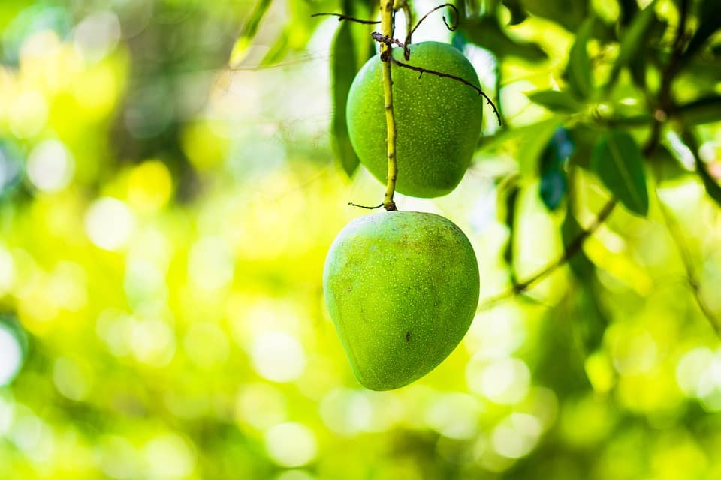
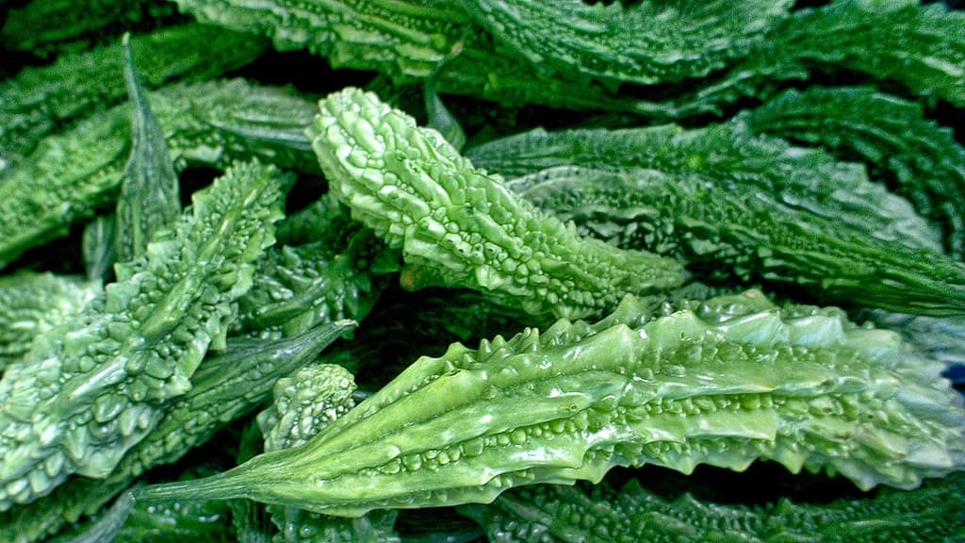
Sour,bitter,spicy,sweet
Name of food | Words for describing food
Singara
Olive
Mango
Bitter gourd
Spicy
Sour
Sweet
Bitter

Slide 19
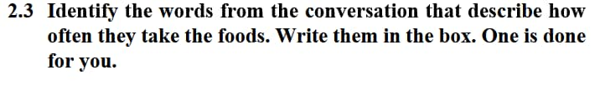
Always, everyday, too often, sometime , usually, regularly

Slide 20

You sholden’t eat them too often.
You also should try.
You can also try them regularly.

Slide 21
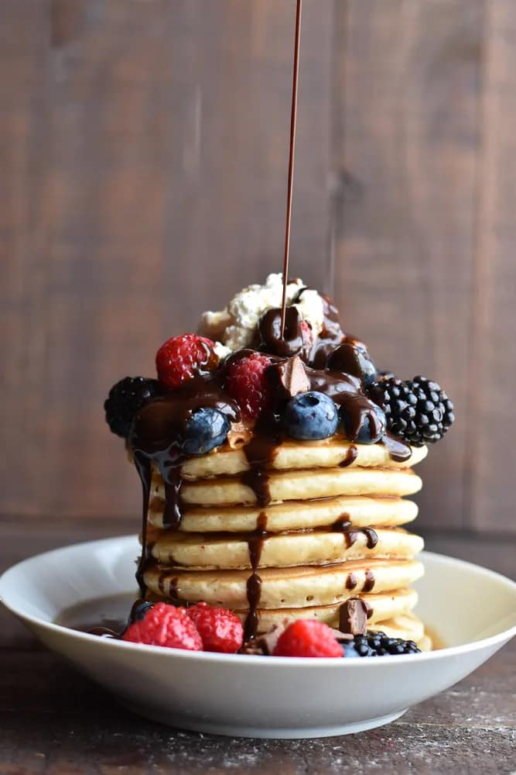


Slide 22
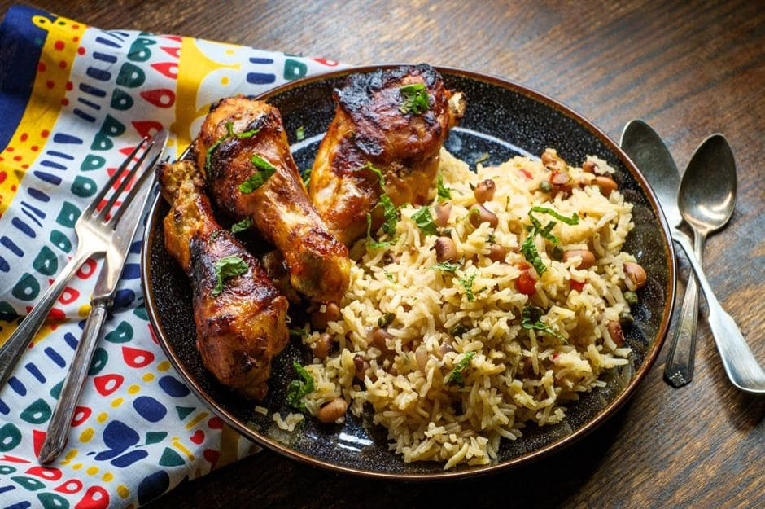


Slide 23
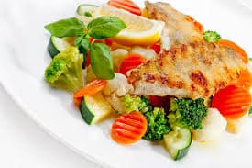


Slide 24
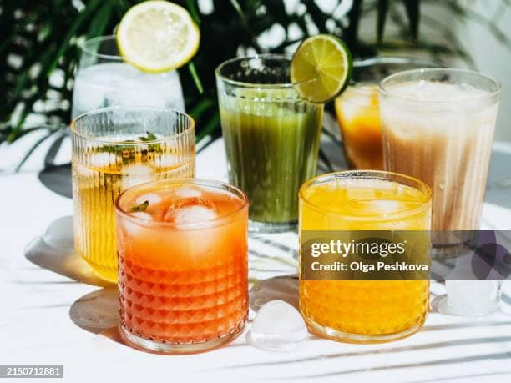


Slide 25
These words are used to describe the quality of foods. These words are adjectives.

Slide 26
When we use adjectives?
We use adjectives to describe persons,places and things.
Example:

Slide 27

I live in a house.
small

Slide 28

My dress is
new

Slide 29

I saw a dog.
black

Slide 30
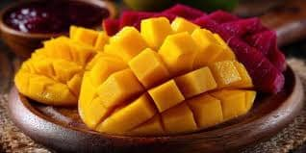
Mangoes taste
delicious

Slide 31
sweet | green | sour | delicious | fresh | crispy | leafy
Nusair went to a grocery shop. First he picked some yellow mangoes. Next he picked some…..grapes. He also bought……vegetables and some potatoes. Back home, he tasted the mangoes . They were……. However, the grapes were…….But , Nusair had a clever idea! He added some sugar to the grapes and blended them to make……juice. Then he asked his mother to make some French fries with the potatoes. They were very ……. Nusair shared this…….food with his younger brother. They enjoyed the food together.

Slide 32
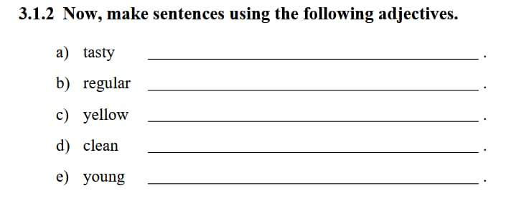

Slide 33
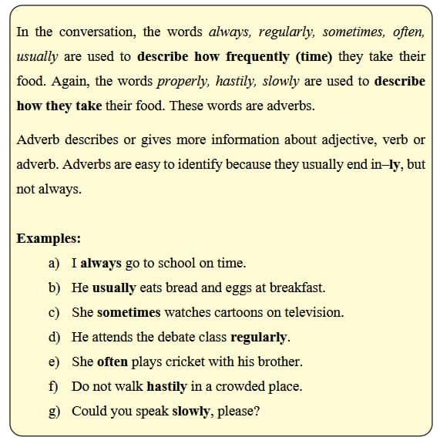

Slide 34
always
properly
soon
safely
never
quickly
usually
sometimes
hastily
late
Sarah enjoys preparing her tiffin box.------------------------ she packes noodles and eggs for tiffin .---------------------------------- , she also takes biscuits and fruits for tiffin. She ----------------- carries a water bottle with her to school. Before having her tiffin, she washes her hands -------------------.She ---------takes her food ----------------------. One morning , Sarah woke up --------------- . She ---------------- packed some snacks in her tiffin box . ----------------- she left home.She arrived at school -------------------------------.

Slide 35
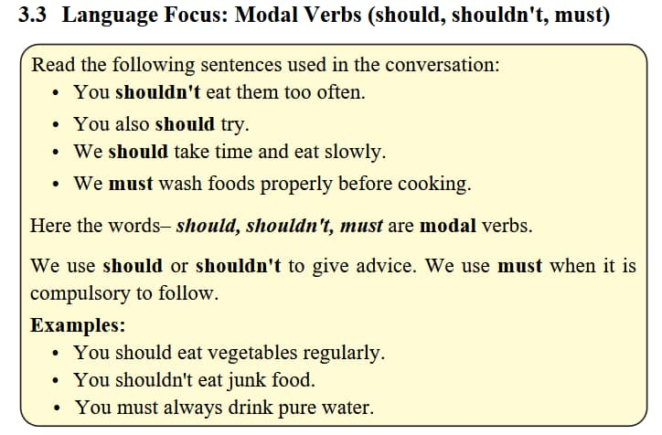

Slide 36
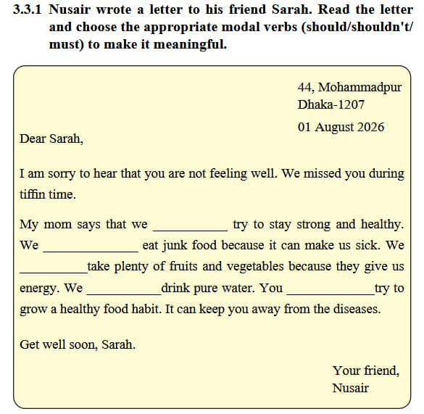

Slide 37

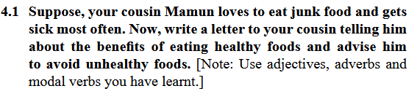
Home Work

Slide 38


