Slide 1

Welcome

Slide 2

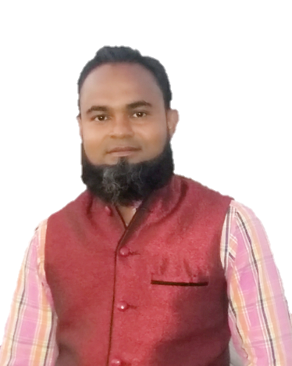

Introduce
Sub: English
Class: 1
Unit: 2( I,J)
Lesson: 11
Time: 40 Mininutes
Date: 26/05/2026
Din Mohammad
Asst. Teacher
Shukundirbag Govt. Primary School
Gazipur Sadar, Gazipur.
Mob: 01720833739
Email: dmshopon1982@gmail.com

Slide 3
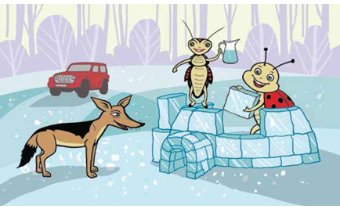
Look at the picture. Say the name of the things

Slide 4
Our todays lesson
I , J

Slide 5
Learning Outcomes
Students will able to…
7.2.1 write non-cursive capital letters neatly and legibly.
7.2.2 write non-cursive small letters neatly and legibly.

Slide 6
Let us sing a song
https://youtu.be/B5csN8gQY4E?si=wHqAohJjSoTAidox

Slide 7
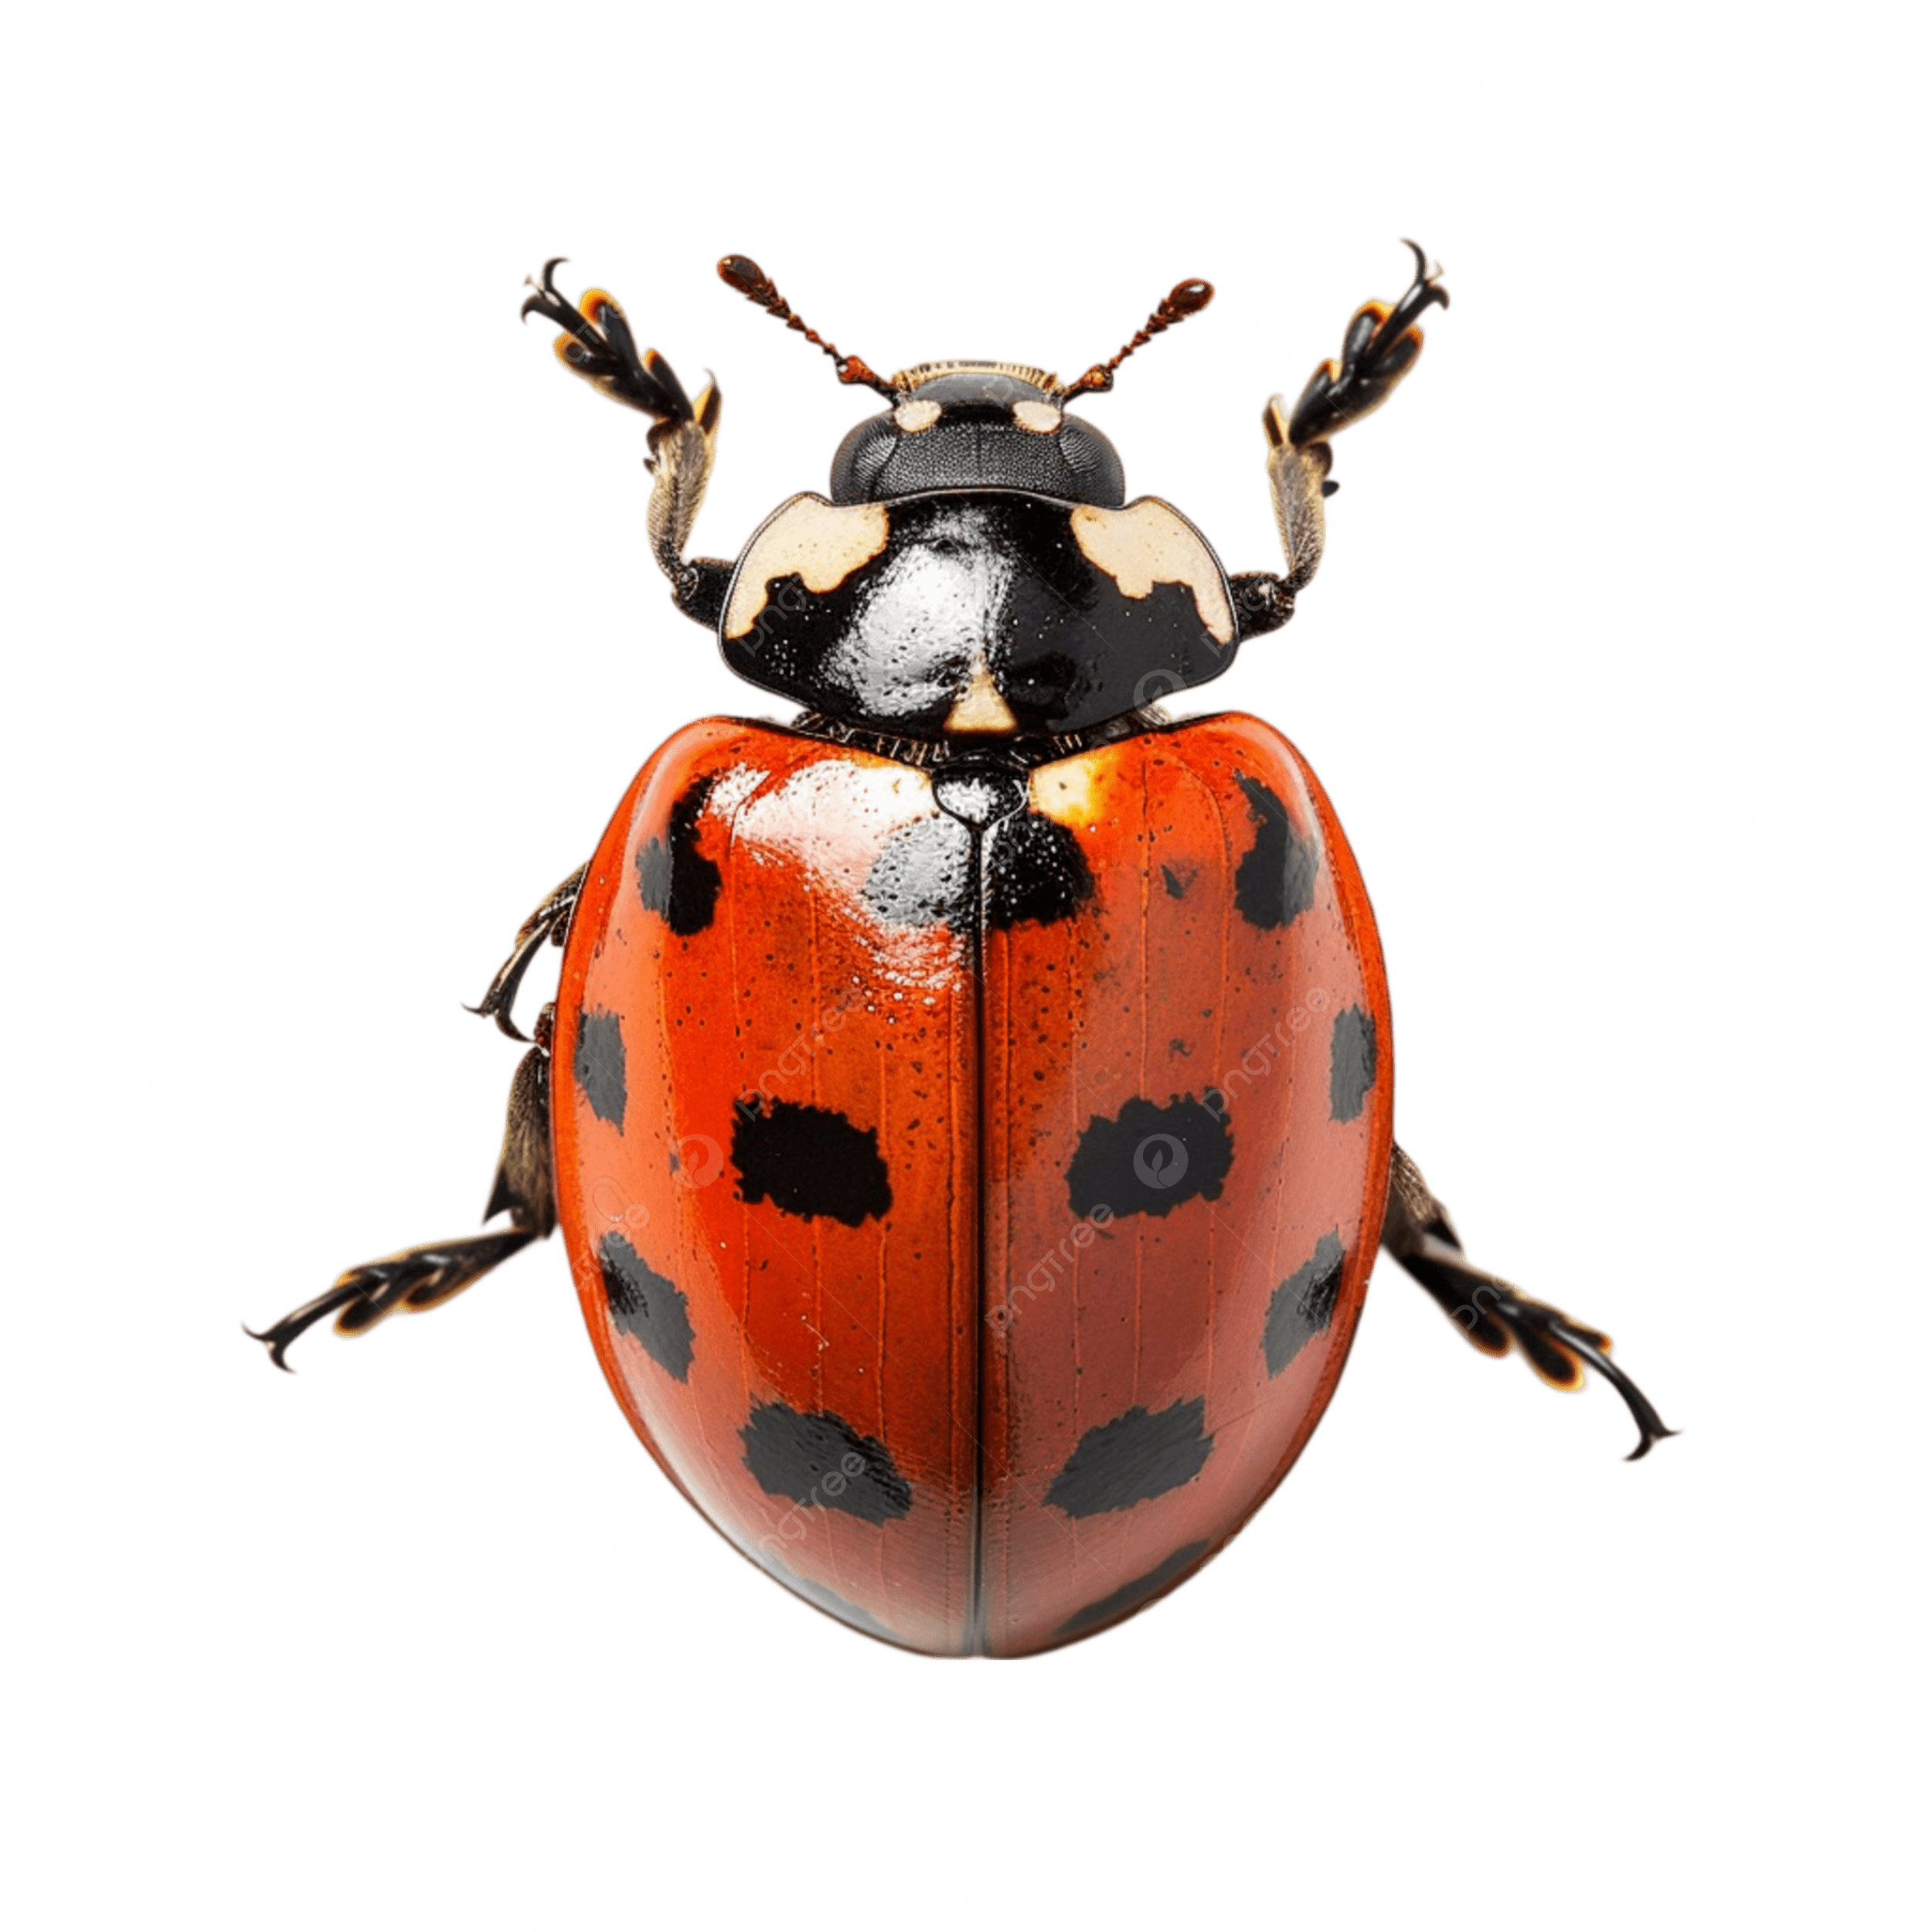
Look listen and see
I
I
nsects
I
nsect

Slide 8
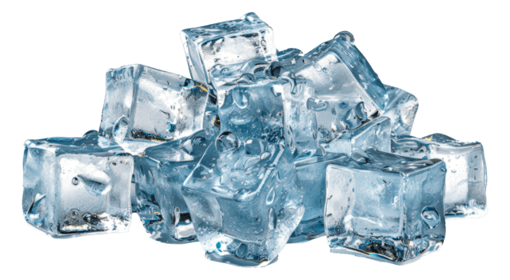
Look listen and see
I
I
ce
I
ce

Slide 9

Look listen and see
J
J
ug
J
ug

Slide 10
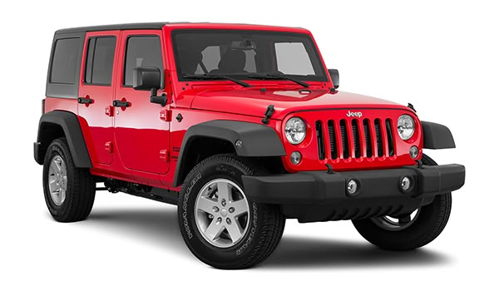
Look listen and see
J
J
eep
J
eep

Slide 11
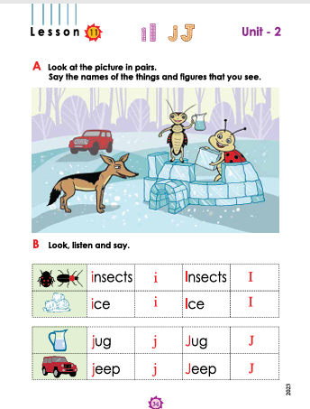
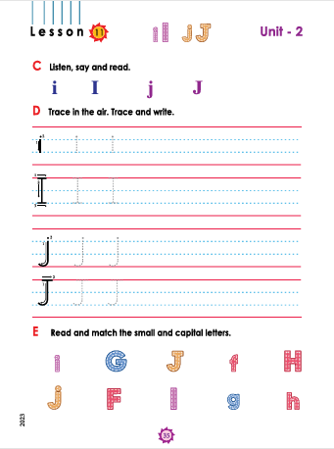
Connect to the text book
Open the page no- 34, 35

Slide 12
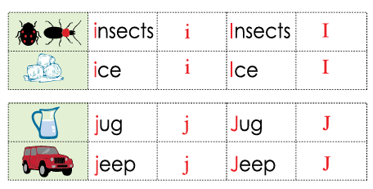
Look listen and say

Slide 13
Trace in the air. Trace and write.
I
I
I
I
I
I
i
i
i
i
i
i
J
J
J
J
J
J
j
j
j
j
j
j

Slide 14
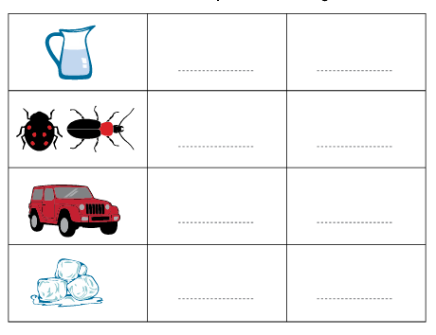
Write the first letter of each word in both the small and capital forms in the given box
jug
Jug
insects
Insects
jeep
Jeep
ice
Ice

Slide 15
Word meaning
Jug
জগ
insects
পোকামাকড়
jeep
জীপগাড়ি
ice
বরফ

Slide 16
Read and match the Small and capital letters
I
j
J
i

Slide 17

Home work
Write non cursive capital letter
“ Ii, Jj ”.

Slide 18
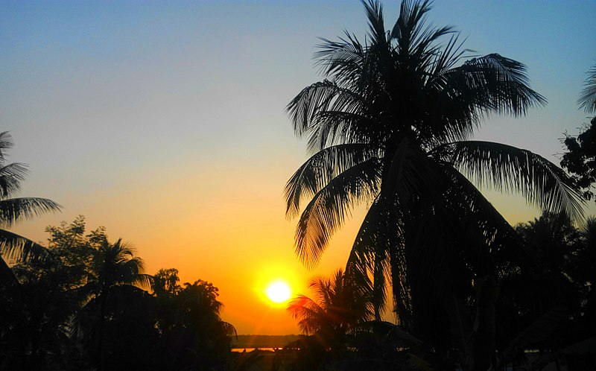
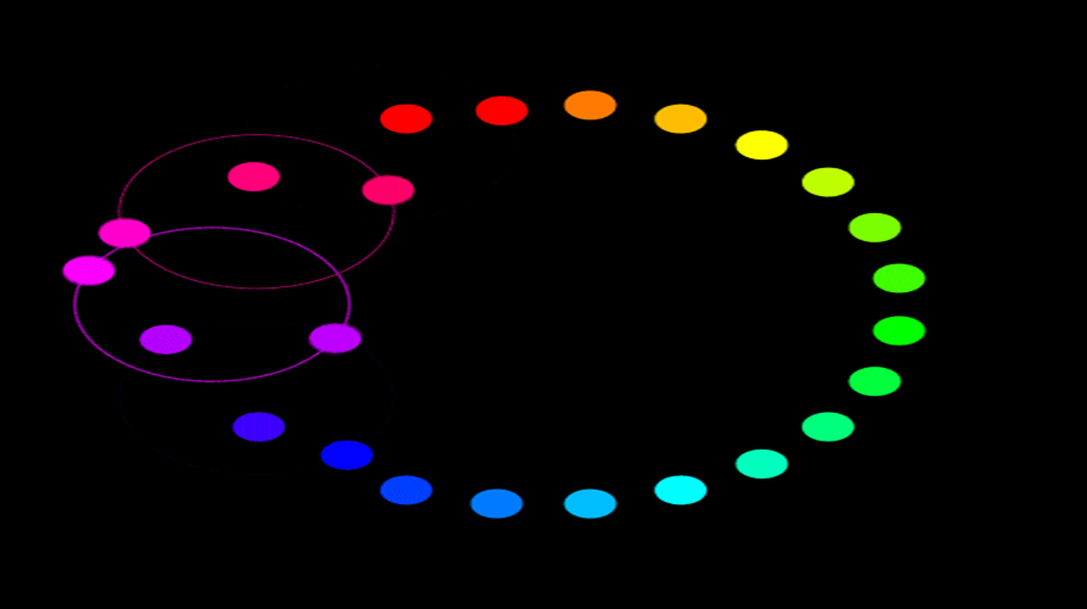
Allah Hafez

