Slide 1
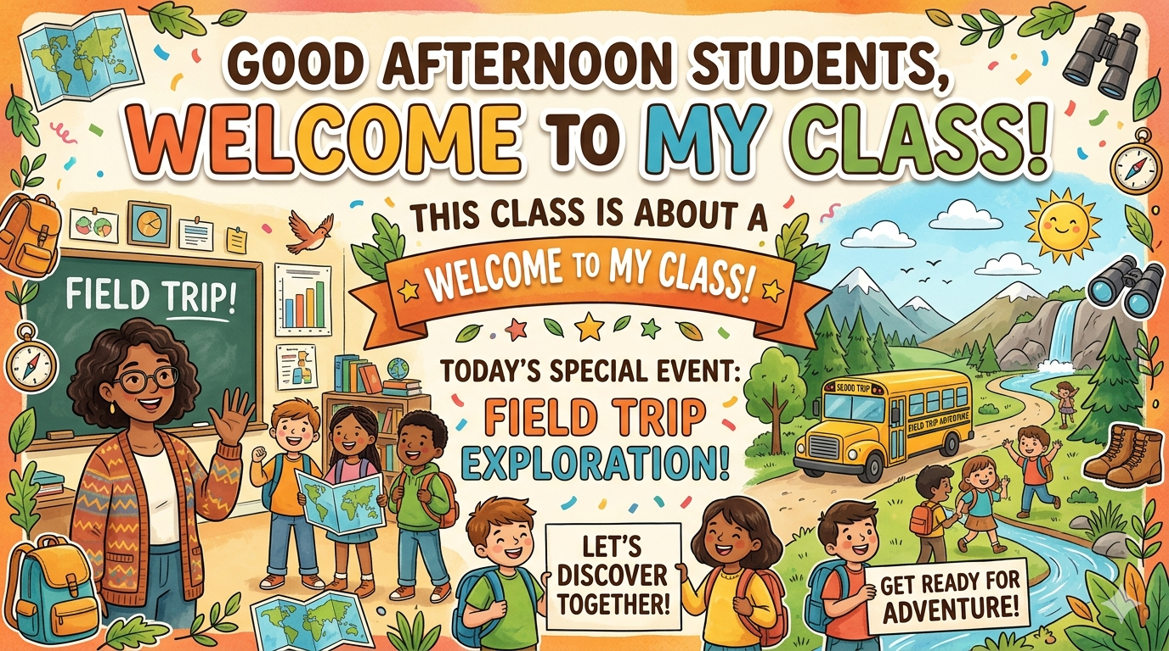

Slide 2
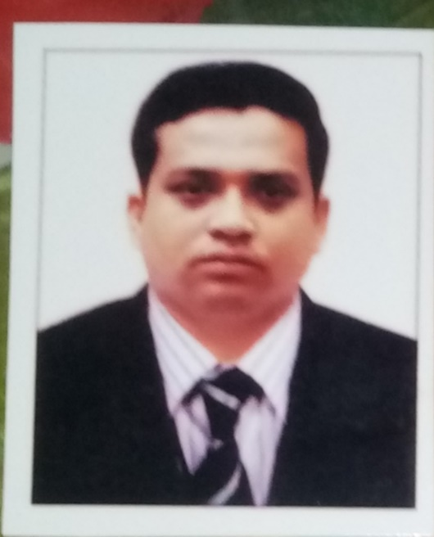
TEACHER’S IDENTITY
Jahangir Alam
Assistant teacher
Abdullahpur Government Primary school , Begumganj Noakhali.

Slide 3
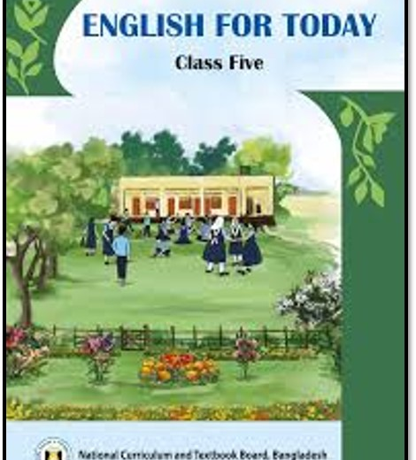
Class: Five
Subject : English
Unit: 8
Title: A Field Trip to Remember
Activity: 1.1, 1.2
Page: 39, 40
Time: 40 minutes

Slide 4
LEARNING OUTCOME
By the end of the lesson SS will be able to:-
3.4.2 Answer simple questions appropriately and confidently
4.2.1 Read aloud texts with proper stress, intonation
5.1.2 Get specific information from simple texts.

Slide 5
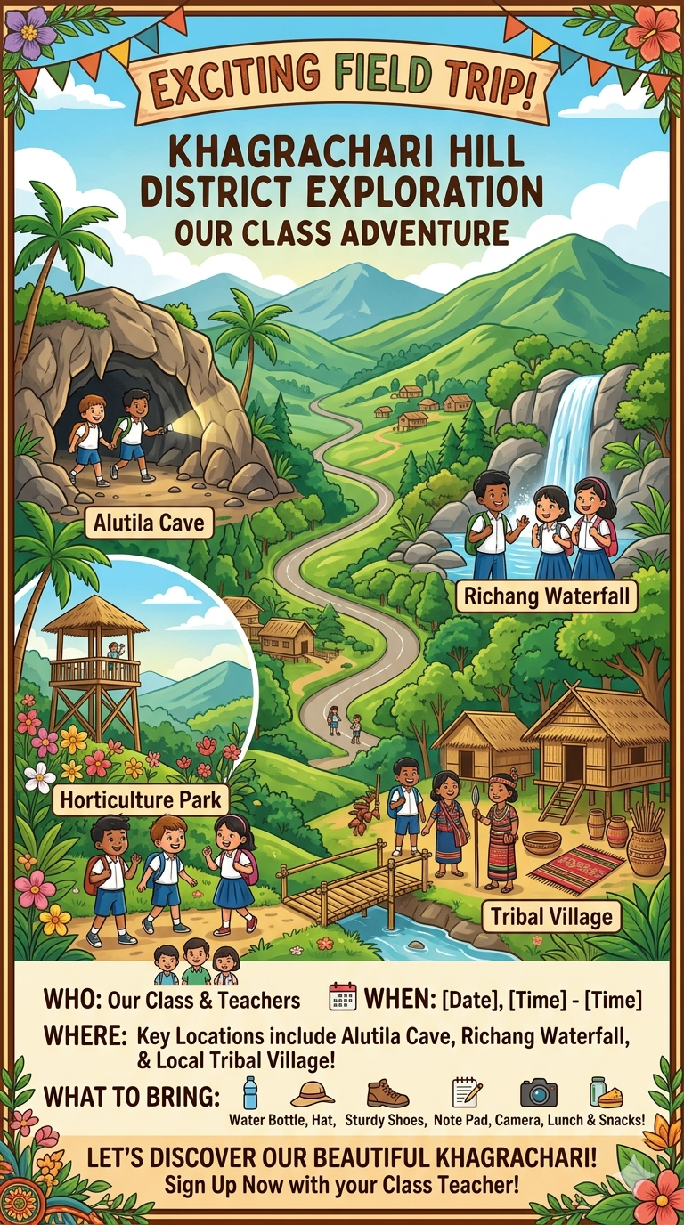
Todays lesson is
A Field Trip You remember
Unit: 8
Activity: 1.1,1.2
Time : 40 min

Slide 6
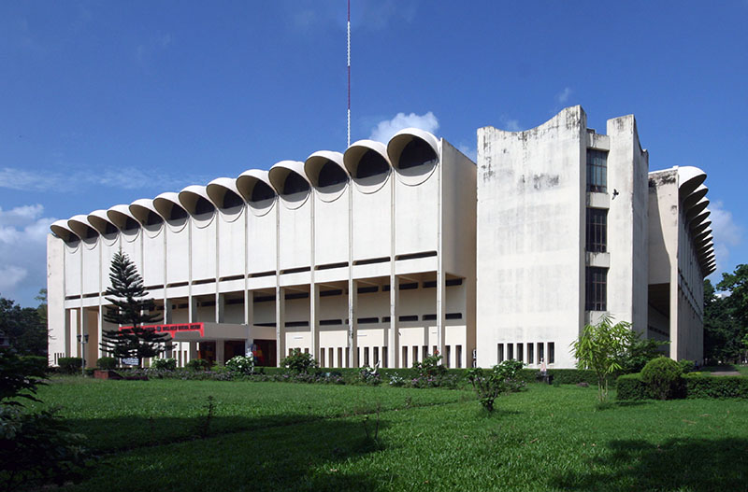
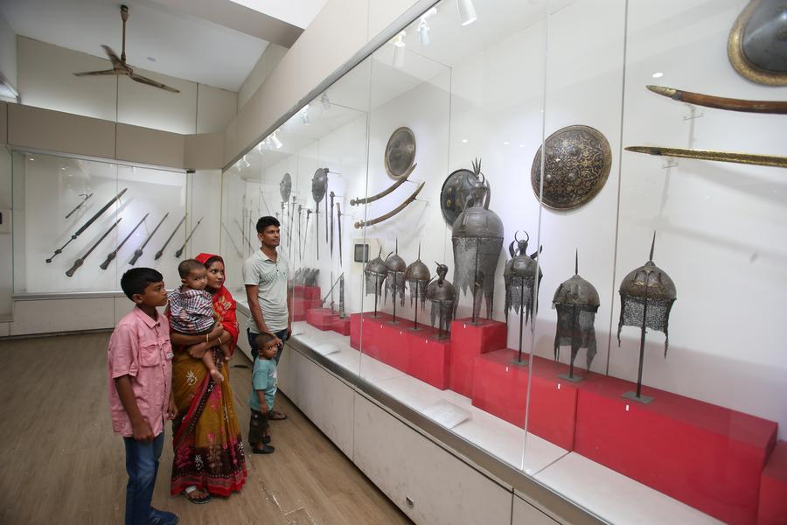
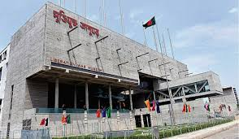
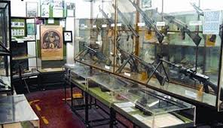
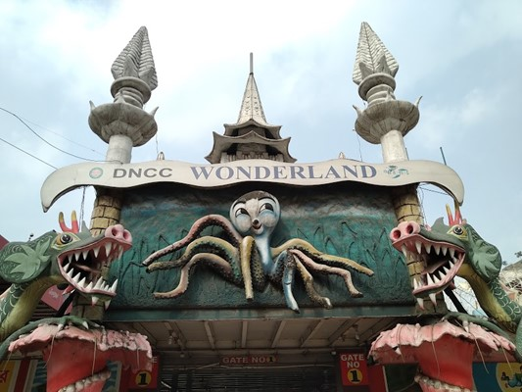
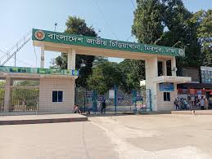
National Museum
National Museum
Liberation War Museum
Liberation War Museum
Wonder Land
National Zoo

Slide 7
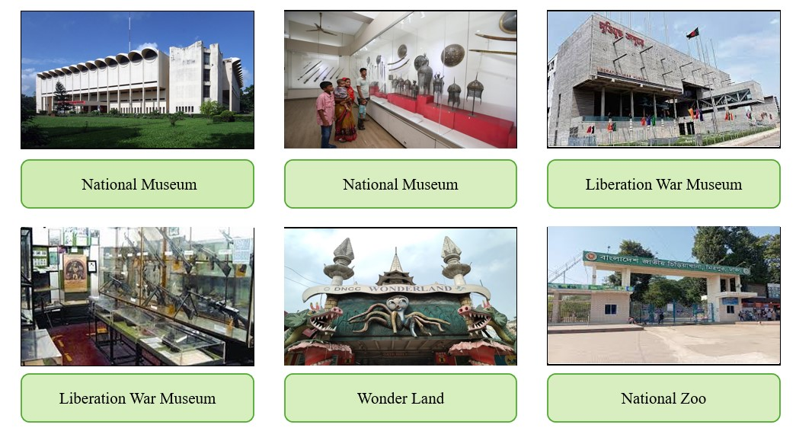
What do the pictures tell you?
Have you ever visited any of these places?
How do you feel when you are on a trip?

Slide 8
Vocabulary
Registration
Field trip
Museum
Liberation War
Chatter
Laughter
Documentary
Attitude
Freedom fighter
Patriotism
Sacrifice

Slide 9
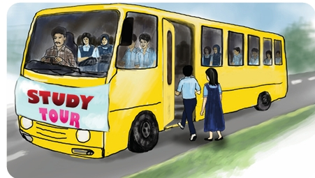
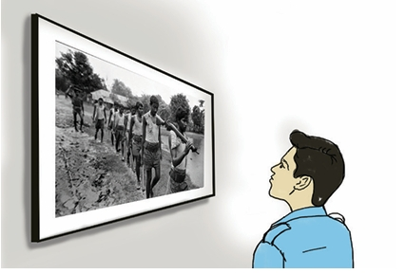
Farhana's school planned a field trip for the students of class five. They
asked students to fill a registration form for the trip. On a sunny morning,
they started for the Liberation War Museum at Agargaon, Dhaka. She and
her classmates were excited to explore the museum. Their class teacher,
Mr. Khan, went with them on this trip. They started from their school by bus at 9 a.m. The bus ride was filled with chatter and laughter. Farhana sat next to his friend, Rabeya. They sang songs together. When they reached the museum at 10 a.m., the guide, Mr.Kamal greeted them. His welcoming attitude pleased them. Mr. Kamal guided them to see the different corners of the museum. First, they watched a short documentary. It showed the bravery of the freedom fighters during the Liberation War. Their patriotism and sacrifice inspired them. Around half past ten, they started visiting different galleries. Old photographs of war, handwritten letters of the freedom fighters, and
their weapons were displayed. They carry the memories of the war. They saw the personal belongings of the war heroes. The display of the
galleries made them curious to learn more about the Liberation War.
Finally, they thanked their guide for his support.
They left the museum at 12:30 p.m. and returned to school at 1:30 p.m.
They shared their feelings and experiences with their families. It was really
a memorable trip for them.

Slide 10
Group Work
Make four groups
Read the text in group
Answer some short question to each other

Slide 11
Assesment
Chain drill activity using a softball
Student 1 reading
Student 2 reading
Student 3 reading

Slide 12
Summary of the session
Recap the main points of the lesson.
What have we learnt today?
We have read the text aloud properly.
We have learnt some new words.

Slide 13
