Slide 1

welcome

Slide 2


Lesson Introducton
Class-two
Subject-English
Unit 7: Let`s count.
Lesson 4: How many ?
Time: 45 minutes

Slide 3
Teacher Introducton
Rajat Biswas
Assistant teacher
Amborkhana Dorshondeory Govt. Primary School
Sylhet Sadar, Sylhet.

Slide 4
Learning outcome
Students will be able to-
1.To count the numbers.

Slide 5
Today’s Lesson
How many

Slide 6

Vocabulary
one
1

Slide 7

Vocabulary
2
Two

Slide 8
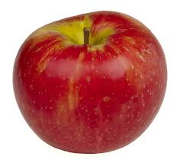
2
1
Three
3

Slide 9

4
Four

Slide 10

5
Five

Slide 11
Say with me
3
2
1
4
5

Slide 12

Say with me
1 | one
2 | Two
3 | Three
4 | Four
5 | Five

Slide 13
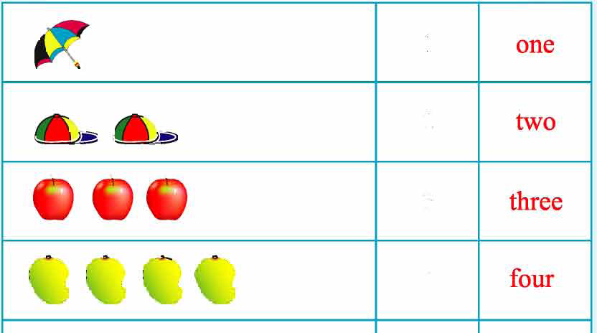
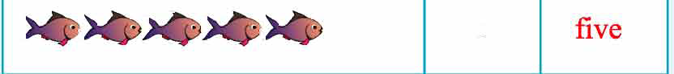
Compare lines with your text book.
1
2
3
4
5

Slide 14
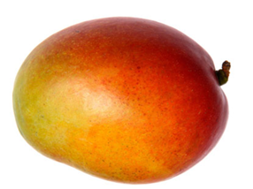
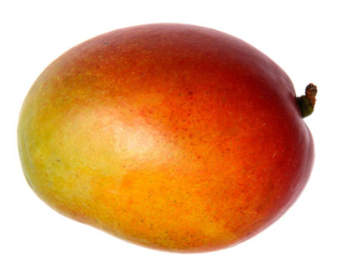
Evaluation
How many mangoes?
2

Slide 15
How many ?
4

Slide 16
Match
Three | 4
Four | 2
Two | 5
Five | 3
One | 1

Slide 17
Prepared by:
SHAMAL DAS
Assistant Teacher
Gobindapur GPS, Sadar, Habiganj.

Slide 18
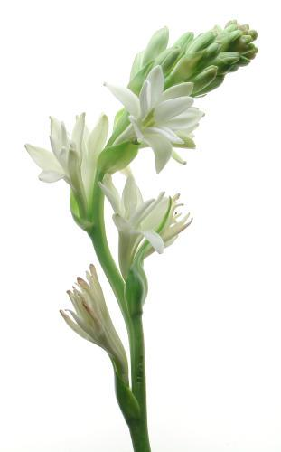
Good bye

