Slide 1

WELCOME

Slide 2
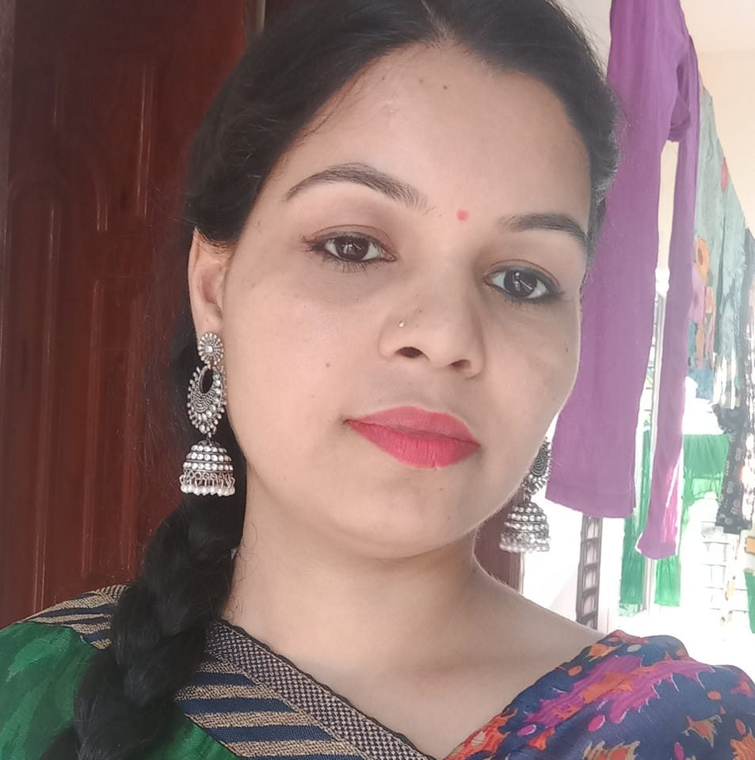

Teachers Name:Fouzia yesmin,
Asistant Teacher,
53 no.Batikamary Govt.Primary School.
Subject: English
Unit:5
Lesson:3
Topic:Seven days of a week.
Class Time:40 min.

Slide 3
Learning Objective
By the end of todays lesson ,students will be able to know …
1-say the names 0f the days of a week.
2-Ask and answer questions about days.
3-Identify todays day.
4-Write the name of the days correctly.

Slide 4
Warm up Activities-
Good morning student
Good morning teacher
How are you all today?
We are fine.thank tou.And you?
Ok Let ‘s sing a song now.

Slide 5
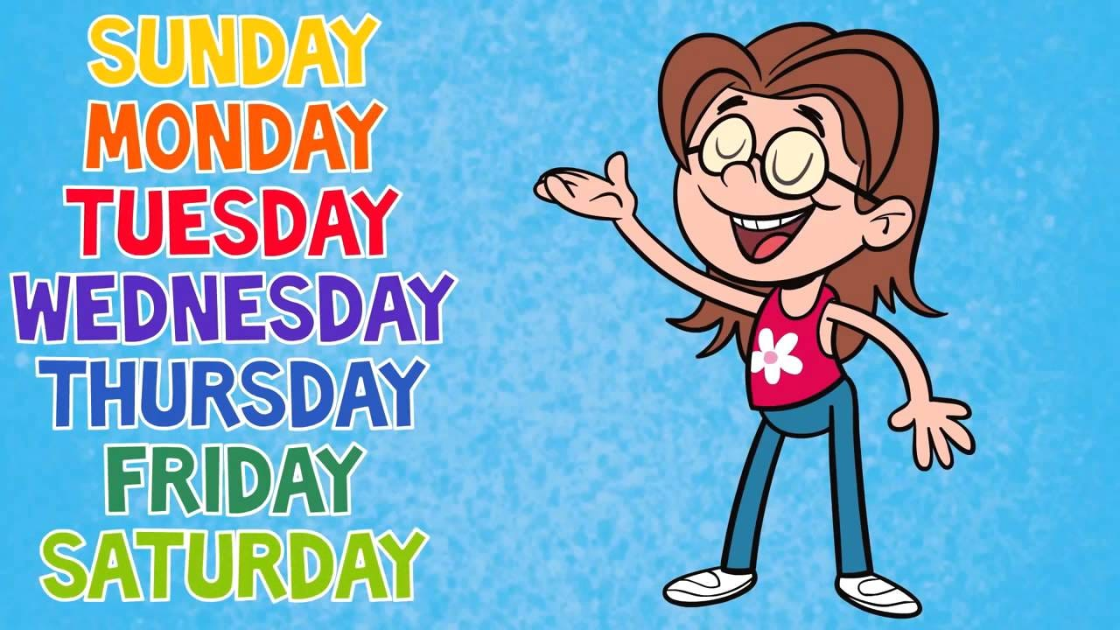
Look at the picture.
And think about it.

Slide 6
Lesson announcement
.
Days of the week

Slide 7
Seven days of a week
Sunday
Monday
Tuesday
Wednesday
Thursday
Friday
Saturday

Slide 8
Listen and say
Teacher: How many days are there in a week?
Students: 7 days.
Teacher: What day is Today?
Students: Today is Monday.

Slide 9
Vocabulary practice
Read aloud(Whole class reading ,Individual reading)
Sanday-
Monday-
Tuesday-
Wednesday-
Thursday-
Friday-
Saturday-
রবিবার
সোমবার
মঙ্গলবার
বুধবার
বৃহস্পতিবার
শুক্রবার
শনিবার

Slide 10
Students activity
S1:How many days aare there in a week?
S2:There are 7 days in a week.
S1:What are they?
S2:They are -
Sunday,Monday,Tuesday
,Wednesday,Thursday,Friday and Saturday

Slide 11
Ask and answer
S1:What day is today?
S2:Today is Monday.
S2:What day comes after Monday?
S3:Tuesday
S3:What day comes after Tuesday?
S4:Wednesday.

Slide 12
Arrange the Days in order-
Friday-Monday-Sunday-Saturday-Thurday-Tuesday-Wensday
Sunday-Monday-Tuesday-Wednesday-Thursday-Friday-Saturday

Slide 13
Fill in the blanks
1-_________comes after Monday
2-____________comes before Friday
3-Today is ________
4-There are _______ days in a week.
Tuesday
Thursday
Monday
Sevevn

Slide 14
Shorts Questions
Write on your exercise book.
1-How many days are there in a week?
2-What day is today?
3-Whice day comes after Friday?
4-Write the name any three days of the week?

Slide 15
Homework
Write the names of the seven days five times in your exercise book?
No more today.Do you have any questions?

Slide 16
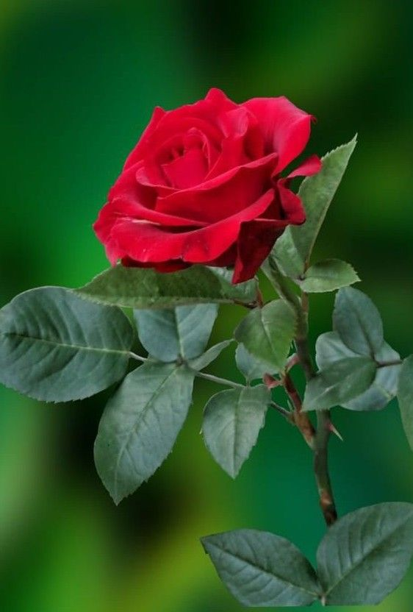
The end
Thank you

