Slide 1


WELCOME
TO THE
ENGLISH
CLASS
Learning
Is
FUN

Slide 2

TEACHER
Aysha Siddika Auntara
Assistant Teacher
Kolapara Government Primary School
Sreenagar, Munshiganj

Slide 3



Lession
Title-A Field Trip To Remember
Class- Five
Subject- English
Unit-8 , Activity-1.1, 1.2
Time-40 minutes
Date: /06/2026

Slide 4

Learning Outcomes:
Students will be able to –
4.2.1 read aloud texts with proper stress and intonation
3.4.2 Answer simple questions appropriately and confidently
5.1.2 get specific information from simple texts

Slide 5
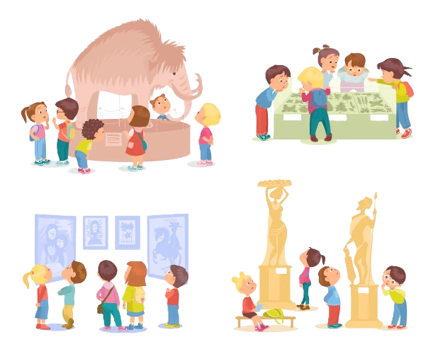
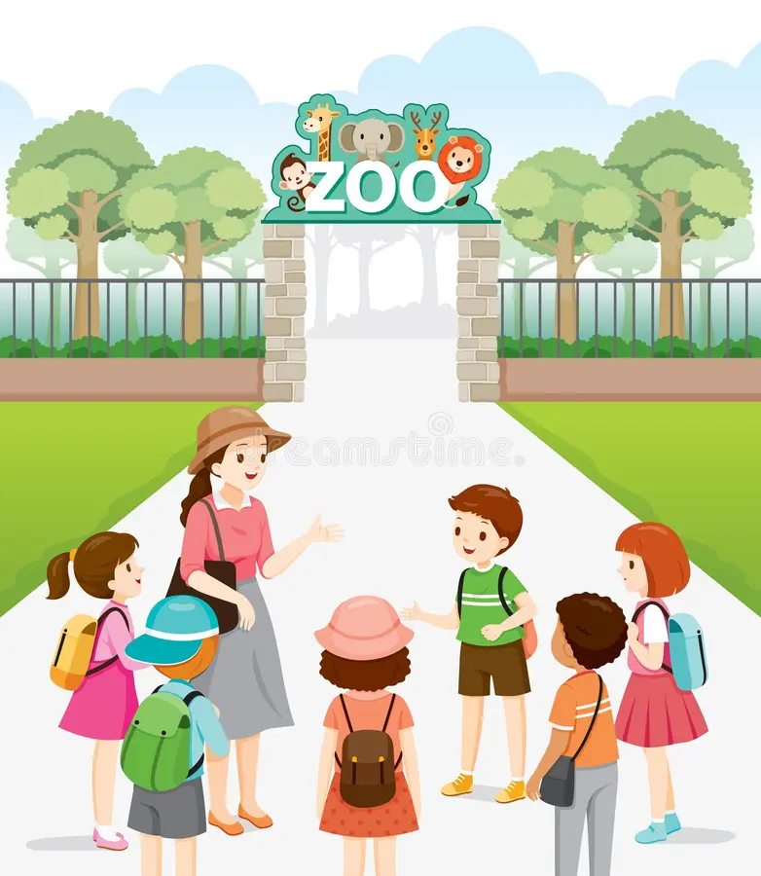
Look at the pictures.
Can you guess what is our today’s lesson?
Notes:
Slide 5 -15- pre reading

Slide 6



Slide 7
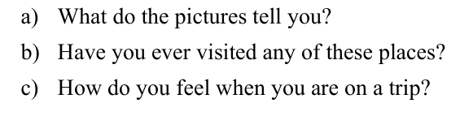
Look at the pictures.
Later you’ll discuss the following questions with your pair.

Slide 8
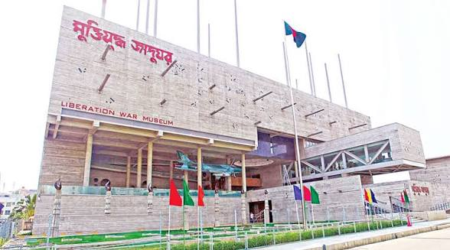
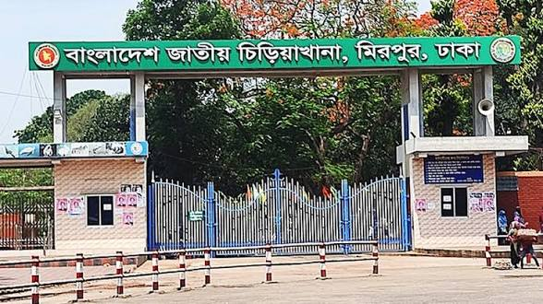
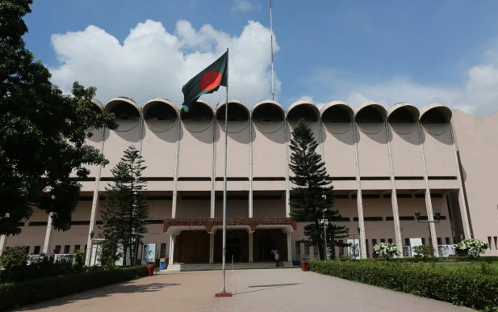
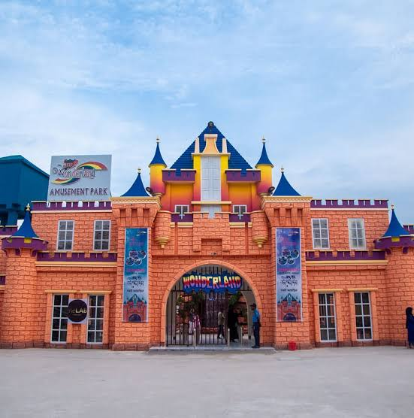
National Museum

Slide 9
National Museum
Liberation War Museum

Slide 10
National Museum
Liberation War Museum
Bangladesh National Zoo

Slide 11
Bangladesh National Zoo
Wonderland

Slide 12

Discuss the following questions in pair.
The given pictures are tourist attractions of Bangladesh.National Museum------
Yes, I have. I have visited …, …, …. /No, I haven’t visited any places.
I feel very happy when I’m on a trip./ I don’t feel anything.
Notes:
Pair work

Slide 13
New words
Trip
T-r-i-p
To visit some where/journey
Museum
M-u s-e u-m
gallery
Explore
E-x p-l-o-r-e
study/look into
Chatter
C-h-a t-t-e-r
small talk
Patriotism
P-a-t r-i o t-i-s-m
love for one’s country
Sacrifice
S-a-c r-i f-i-c-e
To give up/ let go
6/20/2026
13

Slide 14
Turn to page 40

Slide 15

Can you guess where are they going?
Notes:
prediction

Slide 16

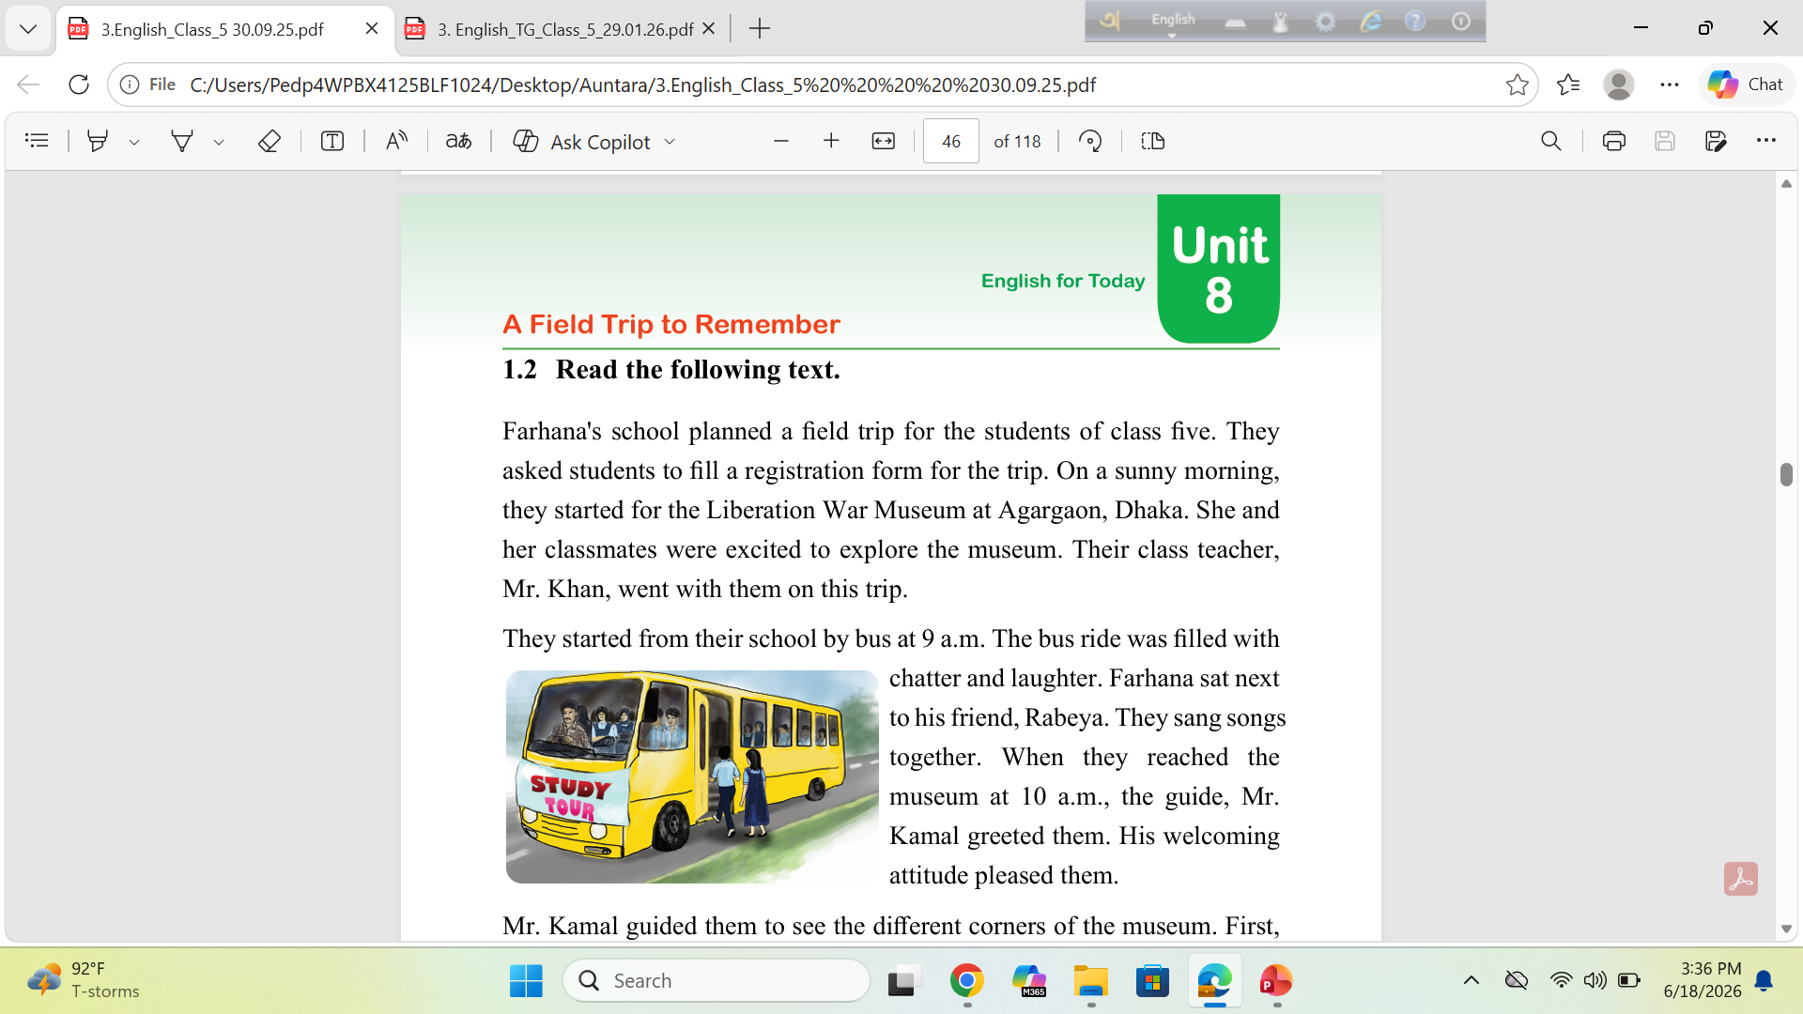
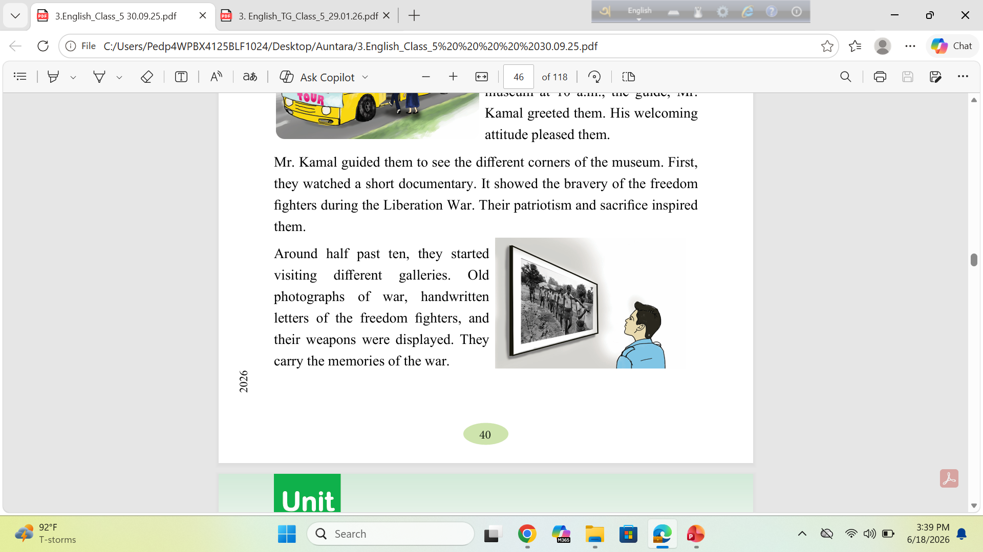
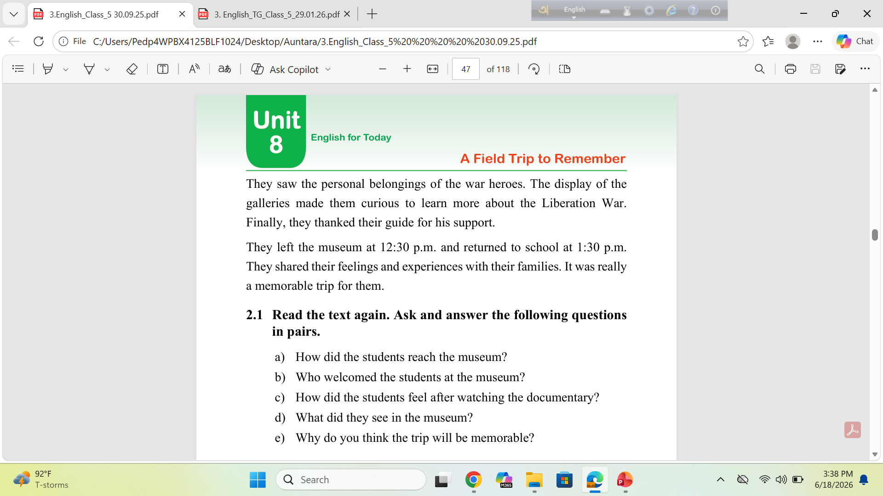
Notes:
16,17- while reading

Slide 17

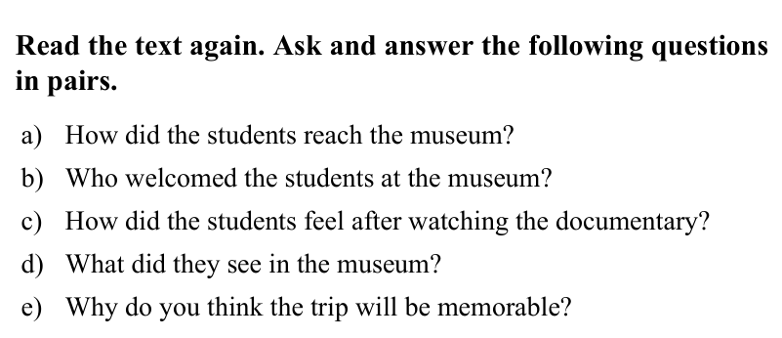
Was your prediction right?

Slide 18
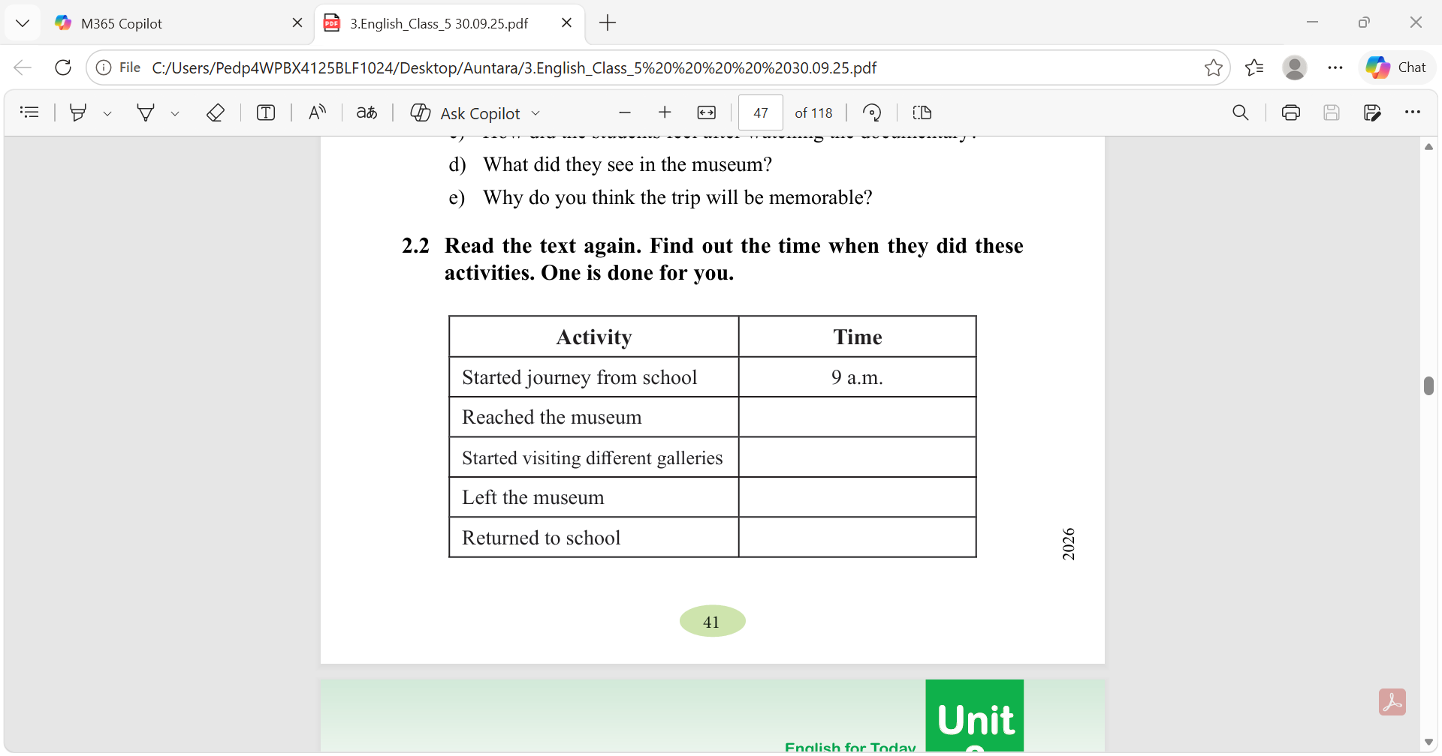

Slide 19
Let’s check the answer.
10 a.m.
10:30 a.m.
12:30 a.m.
1:30 a.m.

Slide 20

Thank you so much

