Slide 1

Welcome

Slide 2

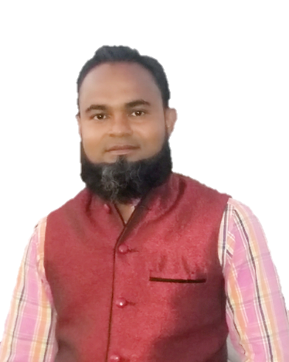

Introduce
Sub: English
Class: 1
Unit: 2( Q,R)
Lesson: 17
Time: 40 Mininutes
Date: 03/02/2023
Din Mohammad
Asst. Teacher
Shukundirbag Govt. Primary School
Gazipur Sadar, Gazipur.
Mob: 01720833739
Email: dmshopon1982@gmail.com

Slide 3
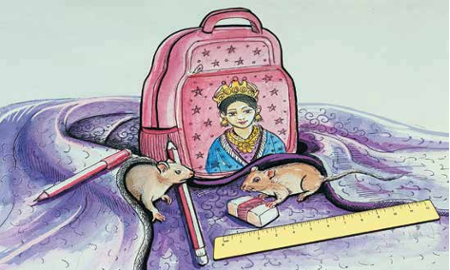
Look at the picture. Say the name of the things

Slide 4
Our todays lesson
Q , R

Slide 5
Learning Outcomes
Students will able to…
7.2.1 write non-cursive capital letters neatly and legibly.
7.2.2 write non-cursive small letters neatly and legibly.

Slide 6
Let us sing a song
https://youtu.be/B5csN8gQY4E?si=wHqAohJjSoTAidox

Slide 7
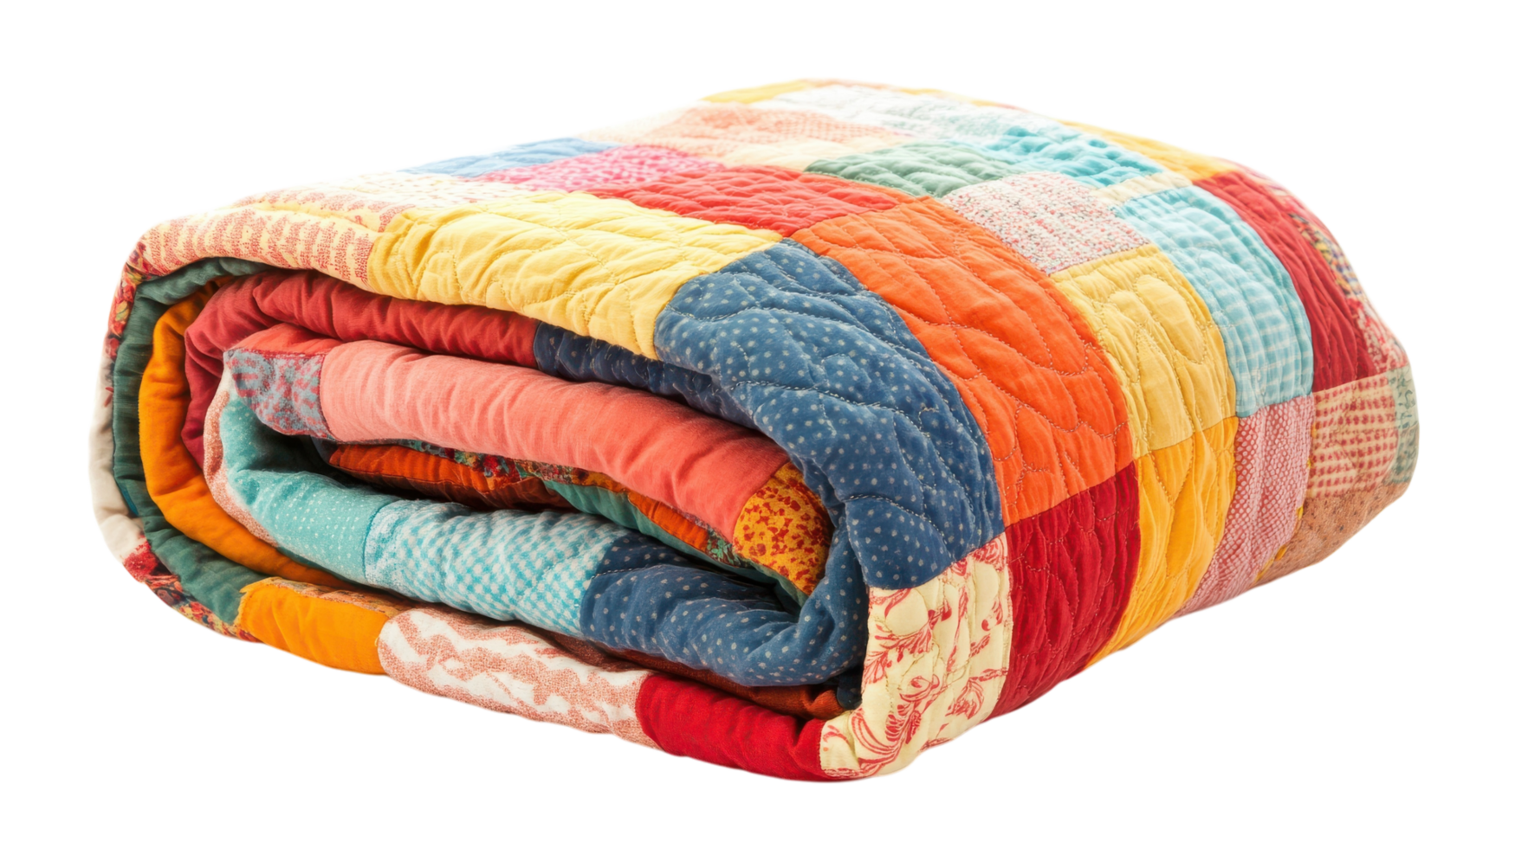
Look listen and see
Q
Q
uilt
Q
uilt

Slide 8
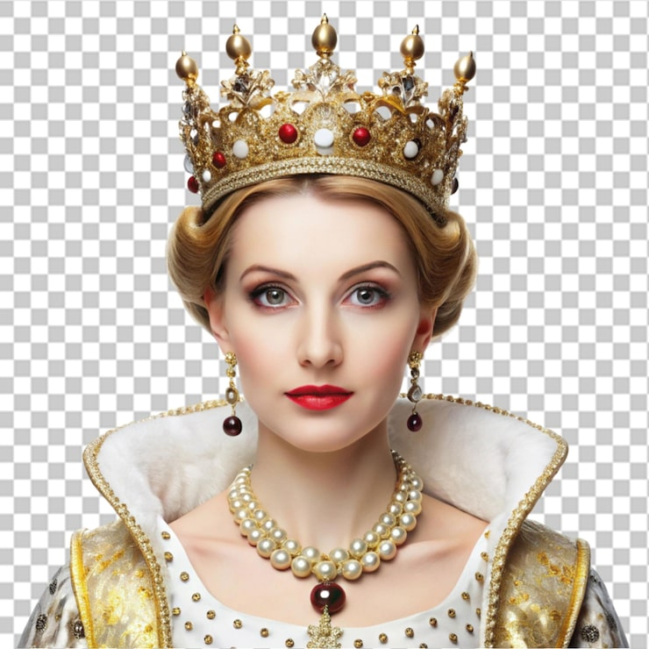
Look listen and see
Q
Q
ueen
Q
ueen

Slide 9
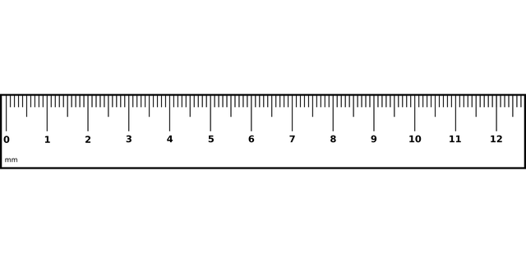
Look listen and see
R
R
uler
R
uler

Slide 10
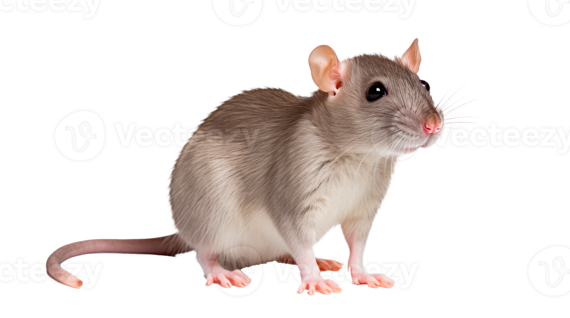
Look listen and see
R
R
at
R
at

Slide 11
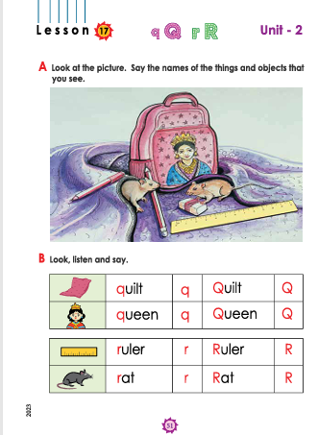
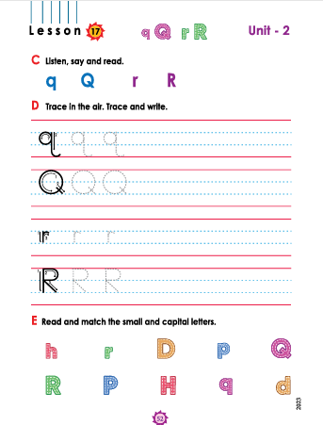
Connect to the text book
Open the page no- 51, 52

Slide 12
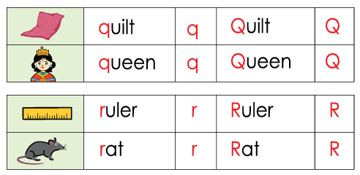
Look listen and say

Slide 13
Trace in the air. Trace and write.
Q
Q
Q
Q
Q
q
q
q
q
q
R
R
R
R
R
r
r
r
r
r

Slide 14
Word meaning
Quilt
লেপ
Queen
রানী
Ruler
রুলার/মাপনি
Rat
ইদুর

Slide 15
Read and match the Small and capital letters
Q
R

Slide 16

Home work
Write non cursive capital letter
“Qq, Rr”.

Slide 17

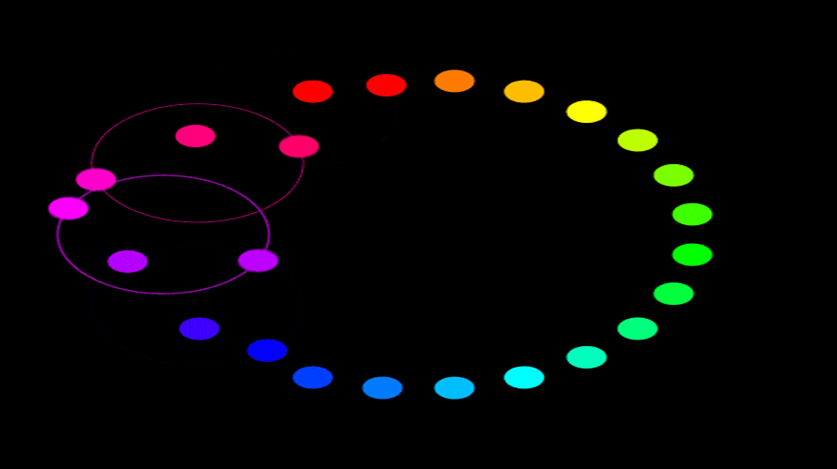
Allah Hafez

