Slide 1


Slide 2
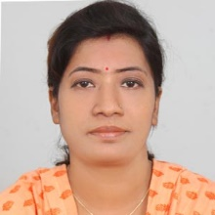
Teachers’ Identity
SUMI DAS
Assistant Teacher
Purba ziri Amania Lokman Hakim Model Govt. Primary School.
Patiya , Chattogram.

Slide 3
Lesson Introduction
Class :5
Unit :12
Title : Eating Healthy
Page : 61,62 ( Activity : 1.1, 1.2, 2.1)

Slide 4
Learning Outcome
3.4.1 Ask simple questions on familiar topics.
3.4.2 Answer simple questions appropriately and confidently.
4.2.1 Read aloud texts with proper stress intonation.

Slide 5
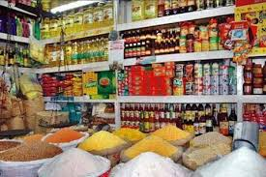

Slide 6
I will ask some questions like:
1)Have you ever bought anything from a store?
2) What did you buy from a store?

Slide 7
Announcement of the Lesson
Eating Healthy

Slide 8
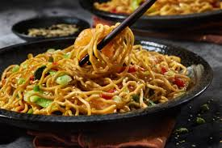
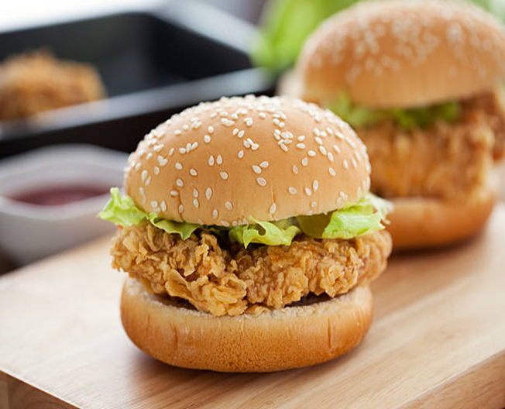
1.2 Read the following conversation.
Shihab : It’s tiffin time. Let’s eat together.
Sarah: Sure. Who else like to join us ?
Mong : Let’s sit over there to enjoy our tiffin.
Sarah : Noodles again ! I wish to have a chicken burger for tiffin everyday.

Slide 9
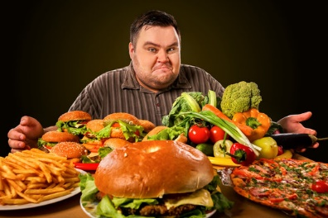
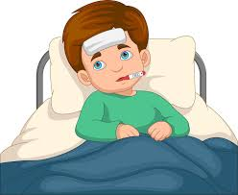
Mong : If you eat them regularly you’ll get fat and sick.
Shihab: Mong is quite reasonable. You shouldn’t eat them too often, Sarah.

Slide 10
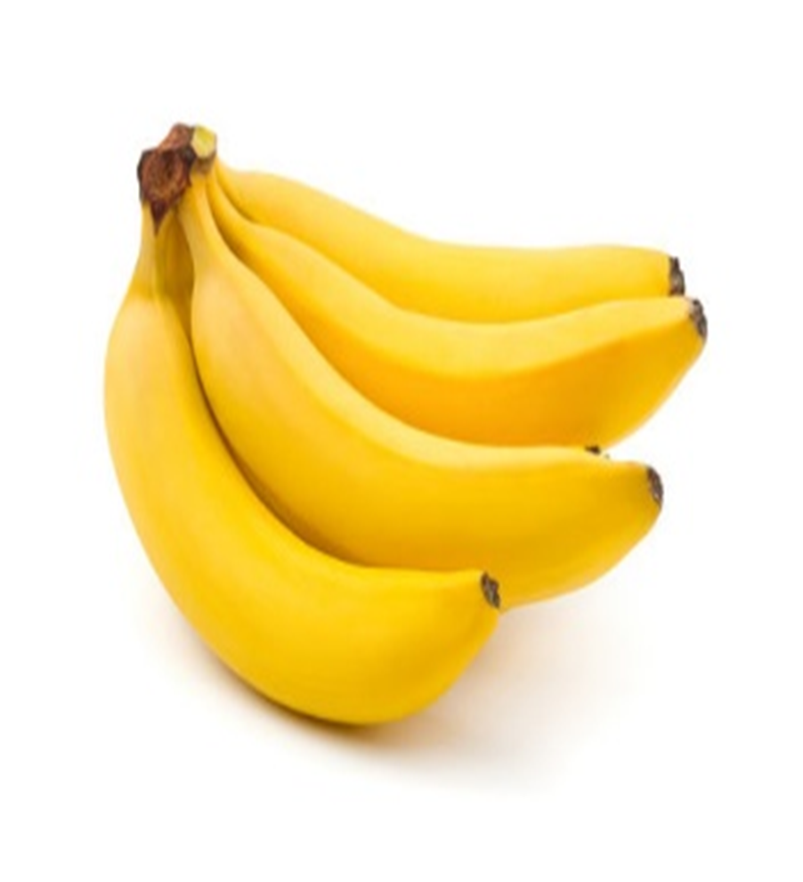
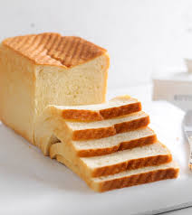
Mong : I have bread and banana today. My mother sometimes prepares new items for me.
Sarah : Oh ! This banana looks fresh. It has vitamins to give you energy.

Slide 11
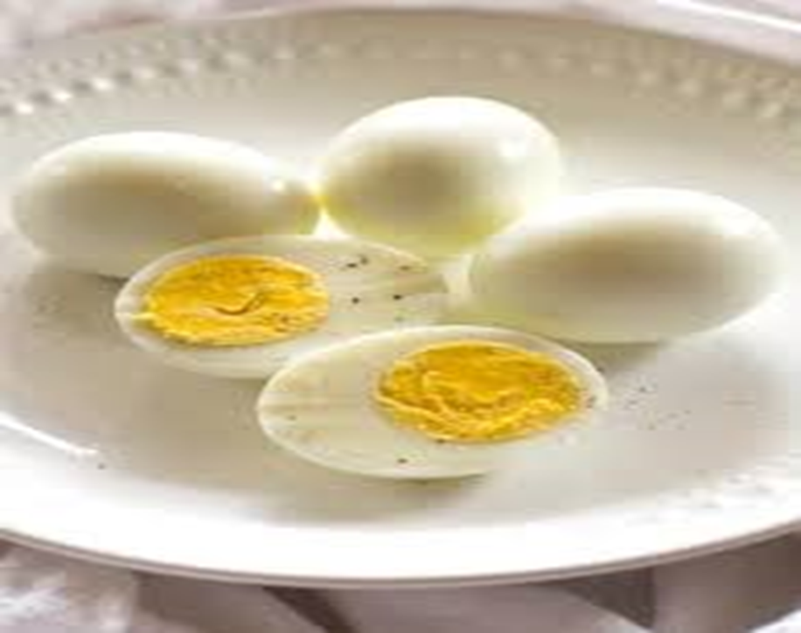
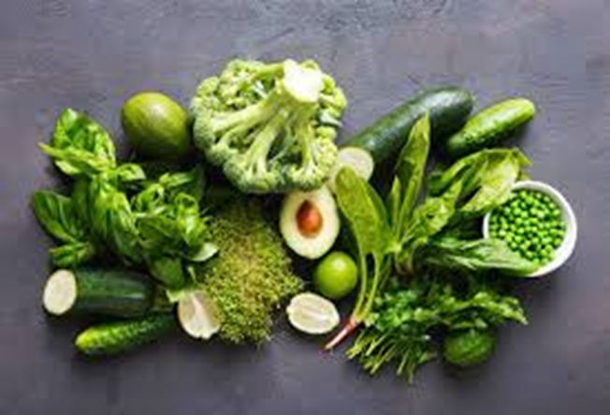
Mong : That’s right. By the way , your noodles with sliced eggs and green vegetables looks delicious .

Slide 12

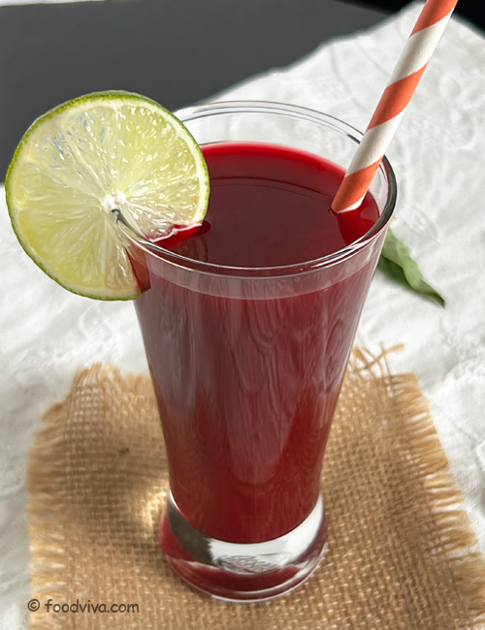
Shihab: Look ! I have sweet cake and juice for my tiffin.
Sarah: Don’t you think those sugary foods are harmful for our healthy?
Mong: Yes, I usually avoid junk food. You also should try.
Shihab: I know. But healthy foods are not always tasty.

Slide 13
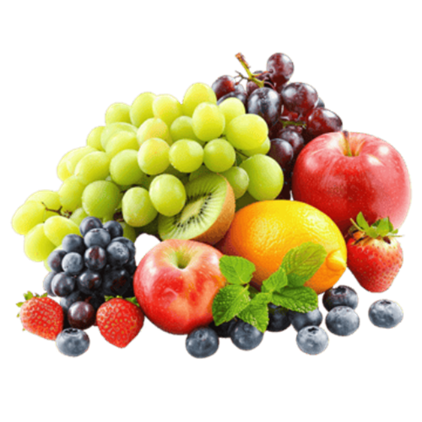

Mong : Really? I find fruits and vegetables tasty. You can also try them regularly.
Sarah: Yes, besides, we must wash foods properly before cooking.

Slide 14
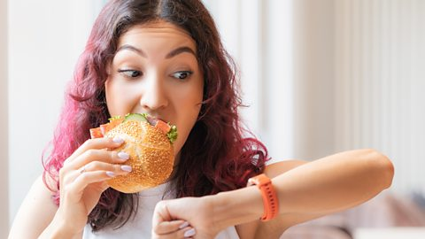
Mong : Oh, our tiffin break will be over soon. Let’s eat quickly.
Shihab: No, Mong, my mom says that eating hastily can cause digestion problems.
Mong: Yes. You are right. We should take time and eat slowly.
Sarah: Let’s finish and go back to the class.

Slide 15
Discuss in pairs and list the healthy and unhealthy foods mentioned in the conversation.
Healthy foods | Unhealthy foods

Slide 16


