Slide 1


Slide 2
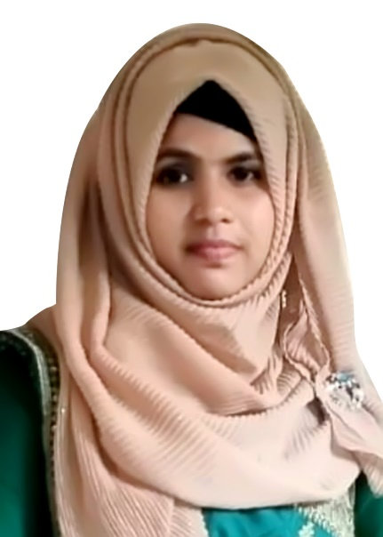
Teacher’s Introduction
Fateha Begum
Assistant Teacher,
Nuyagoan govt. praimary school.
Nabigonj,Hobigonj.

Slide 3
LEARNING OUTCOME
LISTENING 3.1.1-Understand simple questions about student, family and friends
3.3.1-Understand statements.
READING 1.5.1.-Read simple sentences with proper pronounciation and stress.

Slide 4
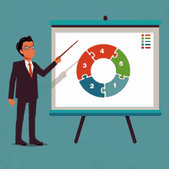
FOREKNOWLSEGE
What are you see in the picture?
What is he doing?

Slide 5
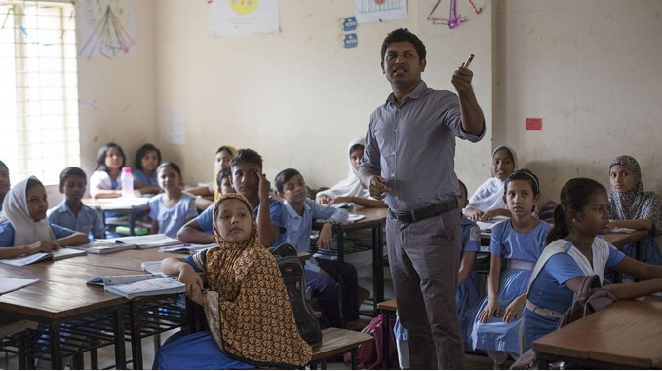
Teachers activity
Showing picture, describing the picture.

Slide 6
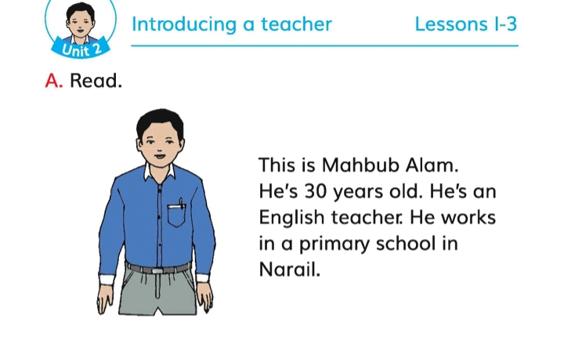
Lession title : Introducing a teacher
Unit 2; Lession : 1; Text : A

Slide 7

Student reading
PAIR WORK.Ask and answer the questions .look at the information in activity A.
*Now describe about yourself.

Slide 8
Group Work
Complete the table with Mahbub`s information
Name
Mahbub Alom
Age
30
Job
Teacher
Work place
Narail

Slide 9
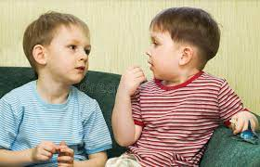
TASK
.*What is the person’s name?
This person’s name is Mahbub Alom.
*How old is he?
He is 30 year`s old.
Where does he work?
He work`s in a primary school.

Slide 10
Kim’s game
Job
Work
Teacher
English
Old
Primary

Slide 11


