Slide 1
Welcome

Slide 2
INTRODUCTION
TEACHER’S IDENTITY
LESSON’S INTRODCUTION
SUBJECT:ENGLISH
CLASS:EIGHT
EXPERIENCE:1
TITLE:GOING ON ATRIP
TIME:50 MINUE
MD. GAUSUL HAQUE
SENIOR TEACHER
KALIKAPUR CHOWKUNI ML. HIGH SCHOOL, KOYRA, KHULNA

Slide 3
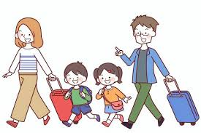
Title:Going On aTrip

Slide 4
LEARNING OUT COME
LISTEN FOR INFORMATION
LISTEN TO AND FOLLOW ANNOUNCEMENTS
READ AND UNDERSTAND TEXTS
ASK AND ANSWER QUESTION

Slide 5
Presentation
Teacher’s Works:
(I) Teachers Enters The Classroom And Thanks To The Student.
(Ii) Teacher Will Discuss About “Going On Atrip .
(Iii) Teacher Will Make It Easy And Understandable And Ask Some Questions To The Students About Going On Atrip.
Student’s Works:
Student Will Stand Up And Honour The Te
For Better Understanding Student Will Note Down The Tittle On Their Exercisebook.
Students Will Try To Answer Correctively The Definition Of Going On Trip.

Slide 6
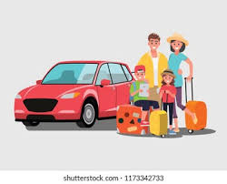
Group Work
*Look at the picture of your trip.And then ,write 5 sentences on what you love about this trip in pairs/groups.

Slide 7
Evaluation
Student’s Works
Teacher’s works
Write a short paragraph about “Going On A trip”.
Teacher will stop and close everything while the bell rings,cleaning the board and leaves the classroom.
1.Students write down the name of the paragraph in their dairy.
2.While the teacher leaves the class, the student honour him on standing.

Slide 8
Homework
Write your experience from your last journey.

Slide 9
THANK YOU

