Slide 1



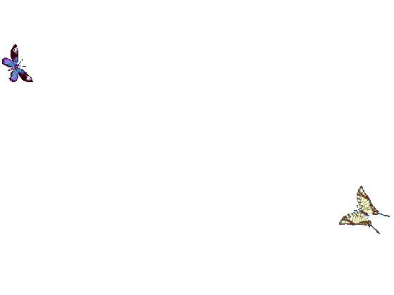
WELCOME TO ALL IN TODAY’S
ENGLISH LESSON

Slide 2




Presented By
Rajib Dutta
Assistant teacher
Bhingrol Govt.Primary School
Anowara, Chottogram
Email: rajibduttaat@gmail.com

Slide 3

Lesson Identity
Class:Two
Subject:English
Unit:5
Lesson(6):Two little birds

Slide 4

Learning Outcomes
Students will be able to know …..

Slide 5

Let’s enjoy the audio.

Slide 6
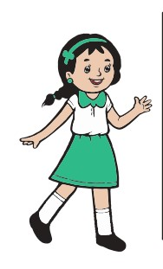
We are going to learn a Rhyme
Two little birds
Now open your book at page 53.

Slide 7
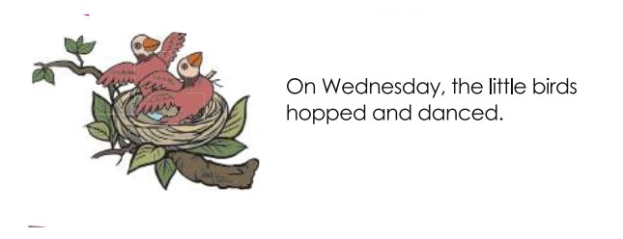


Slide 8
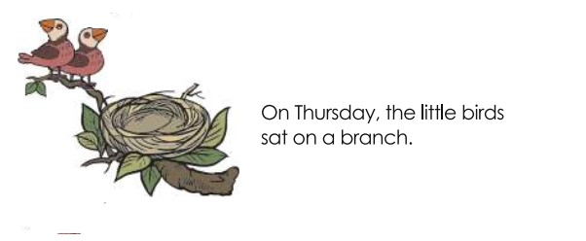
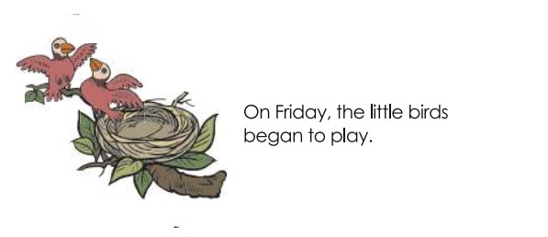

Slide 9
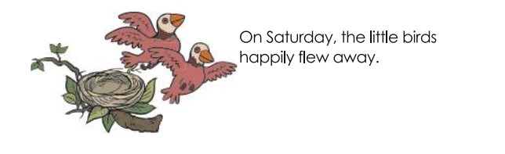

Slide 10
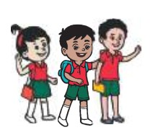
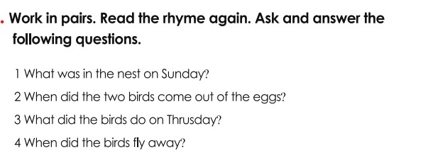
Pair work

Slide 11
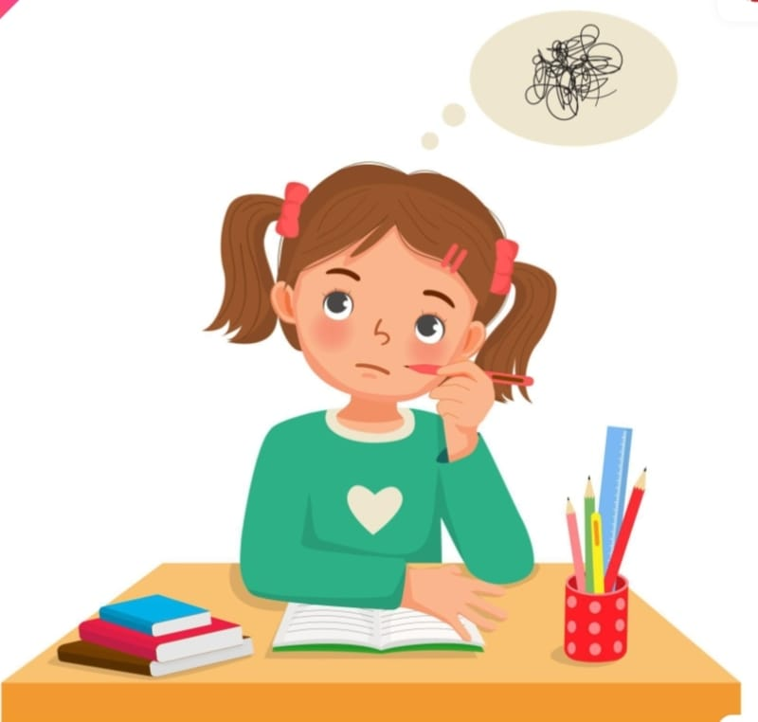
What have we learnt today?
** Wednesday
The little birds hopped and danced.
** Thursday
The little birds sat on a branch.
** Friday
The little birds began to play.
** Saturday
The little birds happily flew away.

Slide 12


Good bye every one
Thanks to all
See you again…

