Slide 1
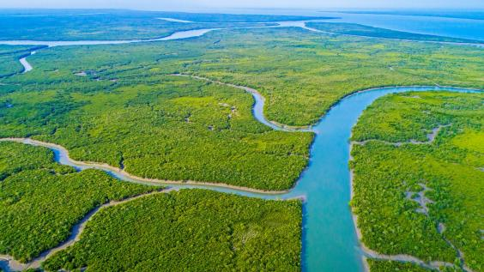
WELCOME TO OUR CLASS

Slide 2
PAPIA JESMIN
ASSISTANT TEACHER
JAFRABAD ADARSHA GOVERNMENT PRIMARY SCHOOL
MOHAMMADPUR, DHAKA

Slide 3

Class: 5
Subject: English
Unit: 7 (The Sundarbans)
Activity: 1.1, 1.2
Page:35,36

Slide 4
Learning outcomes:
1.5.1 Get specific information from listening to a variety of text.
3.4.2 Answer simple questios appropriately and confidently.

Slide 5
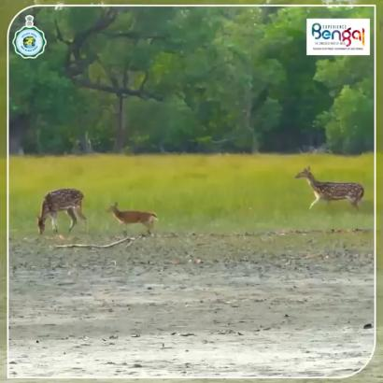

Slide 6
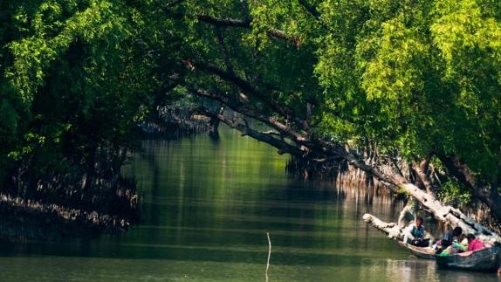
The Sundarban

Slide 7
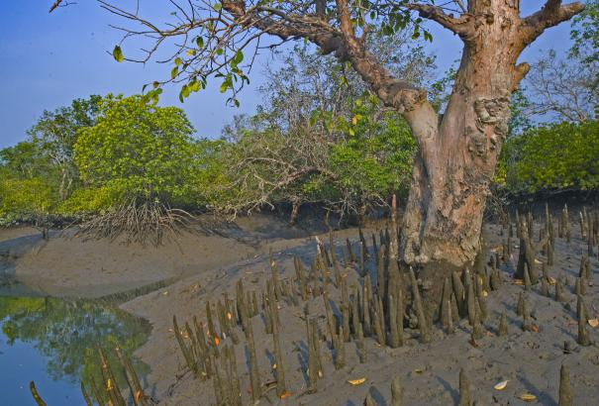
What do you see in the picture?

Slide 8
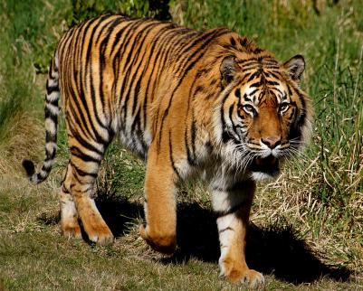
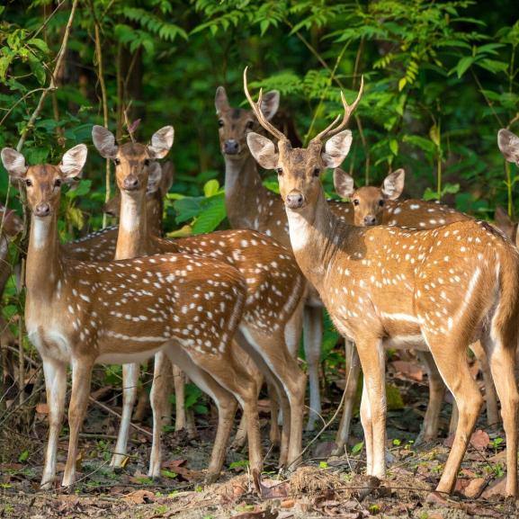
Where do these animals live?

Slide 9
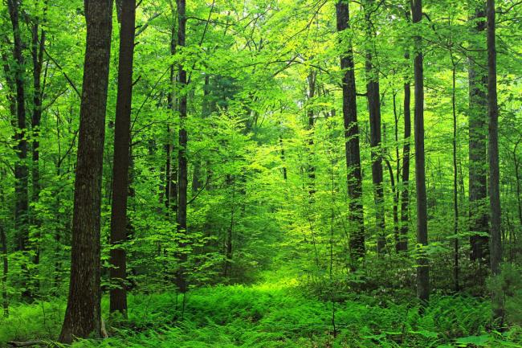
Have you ever visited a forest?

Slide 10
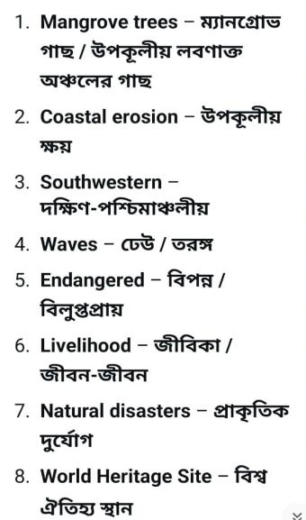

Slide 11
1. Mangrove trees – tidal forest trees, salt-tolerant trees, swamp trees
2. Coastal erosion – shore erosion, coastline wearing away, beach erosion
3. Southwestern – south-west, southwesterly, SW
4. Waves – swells, surges, ripples
5. Endangered – threatened, at risk, vulnerable
6. Livelihood – living, means of earning, occupation, source of income
7. Natural disasters – natural calamities, natural catastrophes, acts of nature
8. World Heritage Site – UNESCO site, heritage site, site of global importance

Slide 12
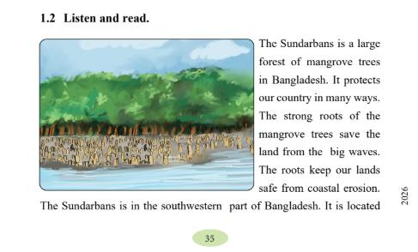

Slide 13
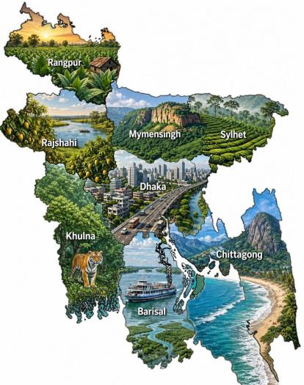
North
East
West
South

Slide 14
Where is the Sundarbans located in Bangladesh?
Answer: The Sundarbans is located in the southwest part of Bangladesh.

Slide 15
Spotted deer

Slide 16
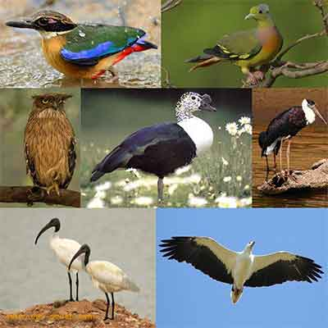
Various types of beautiful birds

Slide 17
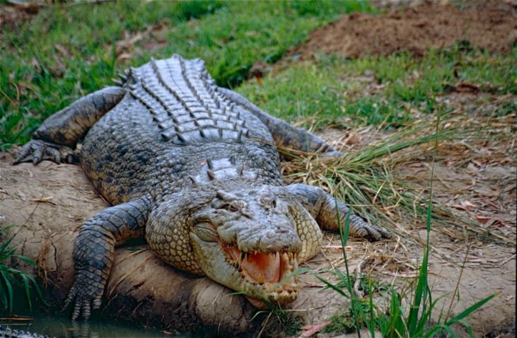
salt water crocodile

Slide 18
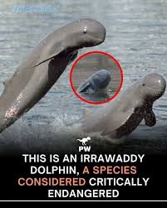

Slide 19
What animals are found in the Sundarbans?
Answer: Many animals live in the Sundarbans.
The most famous animal is the Royal Bengal Tiger.
We can also see deer, monkeys, crocodiles, snakes, and many birds there.

Slide 20
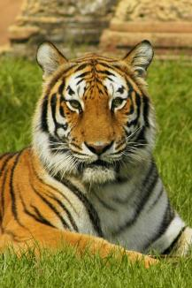
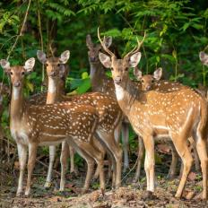

Slide 21
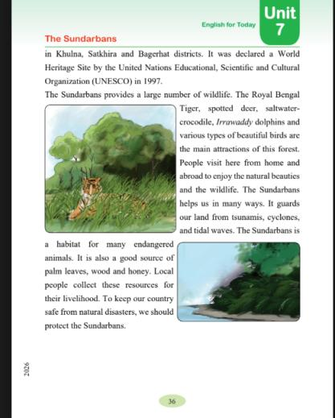

Slide 22
(UNESCO)
United Nations Educational, Scientific and Cultural Organization

Slide 23
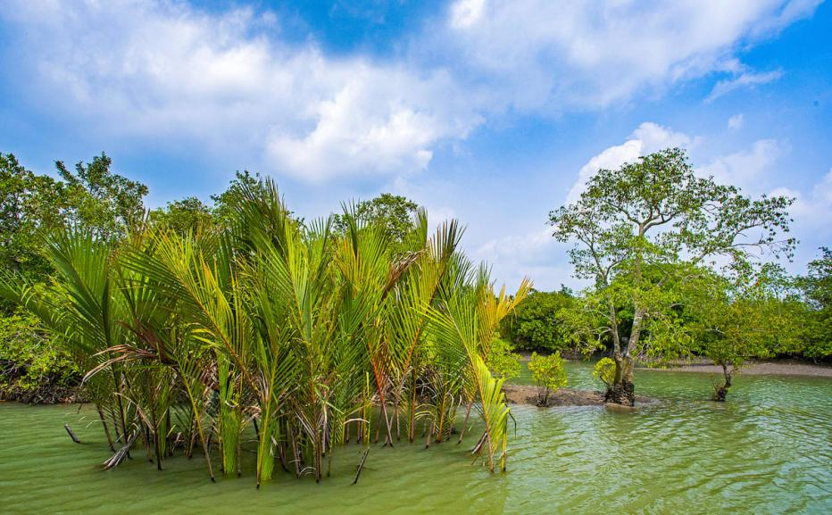

Slide 24
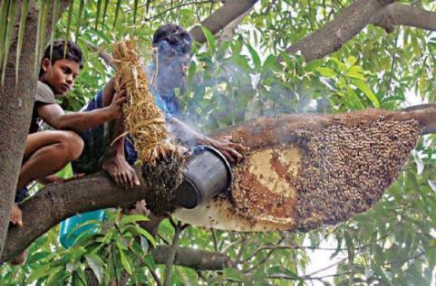

Slide 25
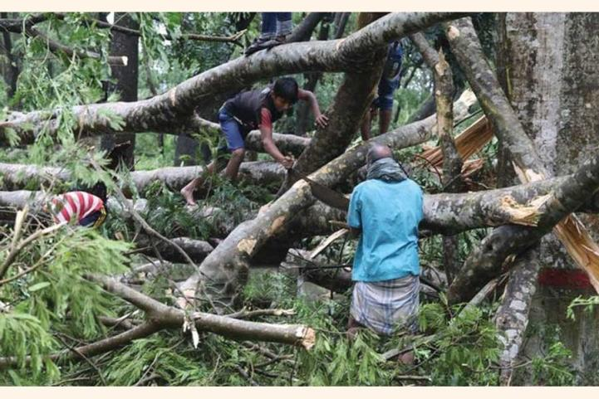

Slide 26
What do people collect from the Sundarbans for their livelihood?
Answer: People collect palm leaves,wood and honey from the Sundarbans for their livelihood .

Slide 27

Make one group with every two benches and takes turns reading one by one.

Slide 28
Task
1. Where is the Sundarbans located?
Answer: The Sundarbans is located in the southwest part of Bangladesh.
2. What kind of trees make up the Sundarbans forest?
Answer: The Sundarbans forest is made up of mangrove trees.
The main trees are Sundari, Gewa, and Goran trees.
These trees can grow in salty water.
3.What animals are found in the Sundarbans?
Answer: Many animals live in the Sundarbans.
The most famous animal is the Royal Bengal Tiger.
We can also see deer, monkeys, crocodiles, snakes, and many birds there.
4.What do people collect from the Sundarbans for their livelihood?
Answer: People collect palm leaves,wood and honey from the Sundarbans for their livelihood .
5.Why is it important to protect the Sundarbans?
Answer: We must protect the Sundarbans because:
- It saves us from big storms and floods.
- It gives home to many animals and birds.
- It helps people to earn their living.
- It is a beautiful World Heritage Site.

Slide 29
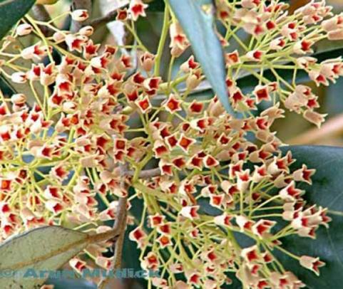
Thank you

