Slide 1


Slide 2

HSC
ENGLISH 1ST PAPER
Abdur Rahman
Lecturer in English
Nowhata Govt. Degree College
Paba, Rajshahi

Slide 3
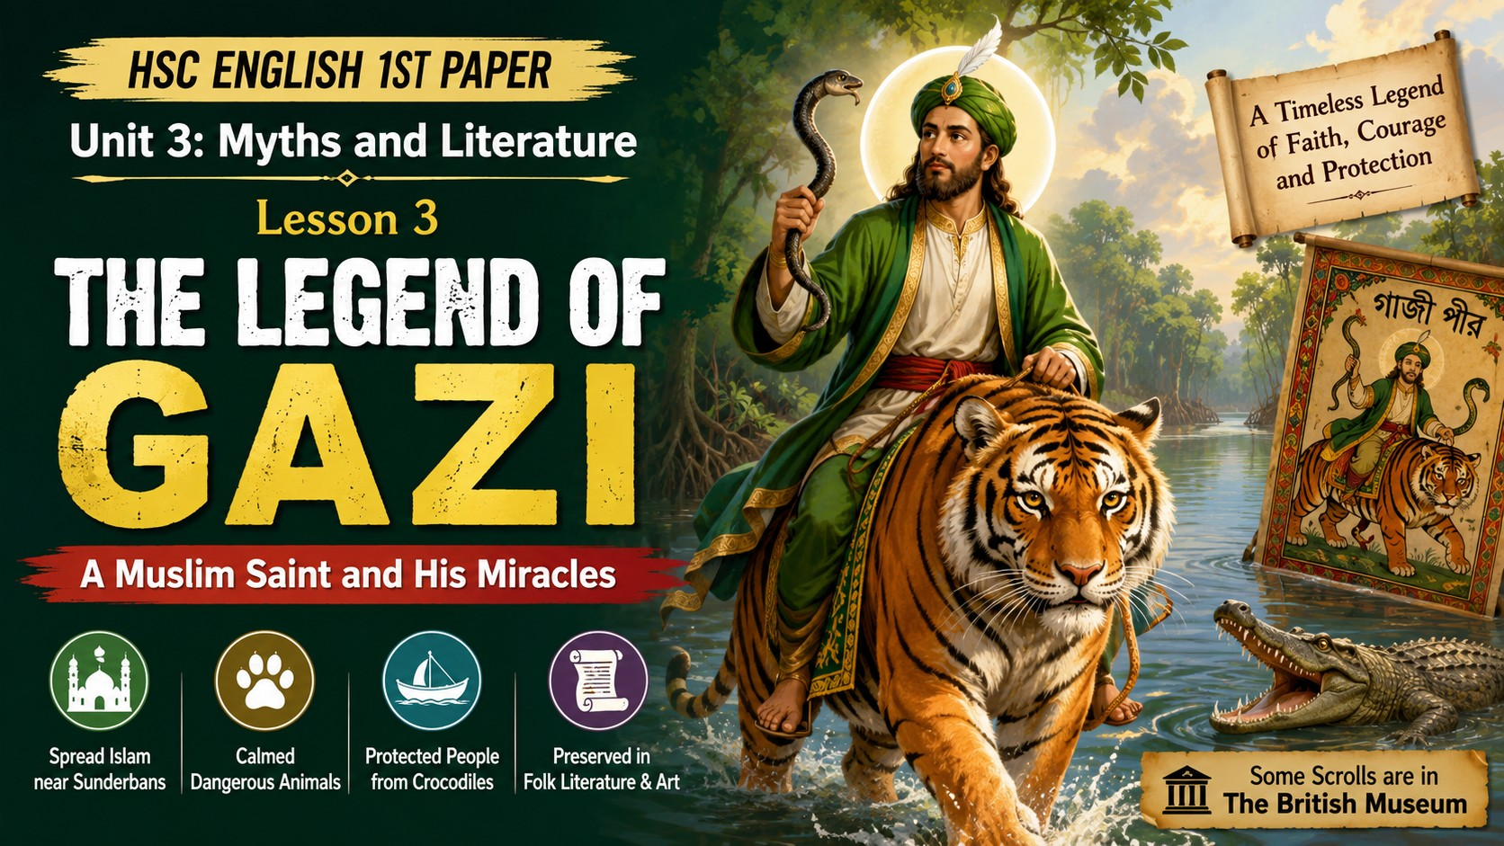

Slide 4
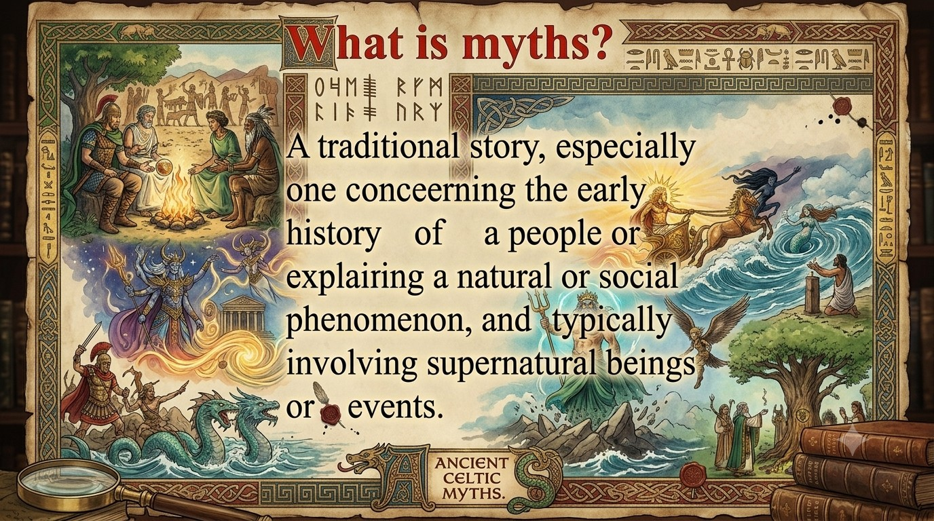

Slide 5
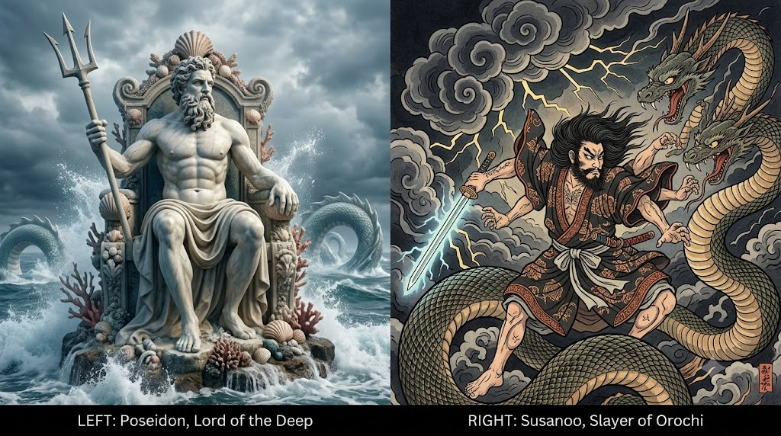

Slide 6


Slide 7
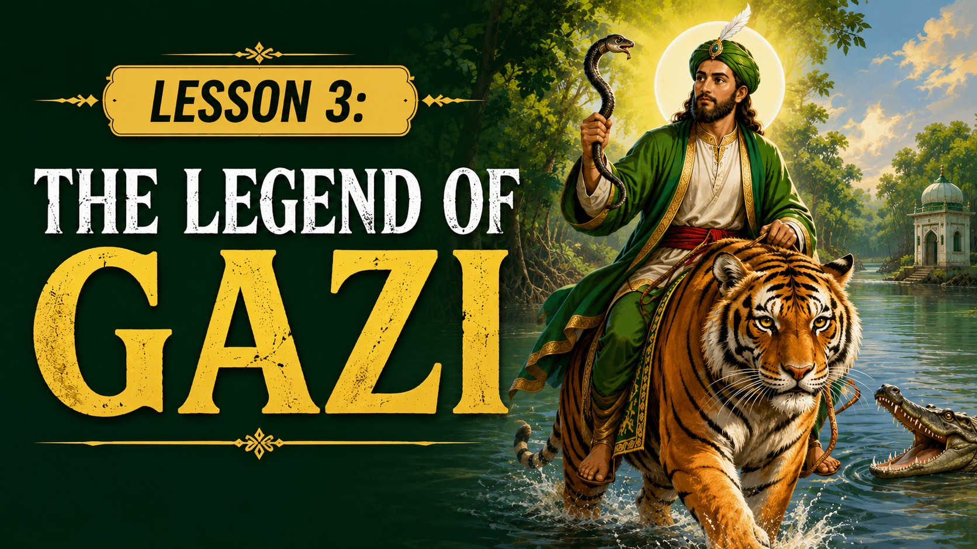

Slide 8
Learning Outcomes
Describe who Gazi Pir was and explain his role in spreading Islam.
Explain how Gazi Pir helped protect people from wild animals.
Analyze the cultural and historical significance of the legend of Gazi Pir in Bangladesh's folk literature, art, and indigenous theatre.
Identify the miraculous powers and legendary qualities attributed to Gazi Pir in Bengali folklore.

Slide 9

_{READ THE TEXT CAREFULLY}

Slide 10
According to some myths and legends, Gazi Pir was a Muslim saint who is said to have spread Islam in the parts of Bengal close to the Sundarbans. He was credited (কৃতিত্ব) with many miracles. For example, he could supposedly calm dangerous animals and make them docile (অনুগত). He is usually depicted in Paats or scroll paintings riding a fierce-looking Bengal tiger, a snake in his hand, but in no apparent danger. According to some stories. he also fought crocodiles (কুমির) who threatened the people of the region full of canals and creeks, indeed, a kind of watery jungle bordering the Bay of Bengal.

Slide 11
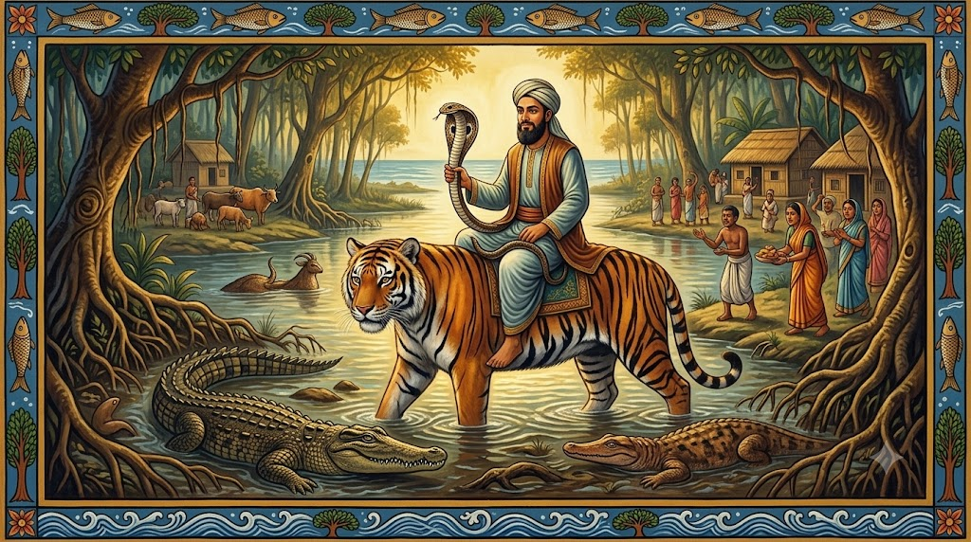

Slide 12
Because of his alert and vigilant (সতর্ক) presence, all predatory (শিকারী) animals were said to have been kept within bounds. It was also believed that he enabled villagers to live close to forests and jungles and cultivate (চাষ করা) their lands. Consequently, people of these regions would pray to him for protection (সুরক্ষা). The story of Gazi Pir has been preserved (সংরক্ষিত) in folk literature as well as art and has been performed in indigenous theatre. Some Gazir paat scrolls are part of the collection of the British Museum.

Slide 13
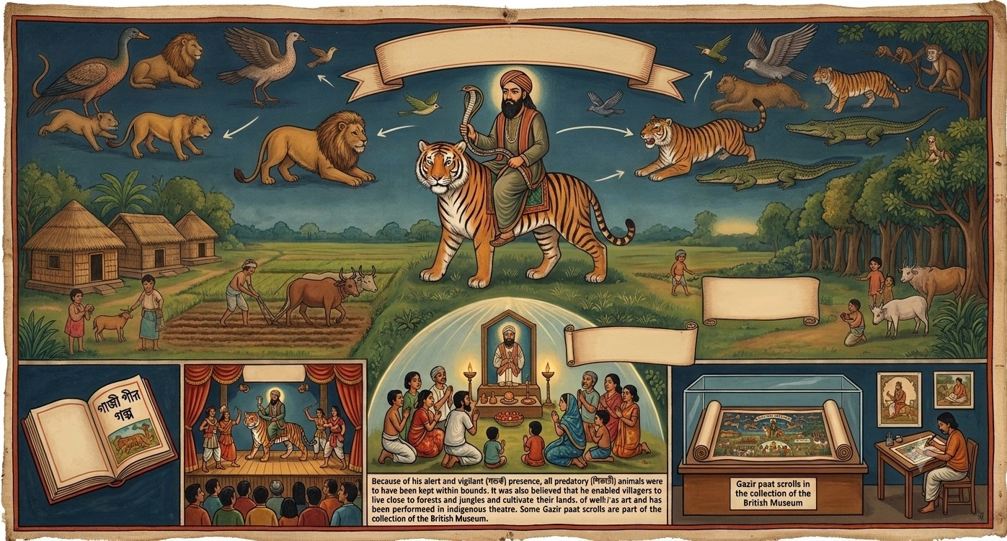

Slide 14
GROUP DISCUSSION
Discuss about some uncommon words

Slide 15

Choose the best answer

Slide 16
Who was Gazi Pir?
a) A warrior
b) A poet
c) A Muslim saint
d) A ruler
Answer: c) A Muslim saint

Slide 17
2. Where did Gazi Pir spread Islam?
a) Northern India
b) The parts of Bengal close to the Sunderbans
c) The Himalayan region
d) The Bay of Bengal
b) The parts of Bengal close
to the Sunderbans

Slide 18
3. What miracle is Gazi Pir known for?
a) Flying across rivers
b) Calming dangerous animals
c) Turning water into food
d) Building canals
Answer: b) Calming dangerous animals

Slide 19
4. How is Gazi Pir depicted in scroll paintings?
a) Riding a horse with a sword
b) Riding a tiger with a snake in his hand
c) Sitting under a tree
d) Fighting with villagers
b) Riding a tiger with a snake in his hand

Slide 20
5. What kind of animals did Gazi Pir reportedly fight?
a) Lions
b) Elephants
c) Crocodiles
d) Wolves
Answer: c) Crocodiles

Slide 21
6. What geographical feature is associated with Gazi Pir’s stories?
a) Deserts
b) Snowy mountains
c) Canals and creeks
d) Open plains
Answer: c) Canals and creeks

Slide 22
7. How did Gazi Pir help villagers?
a) By building houses for them
b) By ensuring safety from predators
c) By teaching them new farming techniques
d) By bringing rain
Answer: b) By ensuring safety from predators

Slide 23
8. Why did villagers pray to Gazi Pir?
a) To gain wealth
b) For protection from predators
c) To improve trade
d) To win wars
Answer: b) For protection from predators

Slide 24
9. In what forms has the story of Gazi Pir been preserved?
a) Historical records only
b) Folk literature, art, and theatre
c) Ancient scriptures
d) Modern books
Answer: b) Folk literature, art, and theatre

Slide 25
10. Where are some of the Gazirpaat scrolls preserved?
  a) The National Museum of India
  b) The Louvre Museum
  c) The British Museum
  d) The Smithsonian Institution
  Answer: c) The British Museum

Slide 26
Flowchart
Muslim saint spreading Islam near Sunderbans.
Credited with calming dangerous animals.
Shown riding a Bengal tiger, holding a snake.
Protected people from crocodiles in canals and creeks.
Enabled safe living near forests and farming.
Some scrolls are in the British Museum.

Slide 27
Summary
The legend of Gazi Pir tell us that he was a Muslim saint who spread Islam in the parts of Bengal close to the Sundarbans. He is usually depicted in Paats or scroll paintings riding a fierce- looking Bengal tiger and having a snake in his hand. He could make a dangerous animal calm and docile. His vigilant presence kept the predatory animals away. So, the people were able to live close to forests and jungles and cultivate their lands. His story has been preserved in folk literature and art and also in British Museum.

Slide 28

1. What kind of extraordinary power did Gazi have?
2. What was the geographical nature of the region where Gazi performed his miracles?
3. Why, do you think, was Gazi admired in parts of rural Bangladesh for a long time?
4. What are the different art forms in which the myth of Gazi is kept alive in Bangladesh and even outside the country?

Slide 29


