Slide 1
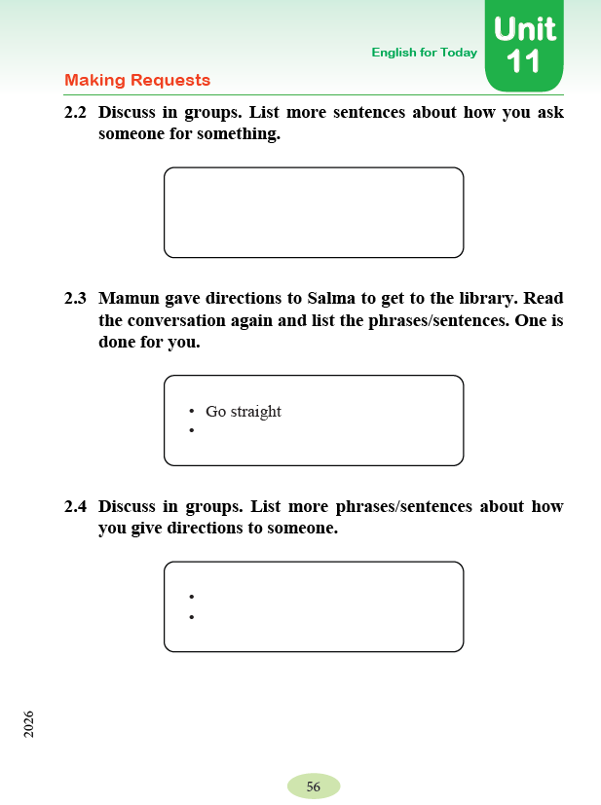
English With Anisur Rahman
Cover
Add your lesson content here...
Class: 5
Subject: English
Unit 11: Making Requests
Page: 56
Activities: 2.2, 2.3 & 2.4
📚 English With Anisur Rahman | Learn English with Bangla Explanation

Slide 2
English With Anisur Rahman
Learning Outcomes
Add your lesson content here...
By the end of the lesson, students will be able to—
✅ make polite requests.
✅ give simple directions.
✅ speak in English confidently.
📚 English With Anisur Rahman | Learn English with Bangla Explanation

Slide 3
English With Anisur Rahman
Warm-up
Add your lesson content here...
Do you ask your teacher for help?
Answer:
Yes, I do.
How do you ask politely?
Answer:
May I ask a question, please?
বাংলা:
আমি কি একটি প্রশ্ন করতে পারি?
📚 English With Anisur Rahman | Learn English with Bangla Explanation

Slide 4
English With Anisur Rahman
Warm-up
Add your lesson content here...
Have you ever asked someone for directions?
Answer:
Yes, I have.
বাংলা:
হ্যাঁ, জিজ্ঞাসা করেছি।
📚 English With Anisur Rahman | Learn English with Bangla Explanation

Slide 5
English With Anisur Rahman
Vocabulary
Word | Meaning
Turn | ঘোরা
Left | বাম
Right | ডান
Straight | সোজা
📚 English With Anisur Rahman | Learn English with Bangla Explanation

Slide 6
English With Anisur Rahman
Activity 2.2
Add your lesson content here...
Discuss in groups.
List more sentences about how you ask someone for something.
Examples:
1. May I borrow your pen?
2. Can you help me, please?
3. Could you open the window?
4. May I use your ruler?
5. Can I have some water, please?
📚 English With Anisur Rahman | Learn English with Bangla Explanation

Slide 7
English With Anisur Rahman
Practice
Add your lesson content here...
Repeat after me.
May I borrow your pen?
Can you help me?
Could you tell me the way?
📚 English With Anisur Rahman | Learn English with Bangla Explanation

Slide 8
English With Anisur Rahman
Activity 2.3
Add your lesson content here...
Mamun gave directions to Salma.
Find the direction sentences.
✅ Go straight.
সোজা যাও।
✅ Turn left.
বাম দিকে মোড় নাও।
✅ The library will be on your right.
লাইব্রেরিটি তোমার ডান পাশে থাকবে।
📚 English With Anisur Rahman | Learn English with Bangla Explanation

Slide 9
English With Anisur Rahman
More Direction Sentences
Add your lesson content here...
Go right.
ডান দিকে যাও।
Turn right.
ডান দিকে মোড় নাও।
Go across the road.
রাস্তা পার হও।
Walk along the road.
রাস্তা ধরে হাঁটো।
📚 English With Anisur Rahman | Learn English with Bangla Explanation

Slide 10
English With Anisur Rahman
More Direction Sentences
Add your lesson content here...
Go past the school.
স্কুলটি পার হয়ে যাও।
Stop here.
এখানে থামো।
📚 English With Anisur Rahman | Learn English with Bangla Explanation

Slide 11
English With Anisur Rahman
Activity 2.4
Add your lesson content here...
Discuss in groups.
Give directions.
How can I go to the mosque?
✅ Go straight.
✅ Turn left.
বাম দিকে মোড় নাও।
✅ The mosque will be on your right.
মসজিদটি তোমার ডান পাশে থাকবে।
📚 English With Anisur Rahman | Learn English with Bangla Explanation

Slide 12
English With Anisur Rahman
Pair Work
Add your lesson content here...
Student A:
Excuse me.
How can I go to the library?
Student B:
Go straight.
Turn right.
The library is beside the school.
📚 English With Anisur Rahman | Learn English with Bangla Explanation

Slide 13
English With Anisur Rahman
Grammar Focus
Add your lesson content here...
Making Polite Requests
Can I...?
May I...?
Could you...?
Can you...?
Would you please...?
📚 English With Anisur Rahman | Learn English with Bangla Explanation

Slide 14
English With Anisur Rahman
Quiz
Add your lesson content here...
Fill in the blanks.
_____ I borrow your pencil?
May
Go ______.
straight
left
Turn ______.
📚 English With Anisur Rahman | Learn English with Bangla Explanation

Slide 15
English With Anisur Rahman
Assessment
Add your lesson content here...
Student A:
Excuse me.
How can I go to the library?
Student B:
Go straight.
Turn right.
The library is beside the school.
📚 English With Anisur Rahman | Learn English with Bangla Explanation

Slide 16
English With Anisur Rahman
Homework
Add your lesson content here...
Write
✅ Three polite requests.
✅ Three direction sentences.
📚 English With Anisur Rahman | Learn English with Bangla Explanation

Slide 17
English With Anisur Rahman
Thank You
Add your lesson content here...
Thank You
See you in the next class.
📚 English With Anisur Rahman | Learn English with Bangla Explanation

