Slide 1
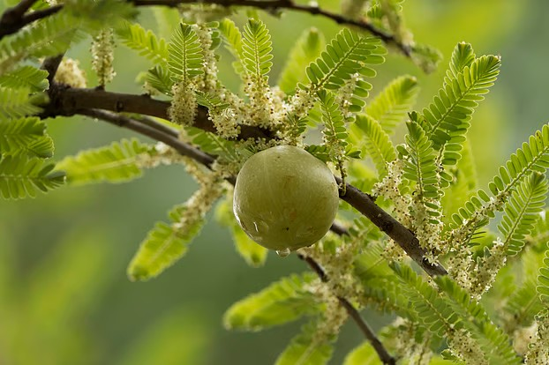
welcome

Slide 2

Mohammod Babul Hossen
Best content maker a2i
Ict division -2022
Assistant teacher
Noagoan west gps
Sarail ,Brahmonbaria

Slide 3
Introduction
Subject-English
Class-Five
Unit-8
Title- A Field Trip to Remember
Lesson-Telling time
Activity-3.1.1,3.2.1
Page-42—44

Slide 4
Learning outcomes-
1.Able to tell the time use a.m/p.m
2.Able to Write the time use a.m/p.m
in words.

Slide 5
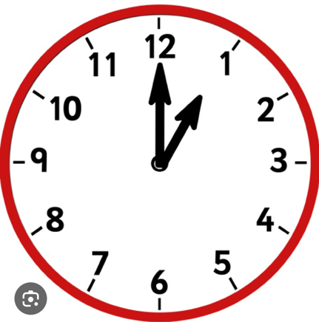
What are you see in the picture?

Slide 6
Today
we’ve learn how to tell the time using A.M & P.M times.

Slide 7
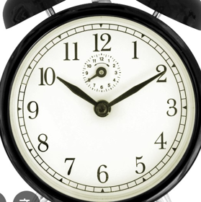
Yes!
It’s a Clock
Ours todays lesson is- Telling time

Slide 8
What Is A.M stand for?-
(Anti Meridian)
12 o’clock midnight to11:59 midday are A.M times.

Slide 9

What is P.M stand for ?
( Post Meridian)12 o’clock midday to11:59 midnight are P.M times.

Slide 10
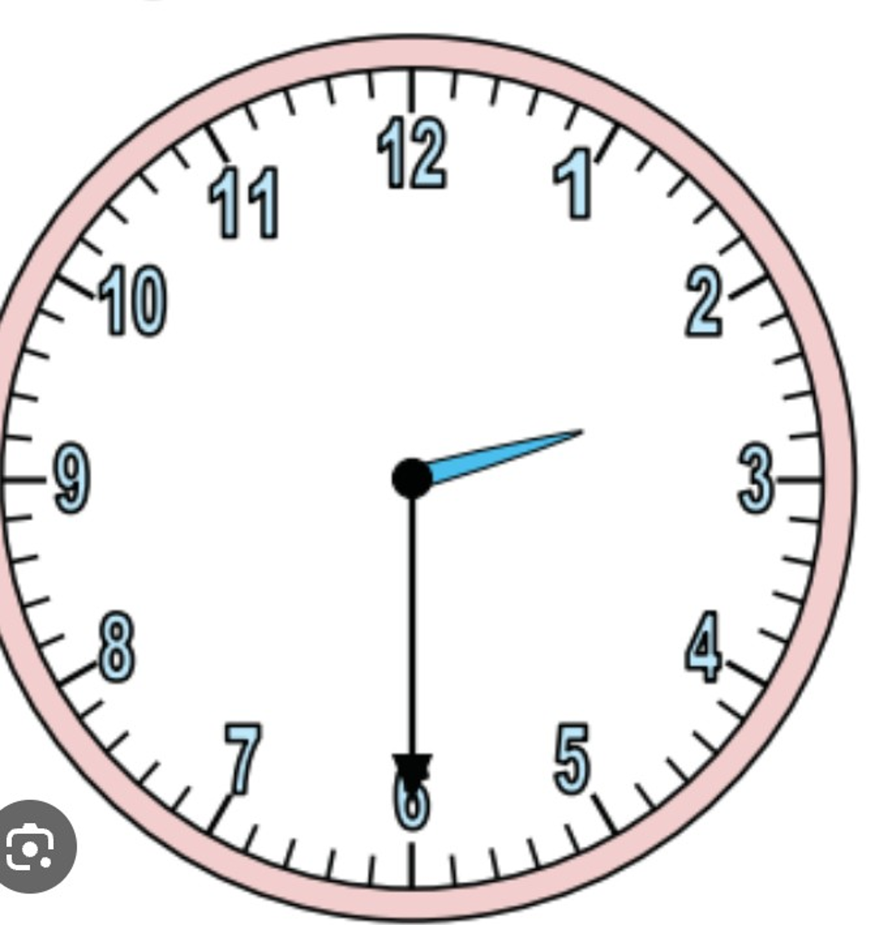
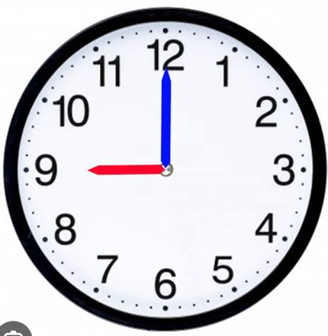
Writing the time in words (using a.m/p.m)

Slide 11
Look at the clock & tell the time

Slide 12
Answer the following questions(using a.m/p.m)
1.When do you gets up from bed?
2.When did you go to school?
3.How long did you stay in the school?

Slide 13
Thanks to all

