Slide 1



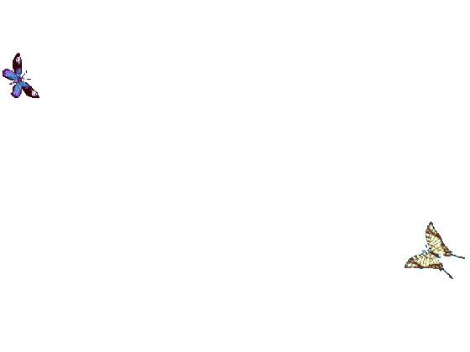
WELCOME TO ALL IN TODAY’S
ENGLISH LESSON

Slide 2


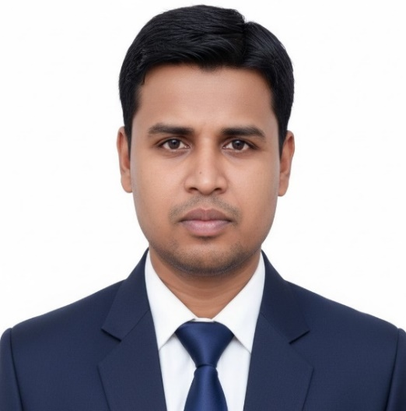

Presented By
Rajib Dutta
Assistant teacher
Bhingrol Govt.Primary School
Anowara, Chottogram
Email: rajibduttaat@gmail.com

Slide 3
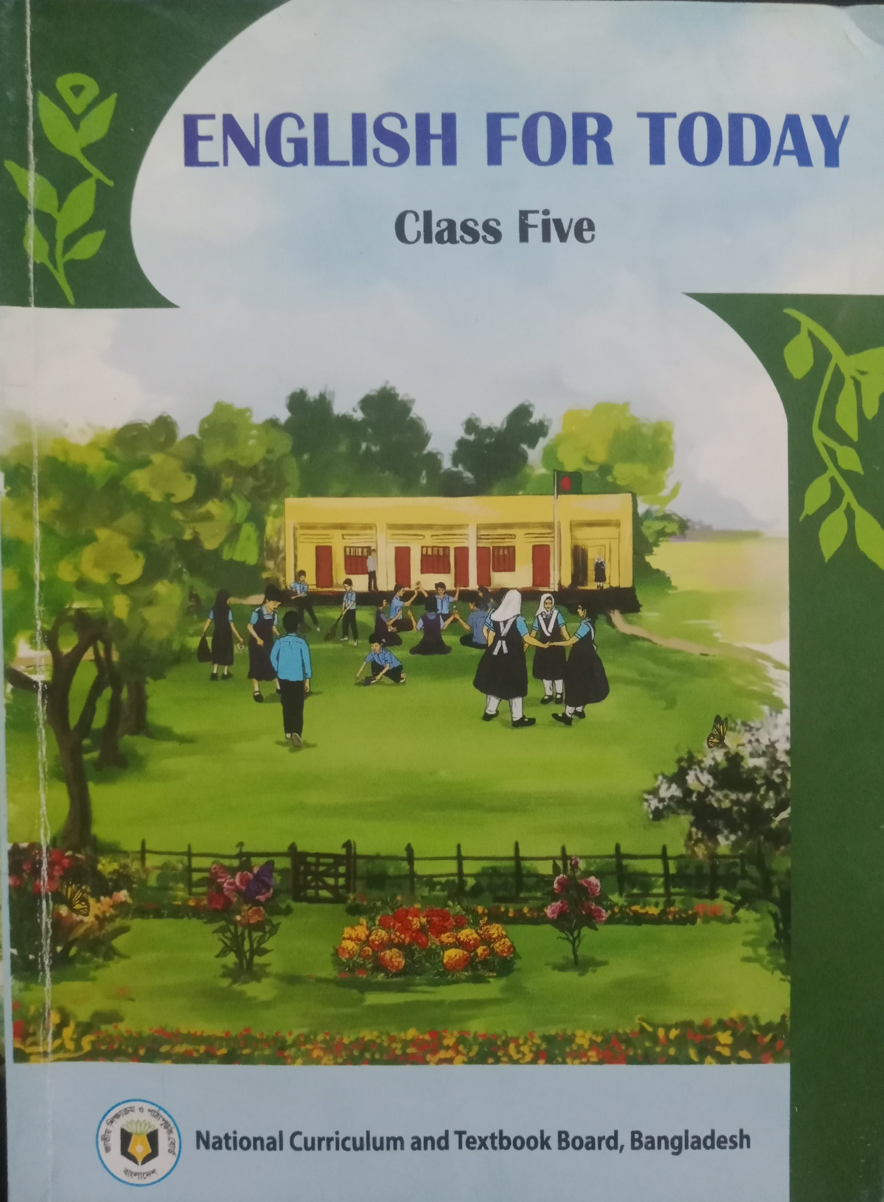
Introduction of the lesson
Class : FIVE
Subject : English
Unit : 13
Lesson : 1
Lesson Title : Quality time togather
TIME :

Slide 4
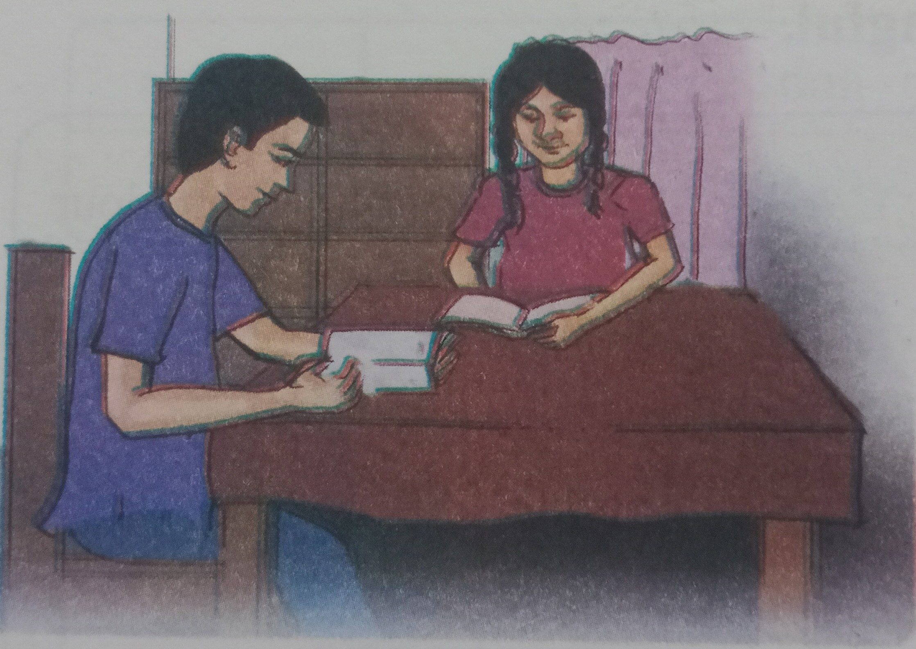
Todays lesson
Saikat’s Family
Quality Time Togather

Slide 5
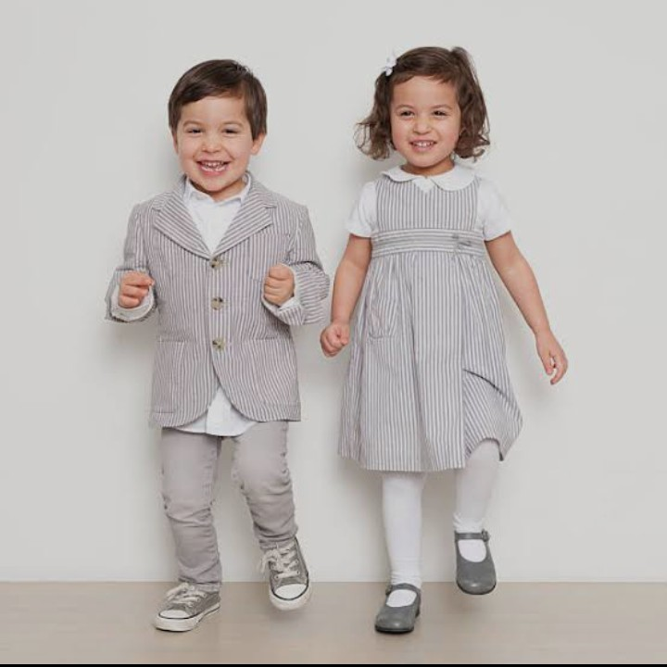
Twins
Two children born at the same time to the same mother

Slide 6
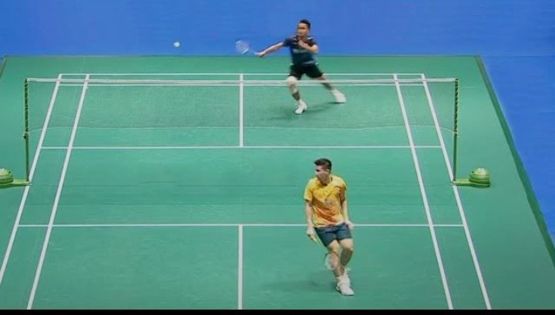
Badminton
A kind of game played with rackets and shuttle.

Slide 7
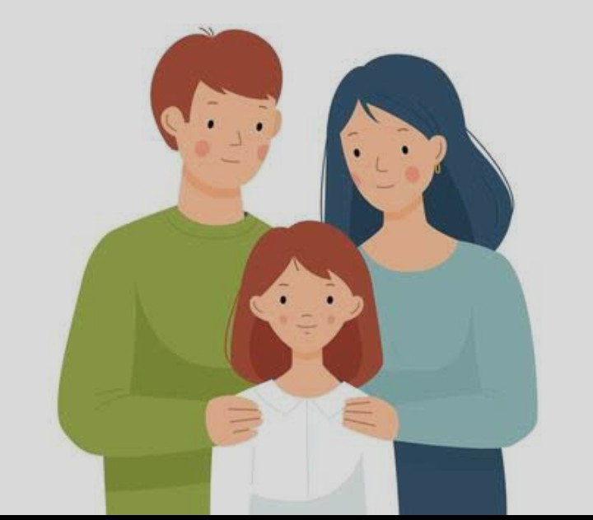
Parents
Father and Mother

Slide 8
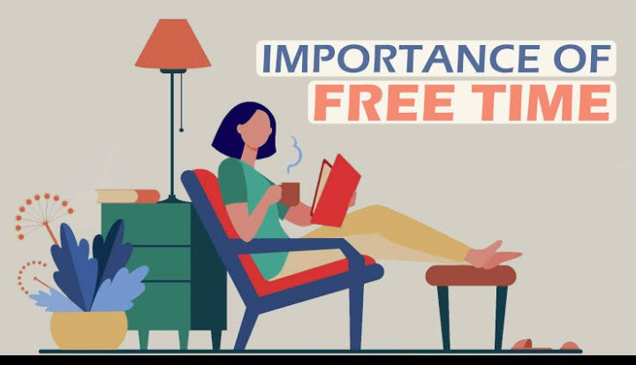
Free Time
Leisure time, when you do not have any work

Slide 9
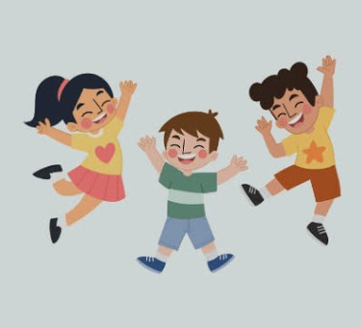
Happiness
Feeling good
Good feelings of mental and physical

Slide 10
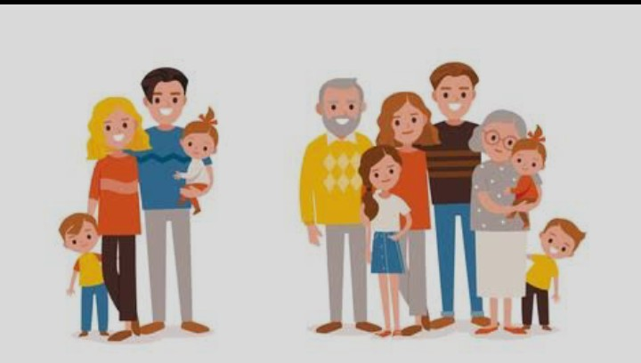
Relative
Relation connected by blood, marriage or adoption.

Slide 11
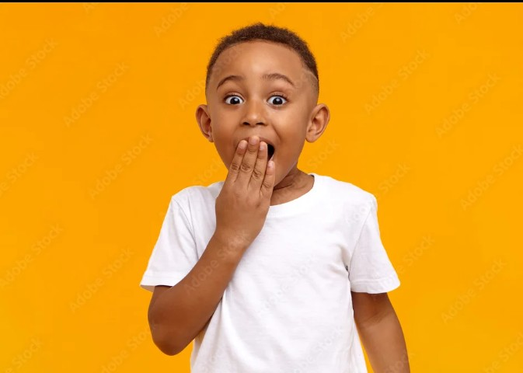

Surprised
Verb
Suddenly an unexpected event happen

Slide 12
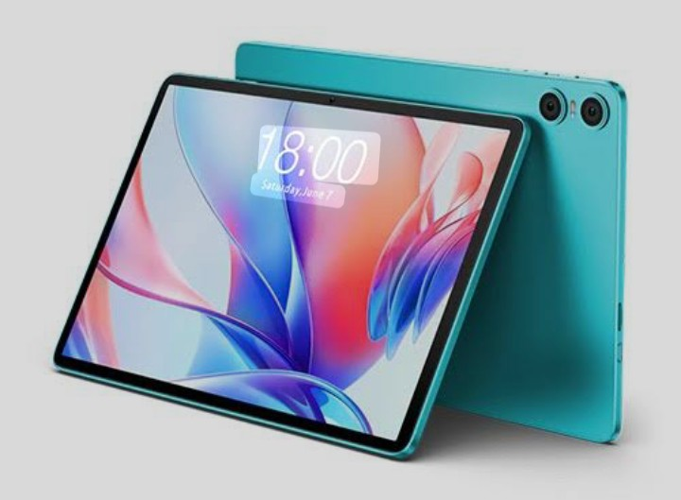
Tablet
Noun
A device like smartphone or laptop with touchscreen display

Slide 13
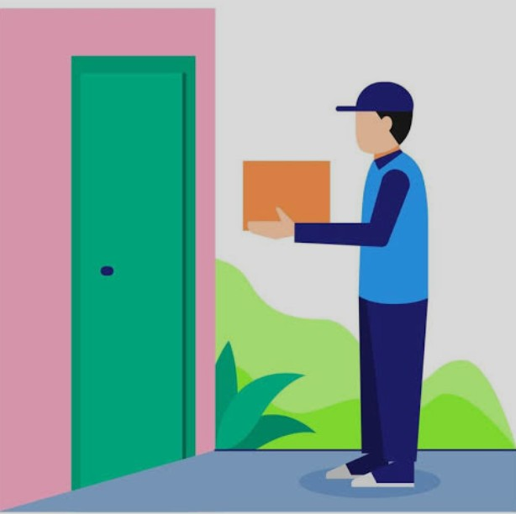
Arrive
Verb
Come to a place at the end of a journey

Slide 14
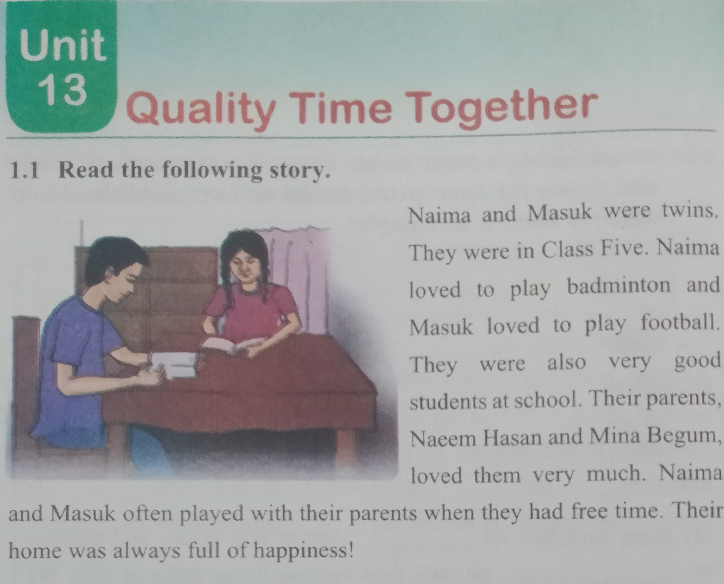
Teacher read text with proper pronounciation two times

Slide 15
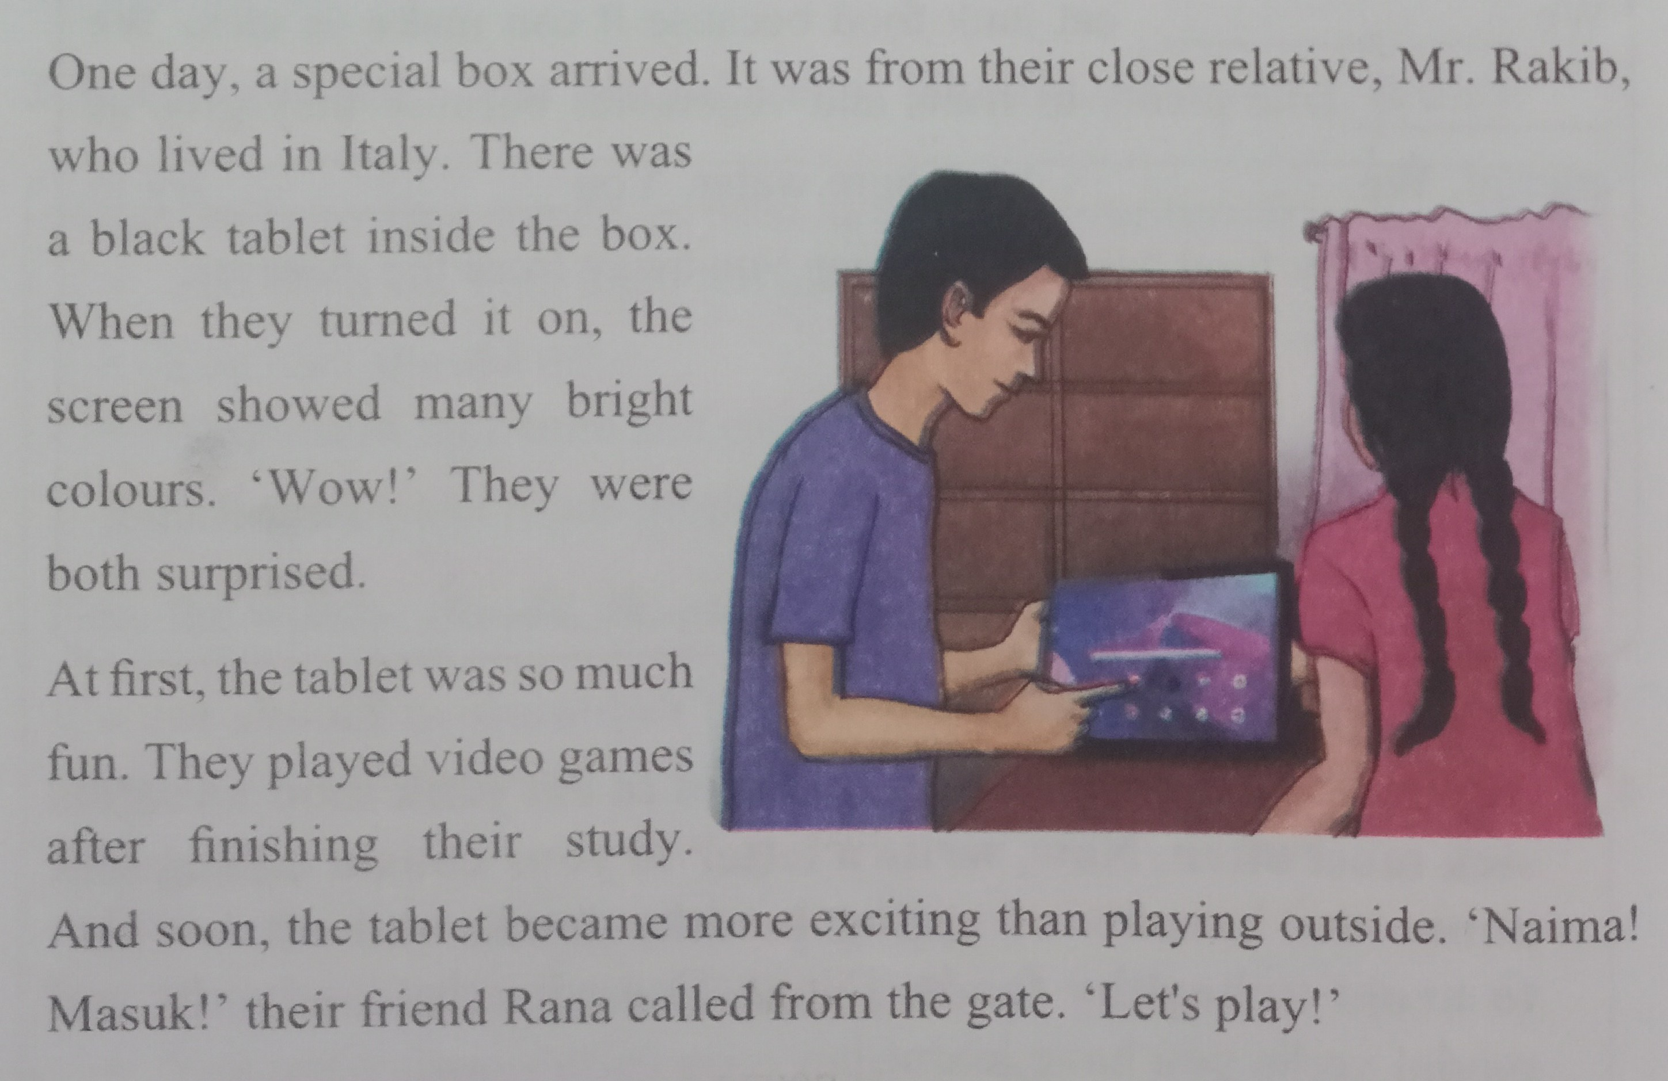
Teacher read text with proper pronounciation two times

Slide 16
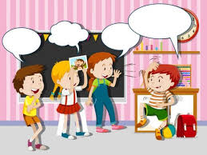
Students activities
1.Students will read the text with pair proper pronounciation.
2Students read the text alone with proper pronounciation.
3.Advanced students help to weaker students.

Slide 17
Students activities
Students will read the text proper pronounciation with missing words
One day, a special box ----------. It was from their close
----------, Mr. Rakib, who lived in ---------. There was a black
---------- inside the box. When they turned it on, the screen showed many ---------- colours. “Wow!” They were both
----------------.
At first, the tablet was so much ------. They played --------- games after finishing their ----------. And soon, the tablet became more ------------ than playing outside. ‘Naima! Masuk!’ their friend Rana ------------ from the gate. “Let”s -------------!”

Slide 18

Match the words with their meaning
1. Twins a device with touchscreen display
2. Surprise realation by blood
3. Parents two children born in the same time
4. Tablet happenbing unexpected event
5. Relatives father and mother

Slide 19
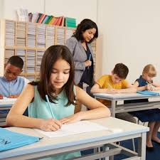
Answers the following questions
1.What class did Naima and Masuk read?
2.What did Masuk love?
3.Where did Mr. Rakib live?
4.How did they spend their free time?
5.When did they play video games?

Slide 20
1.What class did Naima and Masuk read?
Ans: Naima and Masuk were in class Five.
2.What did Masuk love?
Ans: Masuk loved to play football.
3.Where did Mr. Rakib live?
Ans: Mr. Rakib lived in Italy.
4.How did they spend their free time?
Ans: They often played with their parents in their freetime.
5.When did they play video games?
Ans: They played video games after finishing their study.

Slide 21
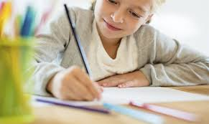
Home work
Write five sentences about Naima and Masuk..

Slide 22

