Slide 2


MD KOYES AHMED
Class: Three
Subject: English
Unit: 2,
Lesson: 1
Page-21
Time: 45 minutes
Assistant Teacher
Mohammadpur A. Gofur GPS
Dakshin Surma, Sylhet.
E-mail: koyesdsurma.syl@gmail.com
Mobile: 01710504502.

Slide 3
Reading aloud simple sentences with proper
stress, intonation and punctuation.
Participating in conversations for exchanging
information about family and friends.
Writing short paragraphs on familiar topics using
prompts or clue

Slide 4

Lead in
“What did we learn in our last class?”
Showing
the activity A
at page 21

Slide 5
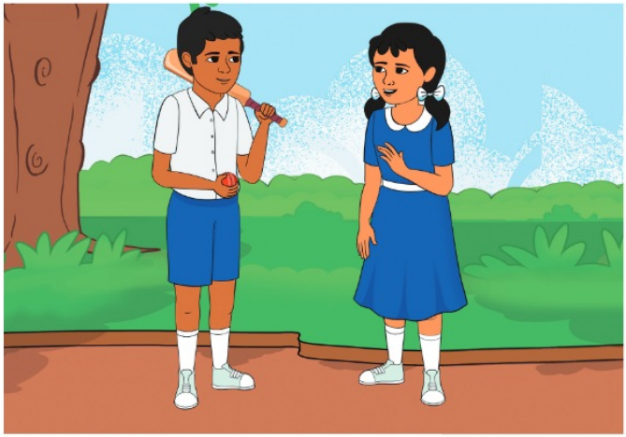
Look at the picture!
What do you see in the picture?
Who are they?
They are friends.

Slide 6
Today’s lesson is
Talking with friends

Slide 7
Open your book at page No. 21

Slide 8
Teacher’s reading loudly
Rishat: Hello, Sujana! How are you?
Sujana: Fine, thanks, and you?
Rishat: I’m fine too. Would you like to play with me?
Sujana: Yes, I’d like that, thank you.

Slide 9
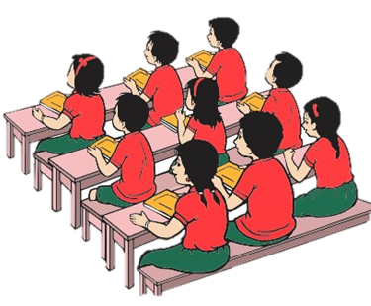
“Everybody Listen and repeat after me”
Rishat: Hello, Sujana! How are you?
Sujana: Fine, thanks, and you?
Rishat: I’m fine too. Would you like to play with me?
Sujana: Yes, I’d like that, thank you.

Slide 10
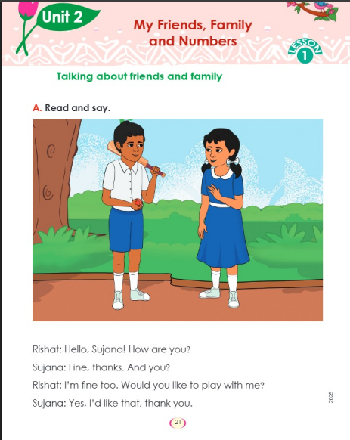
Everybody read and say
Rishat: Hello, Sujana! How are you?
Sujana: Fine, thanks, and you?
Rishat: I’m fine too.
Would you like to play with me?
Sujana: Yes, I’d like that, thank you.

Slide 11
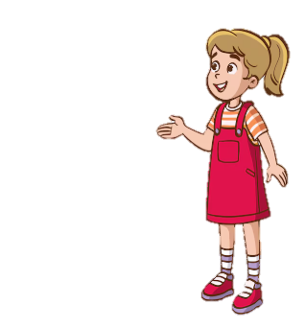
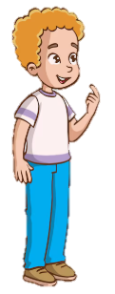
Two students come forward for acting the conversations as Rishad & Sujana.
Rishat: Hello, Sujana! How are you?
Sujana: Fine, thanks, and you?

Slide 12
Two students come forward for acting the conversations as Rishat & Sujana.
Rishat: I’m fine too. Would you like to play with me?
Sujana: Yes, I’d like that, thank you.

Slide 13
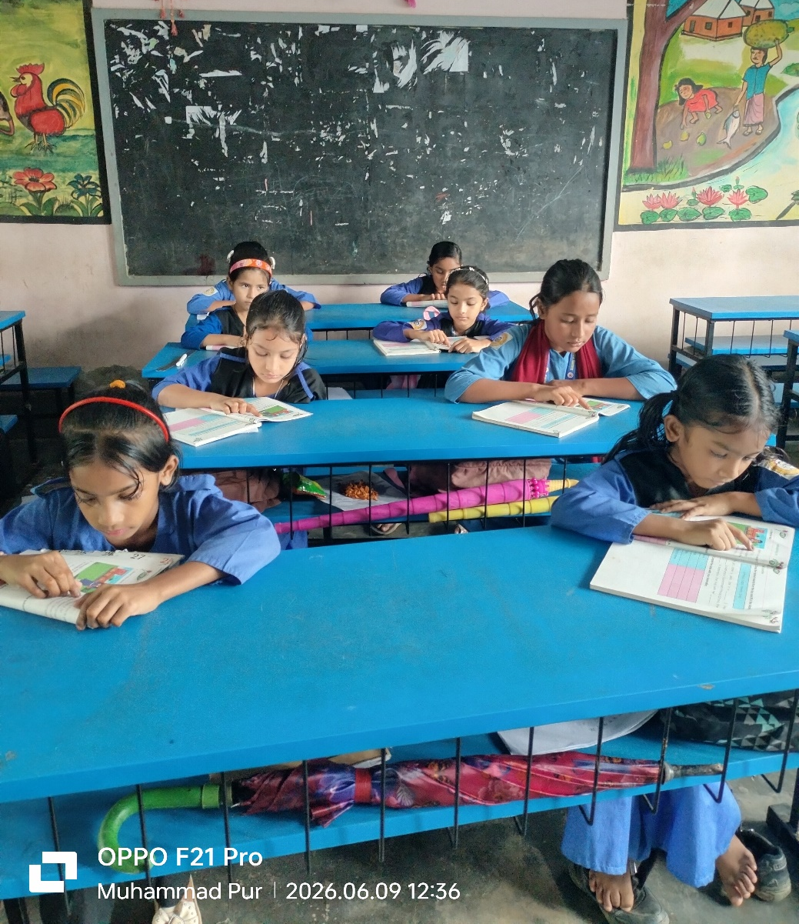
Students Reading Silently

Slide 14
Read and say
again & again

Slide 15
Now acting the conversation as Rishat and Sujana.

Slide 16
Can you discuss your family?
Yes I can

Slide 17
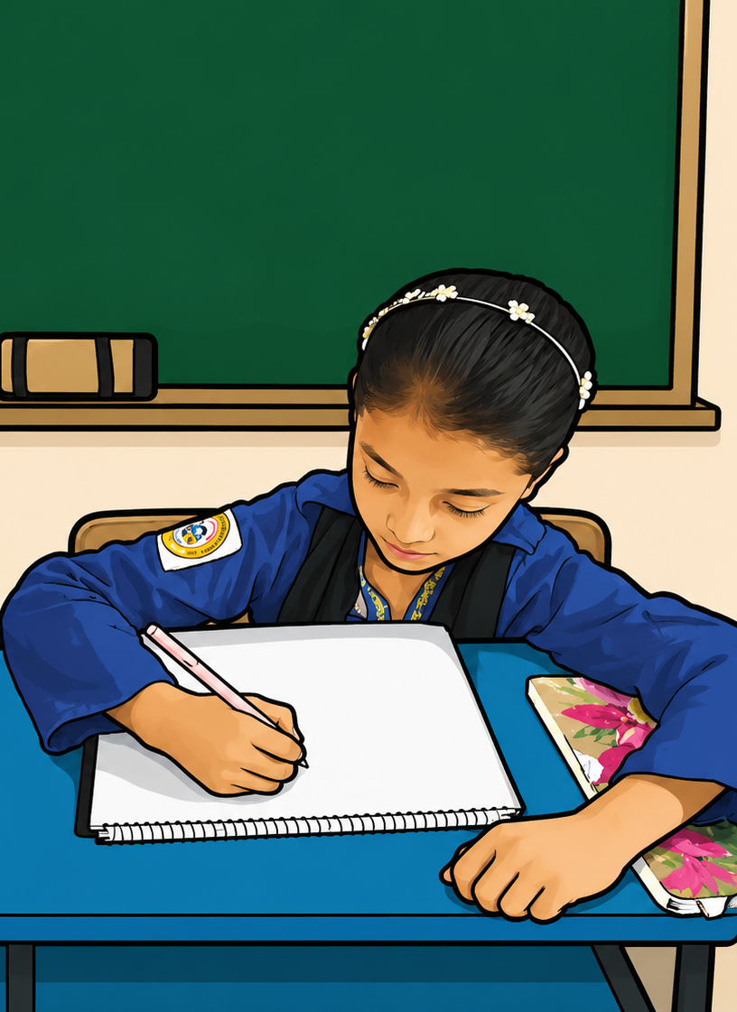
Everybody practice the conversations in front of the mirror and record it your mobile phone then send me if you can

