Slide 1


Slide 2
Teacher introduction
RAJAT BISWAS
Assistant Teacher
Amborkhana Dorshondewry Govt. Primary School
Sylhet Sadar, Sylhet.

Slide 3

Lesson introduction
Class : One
Subject : English for Today
Lesson : Alphabet e,E,f,F (unit 2,lesson 6)

Slide 4
Session Learning Outcomes
3.1 Say proper sounds of the letters in familiar words.
4.1 Recognize and read aloud the capital letters properly.
4.1 Recognize and read aloud the small letters properly.

Slide 5
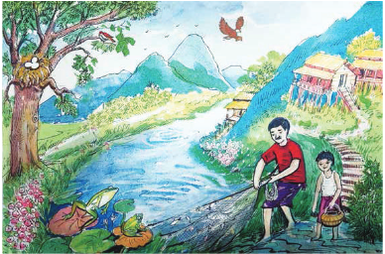

Slide 6
Alphabet e,E,f,F

Slide 7
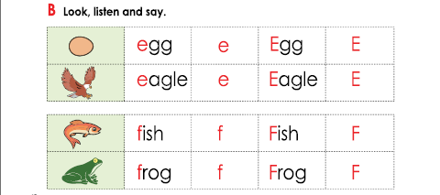
e
E
f
F

Slide 8
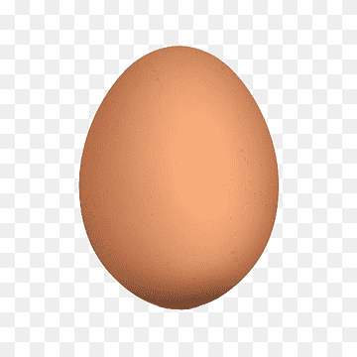
Egg
egg
e
E

Slide 9
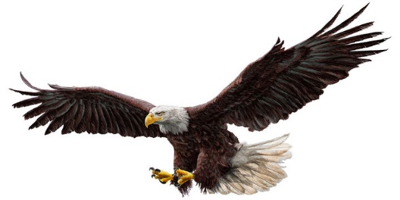
Eagle
eagle
E
e

Slide 10
E
Ear
End
Eye

Slide 11
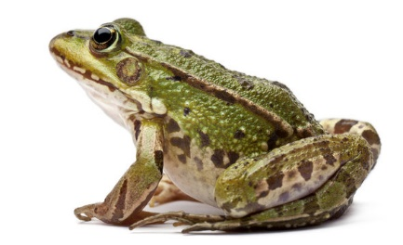
frog
Frog
f
F

Slide 12
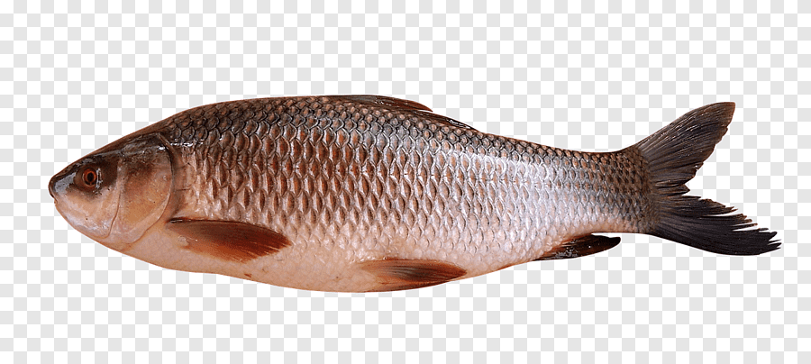
fish
Fish
f
F

Slide 13
F
Fan
Fun
Father

Slide 14
Group work
Group 1-Identify Capital letter E.
Group 2-Identify Small letter e.
Group 3-Identify Capital letter F.
4. Group 4-Identify Small letter f.

Slide 15
Evaluation

Slide 16

Egg
E
egg
e

Slide 17
Eagle
E
eagle
e

Slide 18
Frog
F
frog
f

Slide 19
F
Fish
f
fish

Slide 20
Homework
1.Draw a picture of an Egg.
2.Draw a picture of a Fish.

Slide 21


