Slide 1
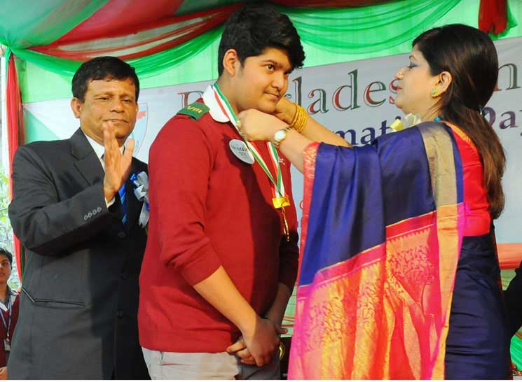
Welcome Everybody

Slide 2
Identity
Mst. Manira Ferdousi
Assistant Teacher (English)
Rotia High School
E-mail: mfboby89@gmail.com
English For Today
Class: Seven
Time: 50 minutes

Slide 3
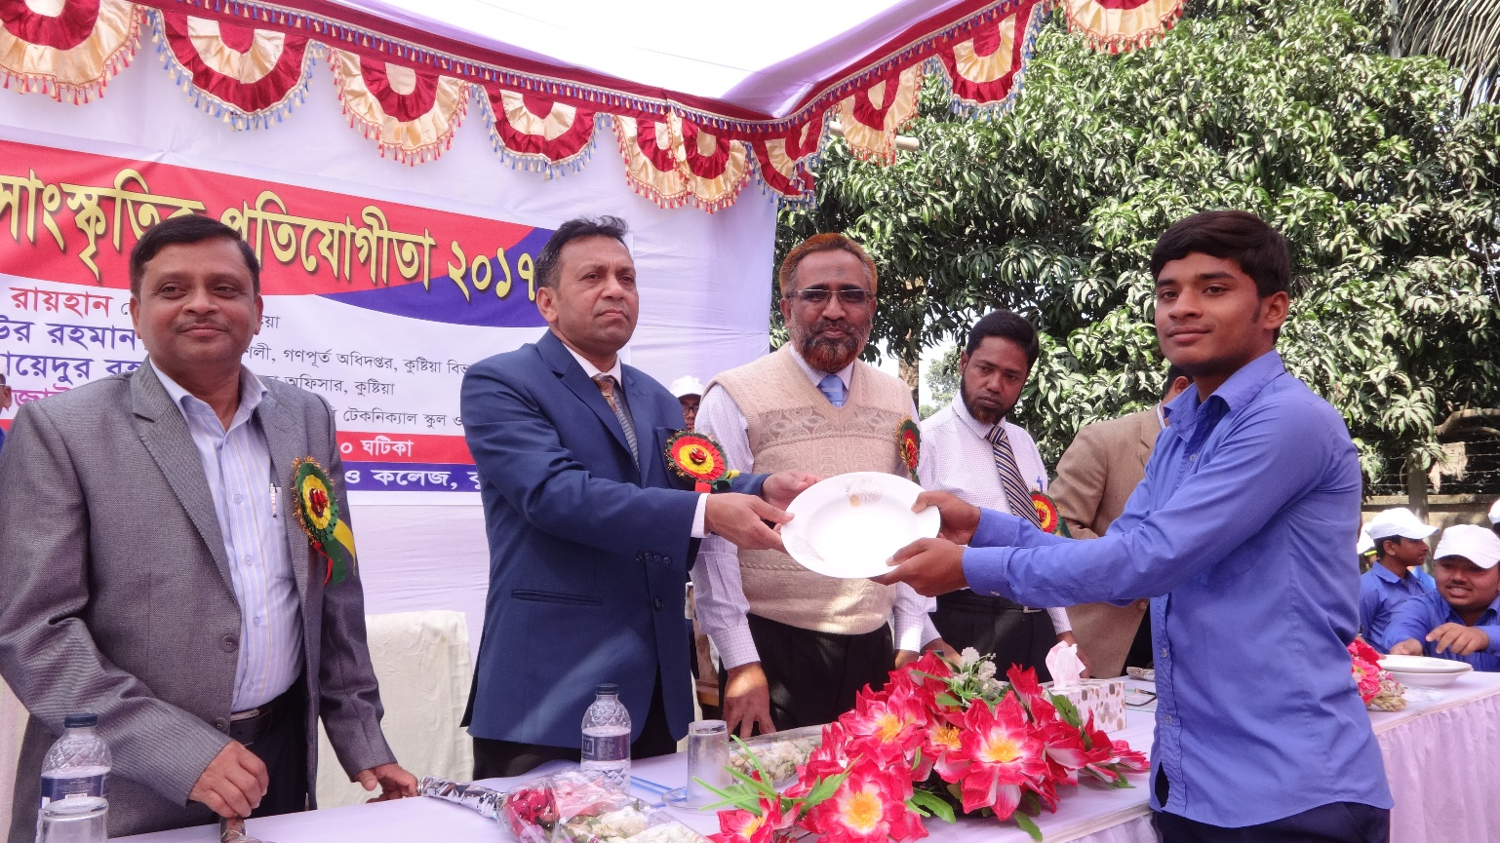
Look at the picture and discuss the following questions.
Who can you see in the picture?
What are they doing?

Slide 4
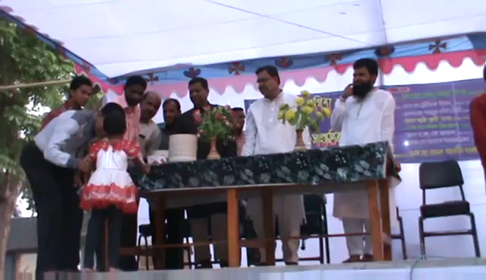
Let’s enjoy the video
So, What today’s lesson might be?

Slide 5
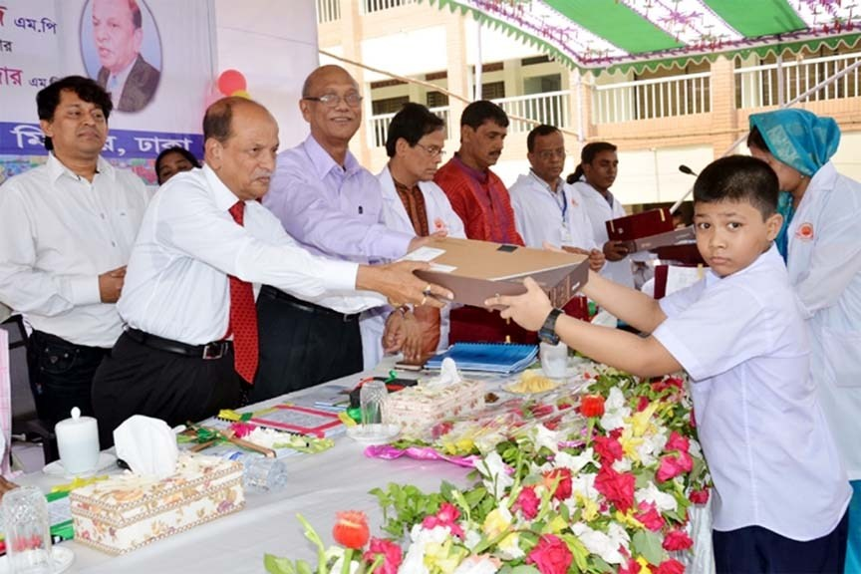
Lesson Announcement
Unit: Three
Lesson: 1
Prize-giving day at school.

Slide 6
After we have studied this lesson , we will be able to-
Learning Outcomes
Ask and answer questions
Read and understand texts
Write answers to question

Slide 7

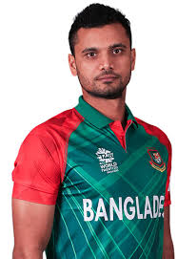
Key words
Meaning:
famous and respected within a particular sphere.
Masrafi Mortaza is one of the world’s most eminent crickter.

Slide 8

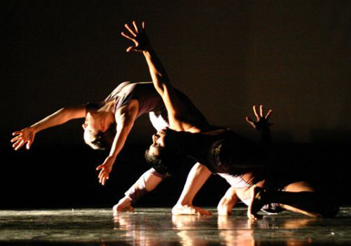
Key words
Meaning: exceptionally good.
This is outstanding performance.
Outstanding

Slide 9
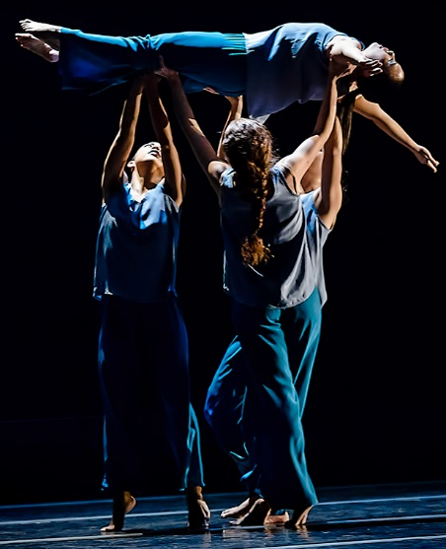
Key words
Meaning:
an act of presenting a play, concert, or other form of entertainment.
The dance performance was enjoyed by everyone in the audience.
Performance

Slide 10
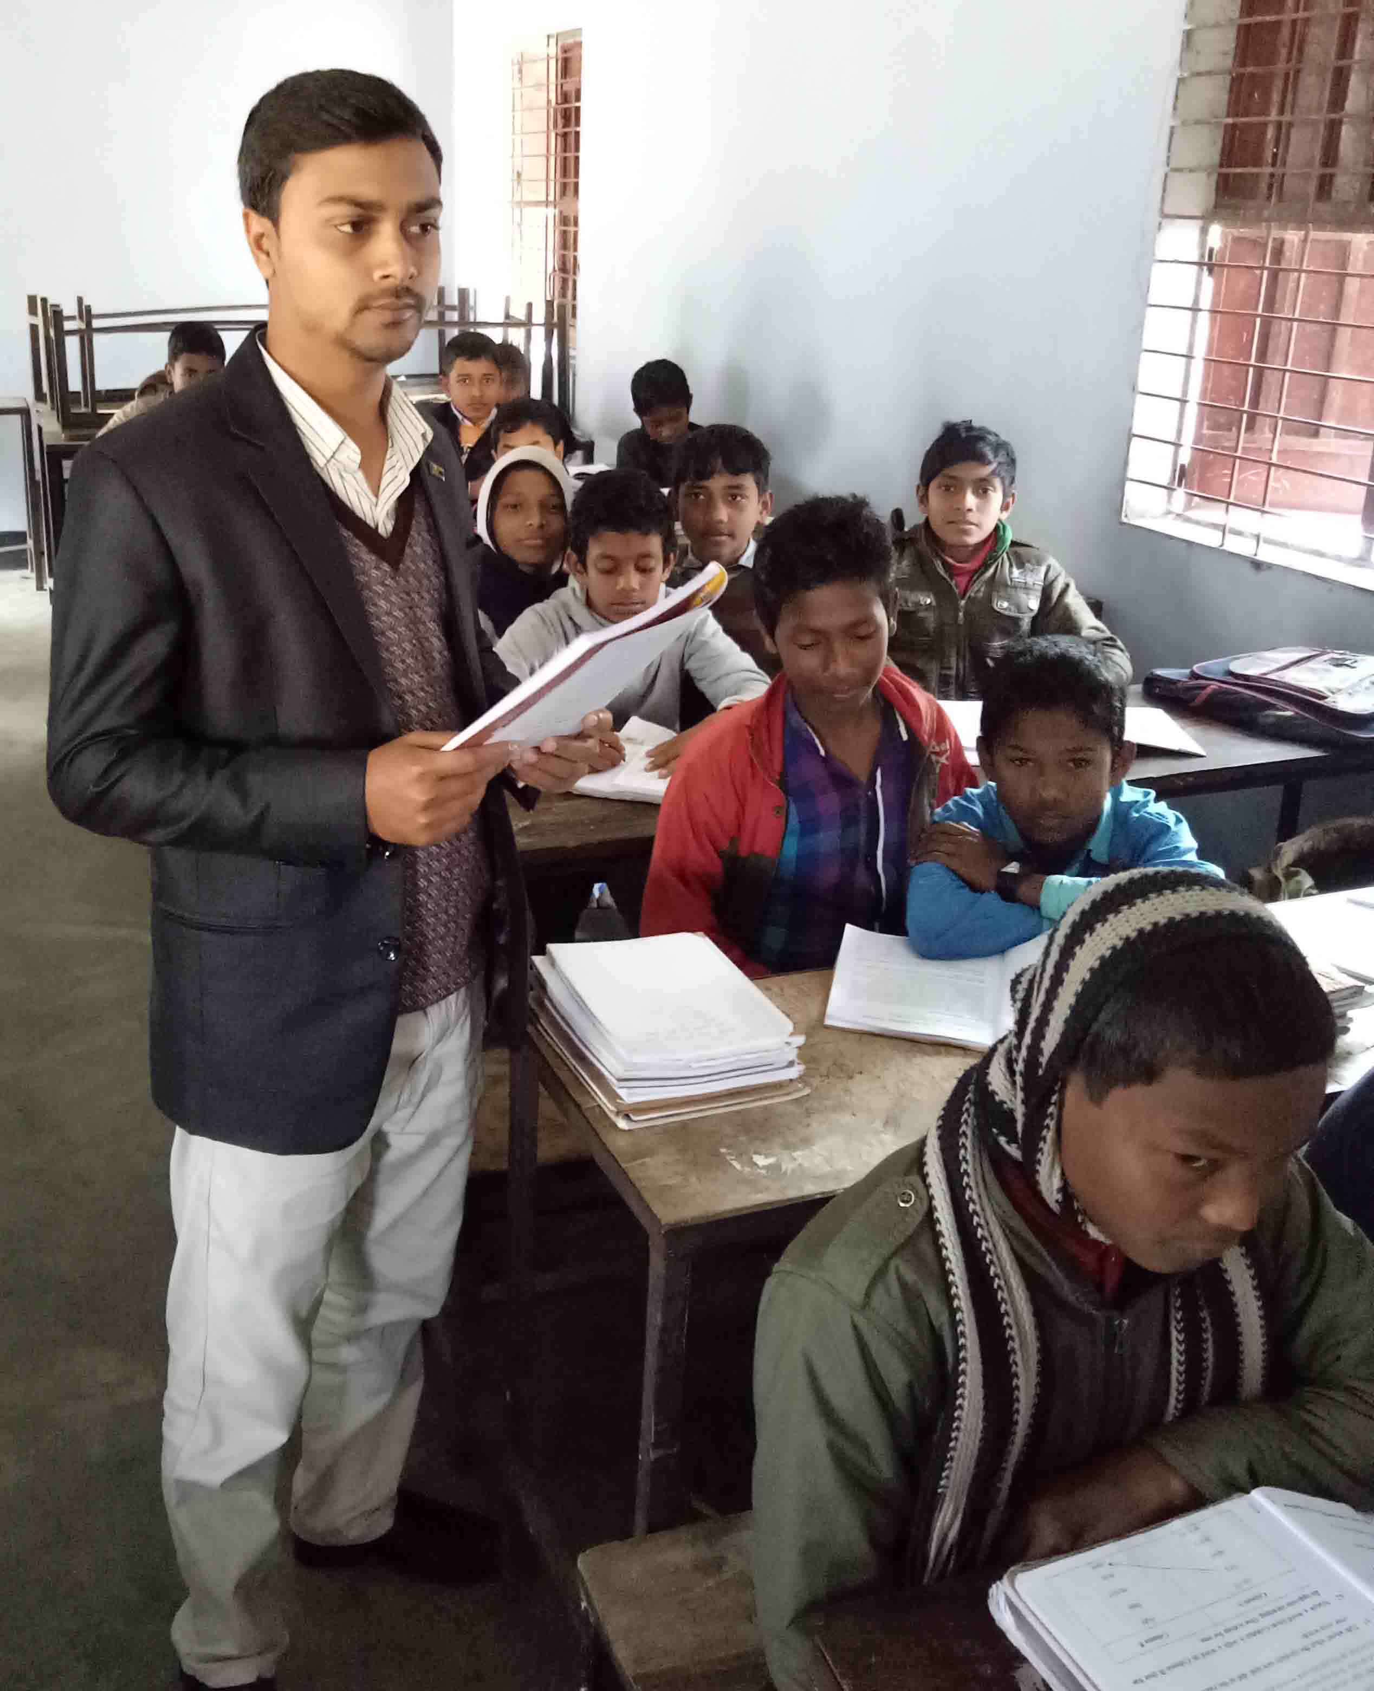
Teachers Model Reading
Keep silent and listen attentively

Slide 11
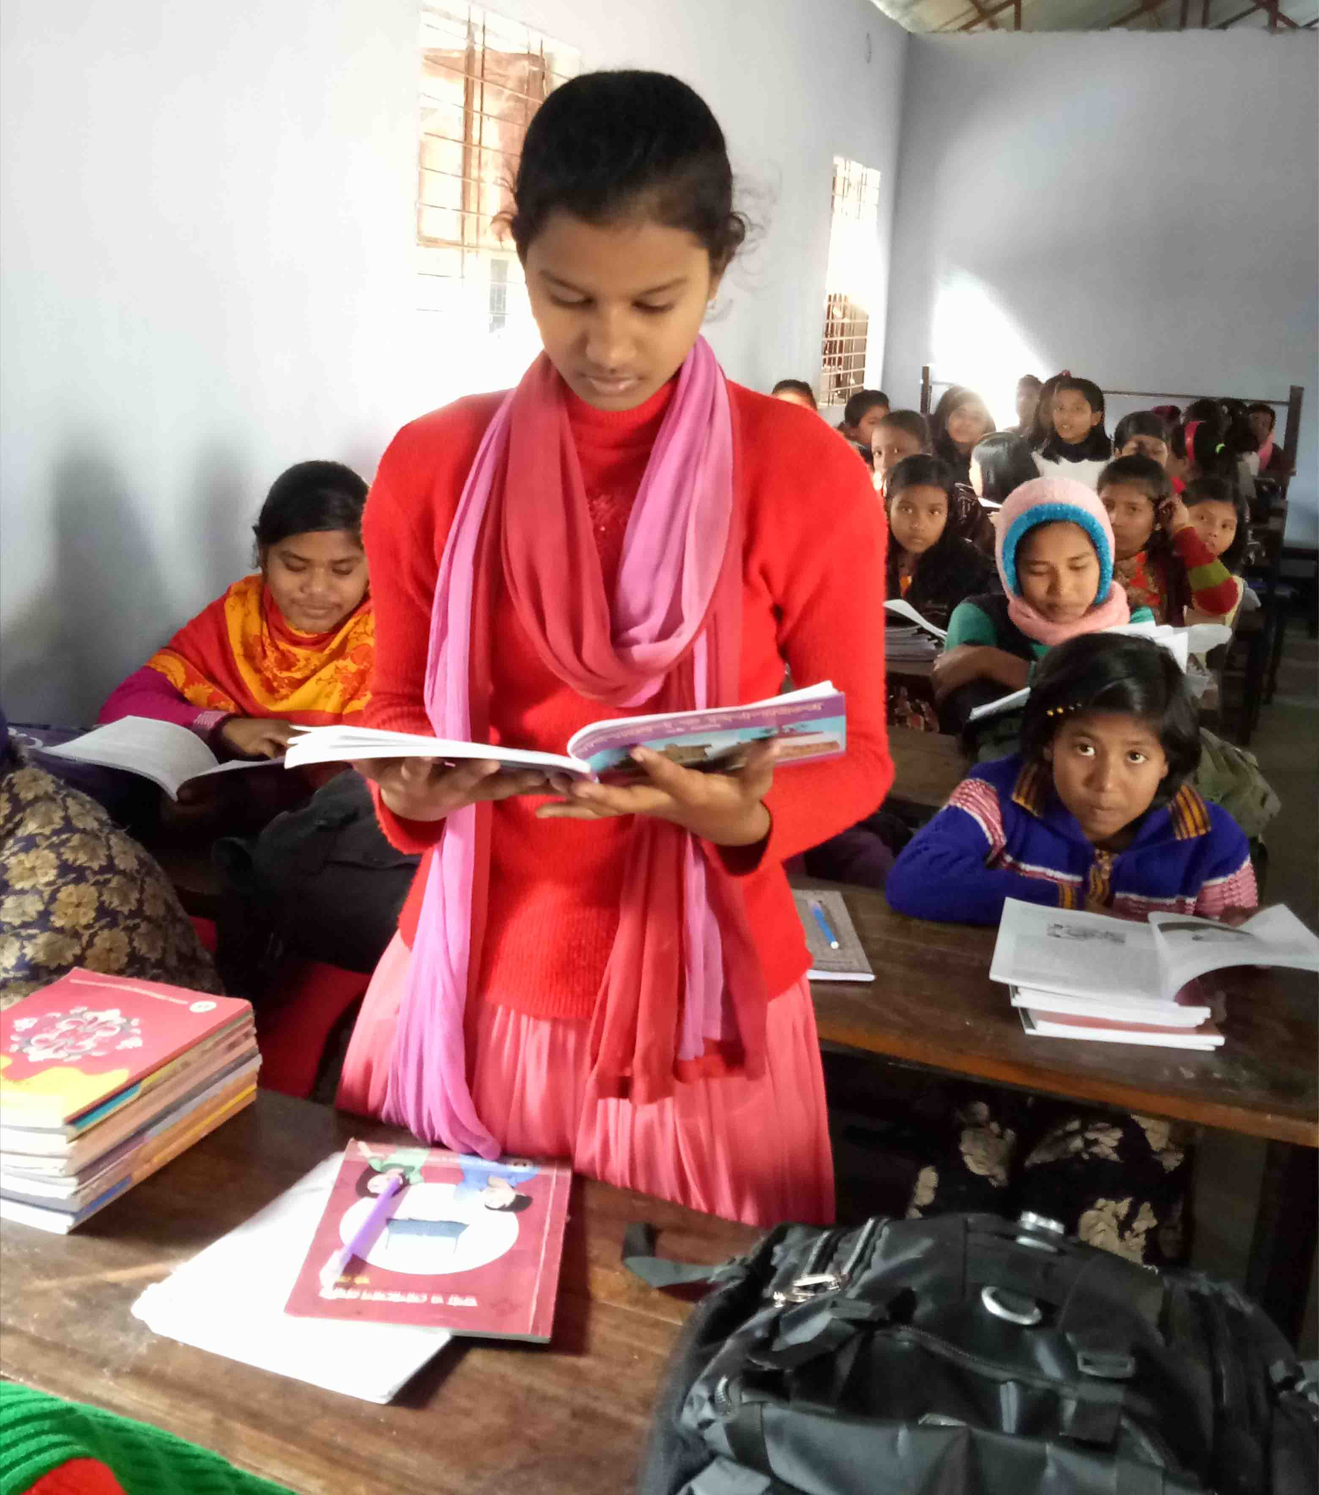
Students Model Reading
Read aloud

Slide 12
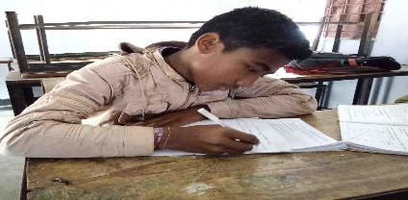
Individual Work
Write whether the statement are true or false. If false give the correct information.
a) Farabi is Flora’s cousin.
False
Correct answer: Farabi is Flora’s best friend.
b) They study in different school.
True
c) Flora has come to visit Farabi.
True
d) They are talking about school.
False
Correct answer: They are talking about prize giving ceremony.
e) The school auditorium was decorated brightly.
True

Slide 13
Pair works
Make questions and then choose answers from this table.
Questions |  |  | Answers
How | was did | the prize-giving function held? | The principal of PN college.
 |  |  | In the school auditorium.
What
 |  | the auditorium decorated? | Read out the annual report.
Who |  | the chief guest at the function? | Brightly.
Where |  | the Head teacher do at the beginning of the function?

Slide 14
Answer
S1 : Where was the prize-giving function held?
S2 : In the school auditorium.
S1 : How was the chief guest at the function?
S2 : Brightly.
S1 : Who was the chief guest at the function?
S2 : The principal of PN College.
S1 : What did the Head teacher do at the beginning of the function?
S2 : Read out the annual report.

Slide 15
Go to the section ‘C’ and match words with their meanings.
Words | Meanings
visit ceremony eminent praise outstanding display | speak highly of something or somebody extremely good go to see a person or place put something in a place where you can see it easily function people having lots of power and influence

Slide 16
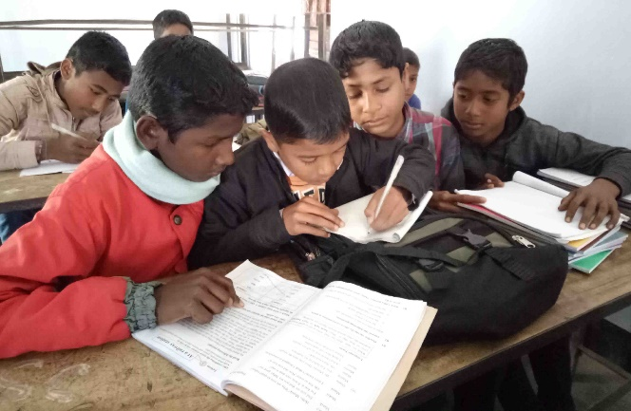
Group works
Complete the passage with the verbs in the box. Give their correct forms.
be sing speak stage
was
At the end of the price-giving function there a cultural show. The students , danced and a one-act play. It was so good that everyone highly of it.
sang
staged
spoke

Slide 17

Evaluation
Do you have a sports day at your school? First tell the class about it and then writes about it in your notebook.

Slide 18
Home work
Write short composition about the prize giving ceremony of your school from your home.

Slide 19

Thank you everybody

