Slide 1


Slide 2

HSC
ENGLISH 1ST PAPER
Abdur Rahman
Lecturer in English
Nowhata Govt. Degree College
Paba, Rajshahi

Slide 3
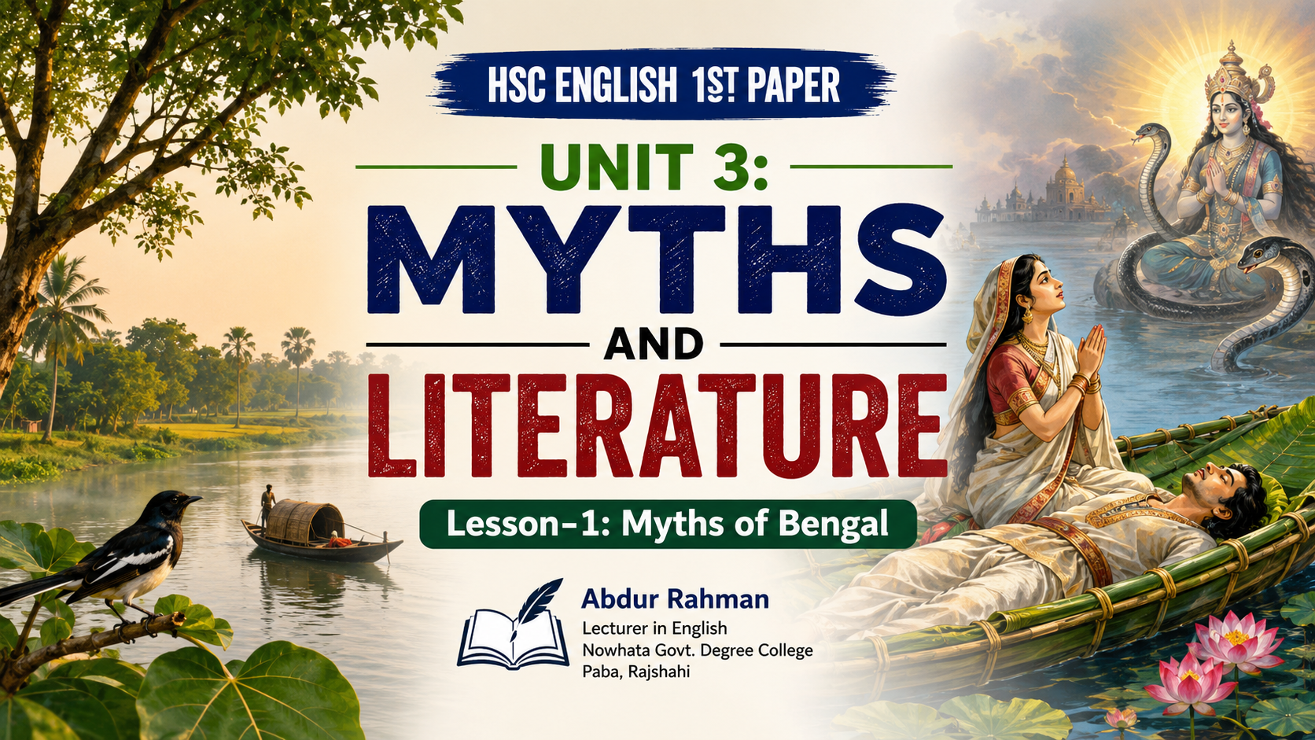

Slide 4
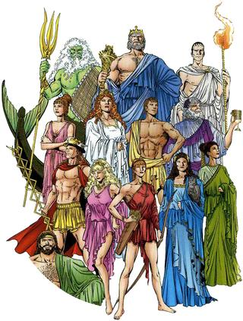
What is myths?
A traditional story, especially one concerning the early history of a people or explaining a natural or social phenomenon, and typically involving supernatural beings or events. "ancient Celtic myths"

Slide 5
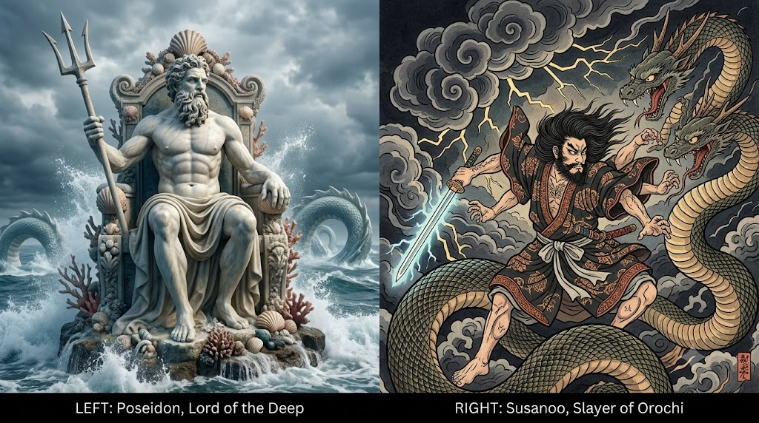

Slide 6
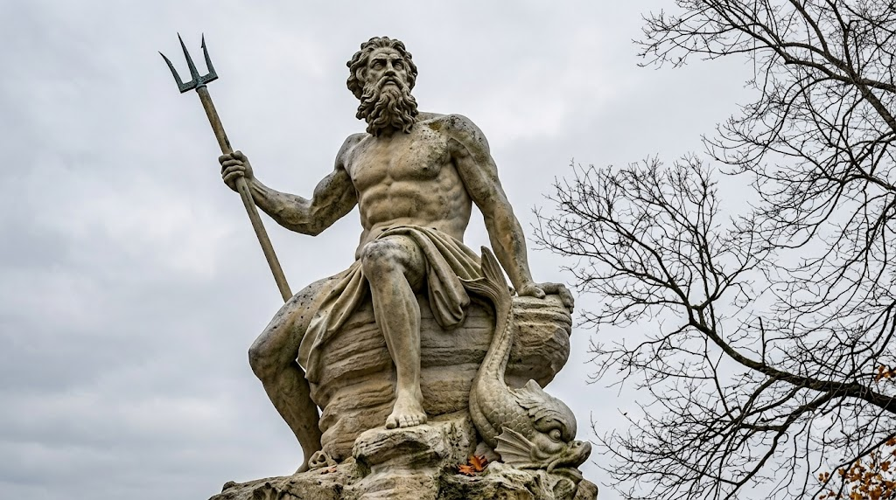

Slide 7


Slide 8

I Have Seen Bengal’s Face By Jibananando Das

Slide 9
I Have Seen Bengal’s Face By Jibananando Das
Because I have seen Bengal’s face, I will seek no more;
The world has not anything more beautiful to show me.
Waking up in darkness, gazing at the fig-tree, I behold
Dawn’s swallows roosting under huge umbrella-like leaves. I look around me
And discover a leafy dome-Jam, Kanthal, Bat, Hijol and Aswatha trees-
All in a hush, shadowing clumps of cactus and zedoary () bushes.
When long, long ago, Chand came in his honeycombed () boat
To a blue Hijal, Bat and Tamal shade near the Champa, he too sighted
Bengal’s incomparable beauty. One day, alas. In the Ganguri,
On a raft, as the waning moon sank on the river’s sandbanks (),
Behula too saw countless aswaths bats besides golden rice fields
And heard the thrush’s soft song. One day, arriving in Amara,
Where gods held court, when she danced like a desolate wagtail,
Bengal’s rivers, fields, flowers, wailed like strings of bells on her feet.

Slide 10
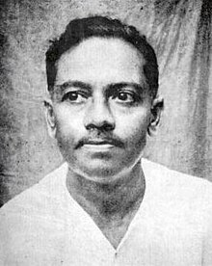
বাংলার মুখ আমি দেখিয়াছি, তাই আমি পৃথিবীর রূপ
খুঁজিতে যাই না আর : অন্ধকারে জেগে উঠে ডুমুরের গাছে
চেয়ে দেখি ছাতার মতন বড় পাতাটির নিচে বসে আছে
ভোরের দোয়েল পাখি – চারিদিকে চেয়ে দেখি পল্লবের স্তূপ
জাম-বট-কাঁঠালের-হিজলের-অশথের করে আছে চুপ;
ফণীমনসার ঝোপে শটিবনে তাহাদের ছায়া পড়িয়াছে;
মধুকর ডিঙা থেকে না জানি সে কবে চাঁদ চম্পার কাছে
এমনই হিজল-বট-তমালের নীল ছায়া বাংলার অপরূপ রূপ
দেখেছিল; বেহুলাও একদিন গাঙুড়ের জলে ভেলা নিয়ে –
কৃষ্ণা-দ্বাদশীর জোৎস্না যখন মরিয়া গেছে নদীর চড়ায় –
সোনালি ধানের পাশে অসংখ্য অশ্বত্থ বট দেখেছিল, হায়,
শ্যামার নরম গান শুনেছিল – একদিন অমরায় গিয়ে
ছিন্ন খঞ্জনার মতো যখন সে নেচেছিল ইন্দ্রের সভায়
বাংলার নদী মাঠ-ভাঁটফুল ঘুঙুরের মতো তার কেঁদেছিল পায়।
বাংলার মুখ
জীবনানন্দ দাশ

Slide 11
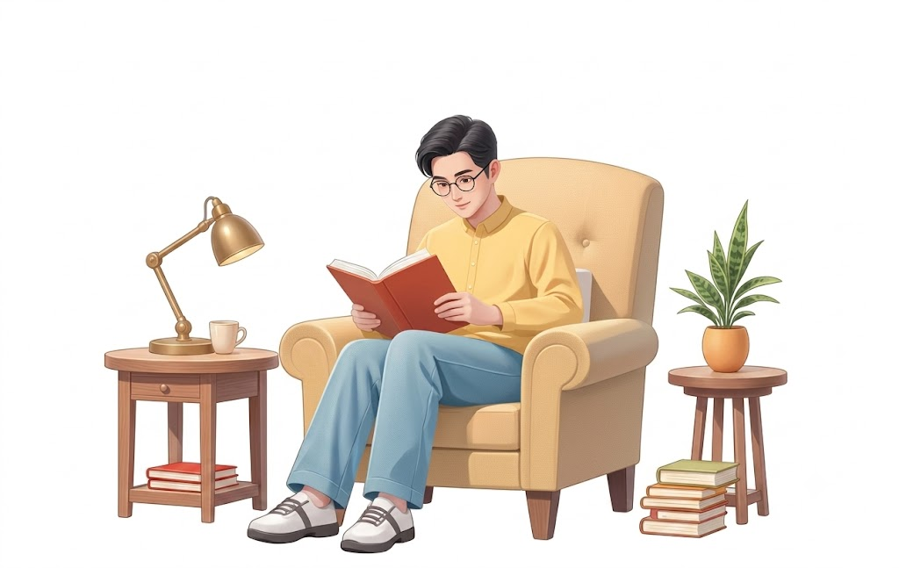
_{READ THE TEXT CAREFULLY}

Slide 12
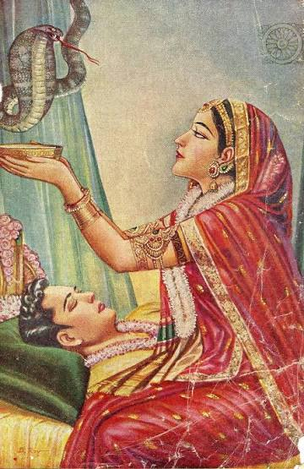
Behula is a legendary folk heroine and one of the main characters of Manasamangal, a medieval epic (মহাকাব্য). She was the daughter of Sayven of Ujaninagar. Lakhindar was the youngest son of Chand Saodagar of Champaknagar. Behula grew up to be a beautiful and intelligent woman and was married to Lakhindar. Chand Saodagar, a devotee of Shiva, had boasted (অহংকার) that he was cleverer and stronger than Manasa, the snake goddess.

Slide 13
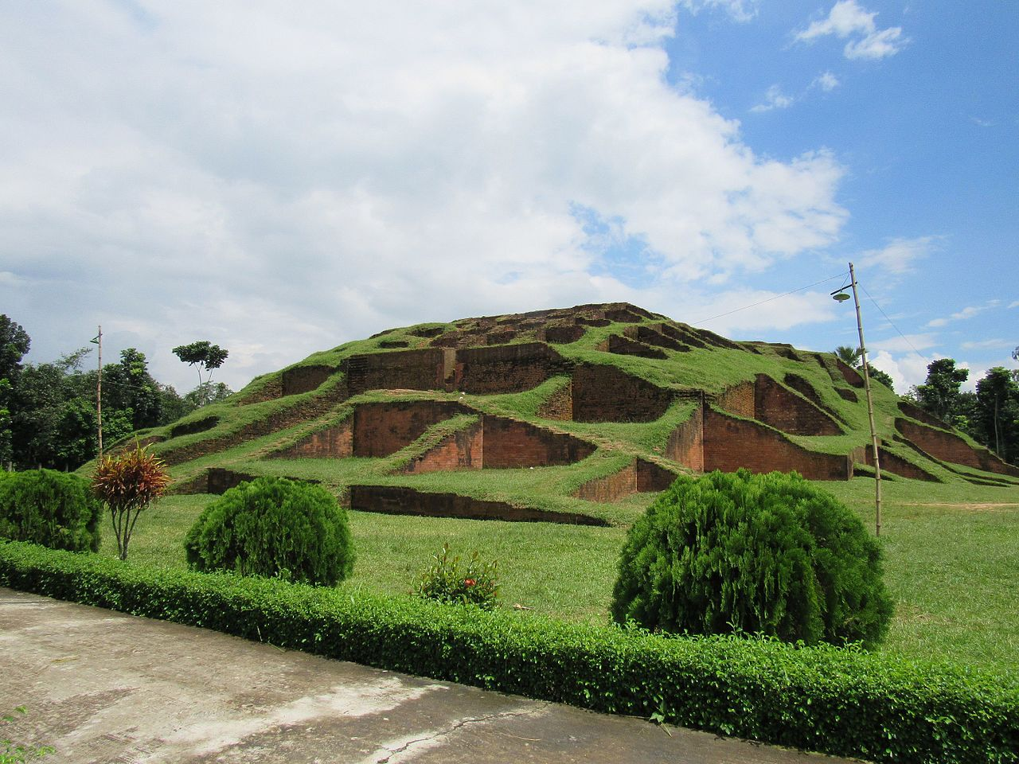
বগুড়া

Slide 14
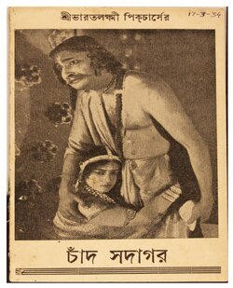
He built an iron chamber for Lakhindar, believing it to be impregnable (দুর্ভেদ্য). However, on the wedding night of Behula and Lakhindar, Manasa sent a snake to kill Lakhindar. The snake made itself as fine as a strand () of hair and, entering the chamber through a minute hole, bit Lakhindar.

Slide 15
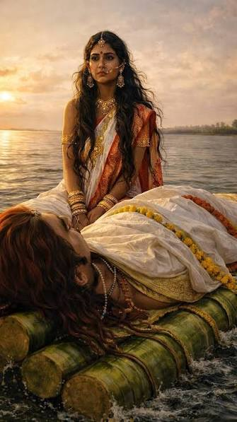
Behula refused to accept her husband's death. She placed her husband's corpse on a banana raft (কলার ভেলা) and set out on a hazardous (বিপজ্জনক) journey towards the abode of the gods. Despite all the dangers and temptations (প্রলোভন), she encountered, Behula continued her journey and finally succeeded in reaching the abode of the gods.

Slide 16
She pleaded (অনুরোধ) for her husband's life and promised Manasa that Chand Saodagar would worship her. Moved by Behula's love for her husband, Manasa not only restored (পুনরুদ্ধার করা) Lakhindar but also his brothers whom she had killed earlier.
Behula returned home with her husband and brothers-in-law, and Chand Saodagar finally bowed before the might of Manasa. Lakhindar and Behula then returned to their heavenly (স্বর্গীয়) abode as Aniruddha and Usa.

Slide 17
PAIR WORK
Make five MCQs from the text

Slide 18
GROUP DISCUSSION
Create a flowchart from the Text

Slide 19

Who was Behula and whom did she marry?
Why did Chand Saudagar build an iron chamber for Lakhindar?
How did Goddess Manasa succeed in killing Lakhindar despite the iron chamber?
What did Behula do after her husband's death, and what challenges did she face during her journey?
How did Behula finally convince Manasa to restore Lakhindar's life, and what was the outcome of her devotion?

Slide 20
SUMMARY OF THE POEM
Jibananando Das here describes the beauty as well as lost glory of Bengal. The poet wants to see a glorious Bengal, a country that had high glory in the antiquity (প্রাচীনত্ব). The poet opens the poem with the description of the dawn when morning bird is sitting beneath a big leaf. He can see a lot of other trees and herbs. Then he names some of the least looked upon reminds us the heritage of the area. He says that this beauty of the Bengal shall be for even and so he does not want to go anywhere.

Slide 21


