Slide 1




Slide 2


Presented by
Maksuda Khanom
Assistant Teacher
Urura Govt.Primary School
Mohammadpur,Magura.
Email-mkhanom.at.87@gmail.com

Slide 3

Introduction to the Lesson
Unit-11
Activity-1.1,1.2
Lesson Title-Making Requests
Class-Five
Sub-English

Slide 4
Learning Outcomes
Students will be able to-
4.2.1 Read aloud texts with proper stress,intonation.
8.1.2 Recognise and use a range of words and phrases in written communication.

Slide 5
Review of the prior knowledge
*How do you make requests to others?
*What do you say when you need help?
*Do you use the word please when asking for something?

Slide 6
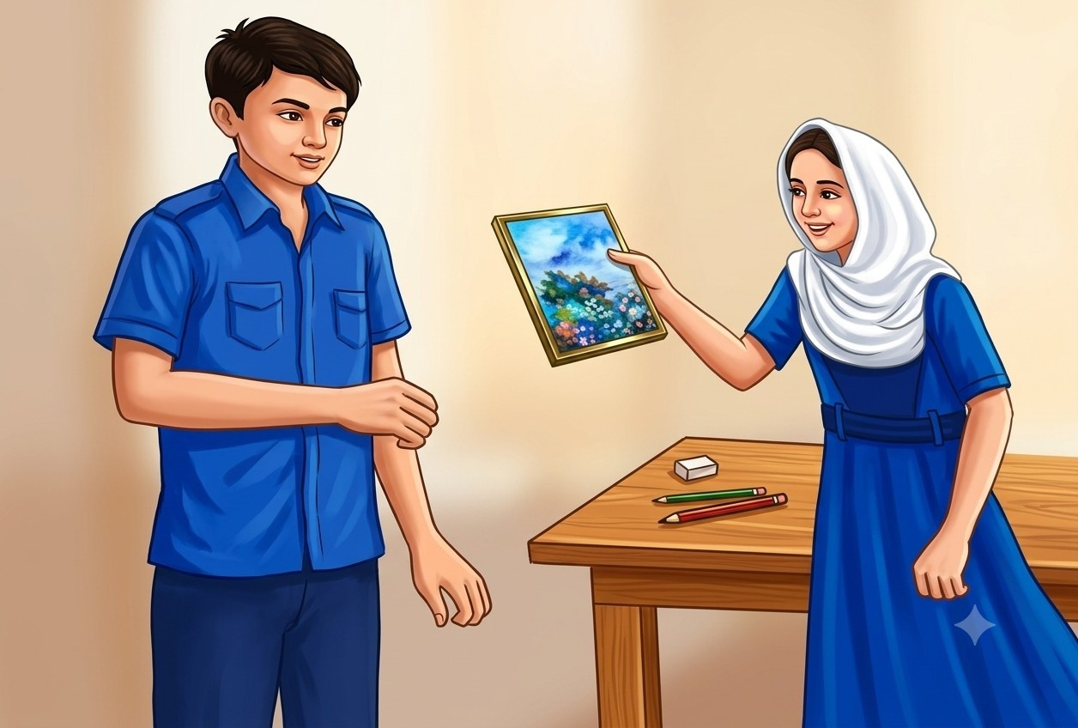
Look at the picture
a.What do you see in the picture?
b.What do you think they are talking about?
c.How do you request someone to get something?

Slide 7
Can you guess what may be our today’s Lesson?

Slide 8


Our Today’s Lesson
Makng Requests

Slide 9
New words
Request
To ask politely for something

Slide 10
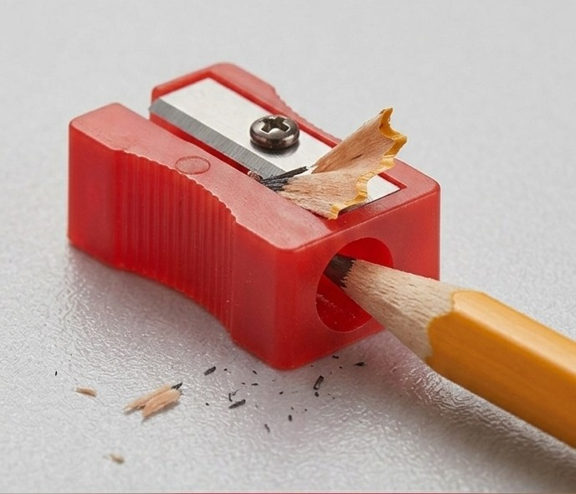
Sharpener
A device used to sharpen pencils

Slide 11

Straight
Frontward

Slide 12
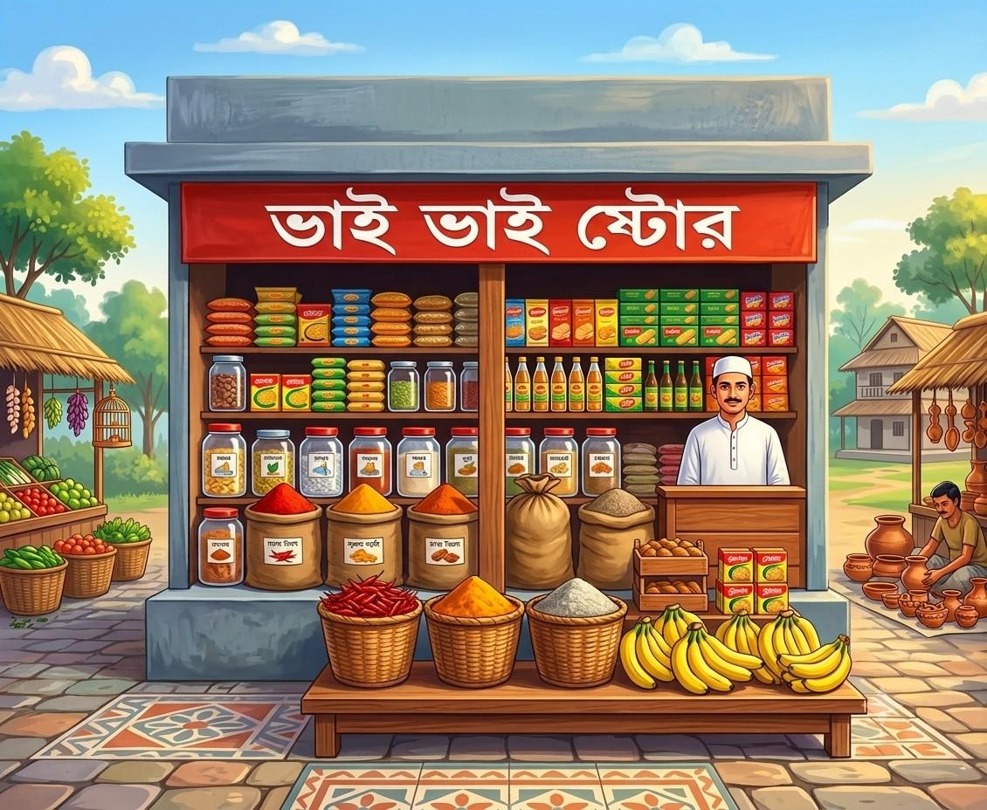
Store
Shop

Slide 13
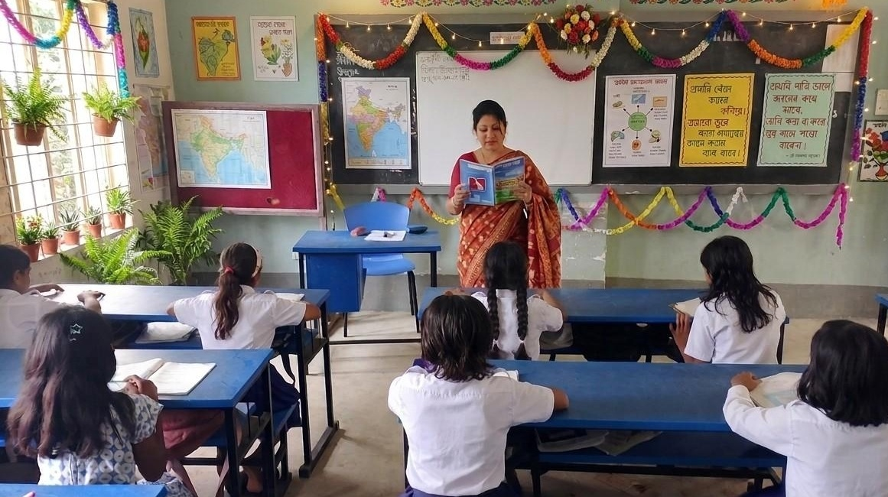
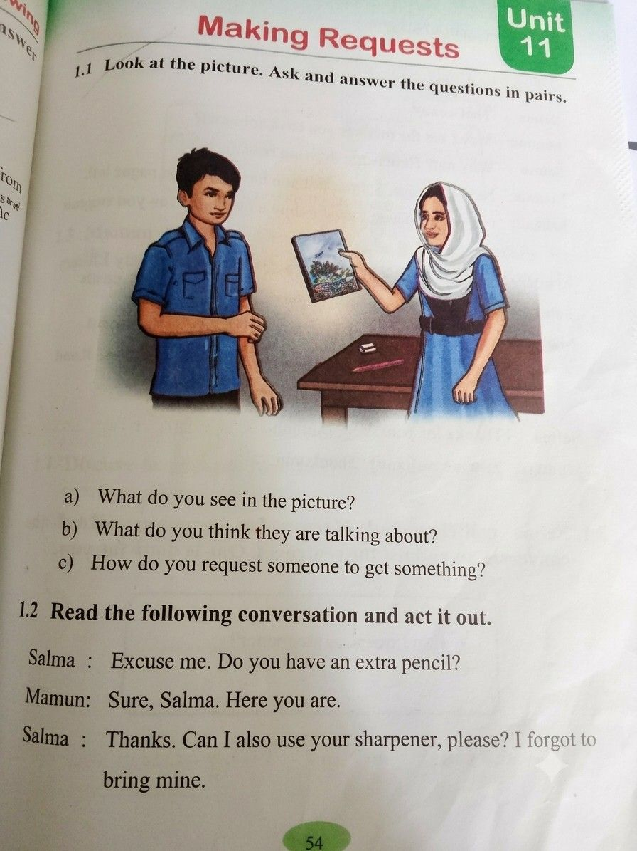
Teacher’s Model Reading

Slide 14
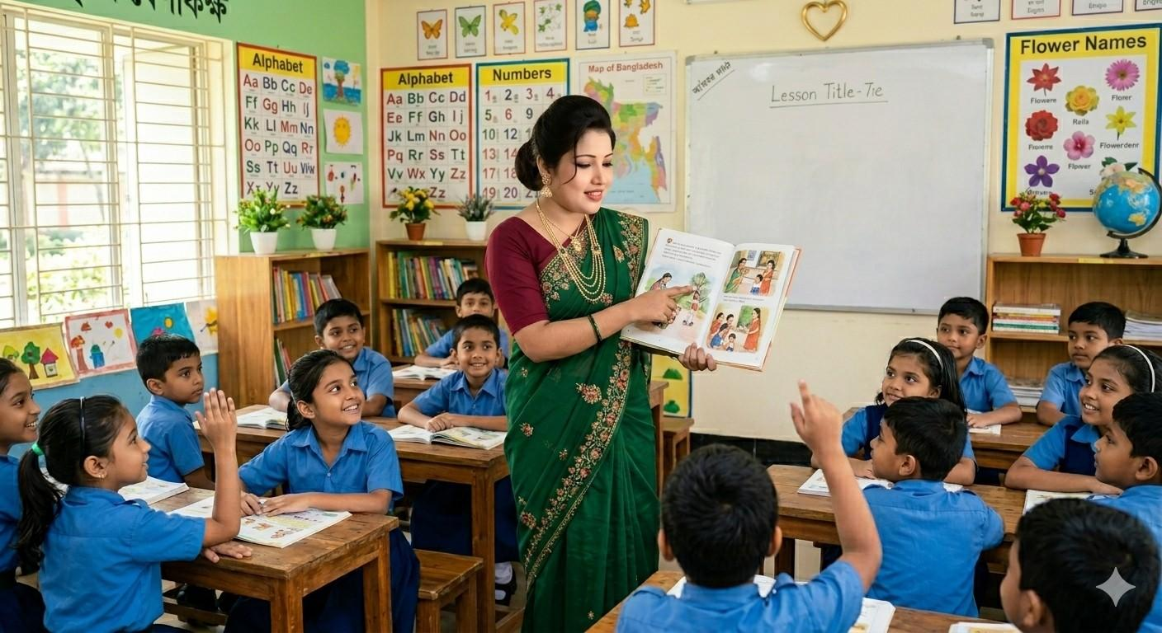
Choral Reading

Slide 15
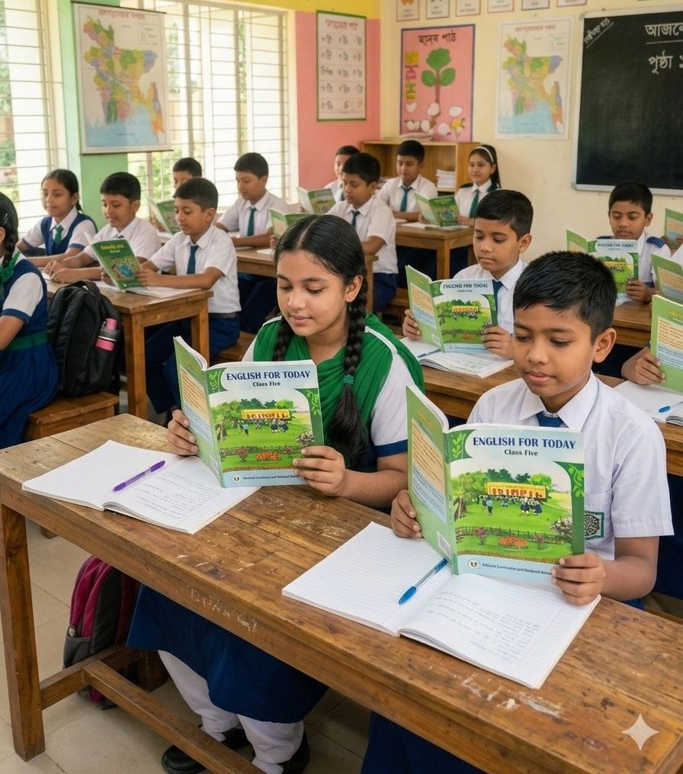
Student’s Reading

Slide 16
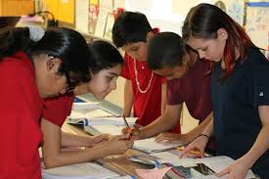
Group Work
Read the text in groups and fill in the blanks.
a.I don’t have a --------------.
b.Here is my ------------book.
c.-------------for your help.
sharpener
drawing
Thanks

Slide 17

Pair Work
Read the text in pairs and role-play the conversation.

Slide 18
One day one word
Extra
অতিরিক্ত
Do you have an extra pen?

Slide 19

Assessment
Read the conversation individually from activity 1.2 at textbook page 54-55.

Slide 20
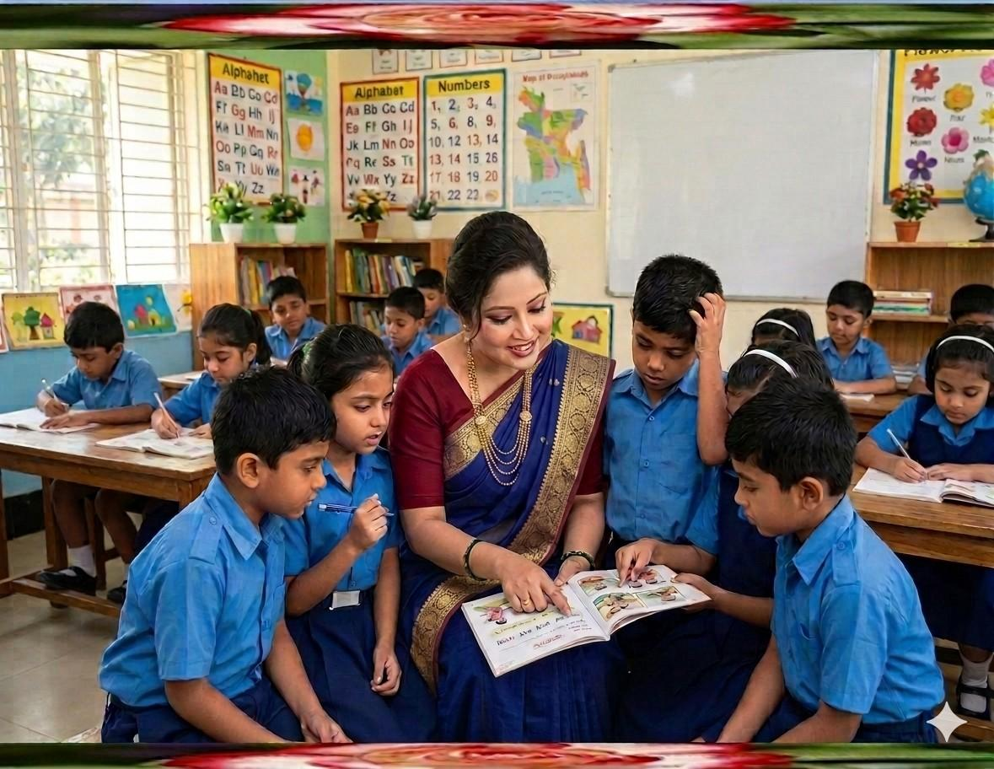

Feedback
Support the students during the class
who cannot read aloud the conversation properly.

Slide 21

Summary of the session
“What have you learnt today?”
We have learnt how to make a conversation.

Slide 22

Home Work
Write 5 polite requests using “Can you…?”or “Could you…?”

Slide 23


