Slide 1


Slide 2
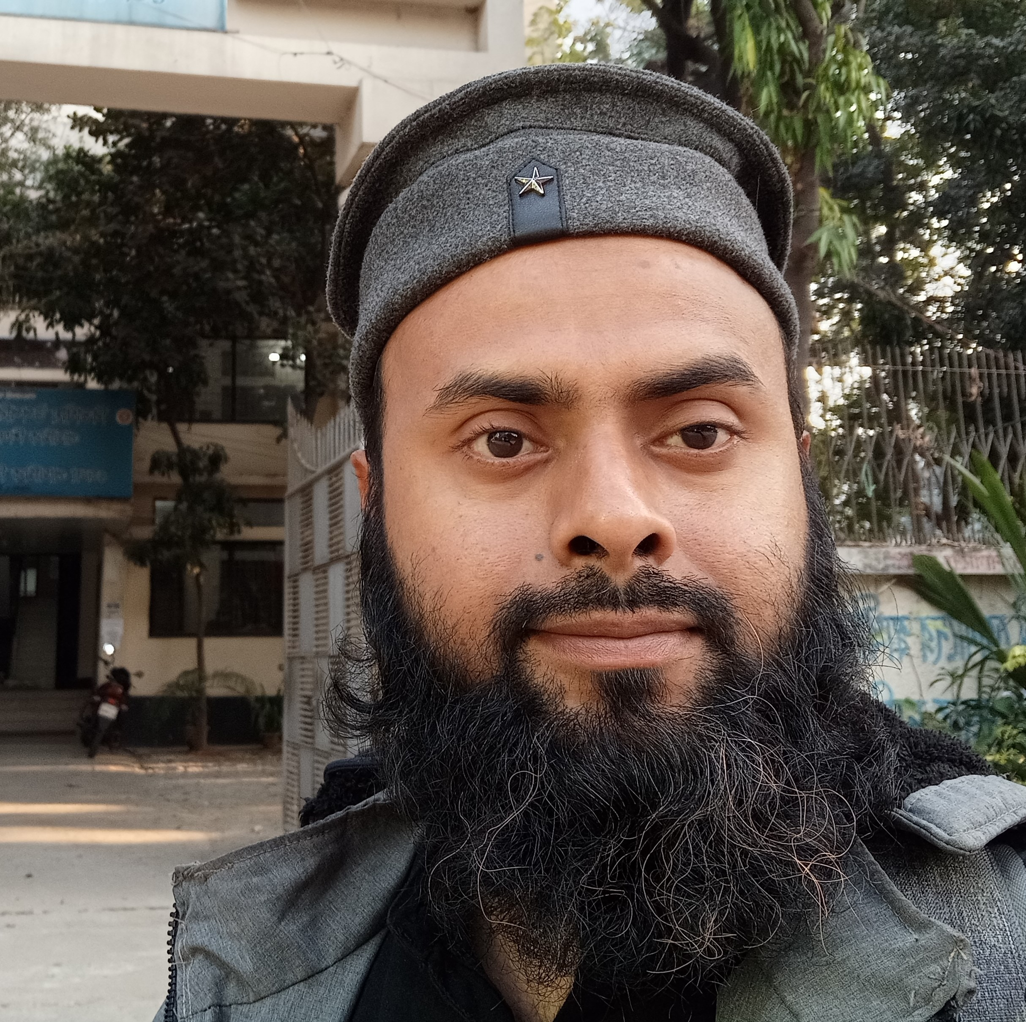
Teachers Identity
Name: Mahmudur Rahman
Assistant Teacher
Konghlachai Chowdhury Para Government Primary School
Khagrachari sadar, Khagrachari.
Email: mahmud01978851122@gmail.com
Mobile: 01511444424

Slide 3
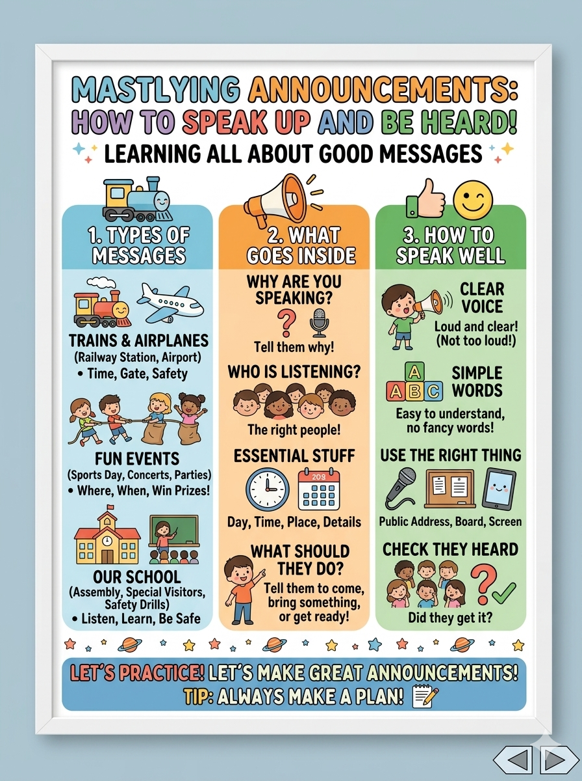
Class: Five
Subject : English
Unit: 9
Title: Get Ready to Listen
Activity: 1.1, 1.2, 2.1
Page: 47,48
Time: 40 minutes

Slide 4
LEARNING OUTCOME
By the end of the lesson SS will be able to:-
1.6.1 Get specific information from listening to
announcements
I .6.2 Get the main ideas from listening to
announcements

Slide 5

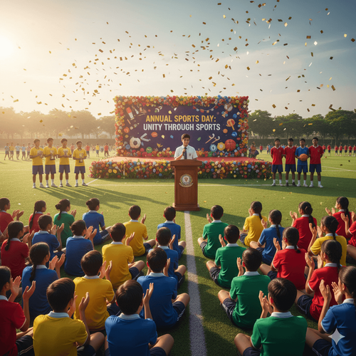


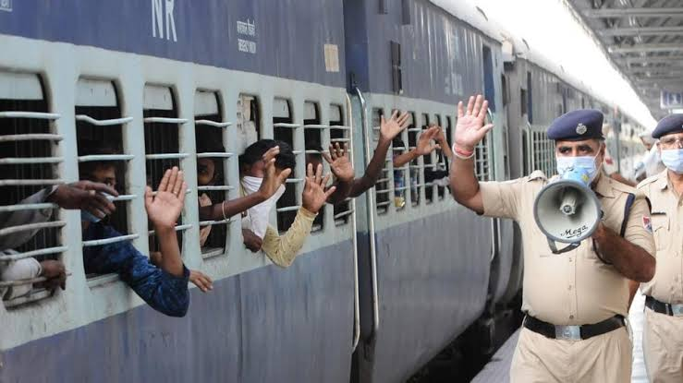
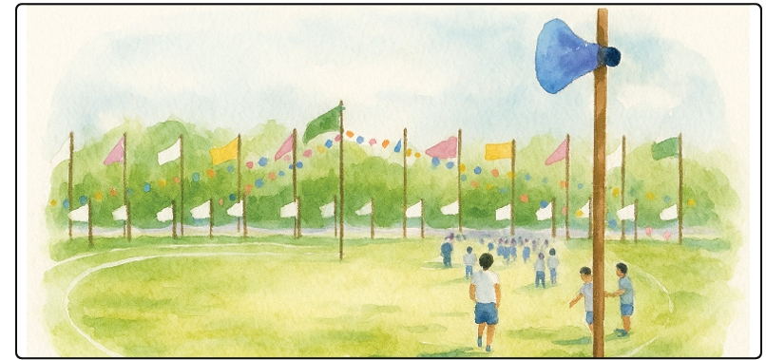

Slide 6

a) Have you ever listened to any announcements at these places?
b) What are the announcements about? Please, share with your class

Slide 7
Vocabulary
Announcement
Annual Sports Day
Decorated
Colourful
Suddenly
Participating
Instruction

Slide 8
Today is the annual sports day at Sumon's school. The school field is decorated with colourful flags. Sumon and his friends are waiting at the corner of the field. They are happy and excited to attend the events. Suddenly, the voice in the loudspeaker drew their attention and they are all ears.

Slide 9
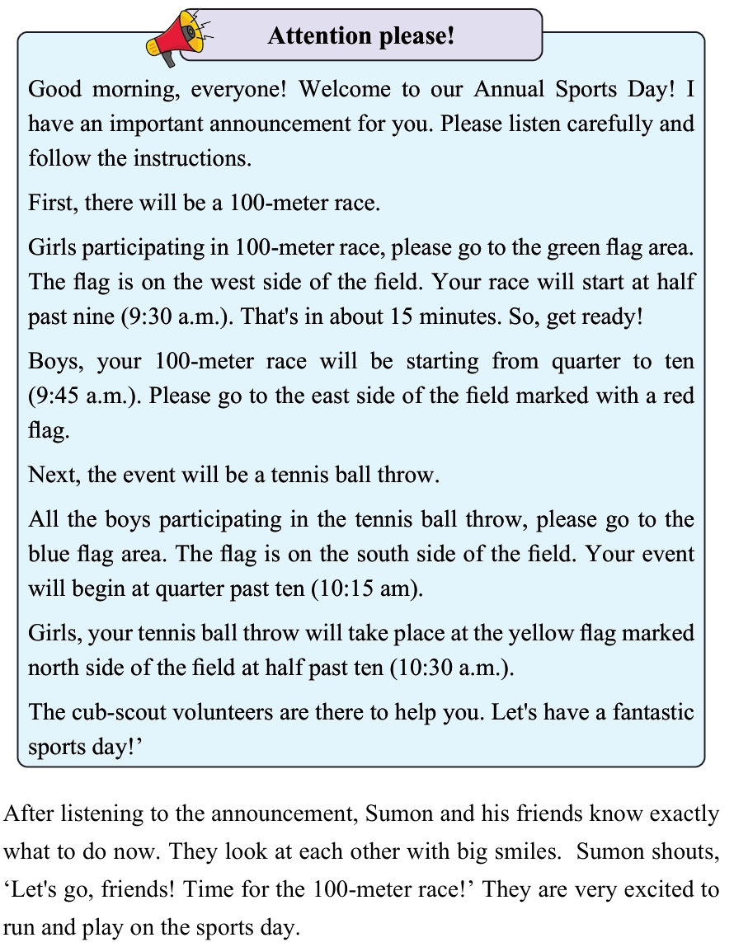

Slide 10
Group Work
Make four groups
Read the text in group
Answer some short question to each other

Slide 11
Assesment
Chain drill activity using a softball
Student 1 reading
Student 2 reading
Student 3 reading

Slide 12
Answer the question please
a)What is the announcement about?
b) When do the girls have their 100-meter race?
c) Where should the boys go for the 100-meter race?
d) What colour flag is marked for boys' tennis ball throw?
e) Where should the girls go for the tennis ball throw?
f) What are the main events announced for the annual sports day?

Slide 13
Summary of the session
Recap the main points of the lesson.
What have we learnt today?
We have read the text aloud properly.
We have learnt some new words.

Slide 14


