Slide 1


Welcome to the class

Slide 2
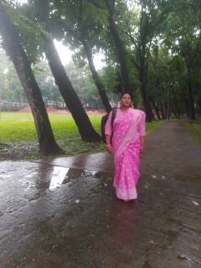
Identity
Mst. Manira Ferdousi
Assistant Teacher (English)
Rotia High School
E-mail: mfboby89@gmail.com
English For Today
Class: Seven
Time: 50 minutes

Slide 3
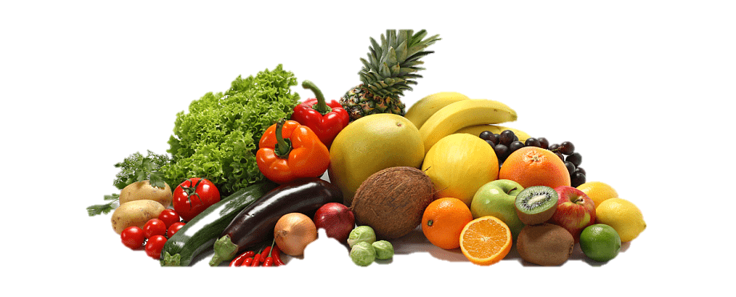
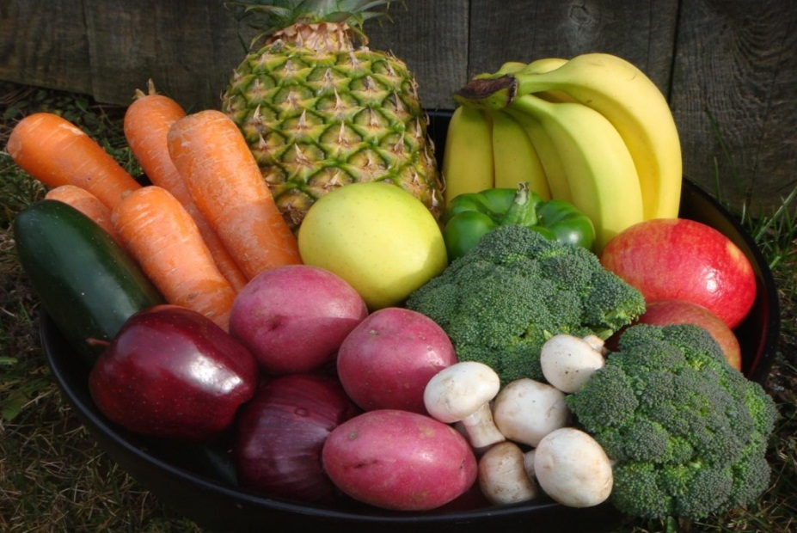
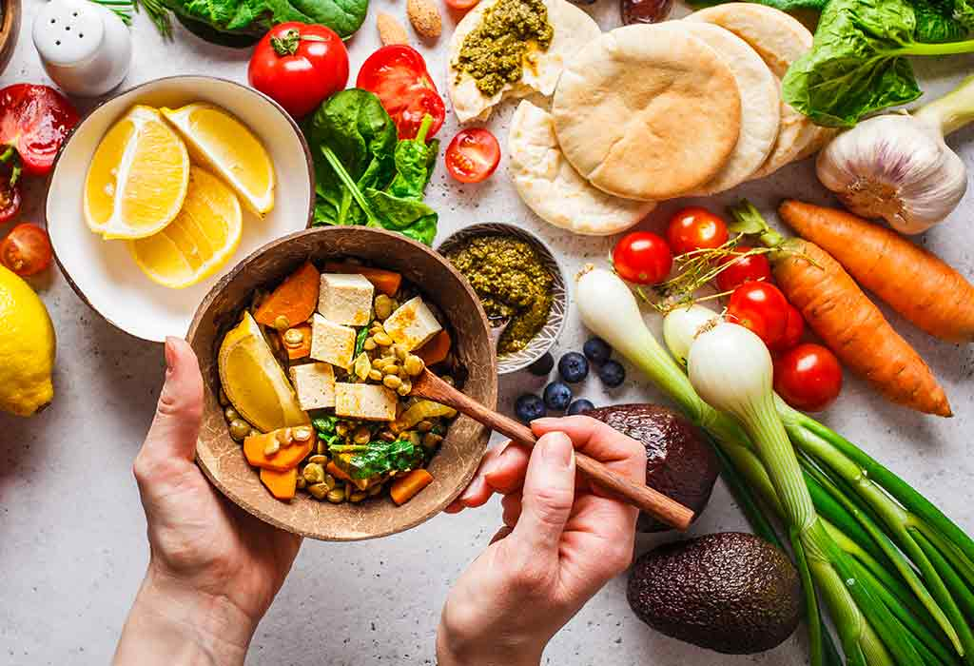
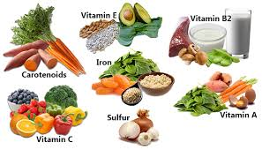
What do you see in the pictures?
What does it bear?
Food and Nutrition

Slide 4
Today’s Our Lesson
Good Food
Unit-02
Lesson-

Slide 5
Learning Outcomes
After this lesson students will be able to….
01. what good food is;
02. to explain the benefits of good food;
03. importance of good eating habits.

Slide 6
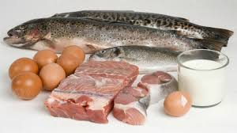
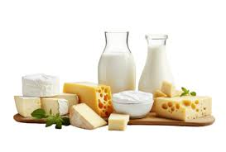
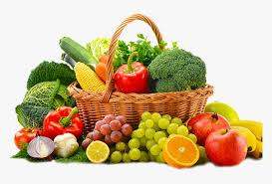
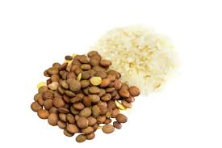
Examples of Good Food
Fish, meat, eggs
Rice, bread, lentils
Fruits and vegetables
Milk and dairy products

Slide 7

Individual Work
1. what good food is;

Slide 8
What is Good Food?
Good food means food that is healthy, nutritious, and safe to eat. It provides the body with essential nutrients like vitamins, minerals, proteins, and energy, which help us grow, stay strong, and remain healthy.

Slide 9

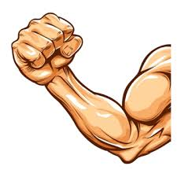


Benefits of Good Food
Gives us energy
Makes our bones and muscles strong
Keeps us active and happy
Increases immunity

Slide 10
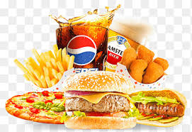
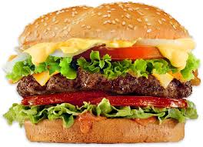
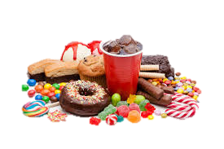
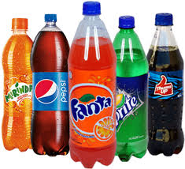
Fast food
Junk food
Too much oily and sugary food
Soft drinks

Slide 11
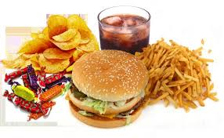
What is Bad Food?
Bad food means food that is unhealthy and has little or no nutritional value. It often contains too much fat, sugar, salt, or artificial ingredients, which can harm our health and cause diseases if eaten too often.

Slide 12
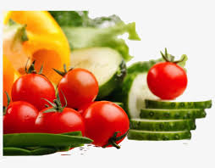
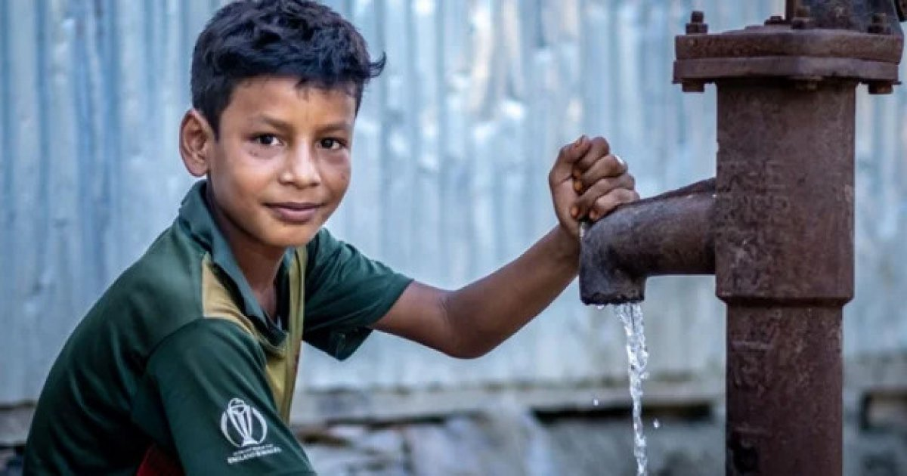
Eat fresh and clean food
Drink enough water

Slide 13

Pair Works
1. Write Three example (Good food)

Slide 14
Evaluation
Complete these sentences…
We should eat good food to_____
We should not eat more than__
Eating too much food is not _____
Good food means_________________
grow properly and stay healthy
what our body needs
good for health
the right kind of food for good health

Slide 15
Home Works
1. Write a summary of the passage in 05 sentence .

Slide 16
Thank’s For All

