Slide 1



Slide 2


Identity
Class:Three
Subject:English for today
Unit:3 Lessons:1
Todays lessons: Simple Commands,.
Page: 35
Time:50 minutes.
Nazmul Hossain
Assistant Teacher
Shaid Gafur Govt’ Primary School.
Paikgaccha,Khulna

Slide 3
Learning Outcomes
Students will be able to…..
1.3.1 Carry out commands and instructions in everyday life with appropriate gesture.
1.3.2 Respond to request properly.

Slide 4
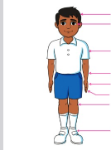


What can you see ?
Can you guess what we are going to learn today?
Today we will learn about.
Simple commands.

Slide 5
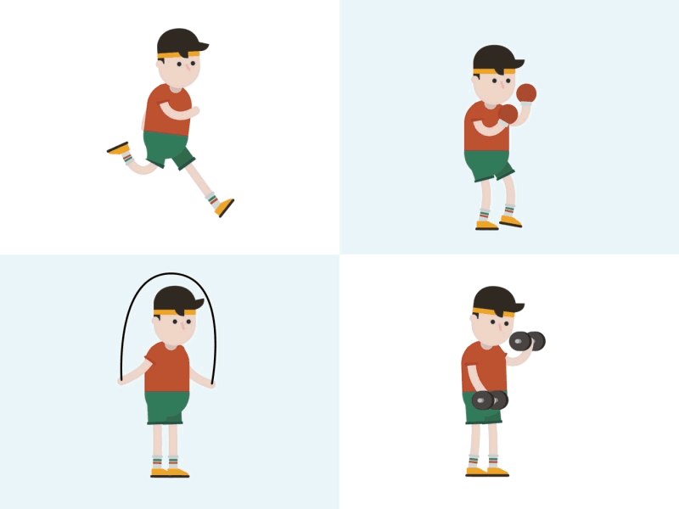
Exercise

Slide 6

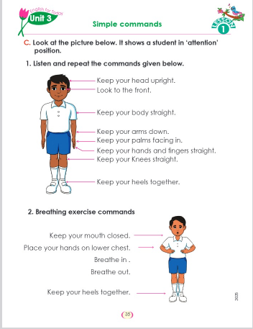
Open your English book at page- 35

Slide 7
Word meaning
Exercise
শারীরিক কসরত/ব্যায়াম
Breath out.
শ্বাস নেওয়া
Still
সোজা
Upright
সোজা করা
Breath in.
Give
দেওয়া
শ্বাস বন্ধ রাখা
Together
Heel
গোড়ালি
Mouth
মুখ
একত্রে
Head
হাত
পুনরাবৃত্তি করা
Repeat
Arm
বাহু
Straight
সোজা
Keep
রাখা
বুকের নিচের অংশ
Lower chest

Slide 8
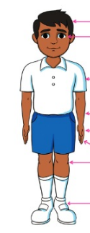
Simple commands.
1.Listen and repeat the commands given below.
Keep your head upright.
Look to the front.
Keep your body straight.
Keep your arms down.
Keep your arms palms facing in.
Keep your hands and fingers straight.
Keep your knees straight.
Keep your heels together.

Slide 9
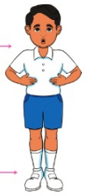
Breathing exercise commands.
Keep your mouth closed.
Place your hands on lower chest.
Breath in.
Breath out.
Keep your heels together.

Slide 10


