Slide 1


Slide 2

HSC
ENGLISH 1ST PAPER
Abdur Rahman
Lecturer in English
Nowhata Govt. Degree College
Paba, Rajshahi

Slide 3

Unit 2:
Art and Craft

Slide 4
What is Art?
Art is a broad and complex concept that refers to the expression or application of human creativity, imagination, and emotion through various forms and media. It includes disciplines like painting, sculpture, music, literature, dance, film, photography, and more.

Slide 5


Slide 6
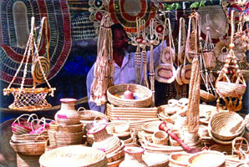

Slide 7
What is Craft?
Craft refers to the skillful creation of objects by hand, often with practical use, aesthetic value, or both. It emphasizes manual skill, technique, and tradition, and is typically associated with functional or decorative objects.

Slide 8
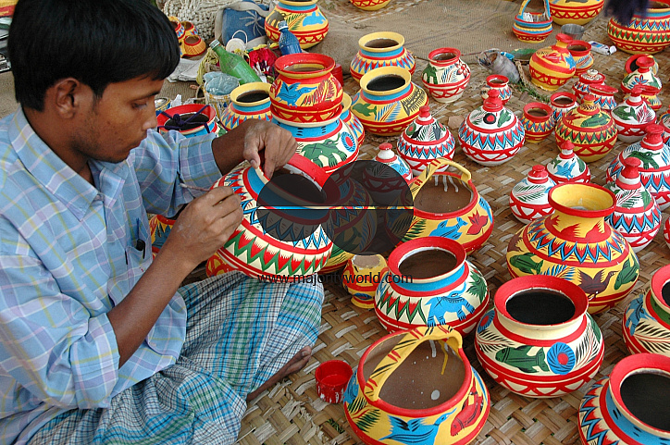

Slide 9
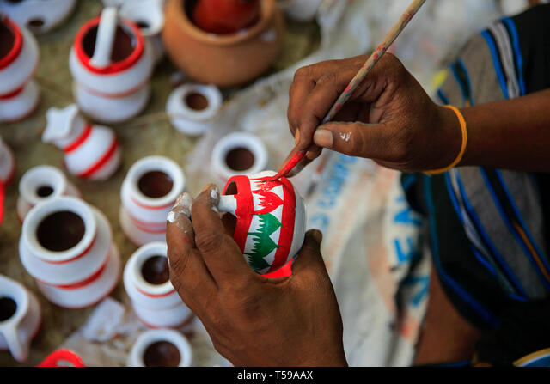

Slide 10
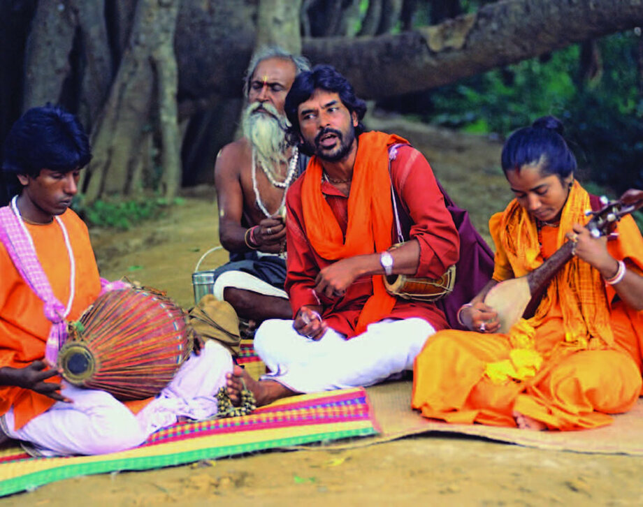
Lesson 2: Folk Music

Slide 11

_{READ THE TEXT CAREFULLY}

Slide 12
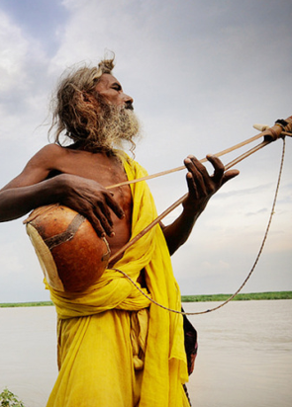
Folk music consists of songs and music of a community (সম্প্রদায়) that are uninfluenced (প্রভাবহীন) by any sophisticated (অত্যাধুনিক) musical rules or any standard music styles. Bangladesh has a heritage (ঐতিহ্য) of rich folk music which includes both religious and secular (ধর্মনিরপেক্ষ) songs.

Slide 13
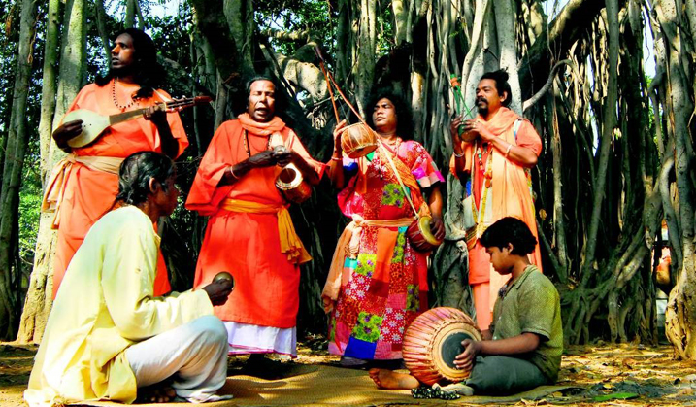

Slide 14
Folk music may be described as that type of ancient music which springs from the heart of a community, based on their natural style of classical (শাস্ত্রীয়) music and modern popular songs. Any mode or form created by the combination (সংমিশ্রণ) of tune, voice and dance may be described as music. Thus, the combination of folk song, folk dance and folk tune may be called folk music. For example, Baul songs are a combination of tune, music and dance.

Slide 15
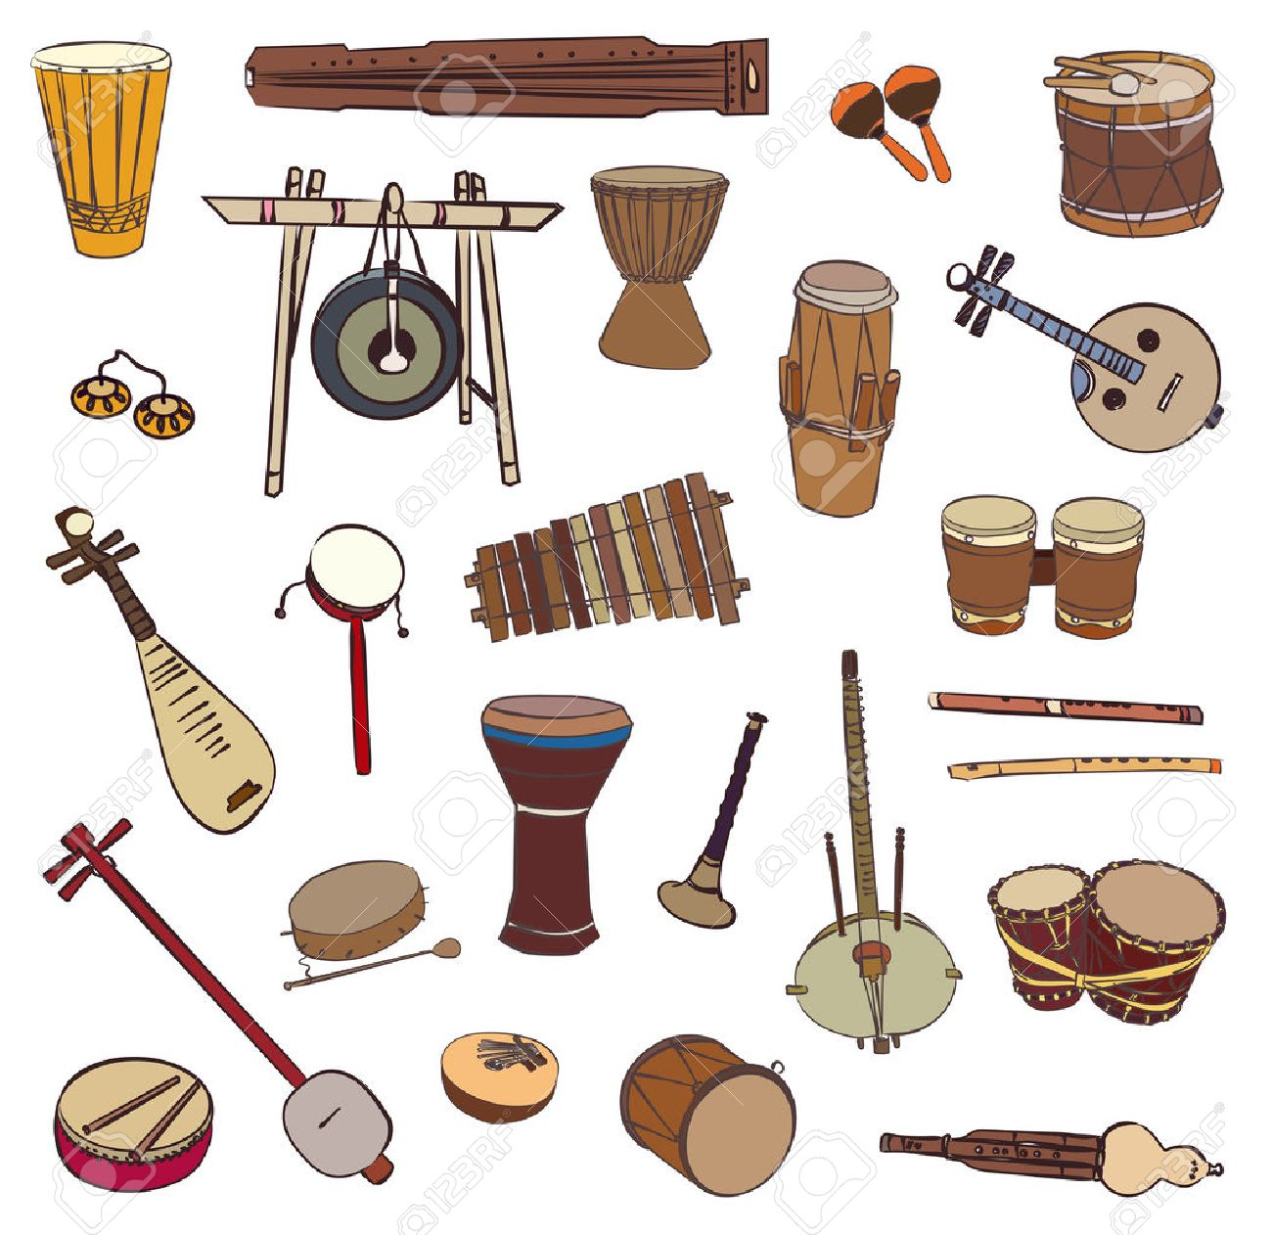

Slide 16
Folk music has the following characteristics:
It is composed by rural folk on the basis of ancient rules transmitted (প্রেরিত) orally;
These ancient rules of music have not been influenced by classical or modern music;
Folk songs may be sung in groups or individually;
No regular practice is required (প্রয়োজনীয়) for folk music;
It is composed and performed by illiterate (নিরক্ষর) or semi-literate people;

Slide 17
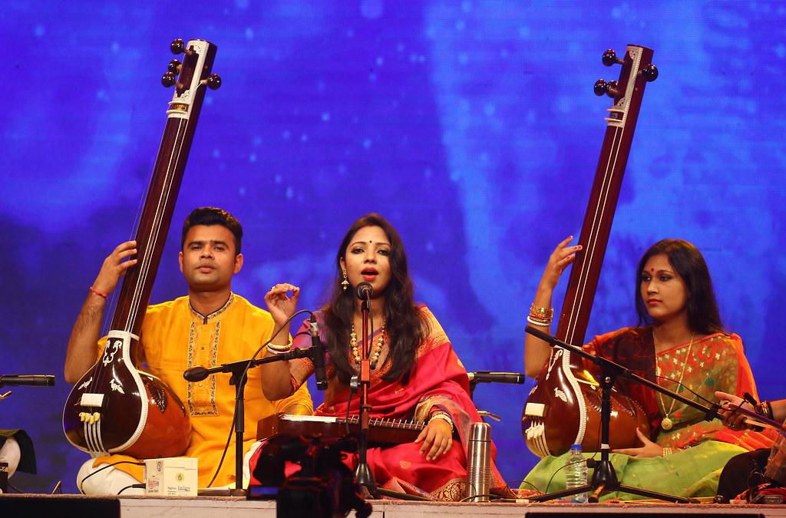

Slide 18
(vi) It is a spontaneous (স্বতঃস্ফূর্ত) expression in easy language, local dialect (স্থানীয় ভাষা), and simple tune;
(vii) Both words and tune are appealing (আবেদনময়);
(viii) despite its universal appeal it uses local dialect;
(ix) It depends upon nature and the rural environment;
(x) It is an explicit manifestation (অভিব্যক্তি) of the joys and sorrows of daily life;
(xi) It uses simple and natural rhythms (ছন্দ);
(xii) It contains a strong emotive expression of human love and separation (বিচ্ছেদ).

Slide 19
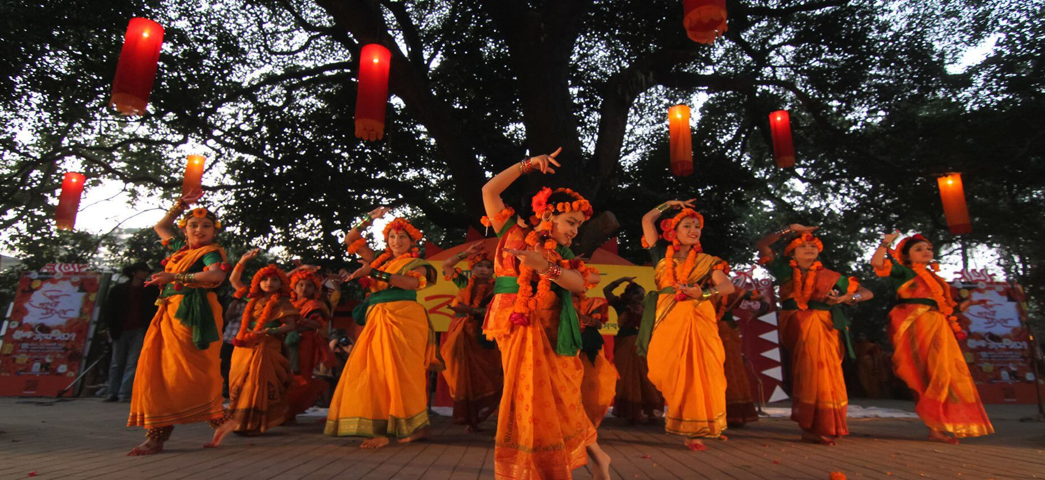

Slide 20
In Bangladesh folk music has great variety (বৈচিত্র্য), with songs being composed on the culture, festivals, views of life, natural beauty, rivers and rural and riverine (নদীপথ) life. These songs are also about social inequality and poverty, about the material world and the supernatural (অতিপ্রাকৃত). Mystical (রহস্যময়) songs have been composed using the metaphors (রূপক) of rivers and boats. Since the country is basically riverine, the Bhatiyali forms an important genre (ধরন) of folk music.

Slide 21
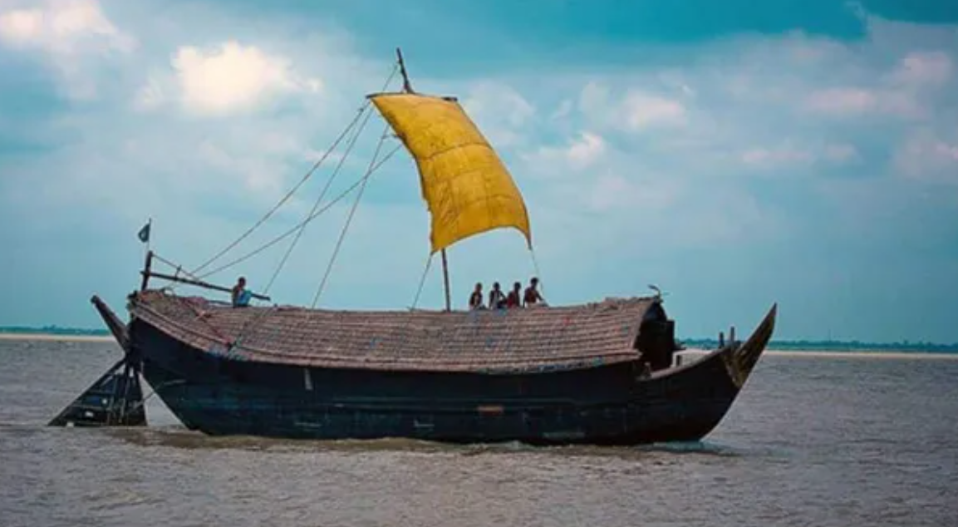

Slide 22
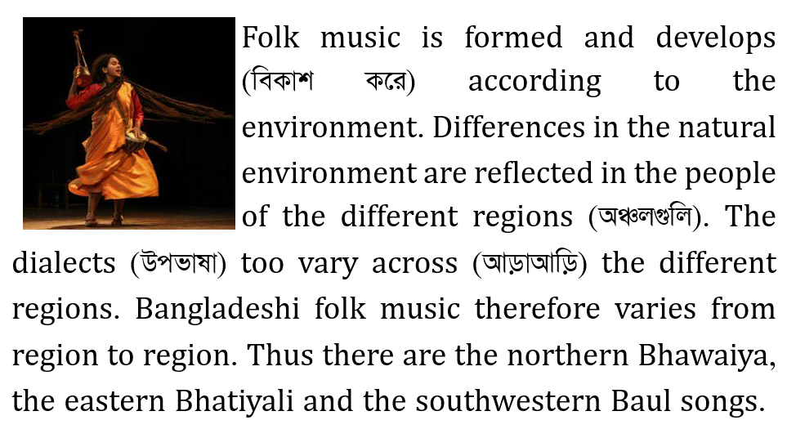

Slide 23
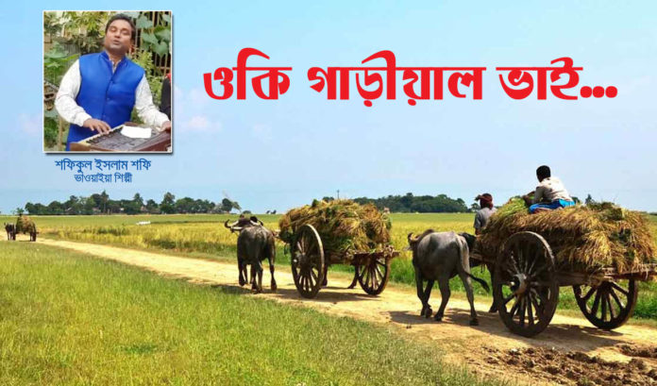

Slide 24
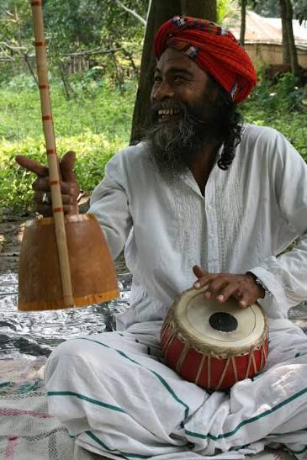
The culture and the lifestyle (জীবনধারা) of the different tribes have also influenced folk music. Tribes like the Santal, Garo, Hajong, Chakma, Manipuri, Tripuri, Manna etc. have interacted (মিথস্ক্রিয়া) with ethnic (জাতিগত) Bengali culture and lifestyle over the years. The interaction has been clearly reflected in the richness of folk music.

Slide 25
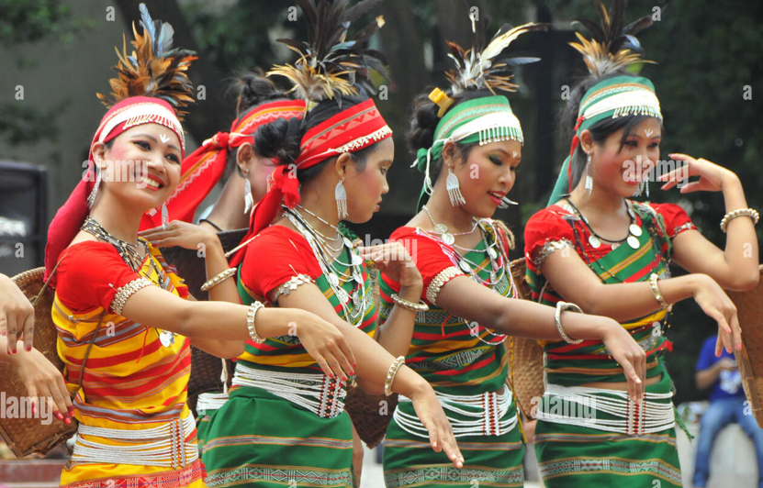

Slide 26
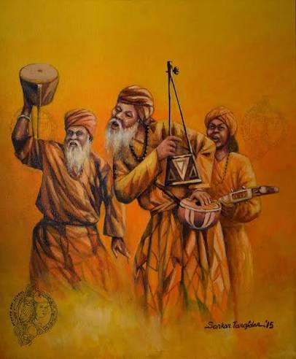
Folk songs may be sung individually or in chorus (গায়কদল). Folk songs sung individually include Baul, Bhatiyali, Murshidi and Marfati, while songs sung in chorus include Kabigan, Leto, Alkap and Gambhira. Some songs are regional in character, but others are common to both Bangladesh and West Bengal.

Slide 27
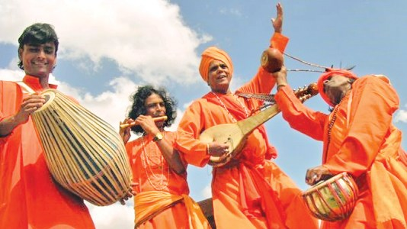

Slide 28
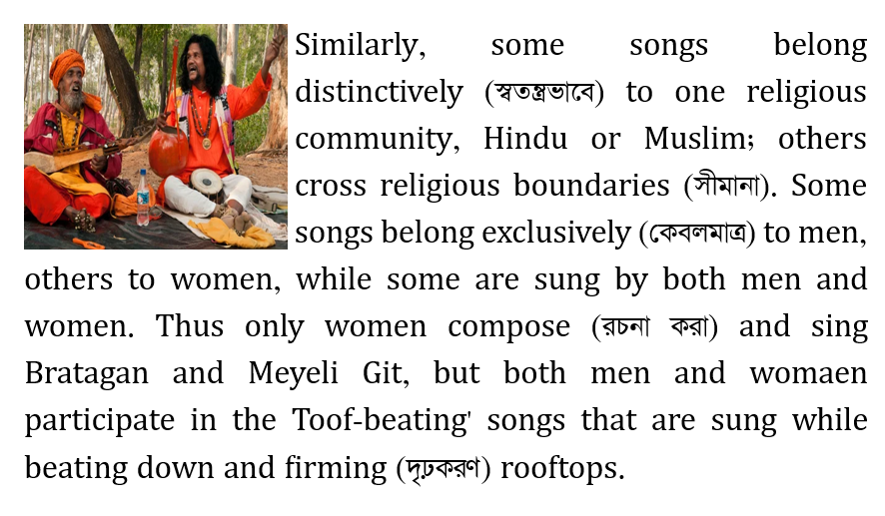

Slide 29
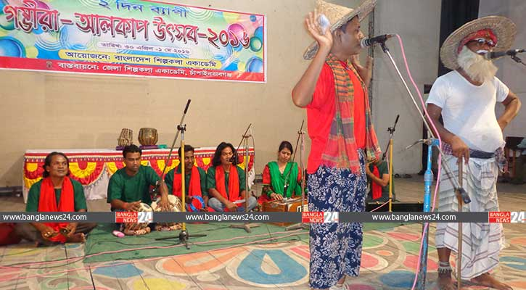

Slide 30
Different folk songs belonging to different regions of Bangladesh are listed below:
Baul songs : Birbhum and Kushtia
Spiritual songs : Birbhum and Kushtia
Jarigan : Dhaka, Mymensingh, Sylhet, Faridpur, Murshidabad.
Bhawaiya : Cooch Bihar, Rajshahi, Dinajpur, Rangpur, Pabna.
Gambhira : Rajshahi, Malda.
Wedding songs : all regions.
Roof-beating songs: the northern regions of Bangladesh.
Sari : the lower marshy regions of Sylhet and Mymensingh.
Bhatiyali : nearly all regions of Bangladesh.
Pastoral songs : Dhaka, Mymensingh, Faridpur, Sylhet, Habiganj.

Slide 31
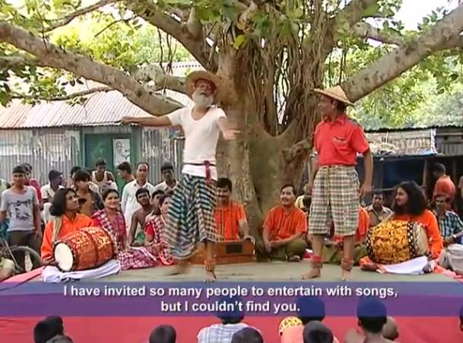

Slide 32
GROUP DISCUSSION
What type of folk music present in your locality?

Slide 33

What are the characteristics of folk music?
What does folk music consist of?
What kind of folk music does Bangladesh have?
How can folk music be described?
What may be described as music?
What may be called folk music? Describe with examples

Slide 34
Choose the best Answer
1. The word sophisticated mentioned in the passage means.
  (i) uncultured (ii) rustic
  (iii) indigenous (iv) refined
  Ans. (iv) refined

Slide 35
2. The word community mentioned in the passage means.
  (i) individual (ii) society
  (iii) singular (iv) singleton
  Ans. (ii) society

Slide 36
3. The word characteristic mentioned in the passage means.
  (i) untypical (ii) theme
  (iii) idea (iv) feature
  Ans. (iv) feature

Slide 37
4. The word influence mentioned in the passage means.
  (i) impact (ii) limit
  (iii) restrain (iv) rule
  Ans. (i) impact

Slide 38
5. Folk music is the combination of……….
  (i) folk song (ii) folk dance
  (iii) folk tune (iv) All of the above
  Ans. (iv) All of the above

Slide 39


