Slide 1



Slide 2

WELCOME

Slide 3

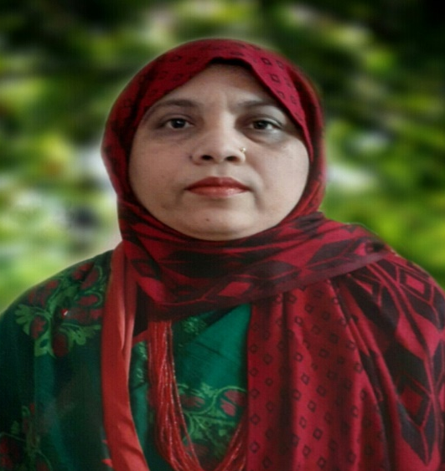
IDENTITY
Muktamony
Head teacher
Atashia Government Primary School
Shibpur , Narsingdi.
Title –Get Ready to Listen
Class - Five
Subject- English
Unit-9 , Page- 47-48
Lesson- 1 (1.1,1.2) Look---day
Time-40 minutes
Date---/06/2026

Slide 4
Learning Outcomes:
Students will be able to -
Listening:
1.2.1 recognize which syllable in a word is stressed.
1.3.1 recognize which word in a sentences are stressed.
Speaking:
1.1.2 say sentences with proper intonation.
6.1.2 say what other are doing.
6.2.1 talk about people, objects, events etc.
Reading:
1.7.1 read paragraphs, dialogoues , stories, letter and other text.
5.1.1 read silently with understanding paragraph.
7.1.1 recognize punctuation marks and read accordingly.

Slide 5
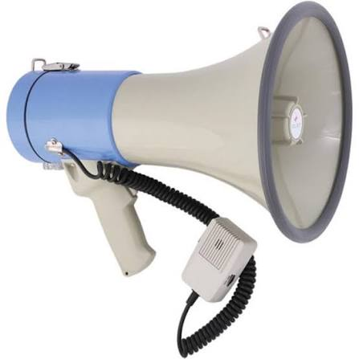

Look at the picture?
Why do we use it ? Where did you see it ? So What do we do then when we hear a voice ?

Slide 6
Our today’s lesson-
Get Ready to Listen

Slide 7
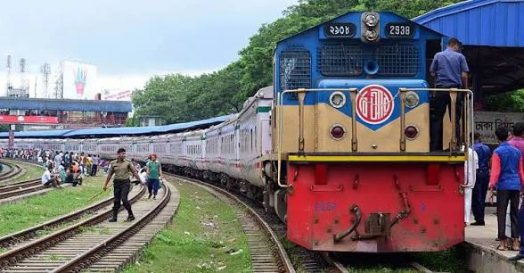
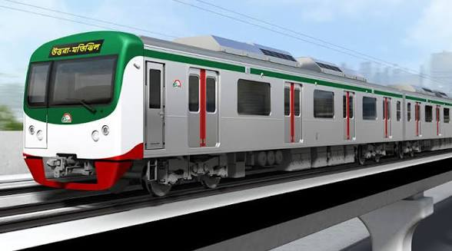
What can you see in this picture ?
Train station and Metro train

Slide 8
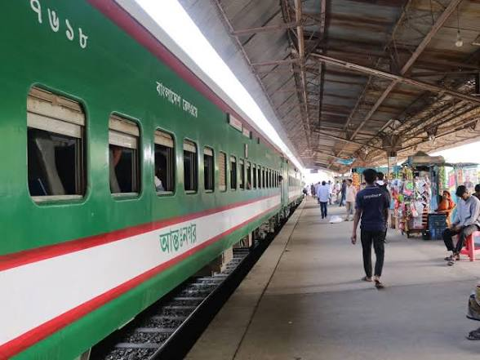
a)Have you ever listened to any announcements at these places ?
a. Yes, I have listened to many announcements at these places.

Slide 9
b) What are the announcements about ? Please ,share with your class ?
b)The announcements are about the arrival or the departure of train . Once I was going to Dhaka from Narsingdi with my father . We are waiting at the station for our coach . Suddenly I heard a voice in the loudspeaker. The station master was announcing about the arrival of the train bound to Dhaka.

Slide 10
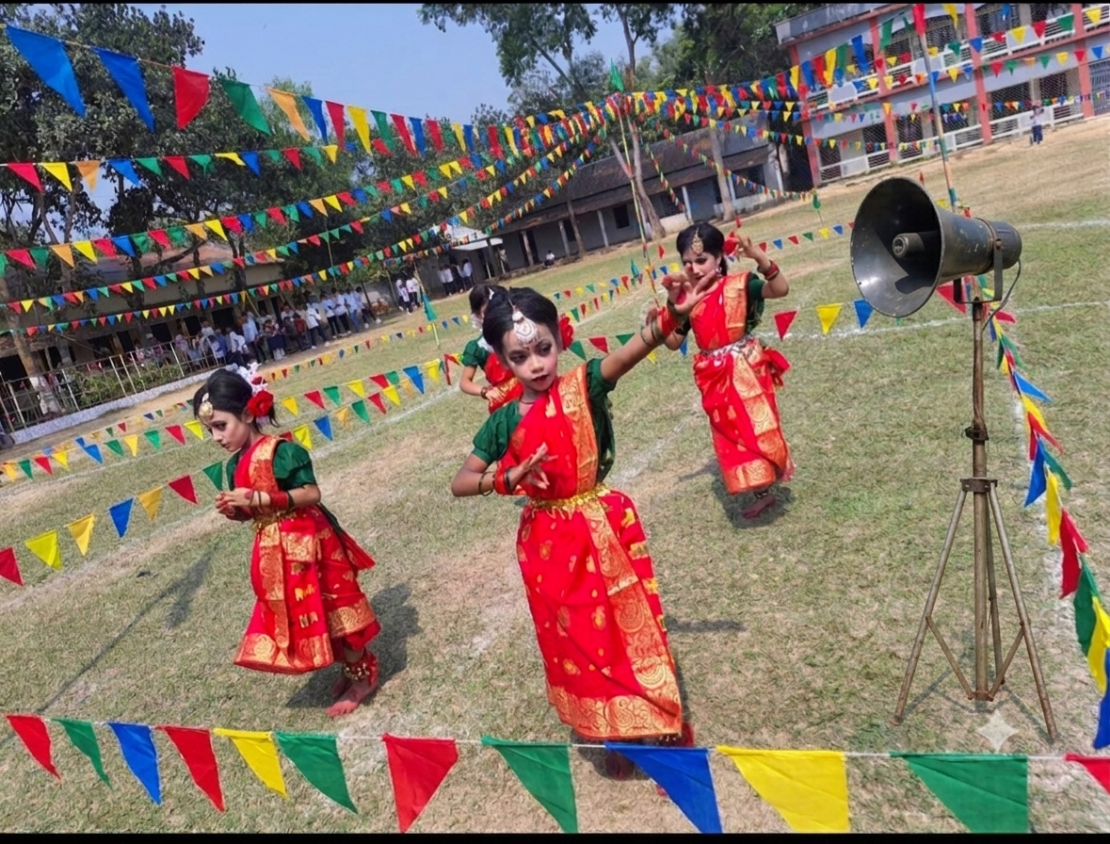

Slide 11
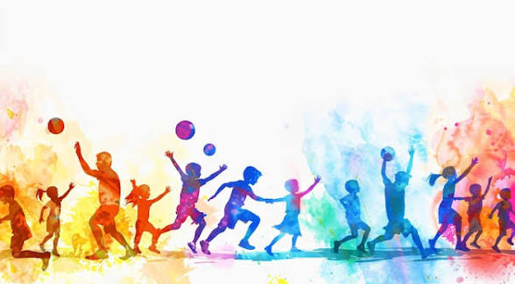





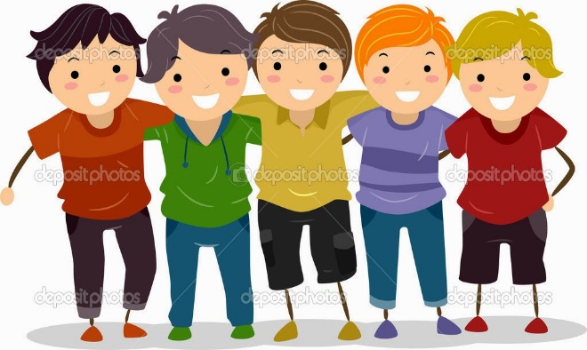
Today is annual sports day at Sumon’s school. The school field is decorated with colourful flags. Sumon and his friends are waiting at the corner of the field.
Annual Sports day at school

Slide 12
Attention please !
Good morning, everyone ! Welcome to our Annual sports Day ! I have an important announcement for you. Please listen carefully and follow the instructions.

Slide 13
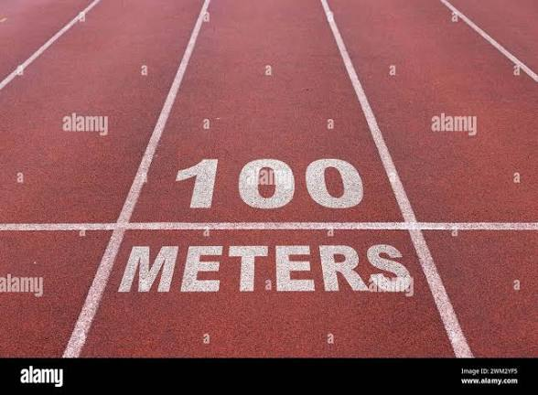
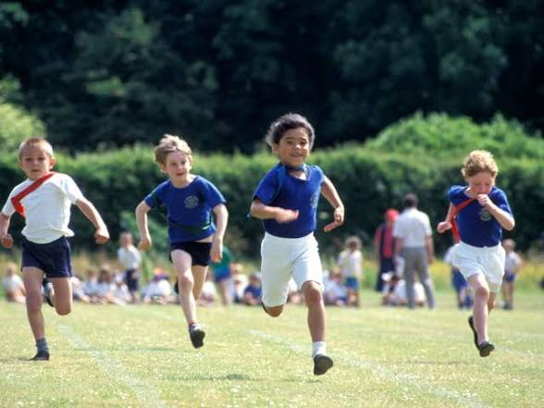
First, there will be a 100-meter race.

Slide 14

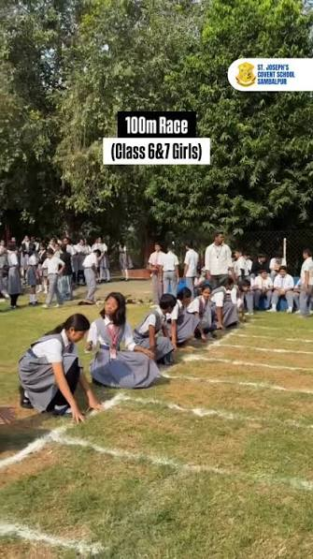
West side
Girls participating in 100-meter race, please go to the green flag area. The flag is west side of the field. Your race will start at half past nine (9:30 a.m .) . That’s in about 15 minutes. So, get ready !

Slide 15
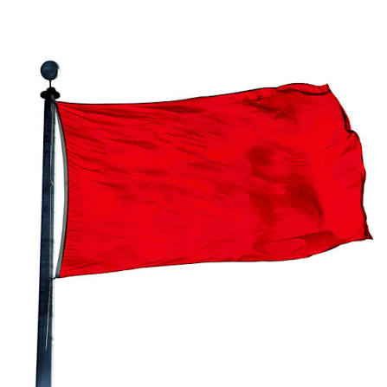
East side
Boys, your 100-meter race will be starting from quarter to ten ( 9: 45a.m.). Please go to the east side of the field marked with a red flag.

Slide 16
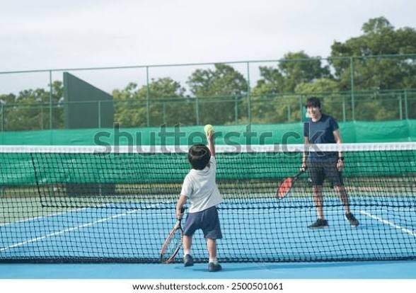
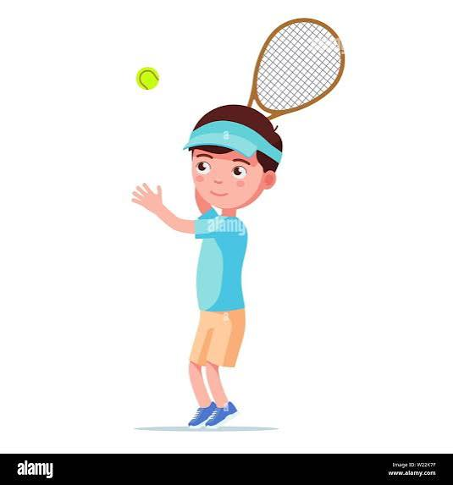
South side
Next, the event will be a tennis ball throw . All the boys participating in the tennis ball throw , please go to the blue flag area . The flag is on the south side of the field .Your event will begin at quarter past ten (10:15 a.m. )

Slide 17
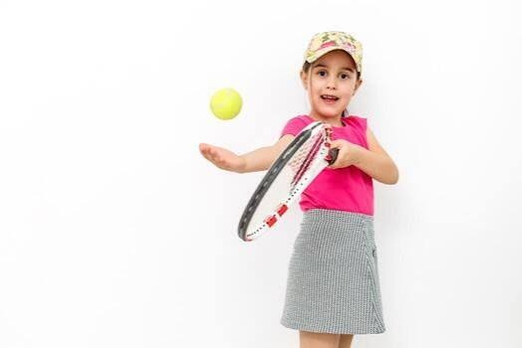
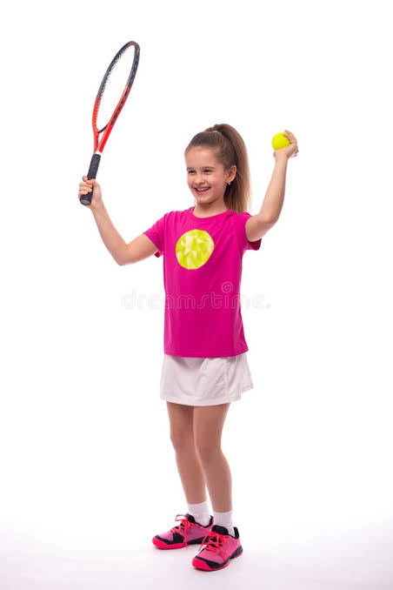
North side
Your event will begin at quarter past ten (10:15a.m. ). Girls , your tennis ball throw will take take place at the yellow flag marked north side of the field at half past ten (10:30 a.m. ).

Slide 18
New words
Annual -বার্ষিক-related to year
Decorated -সুসজ্জিত-something is made to look more attractive
Excited -উত্তেজিত-very enthusiastic
Attend -যোগ দেওয়া-participate
Important -গুরুত্বপূর্ণ- essential
Annoucement -ঘোষণা- declaration
Instruction -নির্দেশনা- direction

Slide 19
Open your book at page no 47-48 .
Model reading
Individual reading

Slide 20

One day one word
Flag-পতাকা
The school field is decorated with colourful flag.

Slide 21
Fill in the blanks with the appropriate word from the text/ box.
Today is the ---------------------- sports day at Sumon’s school.
b. The school field is decorated with ---------------------- flags.
c. They are happy and excited to -------------------in the events,
d. The voice in the loudspeaker drew their -------------------- .
e. Sumon shout, ‘Let’s go , ------------------ !’
annual
colourful
participate
attention
friends

Slide 22

Choose the correct answer from the alternative.
What is happening today at Sumons’s school ?
Annuai debate b. annual sports day
c. Annual examination d, annual meeting
The school field is decorated with colourful --------
A. festoon b. banner c. poster d. flags
iii. Where are Sumon and his friends waiting ?
Corner of the field b. behind the flag
c. in front of the school d. In the school playground
iv. Why are they happy ?
To win in the sports b. to attend the events
c. To hear the announcement d. to see the prizes
What did the voice in the loudspeaker do ?
a. drew their attention b. Stopped their conversation
c. Obstruct their activities d. disturb their attention

Slide 23
What is the announcements about ?
Answer: The announcements is about the events of the annual sports day .
b)When do the girls have their 100 –meter race ?
Answer: The girls have their 100 –meter race at half past nine.
c)Where should the boys go for the 100- meter race ?
Answer: The boys should go to the east side of the field marked with a red flag for the 100-meter race.
d) What colour flag is marked for boys tennis ball throw ?
Answer: Blue coiour flag is marked for boys tennis ball throw.
e) Where should the girls go for the tennis ball throw ?
Answer: The girls should go to the north side of the field marked with yellow flag for tennis ball throw.
f) What are the main events announced for the annual sports day ?
Answer: The main events announced for the annual sports day are 100- meter race for boys, 100- meter race for girls, tennis ball throw for boys and tennis ball throw for girls,

Slide 24
Make sentences:
Annual- Today is the annual sports day at sima’s school.
Decorated- The school field is decorated with colourful flag.
Announcement- I have an important announcement for you.
Instruction- Please listen carefully and follow the instructions.
Important- I have an important announcement for you.

Slide 25
Group Work
Group -100 meter race
Group –Tennis ball throw
Write an Announcement
Write an Announcement

Slide 26

Home Work
1.Write at least 5 sentences about ‘The annual sports day at your school.’

Slide 27
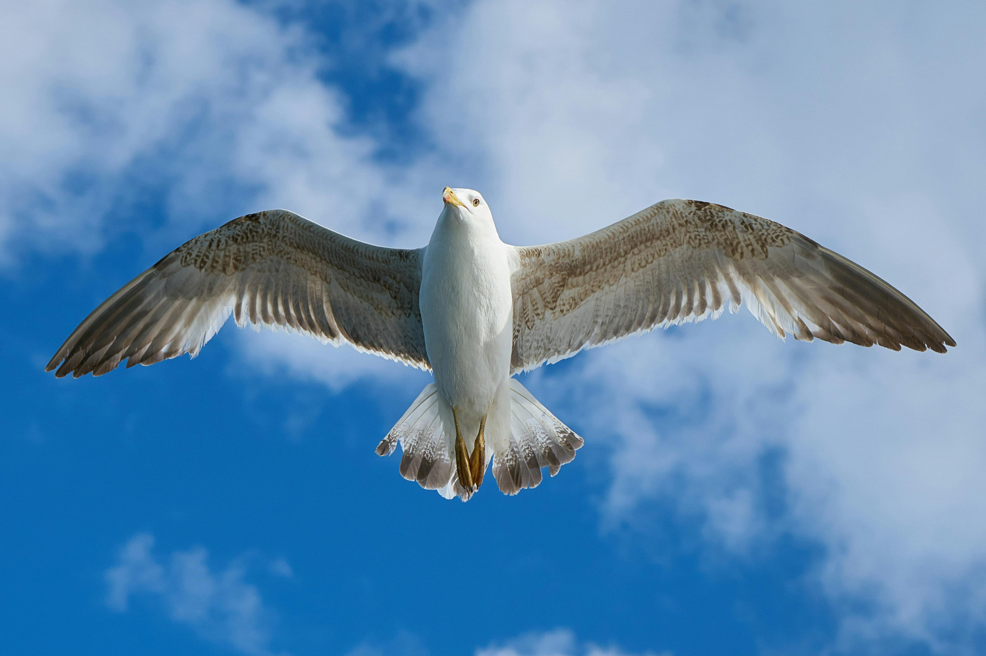
GOODBYE

