Slide 1


Slide 2

Teacher’s Identity
Subarna Sarker
Assistant Teacher
Saduria.Govt.Primary School.
Hakimpur,Dinajpur

Slide 3

Lesson Identity
Class-Five
Subject-English
Unit- 7
Lesson-34

Slide 4
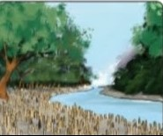


Lets see some pictures
What do you see in the pictures?
Where does the Royal Bengal Tiger live?
Have you ever visited a forest?

Slide 5

Lesson Decleration
Now we are going to read a passage about-

Slide 6

“The Sundarbans”

Slide 7
Teaching New Words
Waves
Wildlife
Costal
Beauty
Erosion

Slide 8

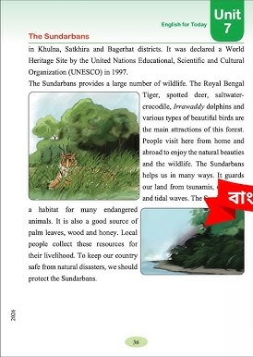
Teacher’s Loud Reading

Slide 9
Listening Test
The Sundarbans is a large forest of mangrove trees in Bangladesh. It protects our country in many ways. The strong roots of the mangrove trees save the land from the big waves.
What is the Sundarbans?
In which country is the Sundarbans located?
What type of trees make up this large forest?
The roots keep our lands safe from costal erosion.The Sundarbans is in the southwestern part of Bangladesh.It is located in Khulna, Satkhira and Bagerhat districts.
Where is the Sundarbans located?
What part of trees keep the land safr?
From which three districts Sundarbans is found?

Slide 10




Group Work
The Sundarbans is a large forest of mangrove trees in Bangladesh. It protects our country in many ways. The strong roots of the mangrove trees save the land from the big waves.
It was declared a World Heritage Site by the United Nations Educational, Scientific and Cultural Organization(UNESCO) in 1997.The Sundarbans provides a large number of wildlife.
The roots keep our lands safe from costal erosion.The Sundarbans is in the southwestern part of Bangladesh.It is located in Khulna, Satkhira and Bagerhat districts.
The Royal Bengal Tiger, spotted deer, saltwater-crocodile, Irrawaddy dolphins and various types of beautiful birds are the main attractions of this forest. People visit here from home and abroad to enjoy the natural beauties and the wildlife. The Sundarbans helps us in many ways. It gurds our land from tsunamis, cyclones, and tidal waves.
The Sundarbans is a habitat for many endangered animals. It is also a good source of palm leaves, wood and honey. Local people collect these resources for their livelihood. To keep our country safe from natural disasters, we should protect the Sundarbans.

Slide 11

Assessment
Write 5 sentences about Sundarbans

Slide 12
Summary Of the Text
The Sundarbans is the largest mangrove forest in our country.It is located in Khulna, Satkhira and Bagerhat district.It got it’s prestige as a World Heritage Site by (UNESCO) in 1997.The Royal Bengal Tiger, spotted deer, crocodile, dolphins are the main wildlife in the forest.S undarbans saves us from natural disasters like tsunamis, cyclones and tidal waves. We should take necessary steps for protecting the Sundarbans.

