Slide 1
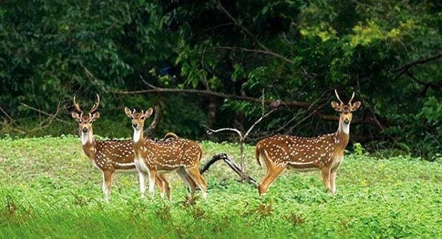

Slide 2


Slide 3
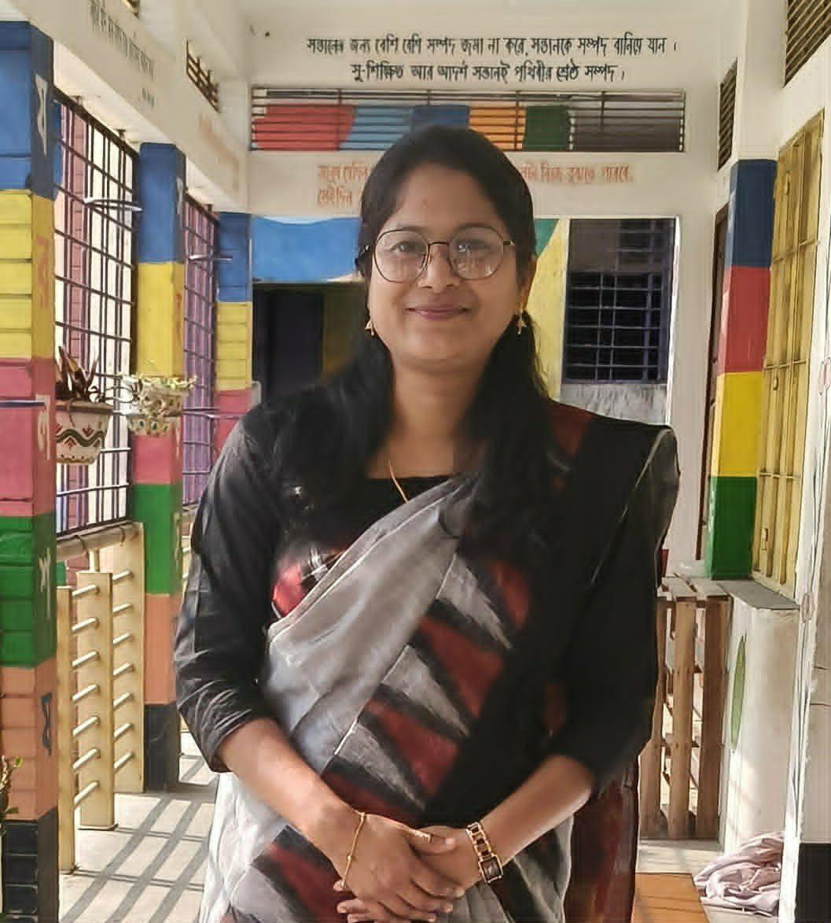
Teacher’s Identity
Subarna Sarker
Assistant Teacher
Saduria.Govt.Primary School.
Hakimpur,Dinajpur

Slide 4
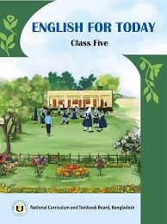
Lesson Identity
Class-Five
Subject-English
Unit- 7
Lesson-36

Slide 5

Review of the previous session
In what ways Sunsarbans help us?

Slide 6

Tittle Decleration
How the Sundarbans help us
Now we will make a list about that

Slide 7




Group Work
The Sundarbans is a large forest of mangrove trees in Bangladesh. It protects our country in many ways. The strong roots of the mangrove trees save the land from the big waves.
It was declared a World Heritage Site by the United Nations Educational, Scientific and Cultural Organization(UNESCO) in 1997.The Sundarbans provides a large number of wildlife.
The roots keep our lands safe from costal erosion.The Sundarbans is in the southwestern part of Bangladesh.It is located in Khulna, Satkhira and Bagerhat districts.
The Royal Bengal Tiger, spotted deer, saltwater-crocodile, Irrawaddy dolphins and various types of beautiful birds are the main attractions of this forest. People visit here from home and abroad to enjoy the natural beauties and the wildlife. The Sundarbans helps us in many ways. It gurds our land from tsunamis, cyclones, and tidal waves.
The Sundarbans is a habitat for many endangered animals. It is also a good source of palm leaves, wood and honey. Local people collect these resources for their livelihood. To keep our country safe from natural disasters, we should protect the Sundarbans.

Slide 8

Group Work
How the Sundarbans help us
How the Sundarbans help us
How the Sundarbans help us
How the Sundarbans help us

Slide 9

Presenting group work by group leader

Slide 10

The ways Sundarbans help us-
Sundarbans help us by saving our land from the big waves.
Sundarbans keep our land from costal erosion.
It provides a large number of wildlife like:tiger, deer,dolphins,crocodile,various birds.
We can get palm leaves, honey, and wood from sundarbans.
Sundarbans give us unlimited natural beauties.

Slide 11

Assessment
Write the ways how do Sundarbans help us in 5 sentences on your exercise book

Slide 12
Summary Of the Session
What have we learnt today?
Today we have learnt how to identify specific information and use them to make a meaningful sentence.

Slide 13

Homework
Write at least 10 sentences about “UNESCO”

Slide 14


