Slide 1
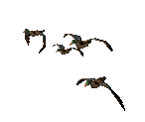



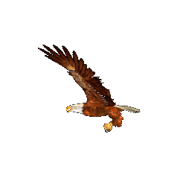



Good morning

Slide 2
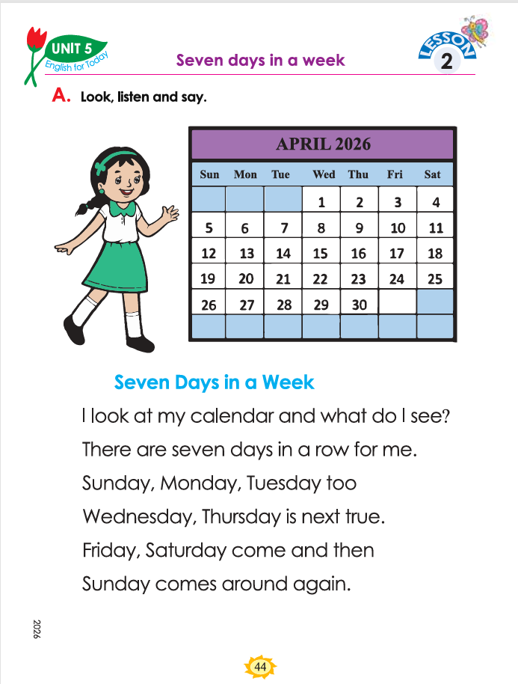


Identity
Teacher
Lesson
Dewan Rezaul Hassan
(Assistant Teacher)
Baropakhia Rothindrapara GPS
Delduar, Tangail.
E-mail:drezaulhassan@gmail.com
Class: Two
Subject: English
Unit:5:: Days in a Week
Lesson:2-Seven Days In a Week Session:44
Period:66, Activity: B,C, Page: 45
Heading: (Seven Days of the Week)

Slide 3
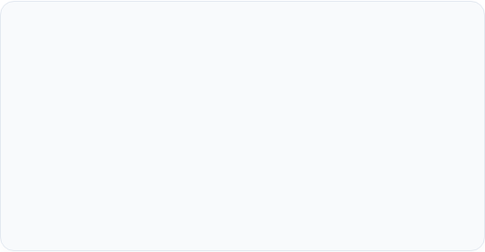
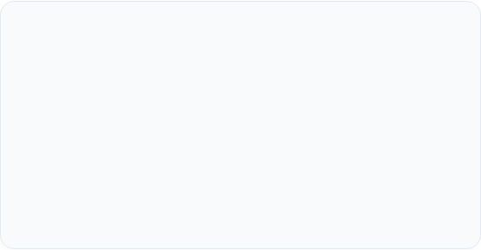
Learning & Session Overview
Key Learning Outcome
Teaching Materials & Aids
To deliver an engaging and interactive session, please prepare:
Lesson 2: 'Seven Days in a Week'
Session
Learning Outcomes
Session 44: В, С
7.4.1 Write familiar words neatly and legibly.
Page: 46
•
A colorful classroom calendar
•
English For Today Class 2 Textbook (Page 44)
Audio player/video clips (where possible)
•
•
Days of the Week visual cards
Baropakhia Rothindrapara GPS
Slide 2

Slide 4

Let’s listen and act with the rhyme “good morning”

Slide 5
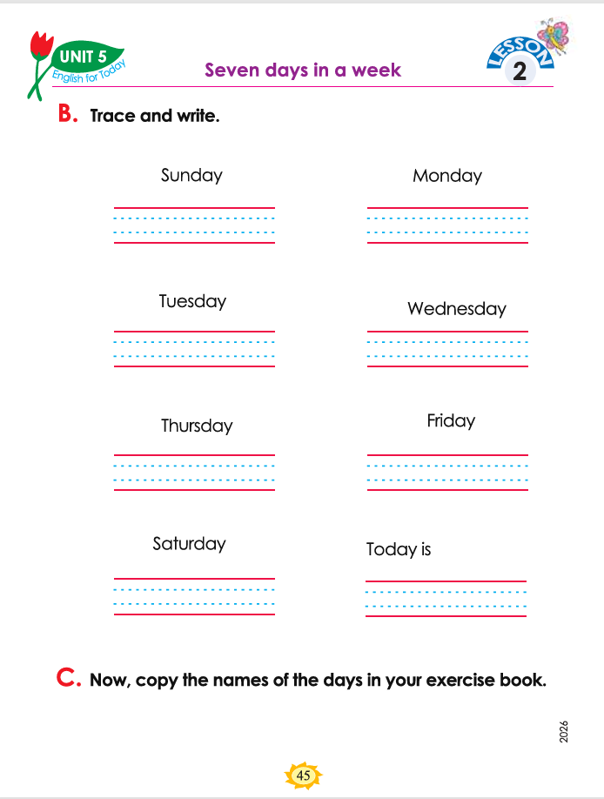
Session Duration: 45 Mins
Seven Days of the Week
Unit 5 • Lesson 2 • Session 44
Page:45, (B,C),

Slide 6
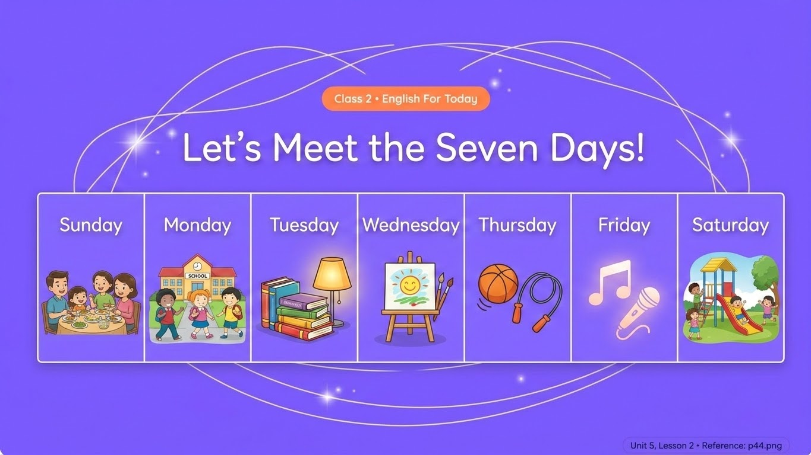




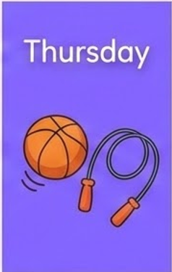



Slide 7


Slide 8



Welcome Back, Friends!
Let's Wave and Say Hello! 👋
Look at the person sitting next to you, give them your biggest smile, and say: "How are you today?"
Can you recite the names of the 7 Days?
Memory Challenge: Who remembers our rhyme "Seven Days in a Week"? Let's stand up and sing it together with clapping! 👏
Let's call them out in order together! starting with Sunday...

Slide 9

Trace in the Air with Me!
How to Write on 4 Lines:
Observe the board carefully! Capital letters start at the top red line and go down to the second blue line.
Sunday
Sunday
Step 1: Raise your magic writing finger!
Step 2: Follow my finger in the air as we draw each letter!
Watch the orange cursor trace correctly from top-to-bottom!

Slide 10


The Partner Writing Check!
Partner 1: Tracing Star!
Partner 2: Tracing Star!
Open your book to Page 45. Trace the first three days:
Now, exchange the book or swap roles! Trace the next three days:
Sunday
Monday
Wednesday
Tuesday
Thursday
Friday
Partner 2 will watch you and check if you stay on the lines!
Help each other to trace properly and neatly!

Slide 11






Let's Trace & Write inside the Book!
Now, let's work quietly! Grab your sharpest pencil and look at Activity B.
Writing Practice Grid
Trace the grey dashed letters first, and then write the word by yourself on the line right under it!

Slide 12


Solve the Day's Puzzle! 🧩
Look at the bottom of Page 45:
"Today is "
(Students, think! What is the name of today? Write it down neatly in the empty book lines!)

Slide 13
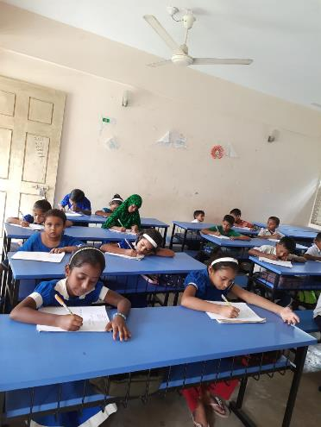
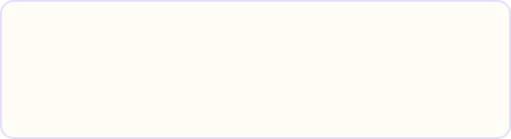
Now, Copy into Your Notebooks!
Activity C Challenge:
Open your lovely writing notebooks. Copy all seven days in a neat list! 📝
Champion Checklist:
• Capital letter at the start of each day.
• Proper gap between the letters.
• Smooth, neat loops for 'y' and 'g' letters!

Slide 14





Swap, Look, and Smile! 👭
How to play the Notebook Swap:
Award your Friend!
1. Finish your writing and gently slide your exercise book to your neighbor.
If your neighbor wrote neat letters, give them one of these awards on the top corner of their page:
2. Pick up a color pencil or a regular pencil.
3. Look at your neighbor's handwriting carefully.
"Are the letters neat and aligned on the lines?"

Slide 15

How Awesome Did We Write Today?
Writing Goal | Our Fun Target | My Star Level Today!
Tracing Challenge | I traced all the days in my book without going off the line. | 😊 😊 😊 Three Smiles!
Neat Writing | I wrote letters that are neat, clear, and very easy to read. | ⭐ ⭐ ⭐ Super Star!
Helping my Friends | I checked my classmate's notebook nicely and gave positive feedback! | 🙌 🙌 🙌 Great Friend!

Slide 16
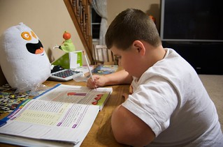
Home work
You will write seven days of the week.

Slide 17





Thanks
for
watching?

