Slide 1



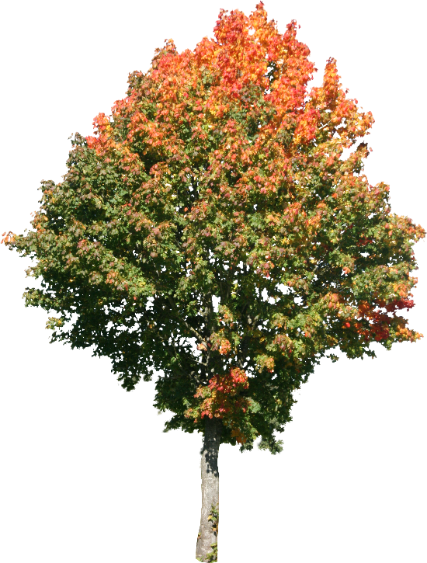
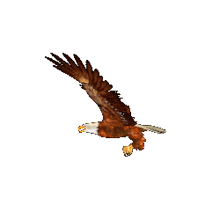



Good morning

Slide 2
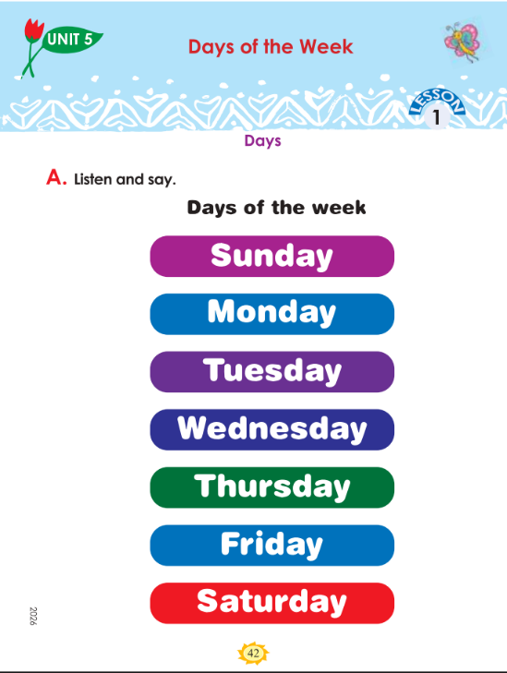
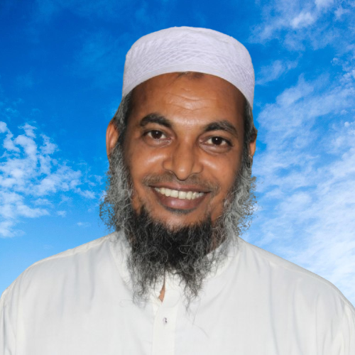

Identity
Teacher
Lesson
Dewan Rezaul Hassan
(Assistant Teacher)
Baropakhia Rothindrapara GPS
Delduar, Tangail.
E-mail:drezaulhassan@gmail.com
Class: Two
Subject: English
Unit:5:: Sport Lesson:1-Days, Session:42
Page: 42,43 (Period:5, Text Part: A,B)
Heading: (Days of the week)

Slide 3
Learning outcomes: Students will be able to
  8.1.1 Recognize familiar words in everyday conversations.

Slide 4

Let’s listen and act with the rhyme “good morning”

Slide 5
Session Duration: 45 Mins
Days of the Week
Unit 5 • Lesson 1 • Session 42 (A, B)

Slide 6
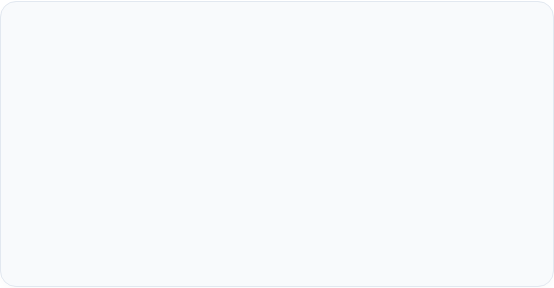
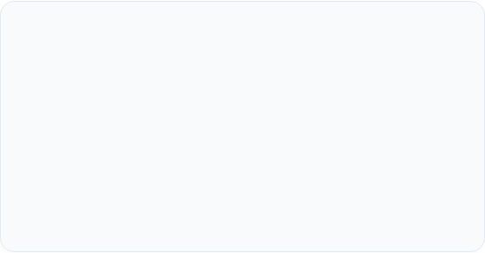
Learning & Session Overview
Key Learning Outcome
Teaching Materials & Aids
LO 8.1.1: Recognize familiar words in everyday conversations.
To deliver an engaging and interactive session, please prepare:
Students will learn to recognize and recall the names of the seven days of the week when spoken or read in everyday classroom scenarios.
•
English For Today Class 2 Textbook (Pages 43-44)
•
A colorful classroom calendar
•
Audio player/video clips (where possible)
•
Days of the Week visual cards
Baropakhia Rothindrapara GPS
Slide 2

Slide 7

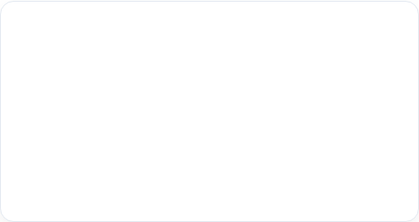
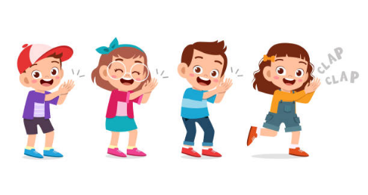
Welcome & Rhyme Warm-Up
Exchange greetings with a warm, smiling face!
Start the session by setting a positive, interactive classroom atmosphere.
Warm-up Rhyme Activity
Begin with a rhythmic 'Days of the Week' chant to active students' memory:
Sing along with simple hand movements.
Encourage the children to clap as they hear day names.
Review the previous session: Ask them what they learned!
Baropakhia Rothindrapara GPS
Slide 3

Slide 8

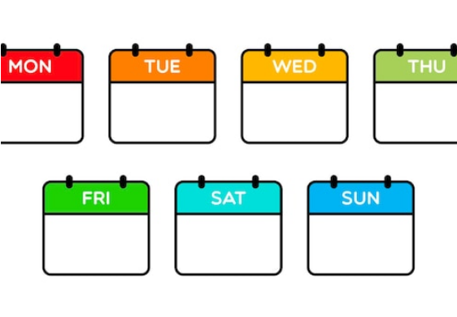
Show and Tell: The Calendar
Spot the Date!
Introduce the calendar to make the lesson real-world and contextually relevant:
Ask: "What do you see here?"
Help students identify Months, Days, and Dates.
Transition: "We are going to learn the Days of the Week, and today's lesson is Days."
Baropakhia Rothindrapara GPS
Slide 4

Slide 9
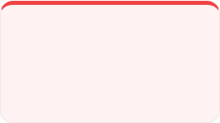
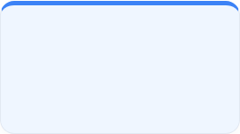
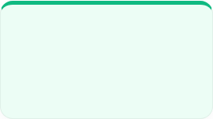



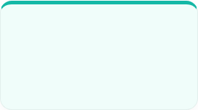

Days of the Week Pronunciation
Play audio / speak with clear pronunciation. Direct students: "Listen to me, then repeat after me."
DAY 1
DAY 2
DAY 3
DAY 4
Sunday
Monday
Tuesday
Wednesday
DAY 5
DAY 6
DAY 7
My Week!
Thursday
Friday
Saturday
7 DAYS TOTAL
Baropakhia Rothindrapara GPS
Slide 5

Slide 10
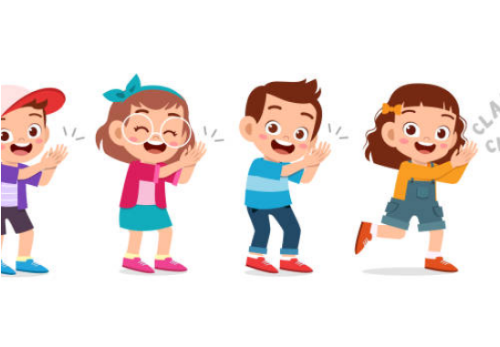
Active Practice: Clapping Rhythms
Clap & Say!
Combine sound and physical activity to reinforce retention:
Clap with the syllable rhythm of each day name.
Instruct: "Listen to me, then follow and repeat after me."
Select individual students who can proudly state the days.
Baropakhia Rothindrapara GPS
Slide 6

Slide 11

Interactive Roles: Seven Days Card
Seven Little Days
A delightful, interactive method straight from the TG:
Invite 7 students to the front.
Each representing one day: Sunday through Saturday.
Tell them: "Say your day's name one by one."
The rest of the class repeats: "Follow and repeat after them!"
Baropakhia Rothindrapara GPS
Slide 7

Slide 12
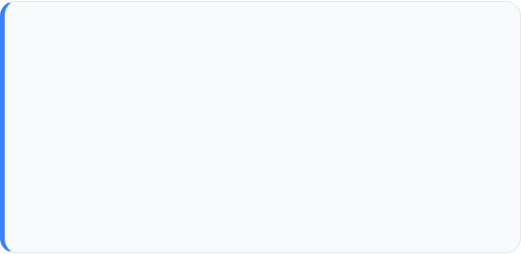

Classroom Group & Pair Activities
Group Activity
Pair Work
Divide students into small groups:
Divide into desk pairs (S1 & S2):
"In each group, one student will say the days of the week with proper pronunciation, while the others listen and repeat. Swap roles and repeat."
"S1 tells S2 the names of the days, and S2 repeats. Then, switch roles: S2 will lead and S1 will repeat. Continue until fluent!"
Teacher monitors and helps.
Support struggling pairs.
Baropakhia Rothindrapara GPS
Slide 8

Slide 13







Interactive Game: Left-to-Right Chain
Keep learners sharp and enthusiastic with a fast-paced sequential day chain game:
Monday
Wednesday
Friday
Sunday
Starts here!
Tuesday
Thursday
Saturday
End of week
"Continue this sequential chain pattern from left to right of the class until every student has declared a day!"
Baropakhia Rothindrapara GPS
Slide 9

Slide 14

Assessment Indicators-42
Domain | Indicators of Achievement
Knowledge | 1. S repeats the names of the Days.
Skill | 2. S says the names of the Days correctly.
Attitude & Values | 3. S recognizes the names of the Days.
Attitude & Values | 4. S helps others to recognize the names of the Days.
Baropakhia Rothindrapara GPS
Slide 10

Slide 15
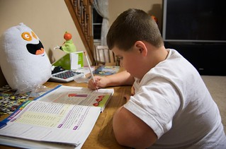
Home work
You will write seven days of the week.

Slide 16





Thanks
for
watching?

