Slide 1
Welcome
to my English class

Slide 2
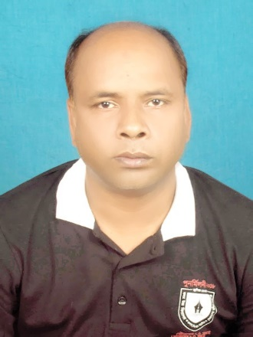
Teacher identity
Md. Abul Bashar
Assistant teacher
Digholgram Govt. primary school.

Slide 3
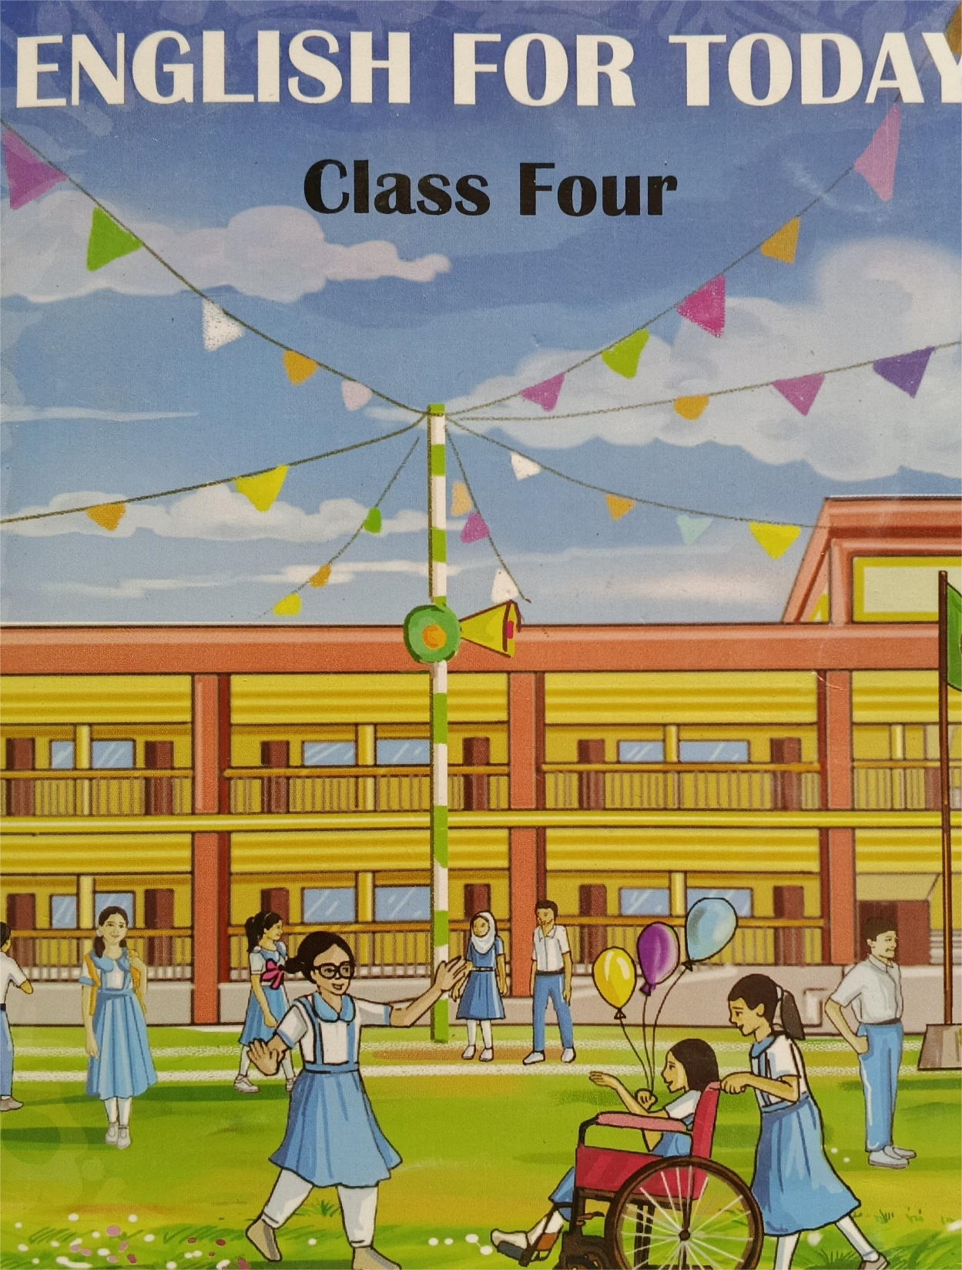
Lesson identity
class: Four
Unit: 9
Lesson:1.1, 1.2, 1.3

Slide 4
8.3.1 say the similar and opposite forms of
familiar words.
8.3.2 write the similar and opposite forms of
familiar words.

Slide 5
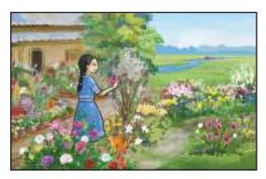
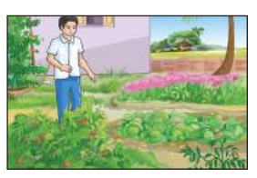
Look at the pictures and what do see?
Do you like gardening?
what plants would you like to grow

Slide 6
Can you say what we will learn today.

Slide 7
Today we will learn about
Gardening.

Slide 8
What things do we need to gardening?

Slide 9
Planting tree
seed
soil
water
Cow dung

Slide 10
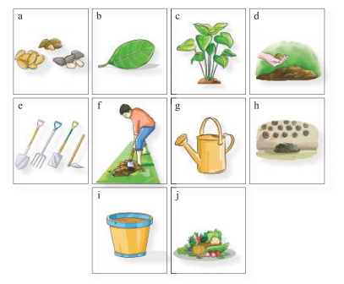
seeds
Leaf
plants
Cow dung
seeds
seeds
Land
Seed bank
Tools
Watering pot
Vegetable
Water tub

Slide 11

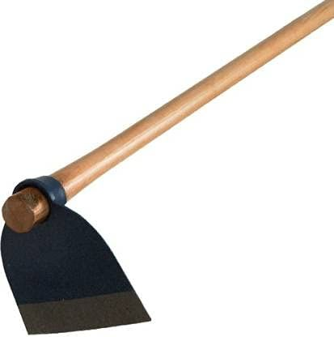



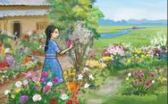
land
জমি
spade
কোদাল
Cow dung
গোবর সার
Watering pot
পানি দেওয়ার পাত্র
vegetable
শাক সব্জি
Garden
বাগান

Slide 12
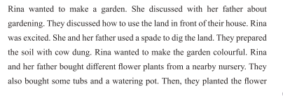

Slide 13
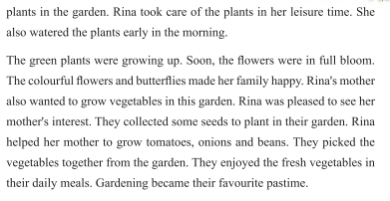

Slide 14
Thanks
See you next day.

