Slide 1


Slide 2


Slide 3

Lesson Identity
Class-Five
Subject-English
Unit- 6
Lesson-34

Slide 4

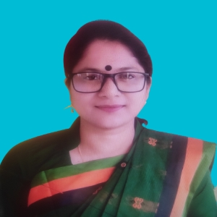
TEACHER’S IDENTITY
SUBARNA SARKER
ASSISTANT TEACHER
SADURIA GOVT. PRIMARY SCHOOL

Slide 5
Let’s See a Video

Slide 6
What do you see in the video?
What did you learn yesterday?
How many parts of an email?
How many of you can write an email now?

Slide 7

Lesson Decleration
Today we will write another email describing our school/village/country

Slide 8
Different parts of an Email: What Goes Where?
1
2
Subject Line
Salutation
Clear and concise — tells the recipient exactly what your email is about before they open it.
A polite greeting, such as "Dear Mr./Ms. [Name]," for formal emails or "Hi [Friend]," for casual ones.
3
4
Body
Closing & Signature
The heart of your message — write clearly, stay on topic, and be respectful throughout.
End with a polite sign-off like "Sincerely" or "Best regards," followed by your name and class.

Slide 9
School
Garden
School Library
Field
Name
Teacher

Slide 10
There is a wonderful garden in my school
My school has a library
It has a big field
There are 5 teachers in my school
The Name of may school is Saduria Govt, Primary School
School

Slide 11

Whole Class Work
Write an email to describe about your school

Slide 12

Provide Teacher’s Support
If students need

Slide 13

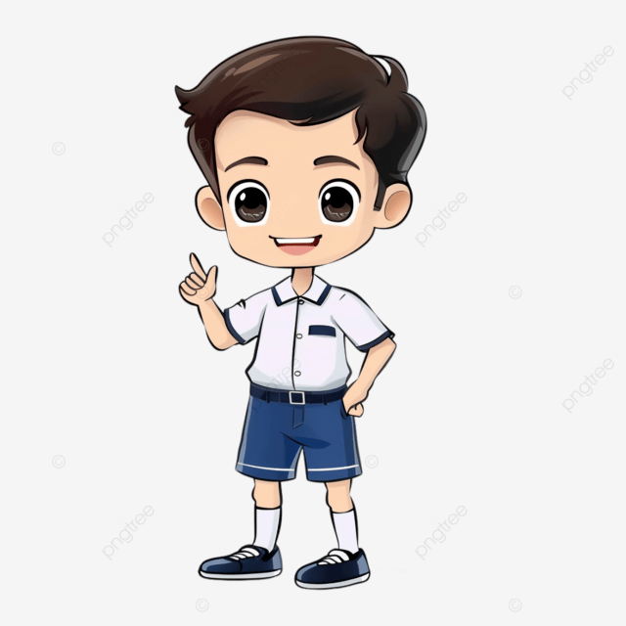
Students Presentation

Slide 14

Students cross cheaking
Students cross cheaking
Students cross cheaking
Students cross cheaking

Slide 15

Teacher’s support after cross checking

Slide 16

Summary of the session
What we have learnt today?

Slide 17

Assessment
Write an email to your friend describing him about your village.

Slide 18

Homework
Write an email to your friend Intan describing him about your country.

Slide 19


