Slide 1


Slide 2

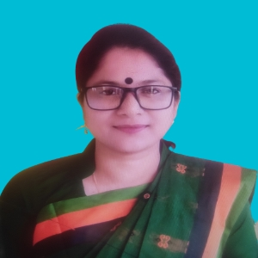
TEACHER’S IDENTITY
SUBARNA SARKER
ASSISTANT TEACHER
SADURIA GOVT. PRIMARY SCHOOL

Slide 3
Let’s See a Video

Slide 4
What do you see in the video?
What did you learn yesterday?
Who can say the parts of an Email?

Slide 5

Lesson Decleration
Today we will learn how to write an email

Slide 6
Different parts of an Email: What Goes Where?
1
2
Subject Line
Salutation
Clear and concise — tells the recipient exactly what your email is about before they open it.
A polite greeting, such as "Dear Mr./Ms. [Name]," for formal emails or "Hi [Friend]," for casual ones.
3
4
Body
Closing & Signature
The heart of your message — write clearly, stay on topic, and be respectful throughout.
End with a polite sign-off like "Sincerely" or "Best regards," followed by your name and class.

Slide 7
The first day of Bangla new year
Colourful procession
Panta-ilish
Phohela Baishak
mela
Nagordola
halkhata

Slide 8
The first day of Bangla new year
Pohela Baishakh is the first day of Bangla new year
Panta-ilish
My sister likes to eat panta-ilish
Nagordola
Nagordola looks wonderful
Halkhata
Halkhata is a wonderful tradition of Phohela Baishakh
Mela
I like to go to mela
Colourful procession
Every Phohela Baishakh I join the colourful procession

Slide 9

Group Work
Draw a Circle
Describe a festival

Slide 10

Write an email to your friend describing any festival

Slide 11
Eid
Chrismars
Birthday
Puja

Slide 12

Assessment
Write an email to your friend describing any festival

Slide 13


