Slide 1


Slide 2

Lesson Identity
Class-Five
Subject-English
Unit- 6
Lesson-34

Slide 3

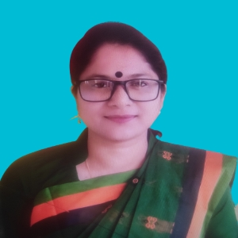
TEACHER’S IDENTITY
SUBARNA SARKER
ASSISTANT TEACHER
SADURIA GOVT. PRIMARY SCHOOL

Slide 4

Let’s See a Video
Indonesia

Slide 5
What do you see in the video?
What did you learn yesterday?
Last class we read about Intans email about his country to Shahin

Slide 6

Page No-32
Look at the Activity 2.1
And 2.2

Slide 7
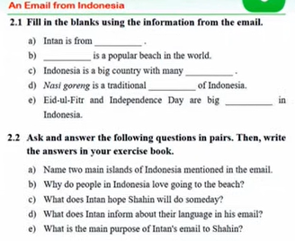

Slide 8
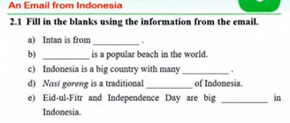

Slide 9
Intan is from …....................
……………… is a popular beach in the world.
Indonesia is a big counry with many……………..
Nasi goring is a traditional…………of Indonesia.
Eid-ul-Fitr and independence day are big………… in Indonesia.
Indonesia
Bali
Island
Food
Festival

Slide 10

Group Work
Fill the gapes and write in your exercise book

Slide 11

Group Presentation
Intan is from Indonesia
Bali is a popular beach in the world.
Indonesia is a big counry with many Islands
Nasi goring is a traditional Food of Indonesia.
Eid-ul-Fitr and independence day are big Festival in Indonesia.

Slide 12
Page No-32
Look at the Activity
And 2.2

Slide 13
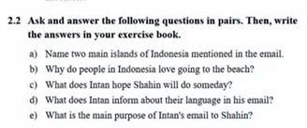
write the answer of the questions in your exercise book

Slide 14

Students Pair Work
Name two main islands of Indonesia mentioned in the email
Bali and Java are the two main islands mentioned in the email.

Slide 15


What does Intan hope Shahin will do someday?
Intan hopes someday Shain will visit his country and enjoy it’s beauty.

Slide 16
Group presentation
Name two main islands of Indonesia mentioned in the email
Bali and Java are the two main islands mentioned in the email.
Why do people in Indonesia love going to the beach?
The Indonesian people love to go to the beach because its weather usually warm and sunny.
Intan hopes someday Shain will visit his country and enjoy it’s beauty.
What does Intan hope Shahin will do someday?

Slide 17
Lets play a game
“Ladder Chat”
Name two main islands of Indonesia mentioned in the email
Bali and Java are the two main islands mentioned in the email.
Why do people in Indonesia love going to the beach?
The Indonesian people love to go to the beach because its weather usually warm and sunny.
Intan hopes someday Shain will visit his country and enjoy it’s beauty.
What does Intan hope Shahin will do someday?

Slide 18

Homework
Write the answer of the questions of Activity 2.2 from your home.

Slide 19


