Slide 1


Slide 2

Lesson Identity
Class-Five
Subject-English
Unit- 6
Lesson-34

Slide 3


TEACHER’S IDENTITY
SUBARNA SARKER
ASSISTANT TEACHER
SADURIA GOVT. PRIMARY SCHOOL

Slide 4

Let’s See Some Pictures
Whole Class work

Slide 5
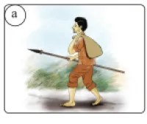
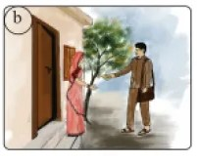
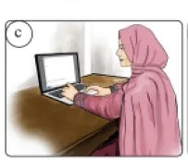
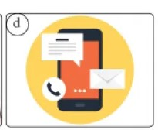

Slide 6
What do you see in the picture?
What are they doing?
Do you find anything common in the picture?
Have you ever received a letter or an Email from anyone?

Slide 7

Tittle Decleration
An Email from Indonesia

Slide 8


Teaching New Words
Island
Sunny

Slide 9

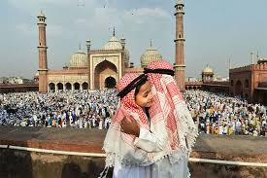
Weather
Festival

Slide 10

Traditional

Slide 11

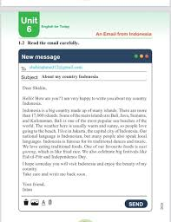
Teachers Loud Reading

Slide 12
Different parts of an Email: What Goes Where?
1
2
Subject Line
Salutation
Clear and concise — tells the recipient exactly what your email is about before they open it.
A polite greeting, such as "Dear Mr./Ms. [Name]," for formal emails or "Hi [Friend]," for casual ones.
3
4
Body
Closing & Signature
The heart of your message — write clearly, stay on topic, and be respectful throughout.
End with a polite sign-off like "Sincerely" or "Best regards," followed by your name and class.

Slide 13



Writing Your First Email: A Step-by-Step Guide
Scenario: You need to ask your teacher a question about Math homework.
Subject: "Question about Math Homework – [Your Name] – Class 5-2026"
Salutation: "Dear Mrs. [Teacher's Last Name],"
Subject
Salutation
Body
Closing
Body: Clearly state your question and explain what you have already tried.
Closing & Signature: "Sincerely, [Your Full Name]"

Slide 14
Example of an Emal
To: ssubarnasarker717@gmail.com
Subject: Invitation to Bali Cultural Event
Hi Devi,
Thanks YOU so much for inviting me — I'm really excited about the trip! I've been looking into what we can do, and I think we should definitely check out the traditional Balinese dance performance and visit the silver craft village in Celuk. I'd also love to try some authentic local food while we're there!
See you soon,Ika
✅ Acknowledges the Invite
✅ Shows Enthusiasm
✅ Adds Personal Details
✅ Warm Closing

Slide 15

Chain Drill

Slide 16
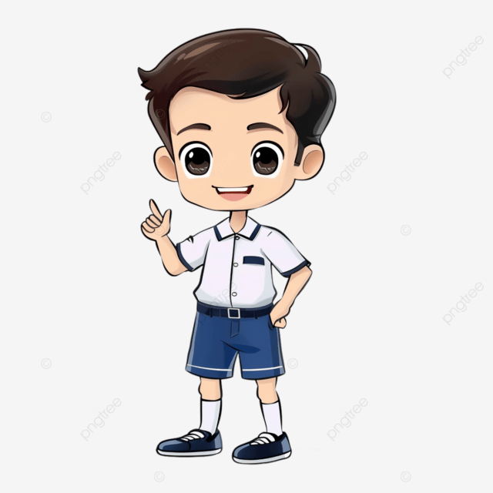



Group presentation
Email Address
Subject
Greetings
Closing
Body

Slide 17
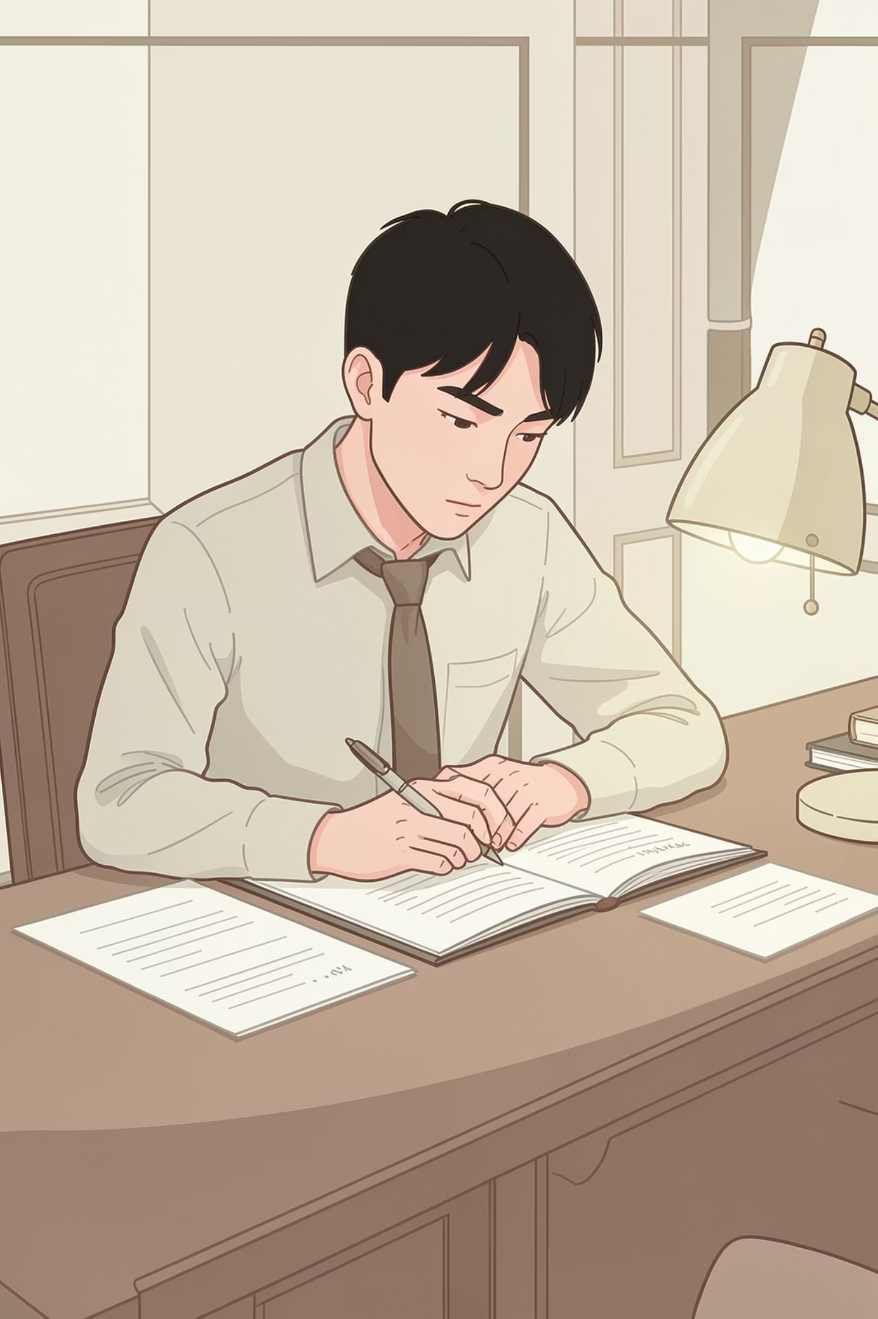
Assessment
Write the main parts of an Email

Slide 18

Your Next Steps: Practice Makes Perfect!
Homework
Responding to an Email
Of your friend Intan

Slide 19


