Slide 1

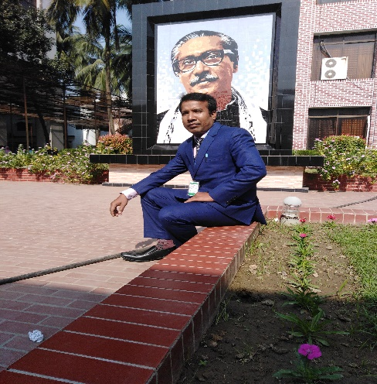
শিক্ষক পরিচিতি
পাঠ পরিচিতি
বিষয় – তথ্য ও যোগাযোগ প্রযুক্তি
শ্রেণী – দ্বাদশ
অধ্যায় – পঞ্চম সময় – ৫০ মিনিট
মোঃ ইকবাল হোসাইন রাজা
প্রভাষক- আইসিটি
মহাজনপুর কলেজ
মুজিবনগর,মেহেরপুর।
E-mail:raza.maa@gmail.cpom
1

Slide 2
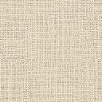
এই পাঠ শেষে যা যা শিখতে পারবে-
1। 1¹+2²+3³+-----+N^{N} অথবা,(90)²+(80)²+---+(10)² অথবা, 1²+2²+3²+---+N² (Algorithm, Flowchart, Programming C) লেখ।
২। 1¹+2²+3³+-----+N^{N}/(90)²+(80)²+---+(10)² অথবা, 1²+2²+3²+---+N² (Algorithm, Flowchart, Programming C) লেখ।
৩। 1¹+2²+3³+-----+N^{N} অথবা, (90)²+(80)²+---+(10)² অথবা, 1²+2²+3²+---+N² (Algorithm, Flowchart, Programming C) লেখ।
৪। 1¹+2²+3³+-----+N^{N} অথবা, (90)²+(80)²+---+(10)² অথবা, 1²+2²+3²+---+N² (Algorithm, Flowchart, Programming C) লেখ

Slide 3
১। 1¹+2²+3³+-----+N^{N}/(90)²+(80)²+---+(10)²/1²+2²+3²+---+N² (Algorithm, Flowchart, Programming C) লেখ।
Programming C: (use for loop statement) Flowchart:
#include<stdio.h>
int main()
{int i, sum=0, N=10;
printf(“Enter Values:”);
scanf(“%d”,&N);
for(i= 90; i>=N; i= i-10)
{
Sum=sum+pow(i,2); false
Printf(“Summation=%d”,sum);}}
Algorithm: true
Step-1: start.
Step-2: input N.
Step-3: i=90, sum=0
Step-4: while(i>=N)
Step-5: sum=sum+pow(i,2) or, sum=sum+pow(i,i) or, sum=sum+pow(i,2)
i=i-10 i<=N
i. goto step-4
Step-6: print sum.
Step-7: End.
start
Input N
i=90
sum=0
i>=N
Print sum
sum= sum+pow(I,2)
i= i-10
End

Slide 4
2। 1¹+2²+3³+-----+N^{N}/(90)²+(80)²+---+(10)²/1²+2²+3²+---+N² (Algorithm, Flowchart, Programming C) লেখ।
Programming C: (use while loop statement) Flowchart:
#include<stdio.h>
int main()
{int i, sum=0, N=10;
printf(“Enter Values:”);
scanf(“%d”,&N);
i= 90;
while(i>=N) false
{
Sum=sum+pow(i,2);
i=i-10; true
Printf(“Summation=%d”,sum);}}
Algorithm: true
Step-1: start.
Step-2: input N.
Step-3: i=90, sum=0
Step-4: while(i>=N)
Step-5: sum=sum+pow(i,2) or, sum=sum+pow(i,i) or, sum=sum+pow(i,2)
i=i-10 i<=N
i. goto step-4
Step-6: print sum.
Step-7: End.
start
Input N
i=90
sum=0
i>=N
Print sum
sum= sum+pow(I,2)
i= i-10
End

Slide 5

৩। 1¹+2²+3³+-----+N^{N}/(90)²+(80)²+---+(10)²/1²+2²+3²+---+N² (Algorithm, Flowchart, Programming C) লেখ।
Programming C: (use do-while loop statement) Flowchart:
#include<stdio.h>
int main()
{int i, sum=0, N=10;
printf(“Enter Values:”);
scanf(“%d”,&N);
i= 90;
do
{
Sum=sum+pow(i,2);
i=i-10;}
While(i>=N);
Printf(“Summation=%d”,sum);}}
Algorithm:
Step-1: start.
Step-2: input N.
Step-3: i=90, sum=0 or, sum=sum+pow(i,i) or, sum=sum+pow(i,2)
Step-4: do{sum=sum+pow(i,2)
i= i-10}
Step-5: while(i>=N)
i. goto step-4
Step-6: print sum.
Step-7: End.
start
Input N
i=90
sum=0
{sum= sum+pow(i,2)
i= i-10}
i>=N
Print sum
End

Slide 6

৪। 1¹+2²+3³+-----+N^{N}/(90)²+(80)²+---+(10)²/1²+2²+3²+---+N² (Algorithm, Flowchart, Programming C) লেখ।
Programming C: (use if-goto loop statement) Flowchart:
#include<stdio.h>
int main()
{int i, sum=0, N=10;
printf(“Enter Values:”);
scanf(“%d”,&N);
i= 90;
Level:
{
Sum=sum+pow(i,2); false
i=i-10;}
if(i>=N); true
Goto level;
Printf(“Summation=%d”,sum);}}
Algorithm:
Step-1: start.
Step-2: input N.
Step-3: i=90, sum=0 or, sum=sum+pow(i,i) or, sum=sum+pow(i,2)
Step-4: level:{sum=sum+pow(i,2)
i= i-10}
Step-5: while(i>=N)
i. goto step-4
Step-6: print sum.
Step-7: End.
start
Input N
i=90
sum=0
Level:{sum= sum+pow(i,2)
i= i-10}
i>=N
Print sum
End

Slide 7


THANK YOU

