Slide 1

Good morning
Prepared by: Md. Saifuddin-Ass. Teacher , Afzal Nagar GPS. Satkania, Chattogram.

Slide 2
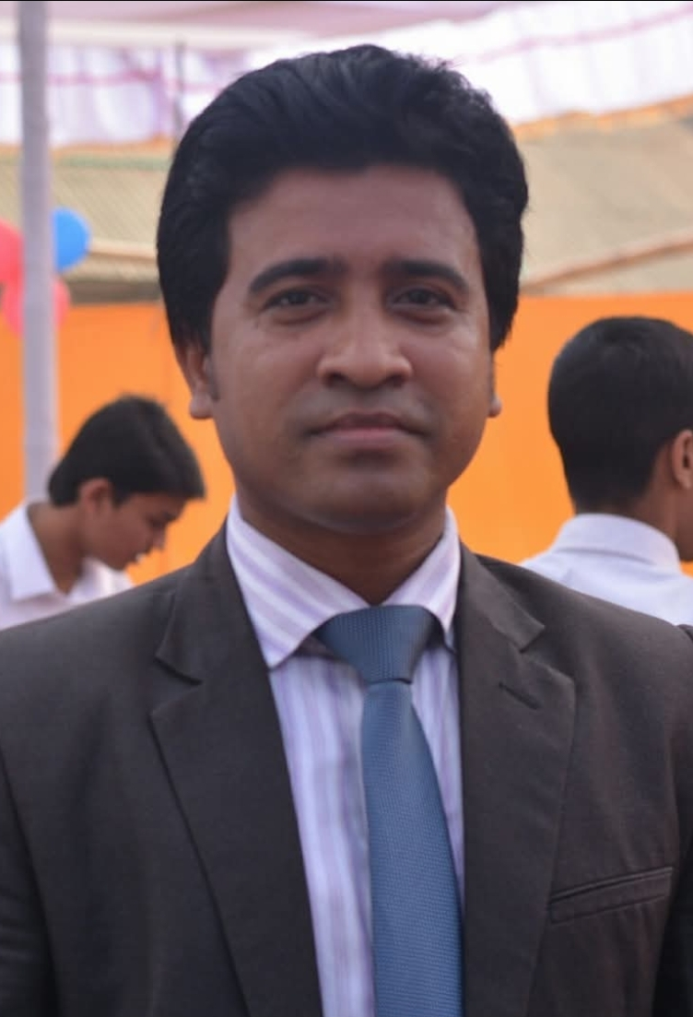
Teacher Profile
Md. Saifuddin
Ass. Teacher of Afzalnagar GPS.
Satkania, CTG.
Prepared by: Md. Saifuddin-Ass. Teacher , Afzal Nagar GPS. Satkania, Chattogram.

Slide 3

Let's see a picture!
Prepared by: Md. Saifuddin-Ass. Teacher , Afzal Nagar GPS. Satkania, Chattogram.

Slide 4
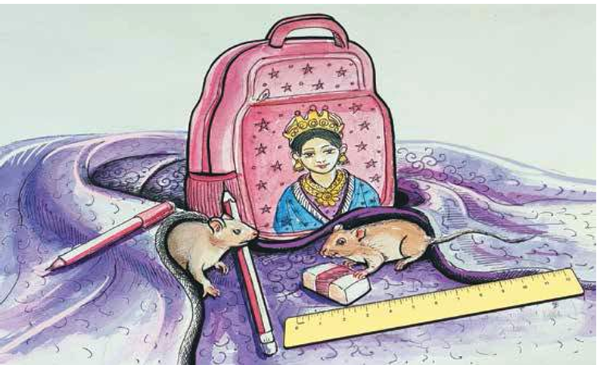
Prepared by: Md. Saifuddin-Ass. Teacher , Afzal Nagar GPS. Satkania, Chattogram.

Slide 5
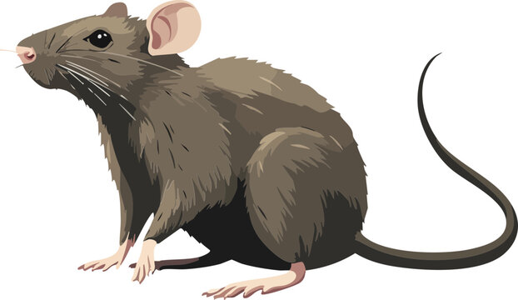
Prepared by: Md. Saifuddin-Ass. Teacher , Afzal Nagar GPS. Satkania, Chattogram.

Slide 6
Rat
R
Prepared by: Md. Saifuddin-Ass. Teacher , Afzal Nagar GPS. Satkania, Chattogram.

Slide 7
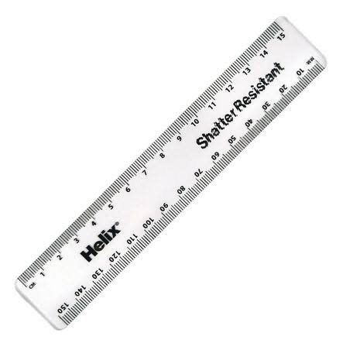
Prepared by: Md. Saifuddin-Ass. Teacher , Afzal Nagar GPS. Satkania, Chattogram.

Slide 8
ruler
r
Prepared by: Md. Saifuddin-Ass. Teacher , Afzal Nagar GPS. Satkania, Chattogram.

Slide 9
Let’s go watching a nice video of O
https://www.youtube.com/watch?v=W5z941Xx2fM&list=RDW5z941Xx2fM&start_radio=1
Prepared by: Md. Saifuddin-Ass. Teacher , Afzal Nagar GPS. Satkania, Chattogram.

Slide 10

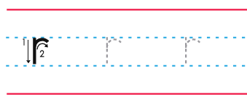
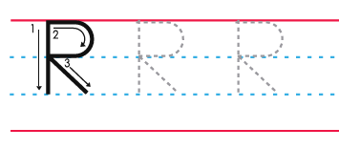
Prepared by: Md. Saifuddin-Ass. Teacher , Afzal Nagar GPS. Satkania, Chattogram.

Slide 11

How to write letter O
Prepared by: Md. Saifuddin-Ass. Teacher , Afzal Nagar GPS. Satkania, Chattogram.

Slide 12
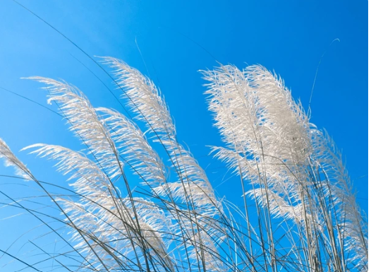
Thank you
for staying with me.
Prepared by: Md. Saifuddin-Ass. Teacher , Afzal Nagar GPS. Satkania, Chattogram.

