Slide 1




WELCOME TO ALL IN TODAY’S
ENGLISH LESSON

Slide 2




Presented By
Rajib Dutta
Assistant teacher
Bhingrol Govt.Primary School
Anowara, Chottogram
Email: rajibduttaat@gmail.com

Slide 3

Introduction of the lesson
Class : FIVE
Subject : English
Unit : 14
Lesson : 1 (Page- 70)
Lesson Title : the champion girl
TIME :

Slide 4
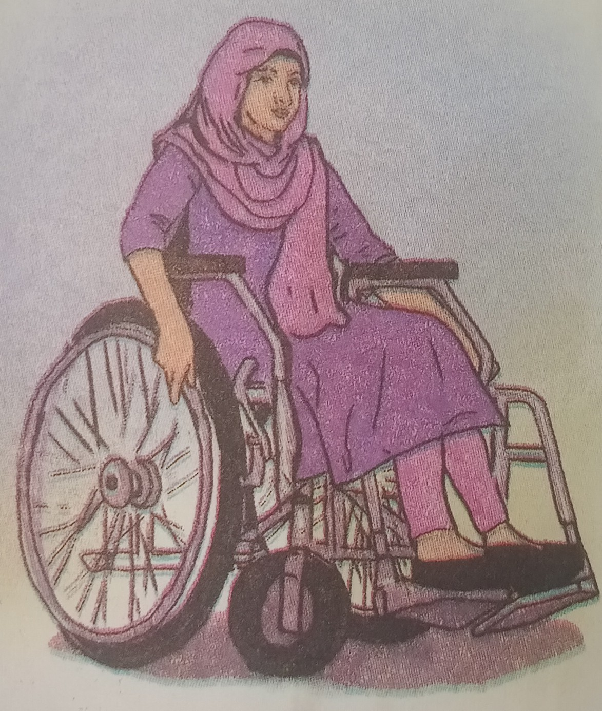
Today’s lesson
The
Champion
Girl

Slide 5
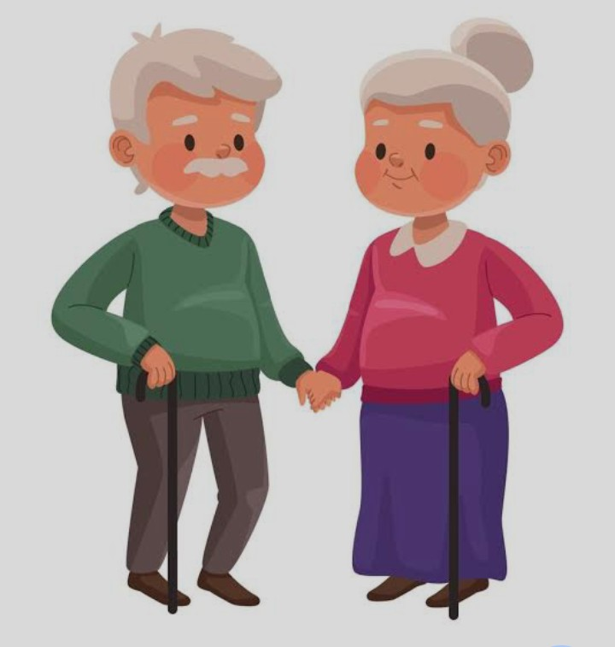
Grandparents
The parents of a person’s mother or father

Slide 6
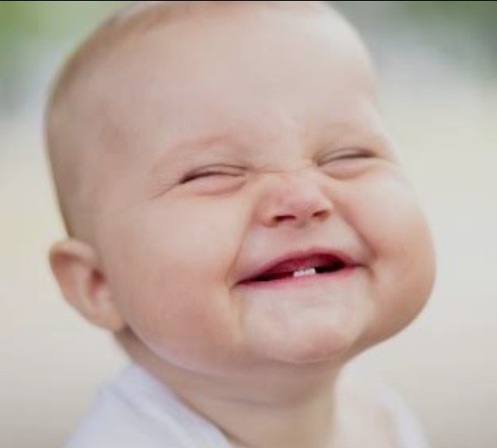

Smile
A universal facial expression by mouth and eyes

Slide 7
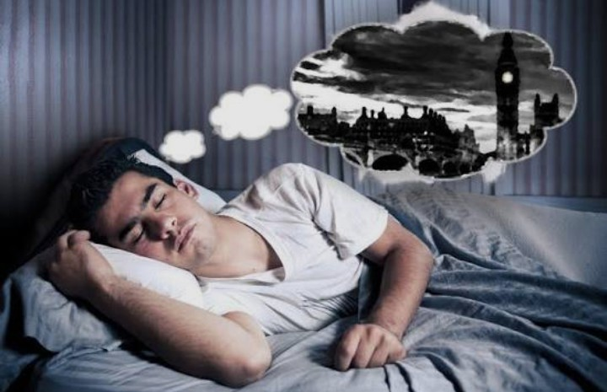
Dreams
A series of thoughts, images occurring in person’s mind during sleep.

Slide 8
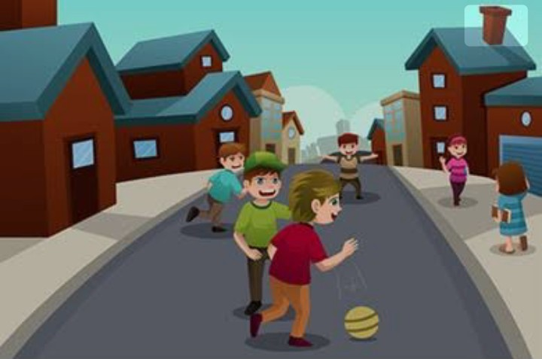
Neighbourhood
A group of people living near each other

Slide 9
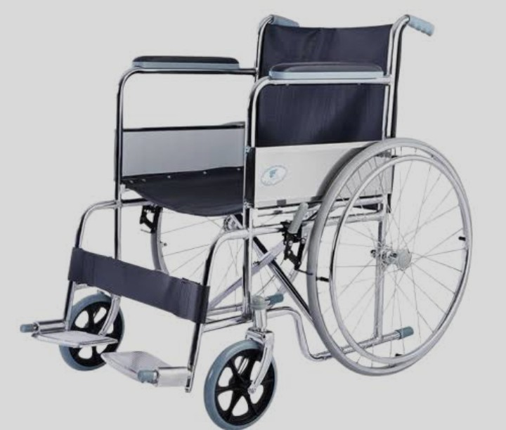
Wheelchair
A special chair for injured people moving with wheel

Slide 10

Morning
The early part of the day.

Slide 11
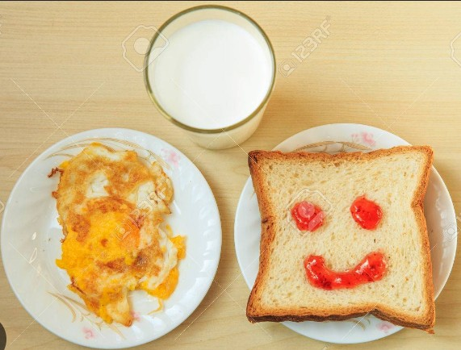
Breakfast
First meal of the day.

Slide 12
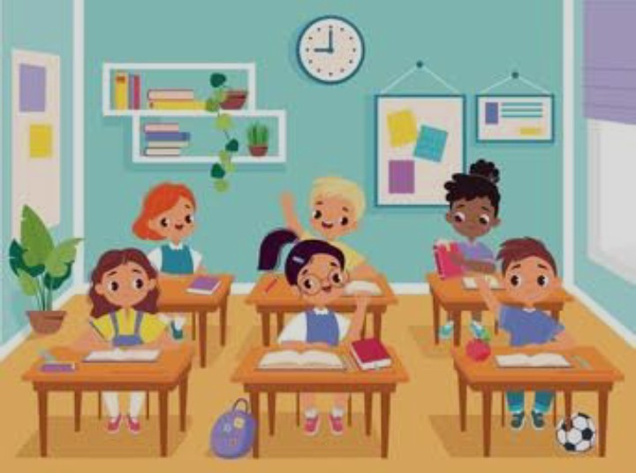
Classmates
Someone who is in the same class

Slide 13
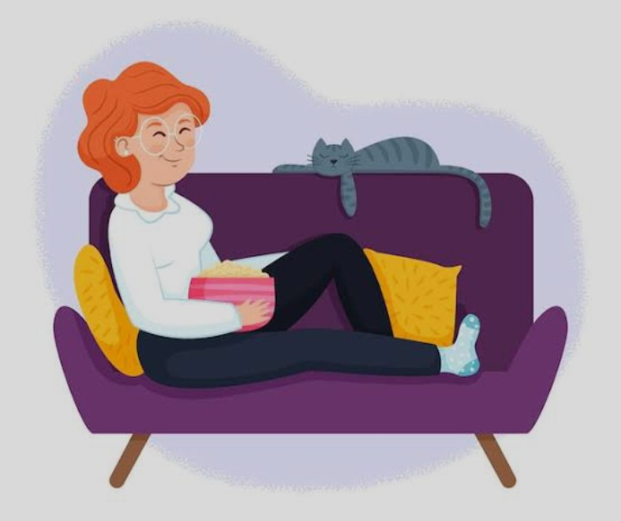
Comfortable
Providing physical and relaxation

Slide 14
Teacher read text with proper pronounciation two times
Lipi lives with his grandparents in a small village. She studies ln a nearby primary school. She has a bright smile and a heart full of dreams. She talks nicely and wins everyone”s heart. She is a lot like any other girls in her neighbourhood . But , Lipi cannot walk like her friends. Instead, she uses a wheelchair to move.
Every morning, Lipi wakes up early, gets dressed and takes her breakfast on time. Lipi’s mother helps her put books in the school bag. Lipi’s classmates help her to sit at the front bench of the class. They also help her to move around the school. Whenever her classmates play, they invite Lipi to join them. Their class teacher Ms. Anita makes sure that Lipi feels comfortable in the class. Her teacher arranges Lipi’s table so that she can see the blackboard clearly.

Slide 15
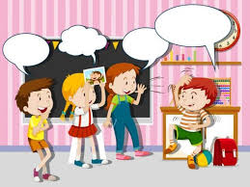
Students activities
1.Students will read the text with pair proper pronounciation.
2Students read the text alone with proper pronounciation.
3.Advanced students help to weaker students.

Slide 16

Match the words with their meaning
1. Smile first meal of the day.
2. Morning the parents of a person’s mother or father
3. Dreams a universal facial expression by mouth and eyes
4. Breakfast the early part of the day.
5. Grandparents a series of thoughts, images occurring in person’s mind
during sleep.

Slide 17
Students activities
Students will read the text proper pronunciation with missingwords
Every morning, Lipi wakes up _______, gets dressed and takes her____________ on _______. Lipi’s __________ helps her put ________ in the school ______ . Lipi’s _________________ help her to sit at the _______ bench of the class. They also help her to move ___________ the school. Whenever her classmates _________, they _____________ Lipi to join them. Their class teacher Ms. _________ makes sure that Lipi feels ________________ in the class. Her __________ arranges Lipi’s table so that she can see the _________________ clearly.
early
breakfast
time
mother
books
_bag
classmates
front
around
play
invite
Anita
comfortabe
teacher
blackboard

Slide 18
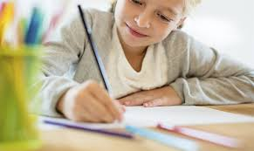
Home work
Write five sentences about ‘ Lipi ’.

Slide 19

