Slide 1




WELCOME TO ALL IN TODAY’S
ENGLISH LESSON

Slide 2


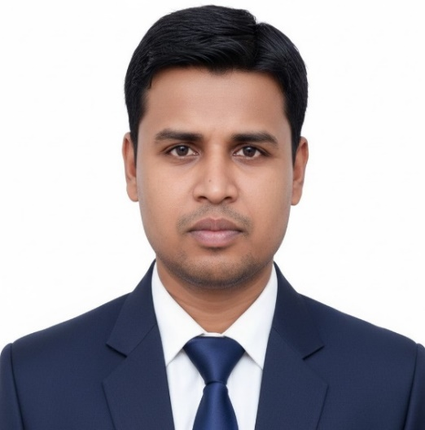

Presented By
Rajib Dutta
Assistant teacher
Bhingrol Govt.Primary School
Anowara, Chottogram
Email: rajibduttaat@gmail.com

Slide 3

Let’s we sing a song.
Good Morning, Good Morning
How are you today?
I am fine , I am fine
I wish you a good day.
Md. Mofakkarul Alam, Assistant Teacher, Goraduba govt. Primary School, Kendua, Netrokona.

Slide 4

Class : Two
Subject : English
Time : 45 minute
*Rajib Dutta. Bhingrool gps. Anowara*. Ctg

Slide 5
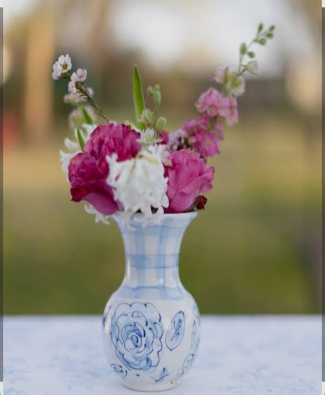
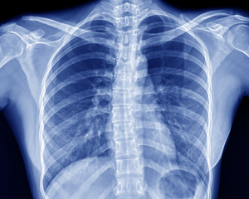
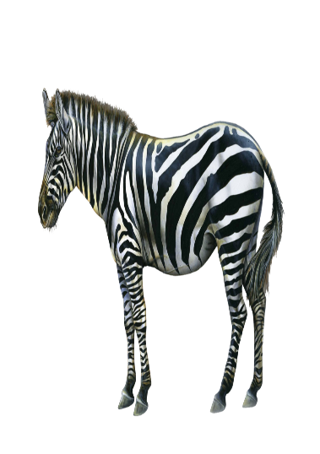
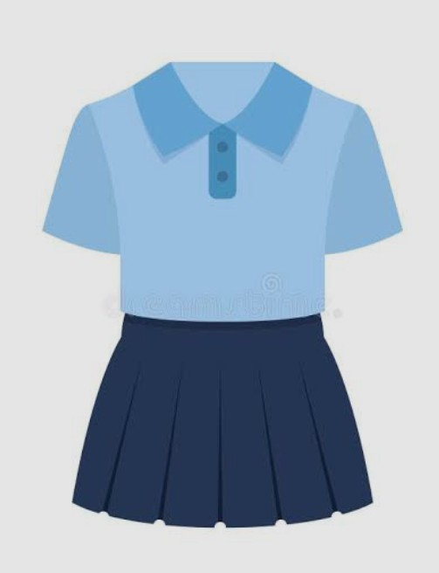
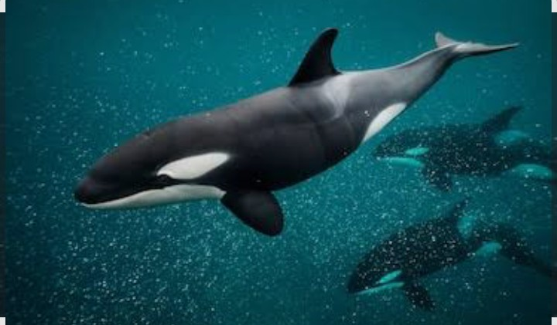
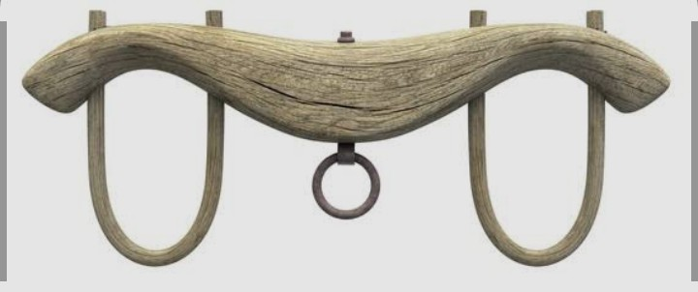
What can you see in the pictures?
Uniform
Whale
Yoke
Vase
X-ray
Zebra
Uniform, Vase, Whale, X-ray, Yoke, Zebra
*Rajib Dutta. Bhingrool gps. Anowara*. Ctg

Slide 6
Today’s lesson
Alphabet Uu-Zz
Uu Vv Ww Xx Yy Zz
Unit : 2
Lesson : 10
Page : 25
*Rajib Dutta. Bhingrool gps. Anowara*. Ctg

Slide 7
Learning outcomes
At the end of the lesson students will be able to-
1.1.1 become familiar with English sounds by listening to common English words.
1.1.1 repeat after the teacher simple words and phrases with proper sounds and stress.
1.1.2 say simple words and phrases with proper sounds and stress.
1.2.1recognize and read the alphabet both small and capital (non-cursive).
1.3.1 recognize and read the name of objects having the same initial and final sounds.
*Rajib Dutta. Bhingrool gps. Anowara*. Ctg

Slide 8
Look listen and say-
Uu
Uniform
*Rajib Dutta. Bhingrool gps. Anowara*. Ctg

Slide 9

Vv
Look listen and say-
Vase
*Rajib Dutta. Bhingrool gps. Anowara*. Ctg

Slide 10
Ww
Look listen and say-
Whale
*Rajib Dutta. Bhingrool gps. Anowara*. Ctg

Slide 11
Xx
Look listen and say-
X-ray
*Rajib Dutta. Bhingrool gps. Anowara*. Ctg

Slide 12
Yy
Look listen and say-
Yoke
*Rajib Dutta. Bhingrool gps. Anowara*. Ctg

Slide 13
Zz
Look listen and say-
Zebra
*Rajib Dutta. Bhingrool gps. Anowara*. Ctg

Slide 14
Pair work
Read and say. Trace and write-
uniform
vase
whale
yoke
X-ray
zebra
*Rajib Dutta. Bhingrool gps. Anowara*. Ctg

Slide 15
Read and say. Trace and write-
Pair work
Uniform
Vase
Whale
X-ray
Yoke
Zebra

Slide 16
Individual work
Write word
U=
V=
Uniform
Vase
W=
X=
Whale
X-ray
Y=
Z=
Yoke
Zebra
*Rajib Dutta. Bhingrool gps. Anowara*. Ctg

Slide 17
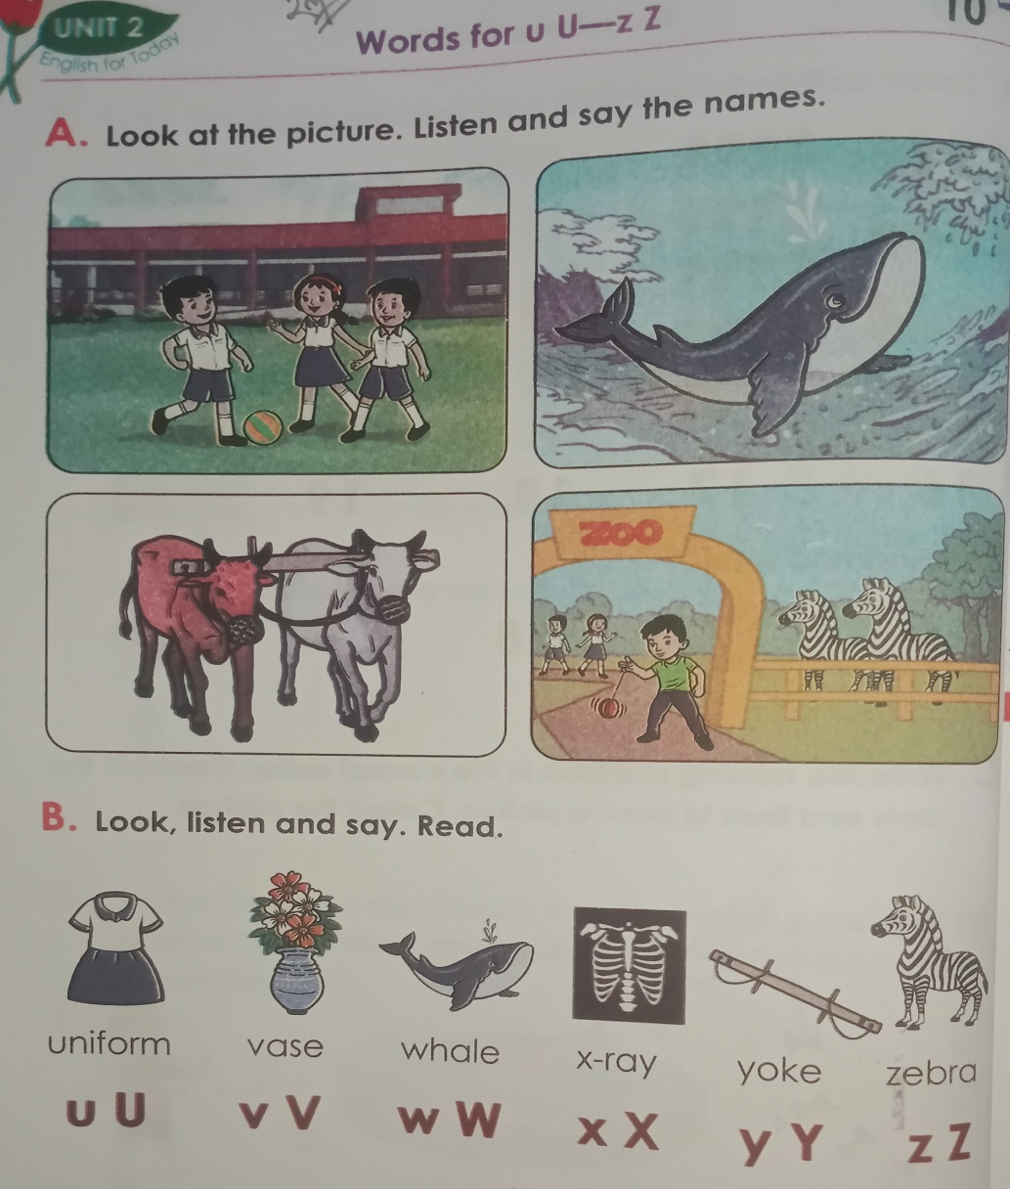
Open your English book Page 25
*Rajib Dutta. Bhingrool gps. Anowara*. Ctg

Slide 18
Click the right letter
Evaluation
Uniform
wrong
wrong
wrong
wrong
X
Y
W
V
U
*Rajib Dutta. Bhingrool gps. Anowara*. Ctg

Slide 19
Click the right letter
Evaluation
Vase
wrong
wrong
wrong
wrong
V
U
X
Y
Z
*Rajib Dutta. Bhingrool gps. Anowara*. Ctg

Slide 20
Click the right letter
Evaluation
Whale
wrong
wrong
wrong
wrong
X
V
Z
Y
W
*Rajib Dutta. Bhingrool gps. Anowara*. Ctg

Slide 21
Evaluation
Click the right letter
X-ray
wrong
wrong
wrong
wrong
Z
V
Y
X
U
*Rajib Dutta. Bhingrool gps. Anowara*. Ctg

Slide 22
Evaluation
Click the right letter
Yoke
wrong
wrong
wrong
wrong
Z
V
X
Y
U
*Rajib Dutta. Bhingrool gps. Anowara*. Ctg

Slide 23
Evaluation
Click the right letter
Zebra
wrong
wrong
wrong
wrong
Y
V
X
Z
U
*Rajib Dutta. Bhingrool gps. Anowara*. Ctg

Slide 24


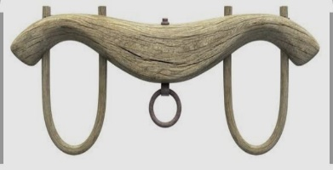

Say, read and match
yoke
uniform
zebra
vase
whale
*Rajib Dutta. Bhingrool gps. Anowara*. Ctg

Slide 25


Good bye every one
Thanks to all
See you again…
*Rajib Dutta. Bhingrool gps. Anowara*. Ctg

