Slide 1




WELCOME TO ALL IN TODAY’S
ENGLISH LESSON

Slide 2


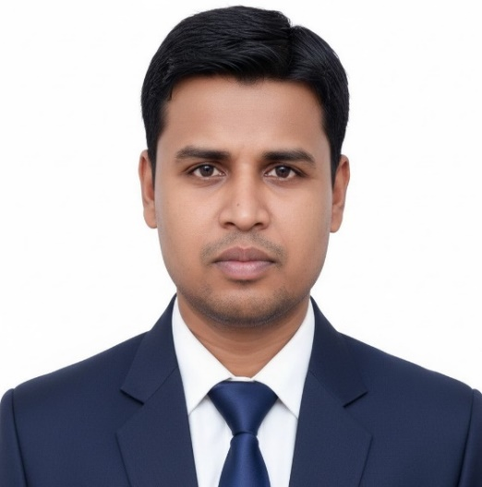

Presented By
Rajib Dutta
Assistant teacher
Bhingrol Govt.Primary School
Anowara, Chottogram
Email: rajibduttaat@gmail.com

Slide 3

Let’s we sing a song.
Good Morning, Good Morning
How are you today?
I am fine , I am fine
I wish you a good day.
Md. Mofakkarul Alam, Assistant Teacher, Goraduba govt. Primary School, Kendua, Netrokona.

Slide 4

Class : Two
Subject : English
Time : 45 minute
*Rajib Dutta. Bhingrool gps. Anowara*. Ctg

Slide 5
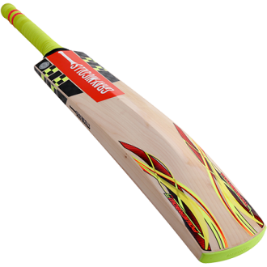

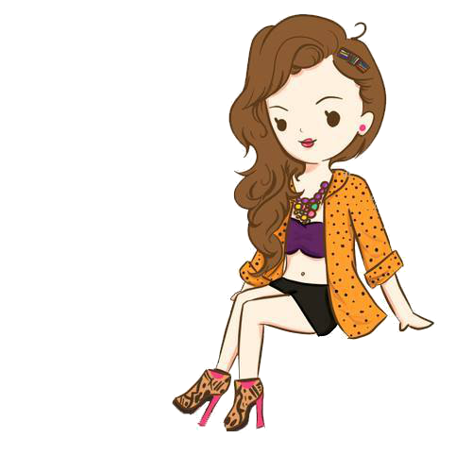
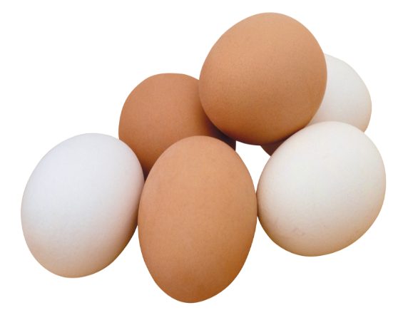
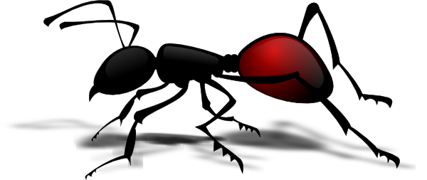
What can you see in this pictures?
Ant, Bat, Cup, Doll, Egg
*Rajib Dutta. Bhingrool gps. Anowara*. Ctg

Slide 6
Today’s lesson
Alphabet Aa-Ee
Aa Bb Cc Dd Ee
Unit : 2
Lesson : 1
Page : 6
*Rajib Dutta. Bhingrool gps. Anowara*. Ctg

Slide 7
Learning outcomes
At the end of the lesson students will be able to-
1.1.1 become familiar with English sounds by listening to common English words.
1.1.1 repeat after the teacher simple words and phrases with proper sounds and stress.
1.1.2 say simple words and phrases with proper sounds and stress.
1.2.1recognize and read the alphabet both small and capital (non-cursive).
1.3.1 recognize and read the name of objects having the same initial and final sounds.
*Rajib Dutta. Bhingrool gps. Anowara*. Ctg

Slide 8
Aa
Look listen and say-
ant
*Rajib Dutta. Bhingrool gps. Anowara*. Ctg

Slide 9
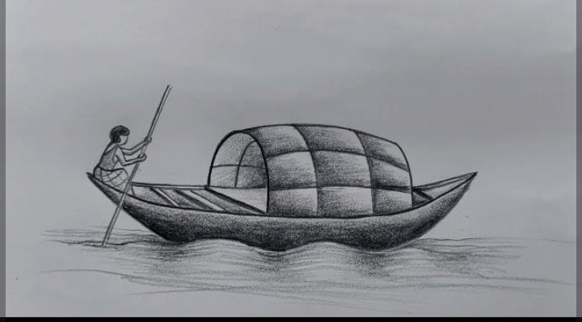
Bb
Look listen and say-
boat
*Rajib Dutta. Bhingrool gps. Anowara*. Ctg

Slide 10
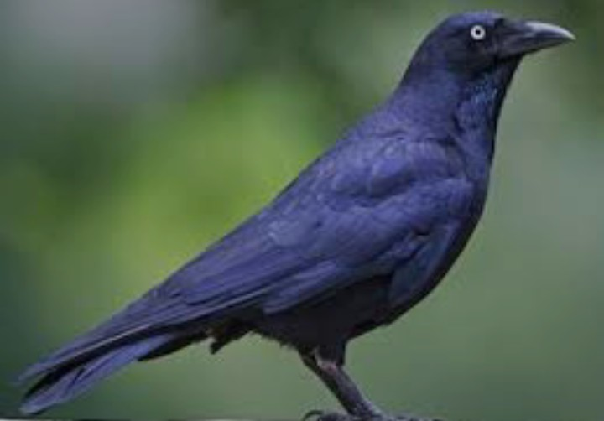
Cc
Look listen and say-
crow
*Rajib Dutta. Bhingrool gps. Anowara*. Ctg

Slide 11
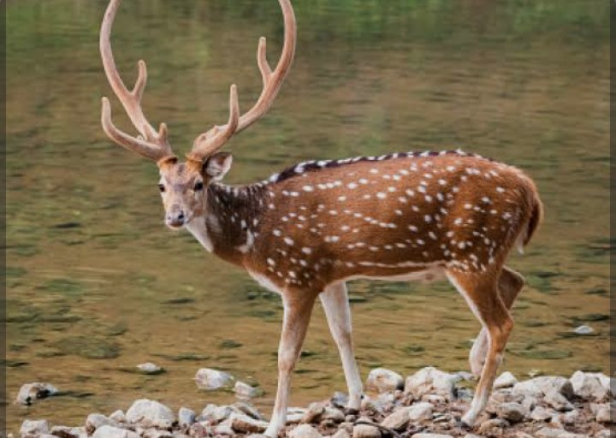
Dd
Look listen and say-
deer
*Rajib Dutta. Bhingrool gps. Anowara*. Ctg

Slide 12
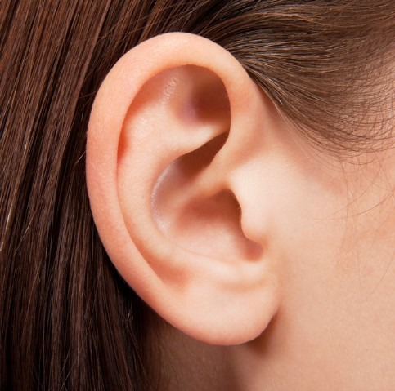
Ee
Look listen and say-
ear
*Rajib Dutta. Bhingrool gps. Anowara*. Ctg

Slide 13
Pair work
Read and say. Trace and write-
ant
crow
boat
deer
ear
*Rajib Dutta. Bhingrool gps. Anowara*. Ctg

Slide 14
Read and say. Trace and write-
Pair work
ant
boat
crow
deer
ear

Slide 15
Individual work
Write word
a=
b=
Ant
Boat
c=
Crow
d=
e=
Deer
Ear
*Rajib Dutta. Bhingrool gps. Anowara*. Ctg

Slide 16
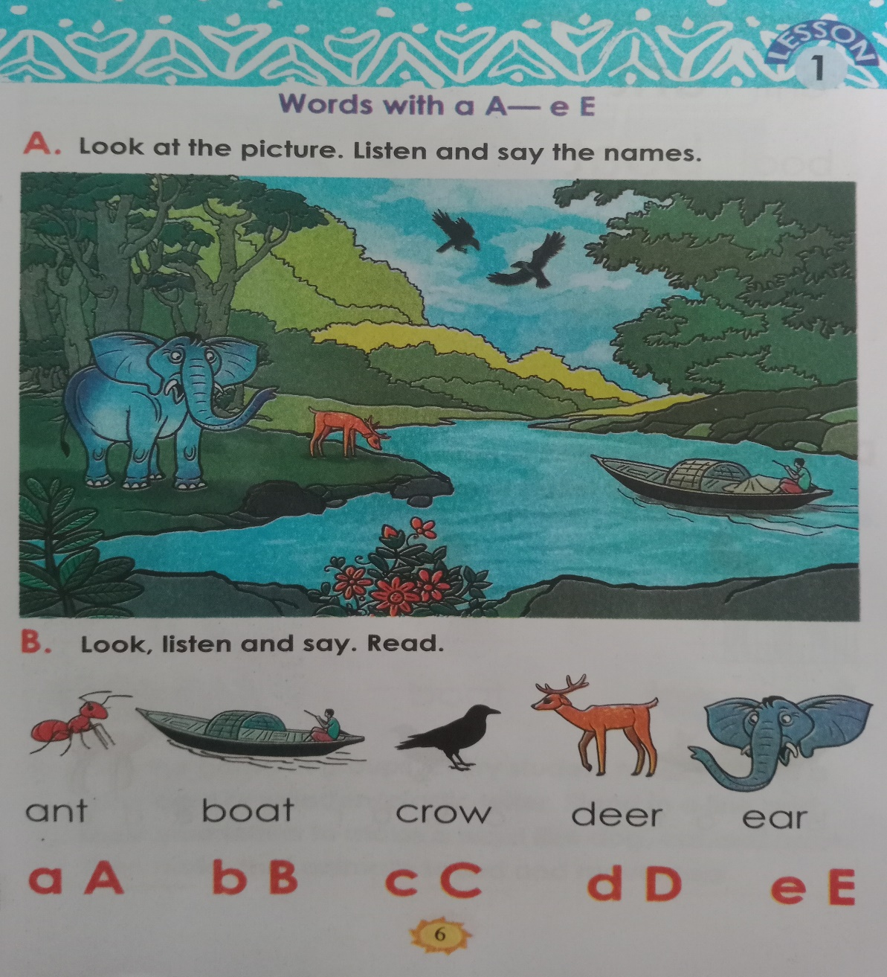
Open your English book Page 6
*Rajib Dutta. Bhingrool gps. Anowara*. Ctg

Slide 17
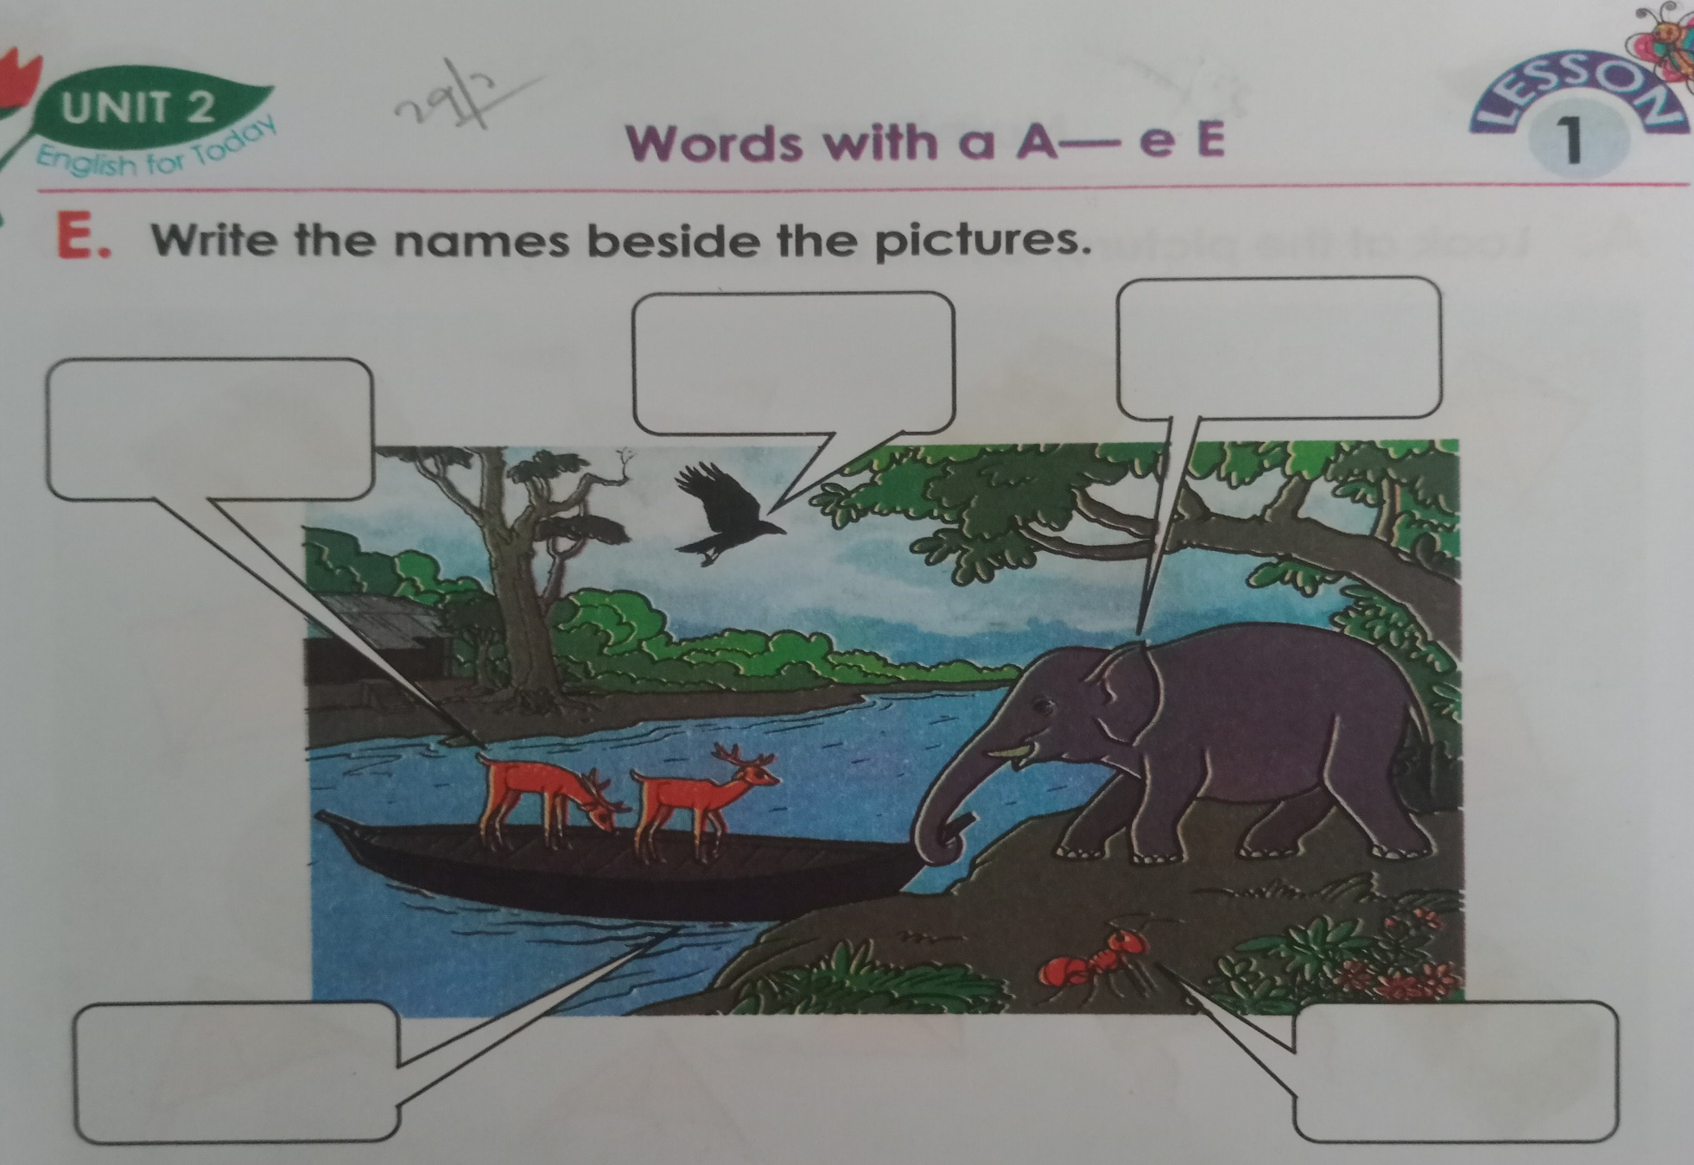
Crow
Ear
Deer
Boat
Ant
*Rajib Dutta. Bhingrool gps. Anowara*. Ctg

Slide 18
Evaluation
Click the right letter
Ant
wrong
wrong
wrong
wrong
B
E
C
D
A
*Rajib Dutta. Bhingrool gps. Anowara*. Ctg

Slide 19
Click the right letter
Evaluation
Boat
wrong
wrong
wrong
wrong
B
C
D
F
E
*Rajib Dutta. Bhingrool gps. Anowara*. Ctg

Slide 20
Click the right letter
Evaluation
Crow
wrong
wrong
wrong
wrong
B
A
E
D
C
*Rajib Dutta. Bhingrool gps. Anowara*. Ctg

Slide 21
Evaluation
Click the right letter
Deer
wrong
wrong
wrong
wrong
B
A
E
D
C
*Rajib Dutta. Bhingrool gps. Anowara*. Ctg

Slide 22
Evaluation
Click the right letter
Ear
wrong
wrong
wrong
wrong
B
A
C
E
D
*Rajib Dutta. Bhingrool gps. Anowara*. Ctg

Slide 23
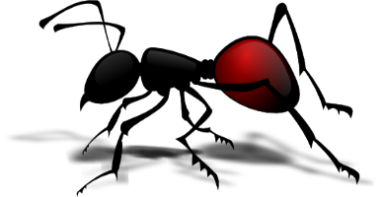
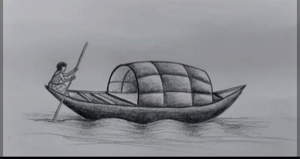



Say, read and match
ear
crow
boat
ant
deer
*Rajib Dutta. Bhingrool gps. Anowara*. Ctg

Slide 24


Good bye every one
Thanks to all
See you again…
*Rajib Dutta. Bhingrool gps. Anowara*. Ctg

