Slide 1


Slide 2



Introduction
Ayesha Siddiqua
Head Teacher
Rampur GPS
Laksam,Cumilla
Class : One
Sub : English
Unit : 2
Lesson : 7
Topics : Numbers Page (20-21)
Time : 30 minutes

Slide 3
LEARNING OUTCOMES
After finishing the lesson students will be able to-
4.1.4 read aloud cardinal numbers in figures properly

Slide 4
“Let’s listen to a song (Number song).
[1, 2, 3, 4, 5
Count the fish from 1 to 5.
6, 7, 8, 9, 10
Count the fish from 1 to 10!]

Slide 5

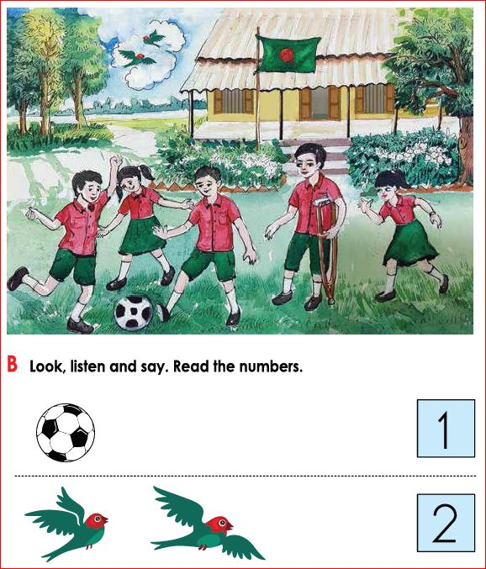
Look at the pictures with great attention:
Dear Student’s what do we see here ?

Slide 6

“Today we are going to learn how to count and read the numbers of 1and 2.”
The topic is “Numbers” 1&2

Slide 7
Review of the previous session:
Ask ss altogether, “What did we learn yesterday?”
[Showing the letter/writing the letters
(c, C, d, D) on board]
Ask a student randomly,
“What is the name of it?” Possible answer should be c/C/d/D.

Slide 8
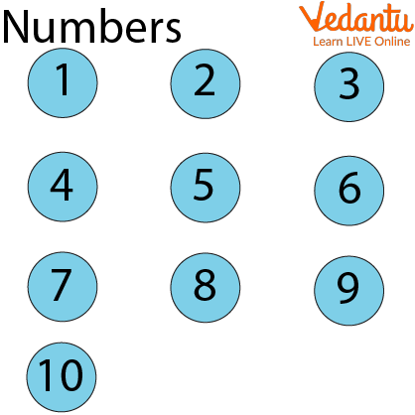
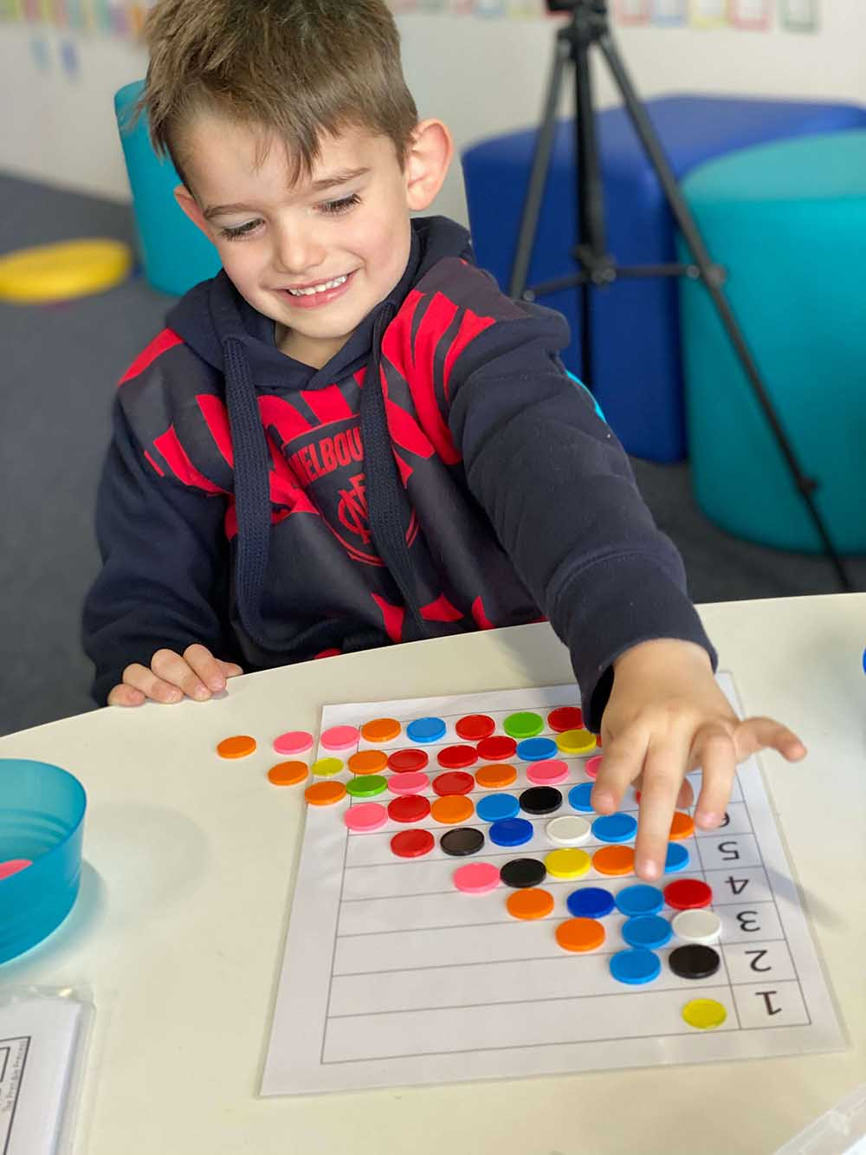
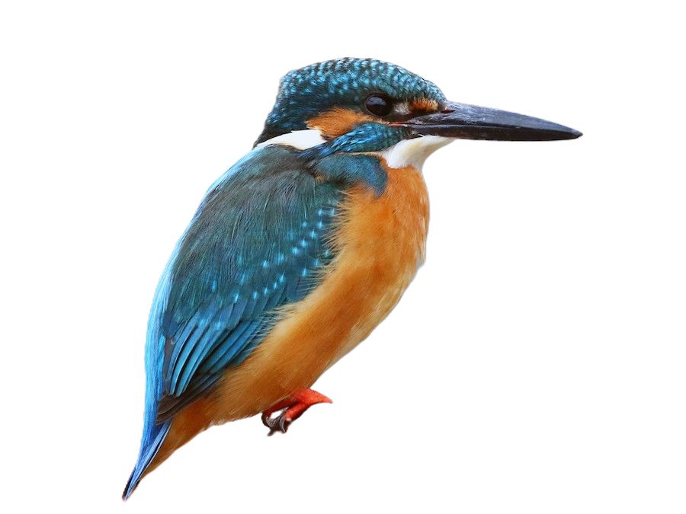
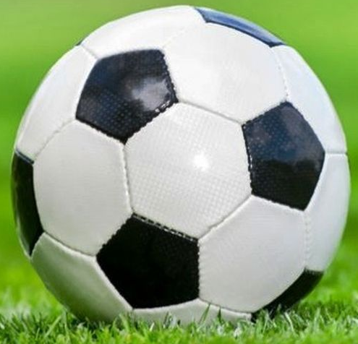
Say the pictures name
Numbers
Counting
One
Two

Slide 9


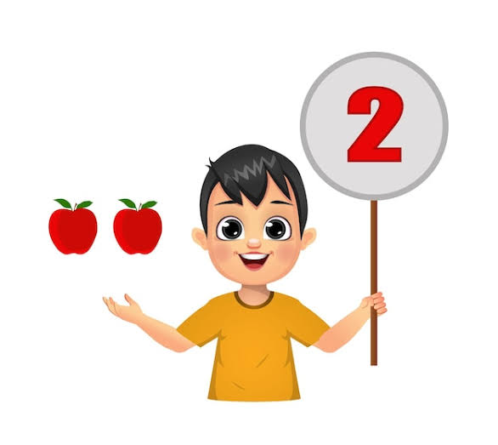
Group work
Read the number.
What is the boy doing?
How many flag is there?

Slide 10


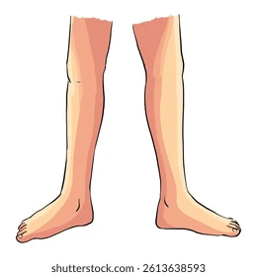

Count the pictures
How many head is there?
How many legs are there?

Slide 12
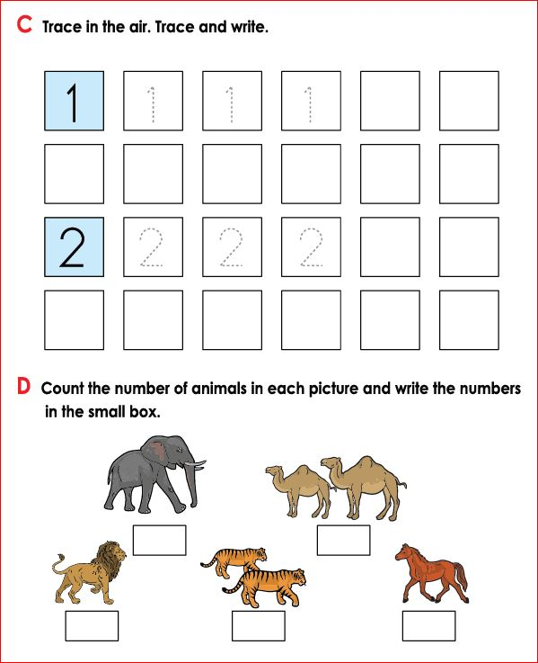

Slide 13


Pair work
Write down 1,2

Slide 14
Read out with me
One
Two

Slide 15
Open your book
Page 20, 21
English for Today

Slide 16

Individual work
Match the pictures with words
Two
One
Counting

Slide 17
1
2
1
2
1

Slide 18
Assessment Indicators-21
Domain | Indicators
Knowledge | 1. S traces the cardinal number (1, 2) neatly and legibly.
Skill | 2. S writes the cardinal number (1, 2) neatly and legibly.
Attitude and values | 3. S counts the cardinal number (1, 2) neatly and legibly.

Slide 19
Feedback
Help the students who can’t read & write properly

Slide 20
Homework
Write 1, 2

Slide 21


