Slide 1
Well Come

Slide 2
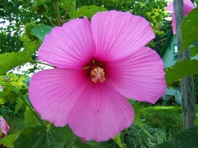
INTRODUCTION
Md. Gausul Haque
Assistant Teacher
Kalikapur Chowkuni High School, Koyra,Khulna
CLASS: SIX
SUBJECT: ENGLISH SECOND PAPER
UNIT: ONE
LESSON: ONE
Time; 50 mint.

Slide 3
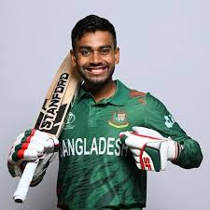

Slide 4
Mehidy Miraz

Slide 5
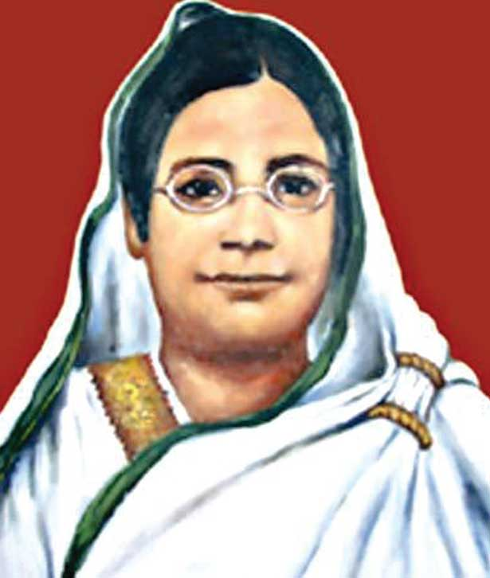
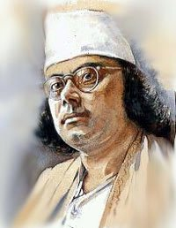
1
2
Begum Rokeya
Kazi Nazrul Islam
1. Begum Rokeya is a social worker and a writer.
2. Kazi Nazrul Islam is our national poet.
Notes:
The students can make sentence orally or they can write sentences on the board. Answers can vary here. Showing the sentences The teacher can say that when the names of persons are used in a sentence they are called noun.

Slide 6
1. Mehidy Hasan Miraz is a cricket player.
2. He plays with the bat.
3. Begum Rokeya is a social worker and a writer.
4. Kazi Nazrul Islam is our national poet.
The naming words in a sentence are called
Nouns.
Notes:
Showing this slide The teacher can clarify what noun is.

Slide 7
Our Todays lesson is
NOUN-part-1

Slide 8
LEARNING OUTCOMES OF THE LESSON
By The End Of The Lesson The Students Will Be Able To
Say What Noun Is.
Identify Noun And Pronoun.
Mention Some Nouns From Real Life Situation.
Make Sentence With Noun As A Subject And

Slide 9
Shat Gombuj Mosque
Would you make sentence with this naming word?
Notes:
The students can make sentence orally then they/teacher can write sentences on the board. Answers can vary here. The sentences will not be erased. Those will be on the board.

Slide 10
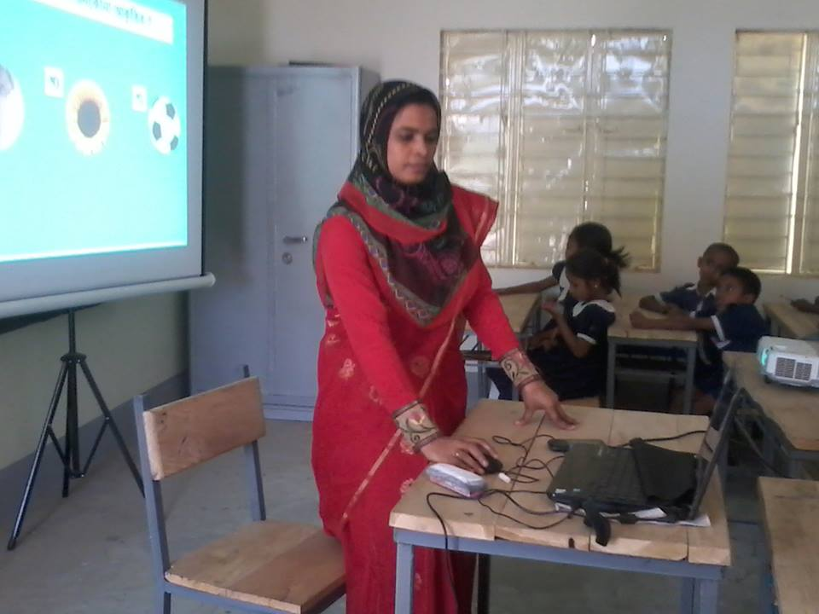
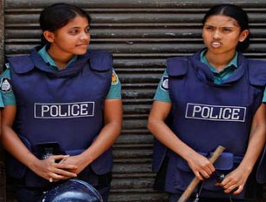
Would you tell the names of their professions?
1
2
Teacher
Police
Notes:
The students can make sentence orally then they/teacher can write sentences on the board. Answers can vary here. The sentences will not be erased. Those will be on the board.

Slide 11
Can you make sentences with these naming words?
Can you match the names of the quality, action or state?
1
2
Happiness
Punishment
Happiness
Punishment
Notes:
The students can make sentence orally then they/teacher can write sentences on the board. Answers can vary here. The sentences will not be erased. Those will be on the board.ক

Slide 12
Look at the sentences and underlined words.
1. Rabidranath Dhakur is our national poet.
2. People like to visit Shat Gombuj Mosque.
3. The teacher is teaching.
4. Happiness keeps us healthy.
The name of any person, place, thing, idea, quality or state in a sentence is called noun.
Notes:
Showing this slide the teacher can explain again what noun is.

Slide 13
Pair work
Read the following passage and find out the nouns from it.
Mahmud Hasan lives in Cumilla. He is a student. He reads at Cumilla Victoria Govt. college. He studies attentively. He is a player too. He likes to play Cricket.
Mahmud Hasan
Cumilla
Student
Cumilla Victoria Govt. College
player
Cricket

Slide 14
Home work
Ten exmple of Noun

Slide 15
THANK YOU

