Slide 1

Good morning
Prepared by: Md. Saifuddin-Ass. Teacher , Afzal Nagar GPS. Satkania, Chattogram.

Slide 2

Teacher Profile
Md. Saifuddin
Ass. Teacher of Afzalnagar GPS.
Satkania, CTG.
Prepared by: Md. Saifuddin-Ass. Teacher , Afzal Nagar GPS. Satkania, Chattogram.

Slide 3

Let's see a picture!
Prepared by: Md. Saifuddin-Ass. Teacher , Afzal Nagar GPS. Satkania, Chattogram.

Slide 4
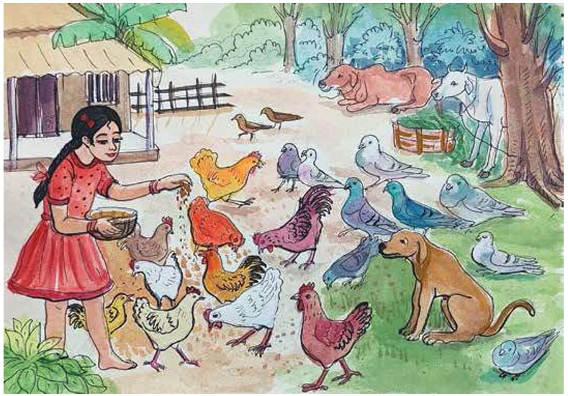
Prepared by: Md. Saifuddin-Ass. Teacher , Afzal Nagar GPS. Satkania, Chattogram.

Slide 5
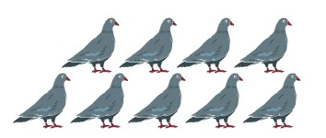

How many pigeons in the picture?
Prepared by: Md. Saifuddin-Ass. Teacher , Afzal Nagar GPS. Satkania, Chattogram.

Slide 6


How many hens in the picture?
Prepared by: Md. Saifuddin-Ass. Teacher , Afzal Nagar GPS. Satkania, Chattogram.

Slide 7
Let’s go watching a nice video of 9
https://www.google.com/search?q=cardinal+number+9+in+youtub+song&sca_esv=467de83371dd8518&biw=1280&bih=585&sxsrf=APpeQnsJBn5b9-XwmGHAj5Q43YFkaOJSRg%3A1787199485521&ei=_X-GaouqH_WehvcPt7OF0Aw&ved=0ahUKEwjLnOjzrK6WAxV1j-EIHbdZAcoQ4dUDCBA&uact=5&oq=cardinal+number+9+in+youtub+song&gs_lp=Egxnd3Mtd2l6LXNlcnAiIGNhcmRpbmFsIG51bWJlciA5IGluIHlvdXR1YiBzb25nSPonUKUMWMUecAF4AZABAJgB9gOgAdQNqgEJMi0yLjEuMS4xuAEDyAEA-AEBmAIEoAKaB8ICBxAjGLADGCfCAgoQABhHGNYEGLADwgIEECEYCsICBhAhGBUYCpgDAOIDBRIBMSBAiAYBkAYJkgcJMS4wLjIuMC4xoAfLCrIHBzItMi4wLjG4B5cHwgcDMS4zyAcFgAgB&sclient=gws-wiz-serp#fpstate=ive&vld=cid:afb02513,vid:7ipl68YUn7Y,st:0
Prepared by: Md. Saifuddin-Ass. Teacher , Afzal Nagar GPS. Satkania, Chattogram.

Slide 8




Let’s trace in the air
Prepared by: Md. Saifuddin-Ass. Teacher , Afzal Nagar GPS. Satkania, Chattogram.

Slide 9


Prepared by: Md. Saifuddin-Ass. Teacher , Afzal Nagar GPS. Satkania, Chattogram.

Slide 10

How to write number 10
Prepared by: Md. Saifuddin-Ass. Teacher , Afzal Nagar GPS. Satkania, Chattogram.

Slide 11
Count and Write the numbers
Prepared by: Md. Saifuddin-Ass. Teacher , Afzal Nagar GPS. Satkania, Chattogram.

Slide 12

Thank you
for staying with me.
Prepared by: Md. Saifuddin-Ass. Teacher , Afzal Nagar GPS. Satkania, Chattogram.

