Slide 1




WELCOME TO ALL IN TODAY’S
ENGLISH LESSON

Slide 2



Presented By
Md. Nurul Karim
Assistant teacher
Salia Govt.Primary School
Parshuram, Feni
Email: nurulkarim1990@gmail.com

Slide 3

Class Identity
Class : Two
Subject : English
Unit : 7
Lesson : 2

Slide 4


Warm up song:
Good Mornig……………….

Slide 5

Today we will learn……
Rainbow
Page:66

Slide 6
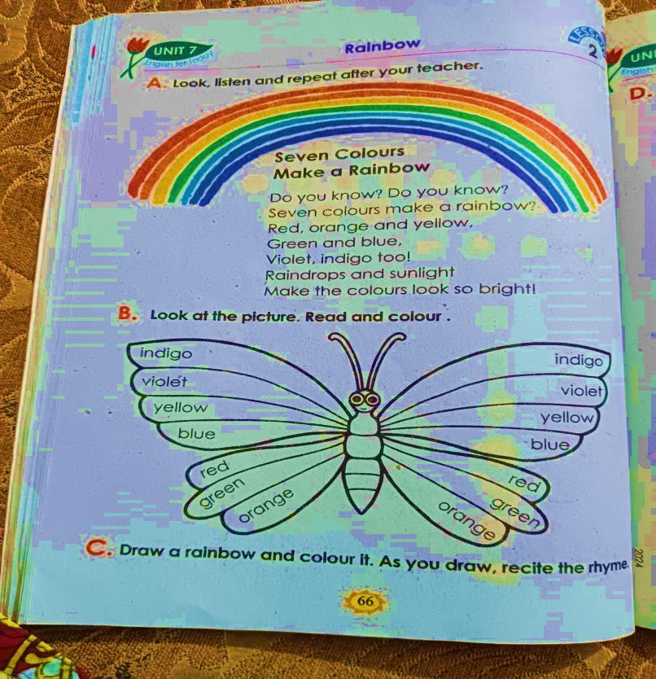
Lets we recite the rhyme……..
Rainbow
Seven Colours Make a Rainbow
Do you know? Do you know?
Seven colours make a rainbow?
Red,orange and yellow,
Green and blue,
Violet,indigo too!
Raindrops and sunlight
Make the colours look so bright!

Slide 7
Lets recite the poem WCW
Rainbow
Seven Colours Make a Rainbow
Do you know? Do you know?
Seven colours make a rainbow?
Red,orange and yellow,
Green and blue,
Violet,indigo too!
Raindrops and sunlight
Make the colours look so bright!

Slide 8
Lets see the new words
rainbow= রংধনু green= সবুজ
colour= রং blue= নীল
red= লাল violet = বেগুনী
orange= কমলা indigo= আকাশী নীল
yellow= হলুদ raindrops= বৃষ্টির ফোঁটা
sunlight= সূর্যালোক bright= উজ্জ্বল

Slide 9
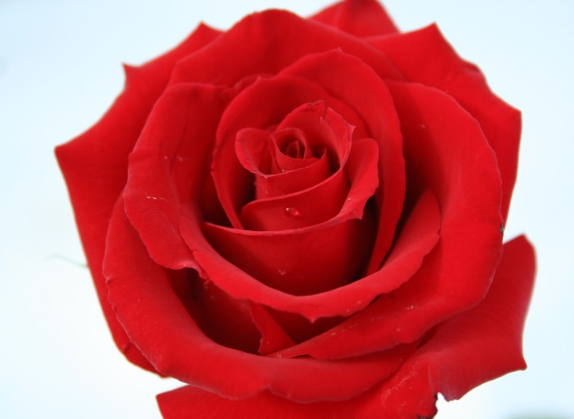

Red

Slide 10
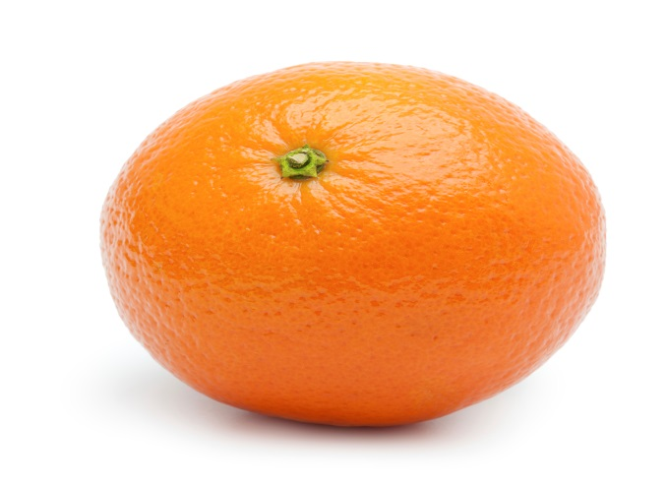

Orange

Slide 11
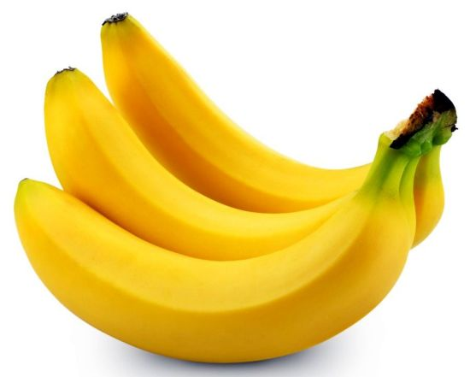

Yellow

Slide 12


Green

Slide 13


Blue

Slide 14
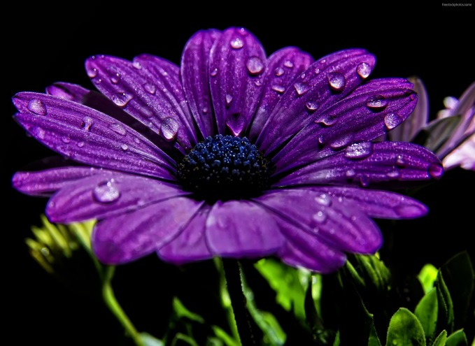

Violet

Slide 15
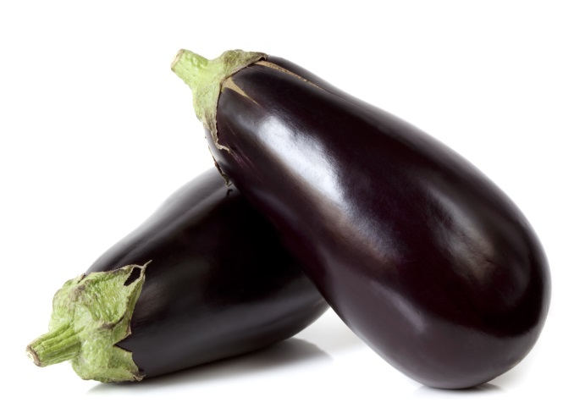

Indigo

Slide 16

Pair Work
Lets recite the rhyme into pairs
Rainbow
Seven Colours Make a Rainbow
Do you know? Do you know?
Seven colours make a rainbow?
Red,orange and yellow,
Green and blue,
Violet,indigo too!
Raindrops and sunlight
Make the colours look so bright!

Slide 17
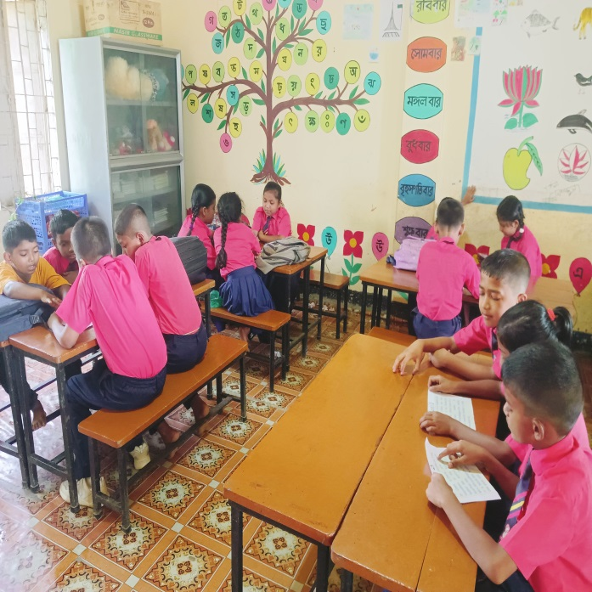
Group Work
Recite the rhyme in groups
Rainbow
Seven Colours Make a Rainbow
Do you know? Do you know?
Seven colours make a rainbow?
Red,orange and yellow,
Green and blue,
Violet,indigo too!
Raindrops and sunlight
Make the colours look so bright!

Slide 18



Individual work
Say the colours name
blue
green
indigo
orange

Slide 19


Home Task
Draw a rainbow and colour it

Slide 20


Good bye every one
Thanks to all
See you again…

