Slide 1



Slide 2


Slide 3

Introduction to the Lesson
Unit-13
Activity-1.1
Lesson Title-Quality
Time Together
Class-Five
Sub-English

Slide 4
Learning Outcomes
Students will be able to-
4.2.1 Read aloud texts with proper stress,intonation.
5.1.1 Comprehend and express the meaning and uses of familiar words.
5.1.4 Get the general ideas from simple texts.

Slide 5
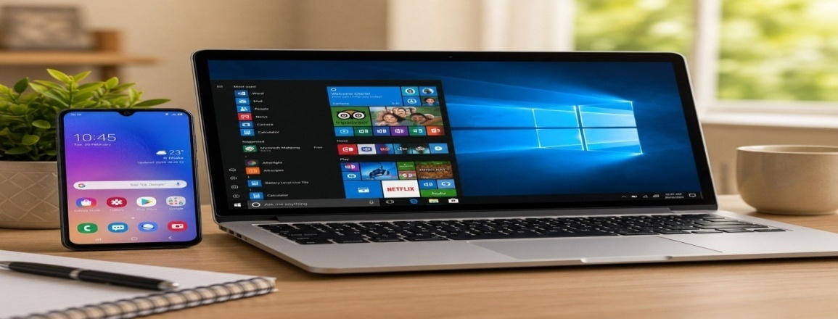
Review of the prior knowledge
*Do your parents have mobile or laptop at your home?
*When do you use it?
*How long do you use it?
*Does it disturb your sleep or keep you away from your friend?

Slide 6
Merits and demerits of using
mobile phone
Merits
Demerits
*We can talk to others.
*We can learn new things.
*We can call for help.
*We can take pictures.
*It wastes time.
*It is bad for our eyes.
*It distracts us from study.
*Some games and videos are addictive.

Slide 7
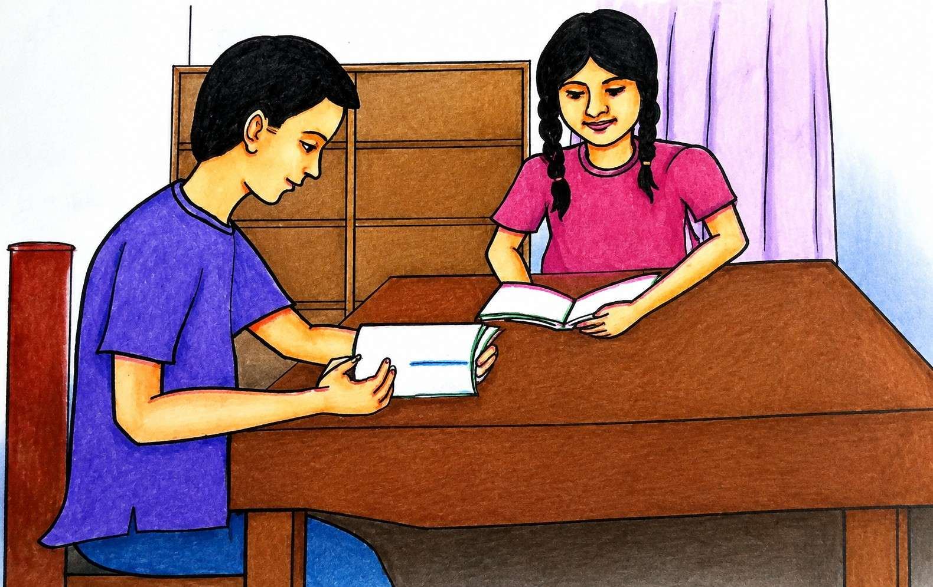
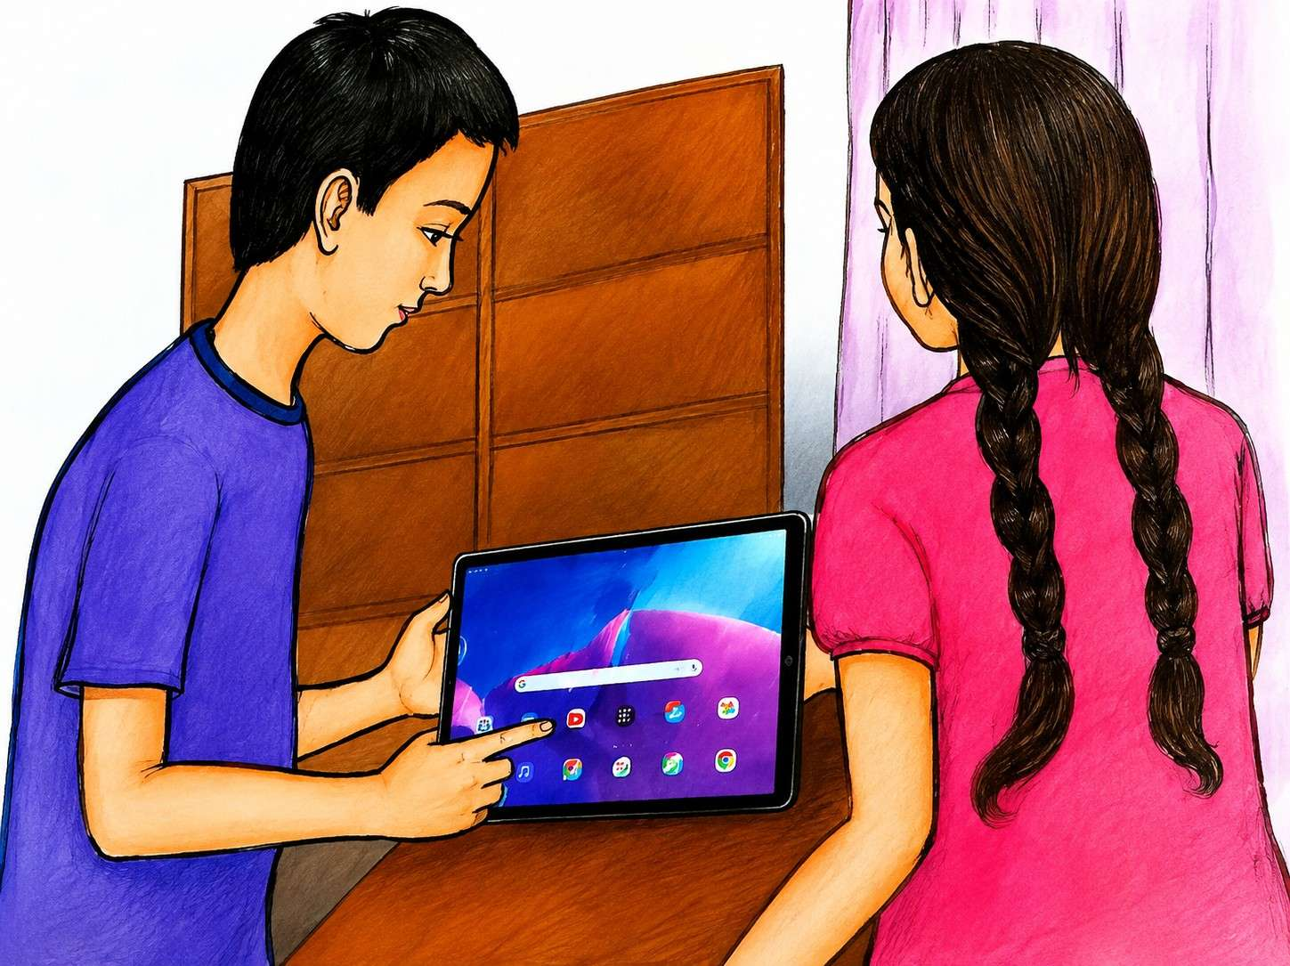
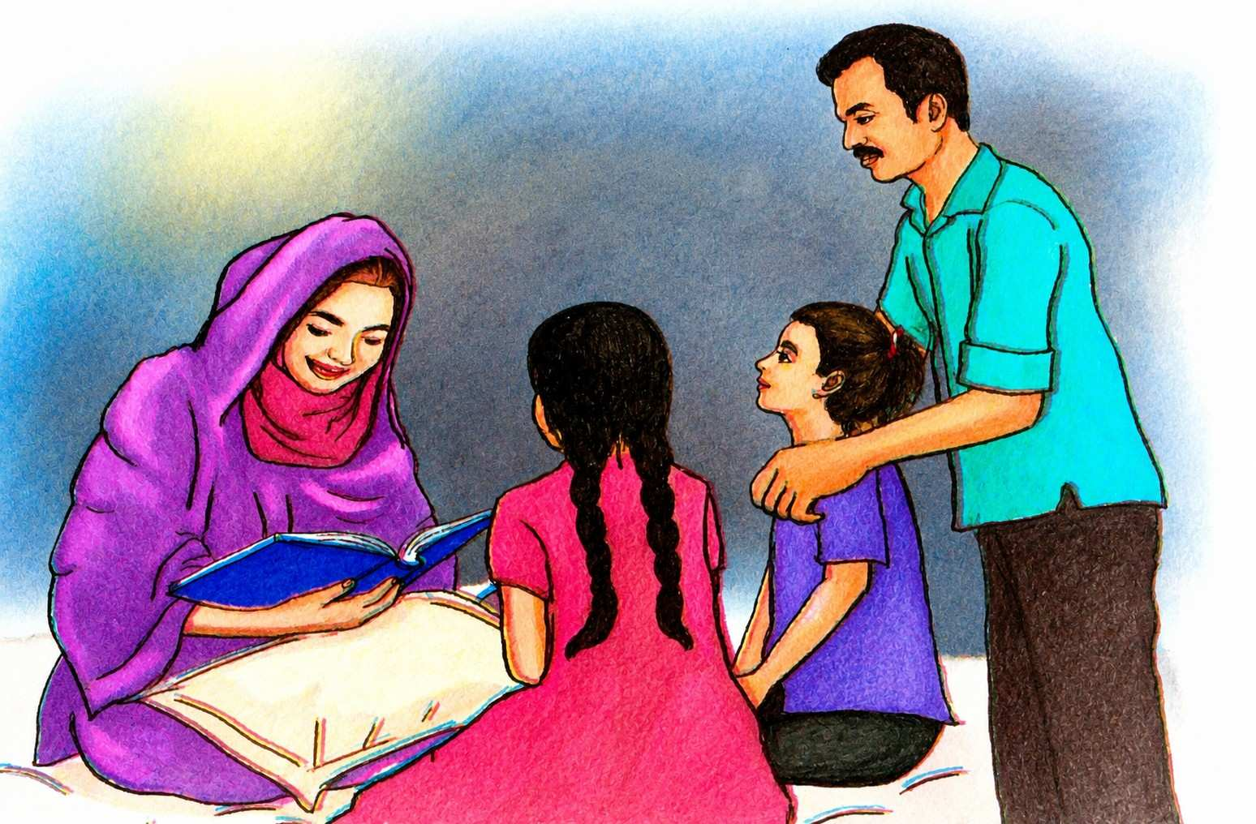
Look at the pictures
a.What do you see in the pictures?
b.What are they doing?

Slide 8
Can you guess what may be our today’s Lesson?

Slide 9
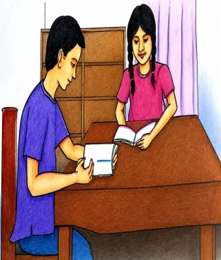
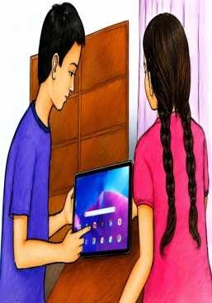

Our Today’s Lesson
Quality Time Together

Slide 10
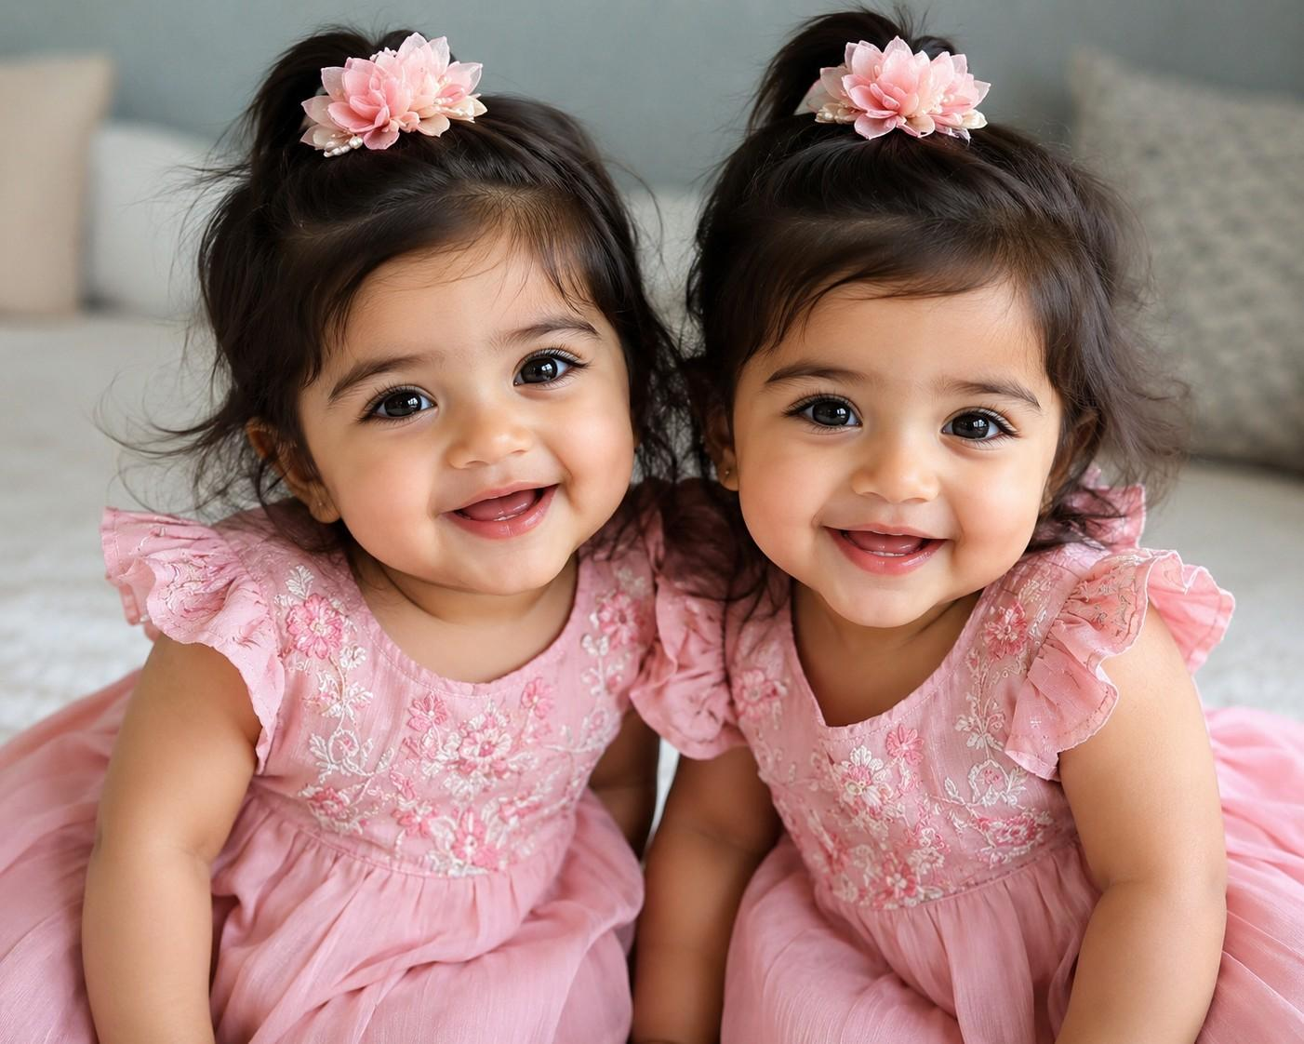
New words
Twin
Two children born at the same time from a mother

Slide 11
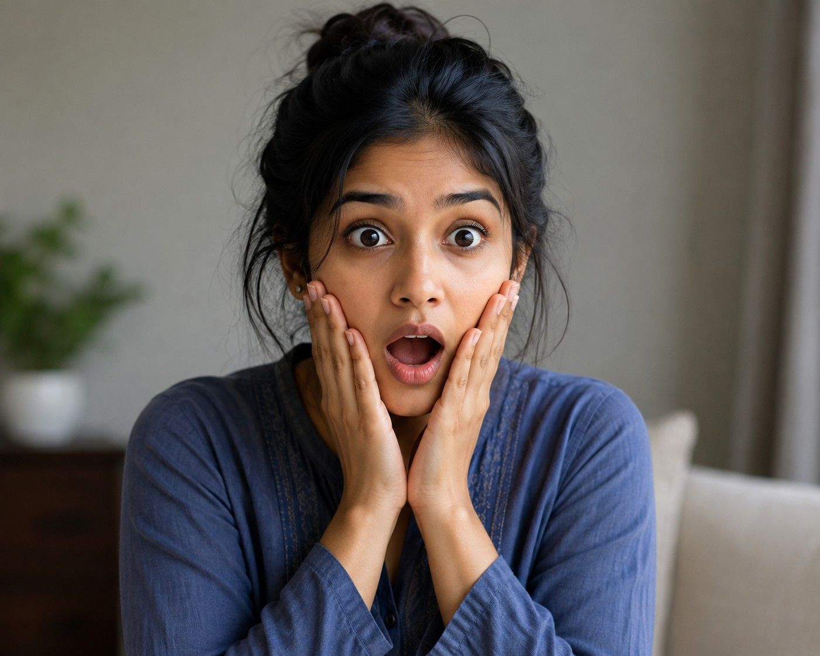
Surprised
Feeling astonished

Slide 12
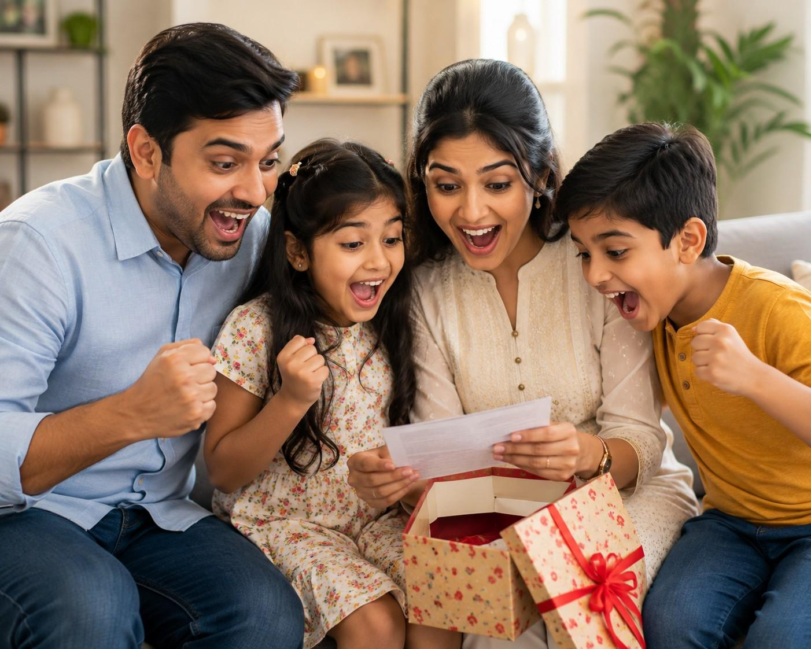
Exciting
Thrilling

Slide 13
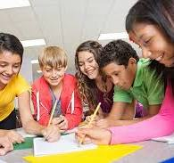
Together
With each other

Slide 14
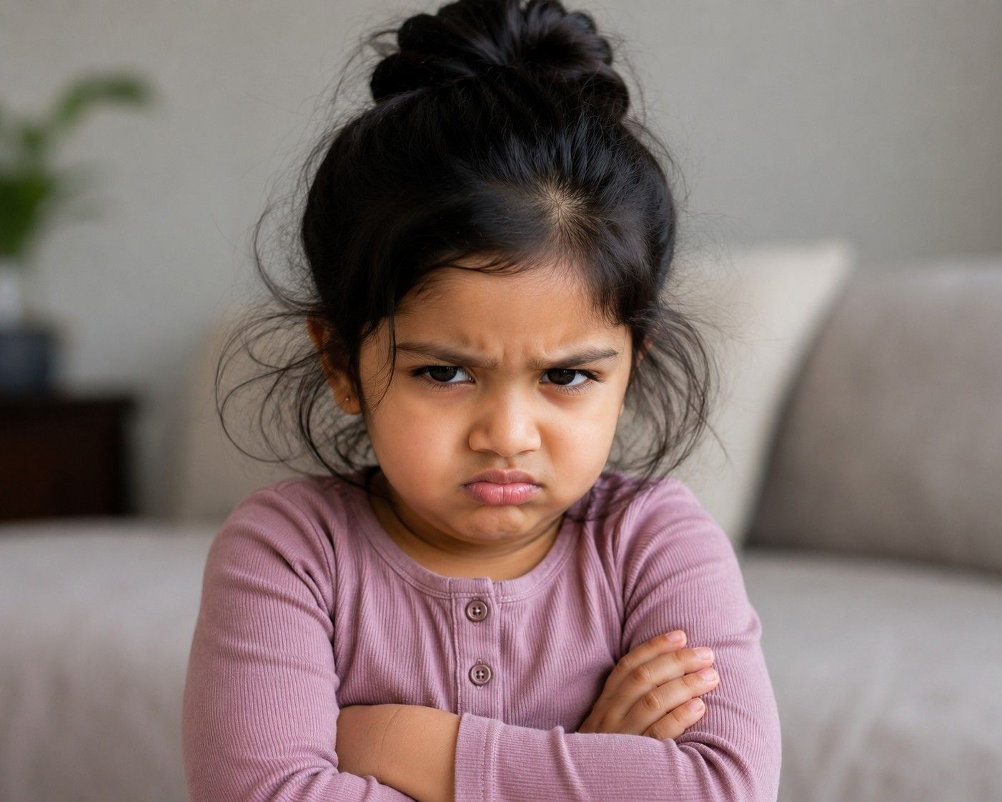
Grumpy
Irritable

Slide 15
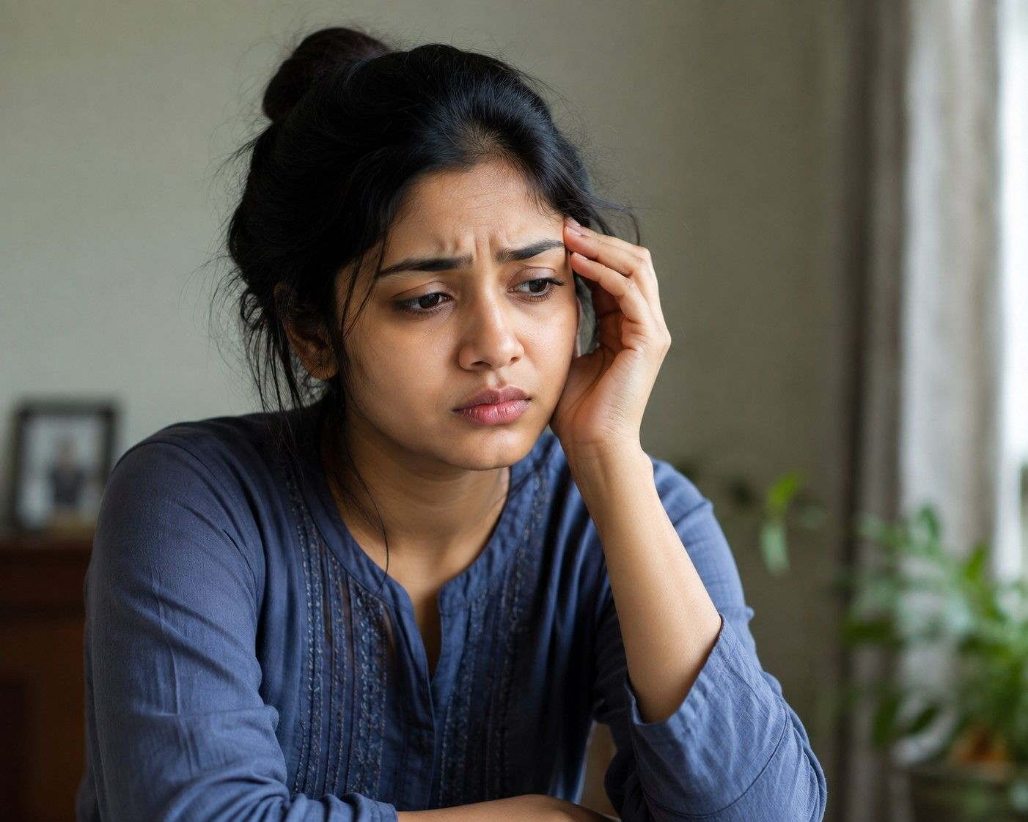
Worried
Anxious

Slide 16
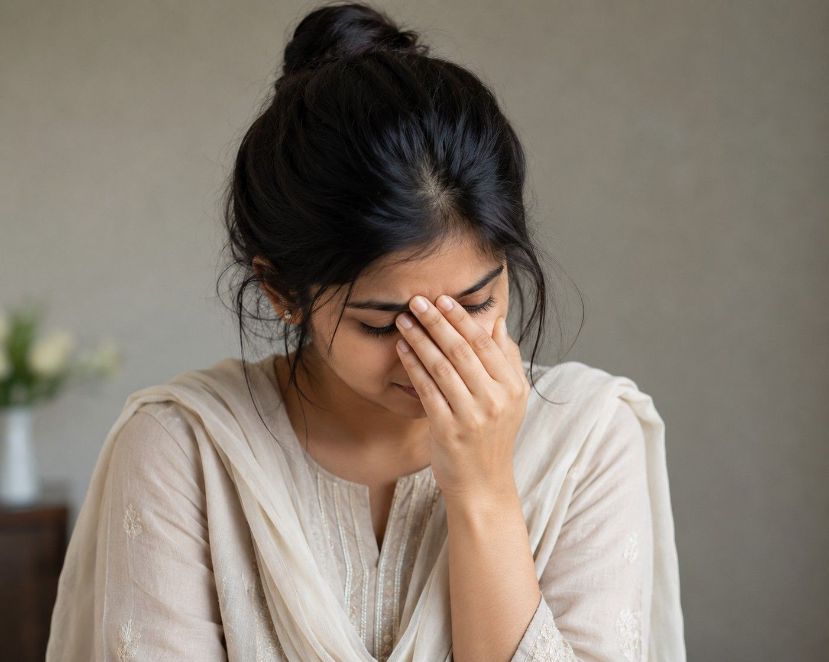
Ashamed
Embarrassed

Slide 17
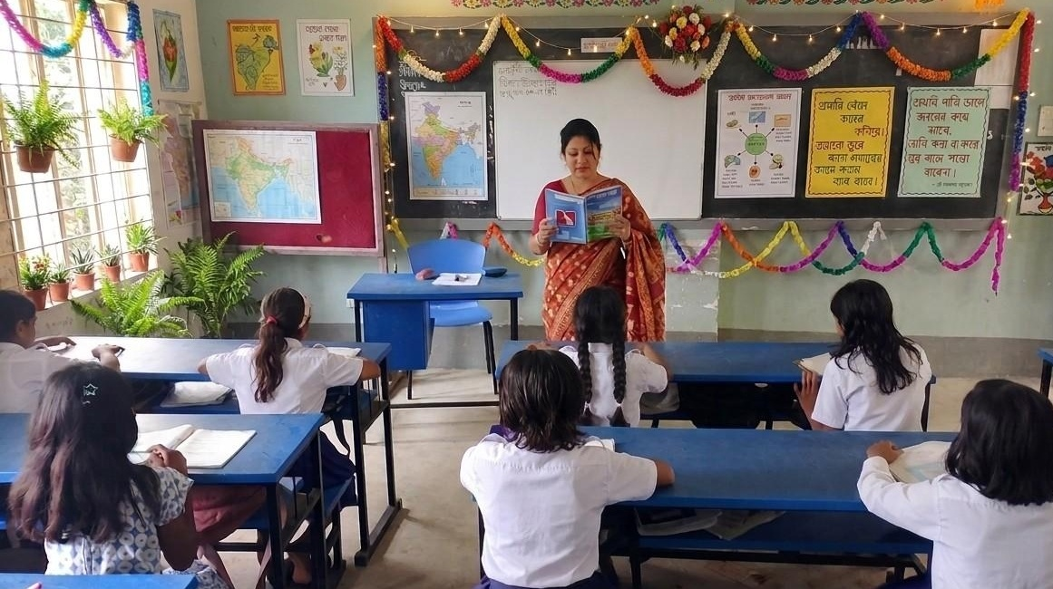
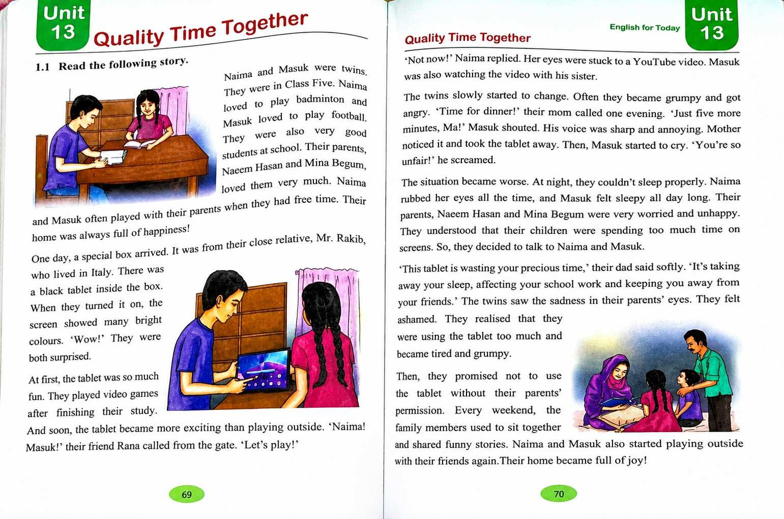
Teacher’s Model Reading

Slide 18
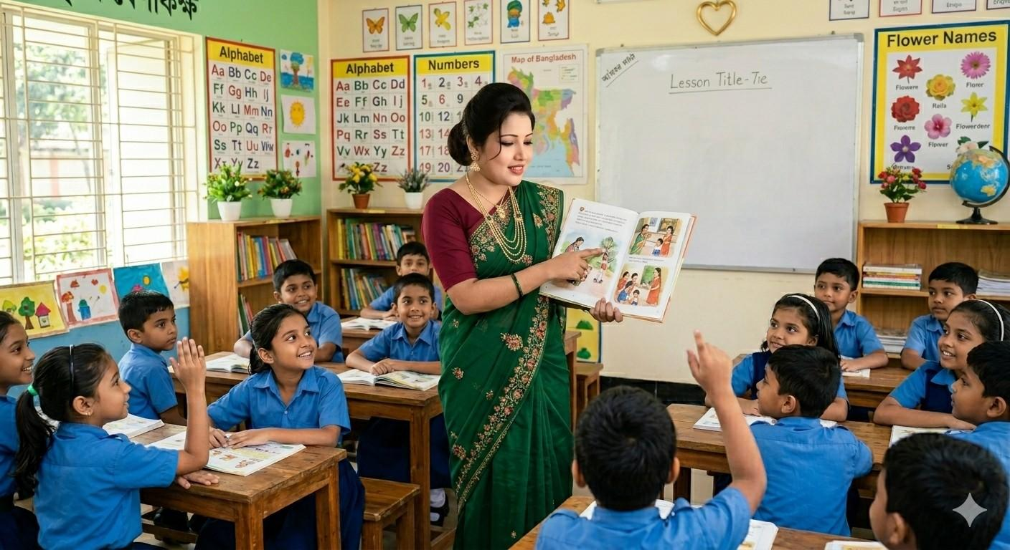
Choral Reading

Slide 19

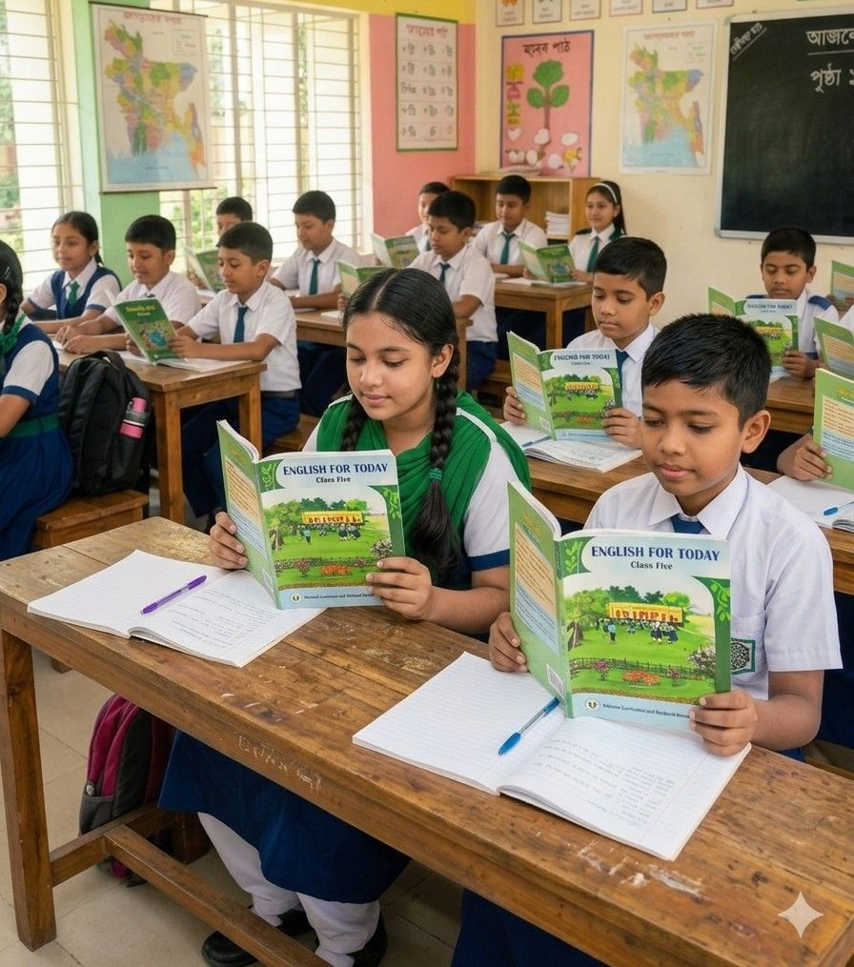
Student’s Reading

Slide 20
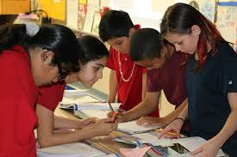
Group Work
Group-1
Group-2
Group-3

Slide 21
Read the text in groups and answer the following questions.
1.What do Naima and Masuk do in their free time?
2.Where did Mr.Rakib live?
3. Why were Naima and Masuk surprised when they turned on the tablet?

Slide 22


Pair Work
Read the text in pairs and make sentences by given words.
Twin,Grumpy,Properly,
Ashamed

Slide 23

One day one word
Promise
প্রতিশ্রুতি
I promise to help you.

Slide 24


Assessment
Read the text with proper stress and intonation individually.
Answer the following questions.
a)What were the main problems faced by Naima and Masuk using the tablet too much?
2)What do you think the story teaches us?

Slide 25
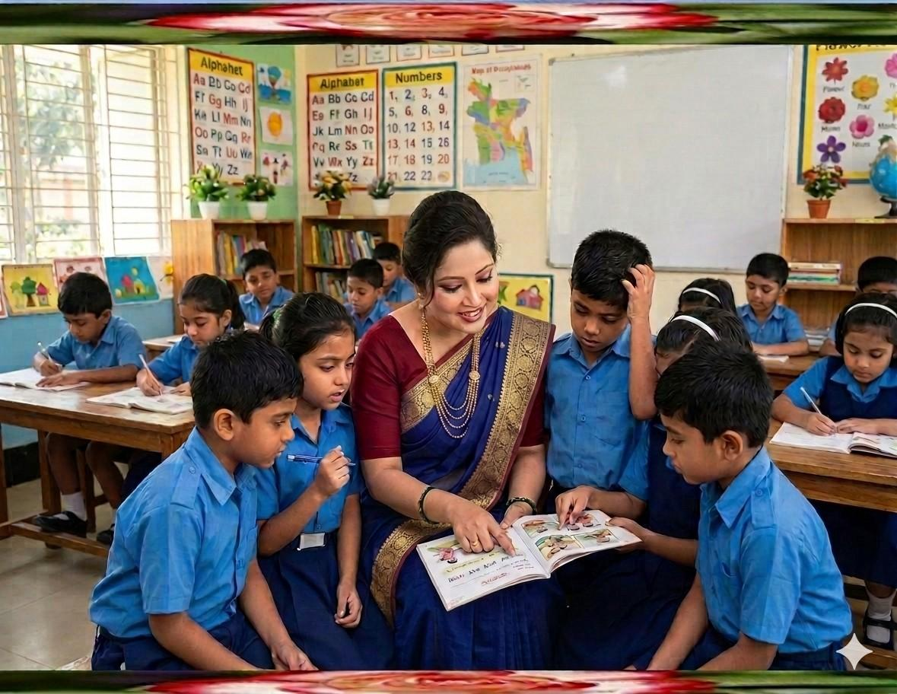
Feedback
Support the students during the class
who cannot read aloud the text properly.

Slide 26
Summary of the session
“What have you learnt today?”
We have learnt the uses of digital devices.

Slide 27
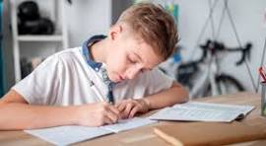
Home Work
Write 5 sentences about how you
Spend your quality time with your family.

Slide 28


