Slide 1


Slide 2
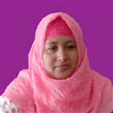


Introduce
Ayesha Siddiqua
Head Teacher
Rampur GPS
Laksam,Cumilla
Class : One
Sub : English
Unit : 1
Lesson : 22
Topics : Two Little Hands
Time : 30 minutes

Slide 3
LEARNING OUTCOMES
After finishing the lesson students will be able to-
2.1.1 Listen to rhymes and respond with joy.

Slide 4
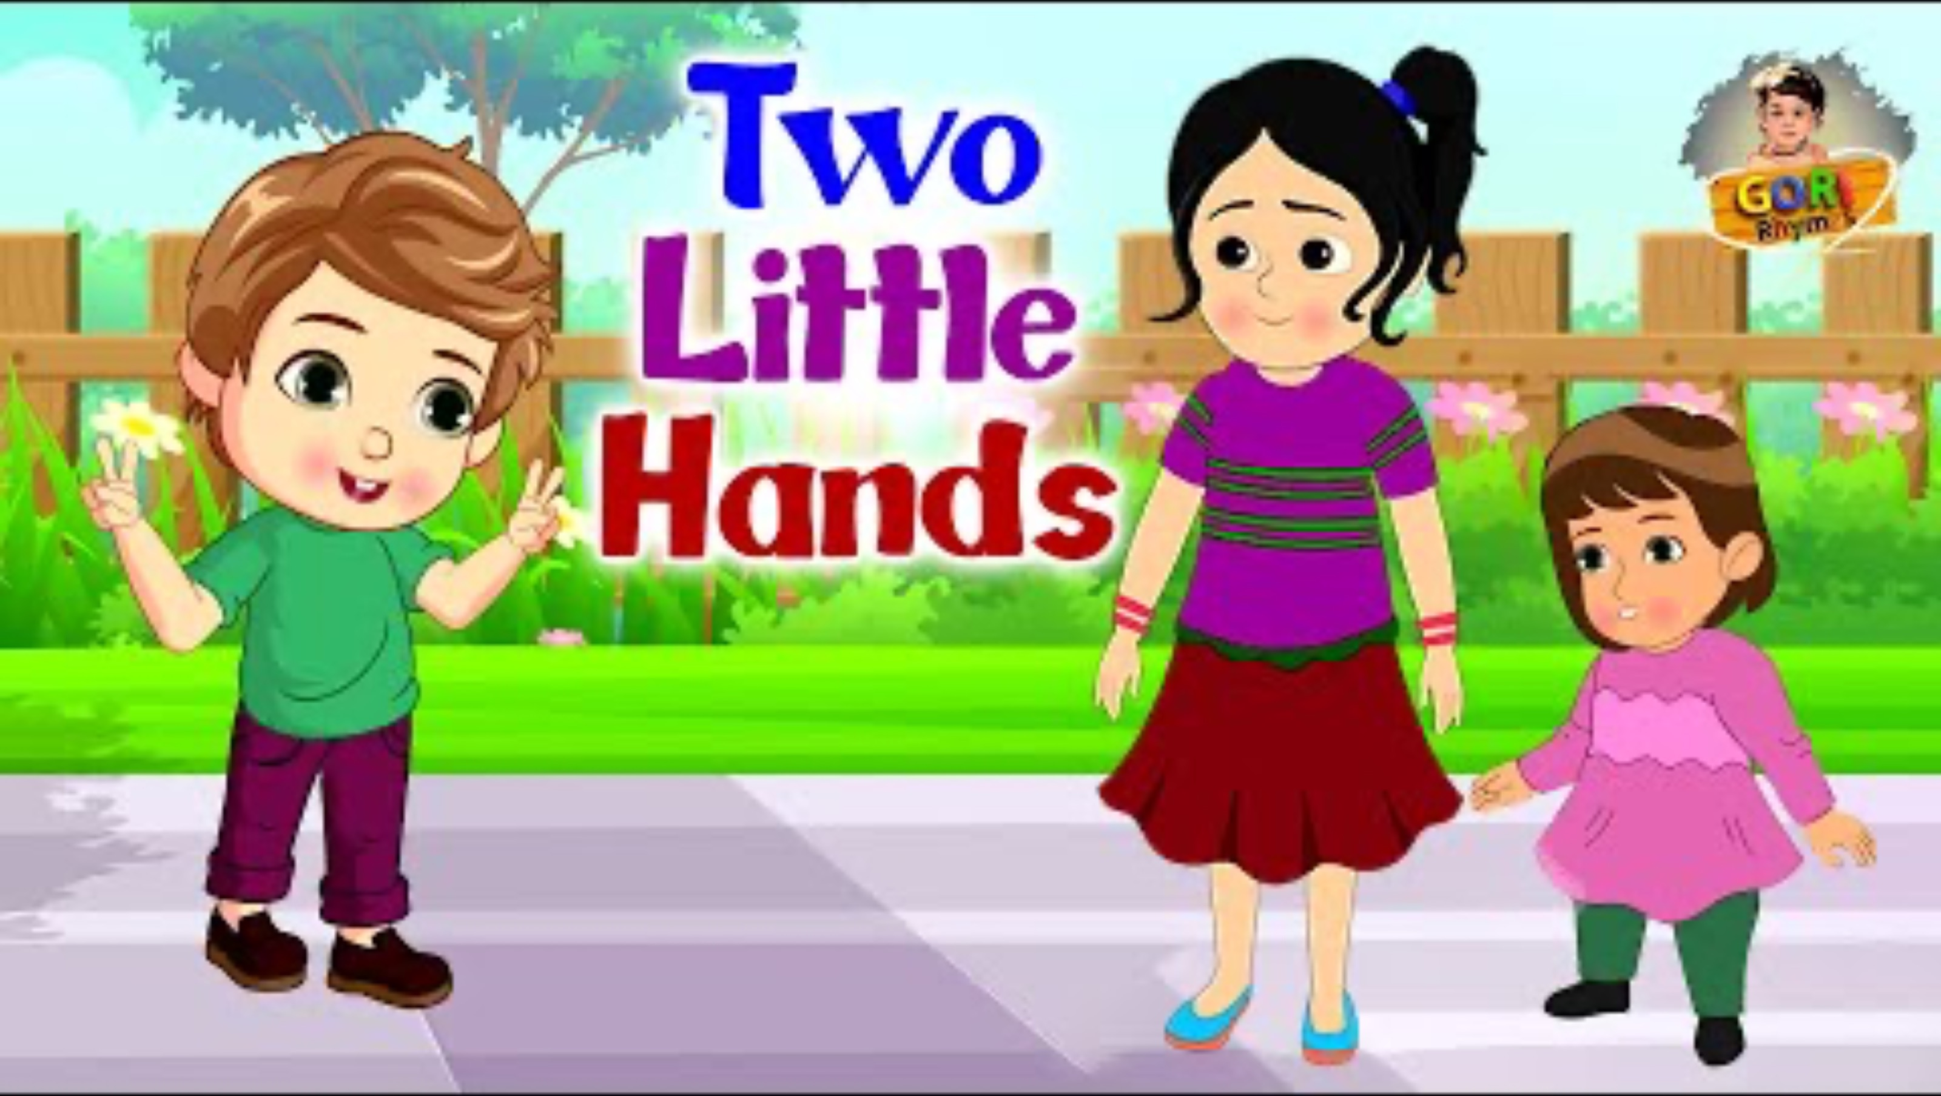
Let’s see a video

Slide 5


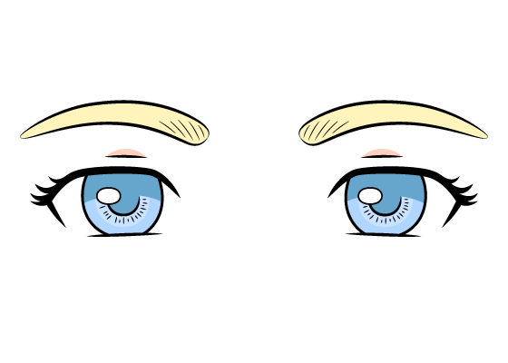
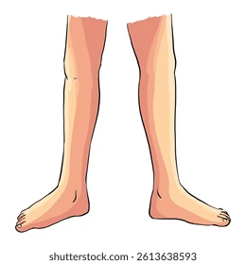
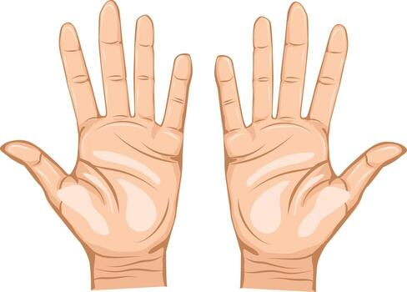
Look at the pictures with great attention:
Dear Student’s what do we see here ?
Head, hands,eyes and legs.

Slide 6
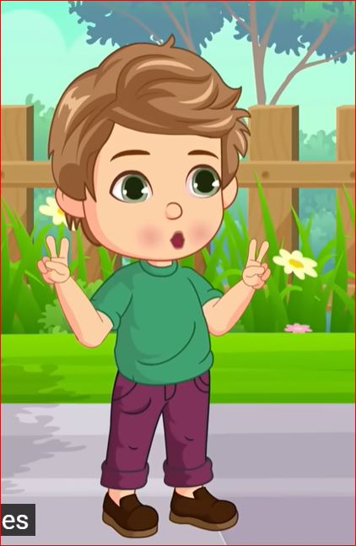
Can you guess what about we will learn today ?
The topic is “Two Little Hands”

Slide 7
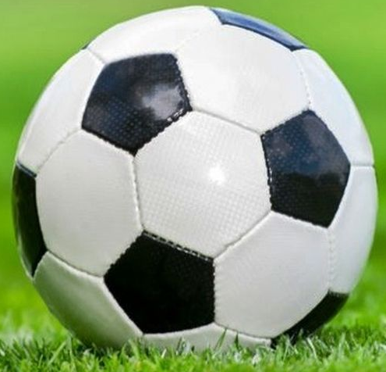
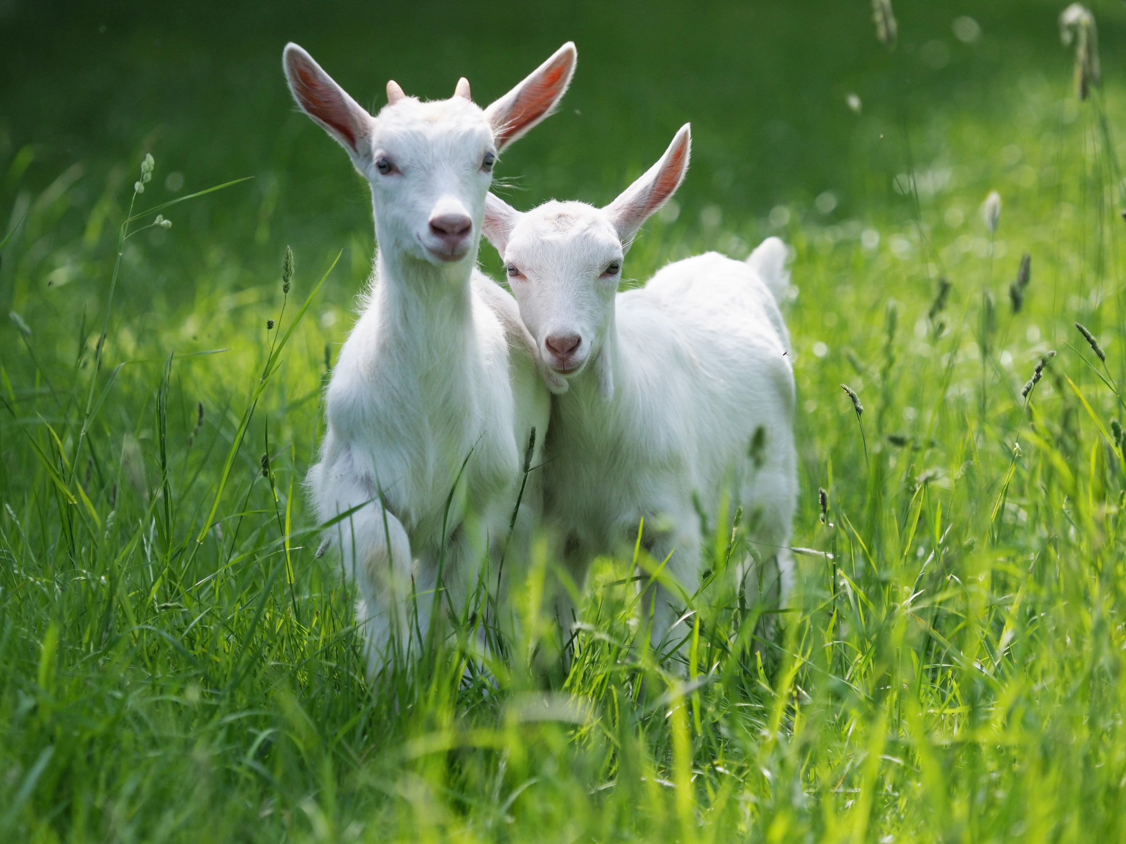

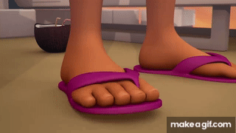

Say the pictures name
Two
little
Hands
Clap
Leg
Tap

Slide 8

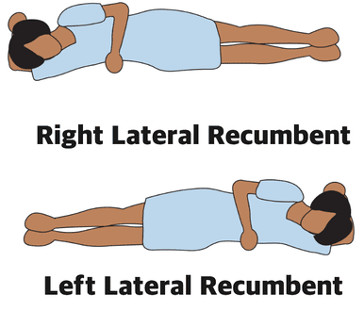
Say the pictures name
Eyes
Wide
Head
Side

Slide 9

Group work
Recite the rhyme in group.

Slide 10
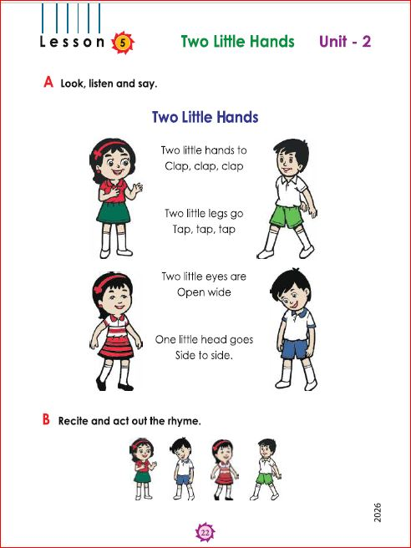
Open your book
Page 22
English for Today

Slide 11




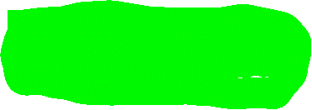
Two little hands
Two little hands to
Clap, clap, clap
Two little legs to
Tap, tap, tap
Two little eyes are
Open wide,
One little head goes
Side to side.

Slide 12

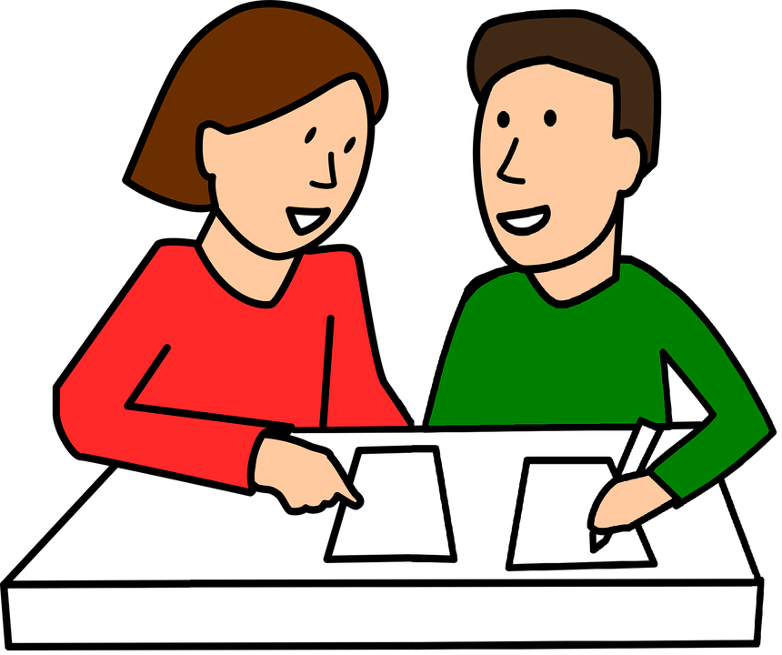
Pair work
Two little hands to
Clap, clap, clap
Two little legs to
Tap, tap, tap,
Two little eyes are
Open wide,
One little head goes
Side to side.

Slide 13
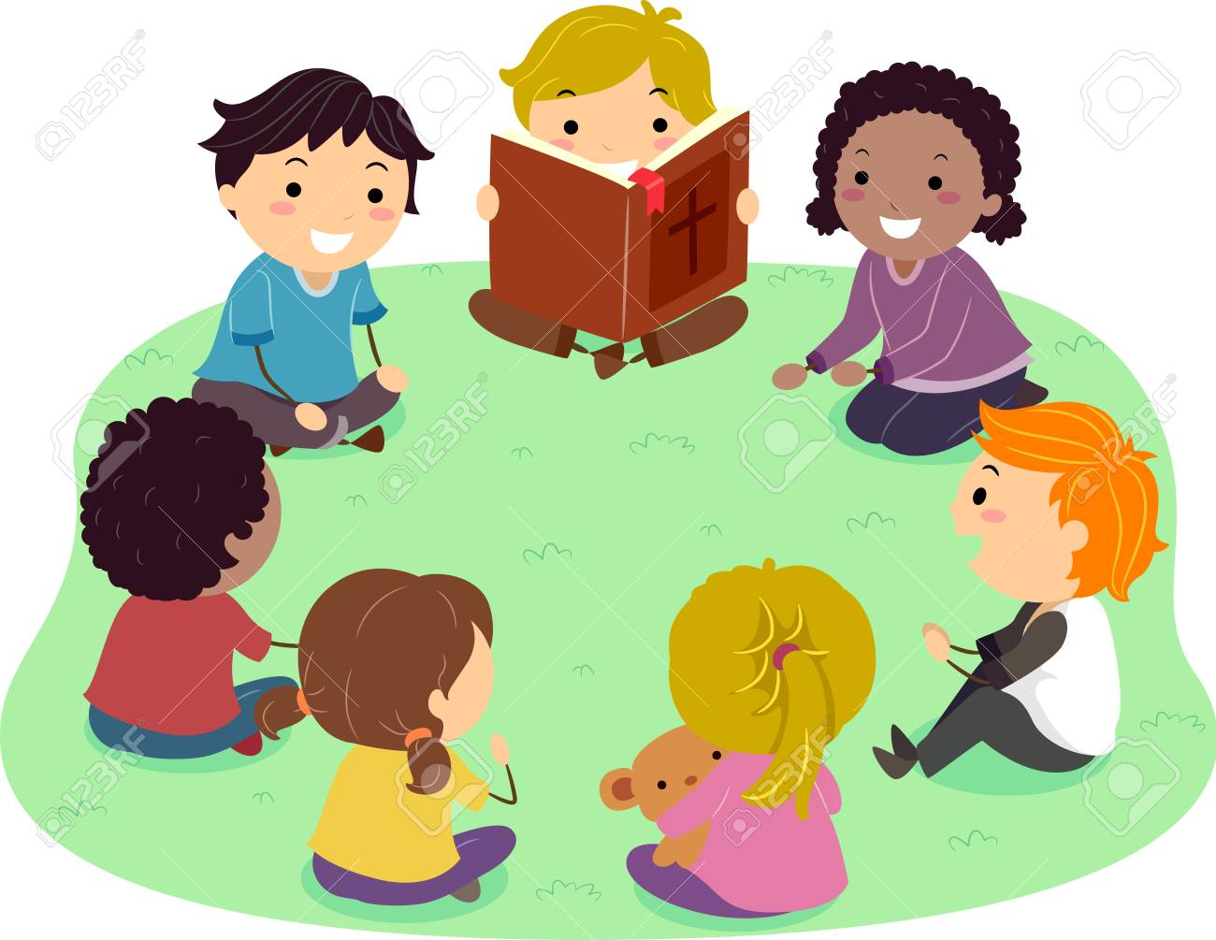
Chain drill : One students recite a line then next one recite the next line

Slide 14

Match the pictures with words
Two
little
Clap
Leg
Head

Slide 15
Assessment Indicators
Domain | Indicators
Knowledge | 1. S repeats the rhymes after teacher.
Skill | 2. S recites the rhyme.
Attitude and values | 3. S enjoys reciting the rhyme with gesture.

Slide 16
Feedback
Help the students who can’t recite properly

Slide 17
Homework
Recite the rhyme.

Slide 18


